Slide 1
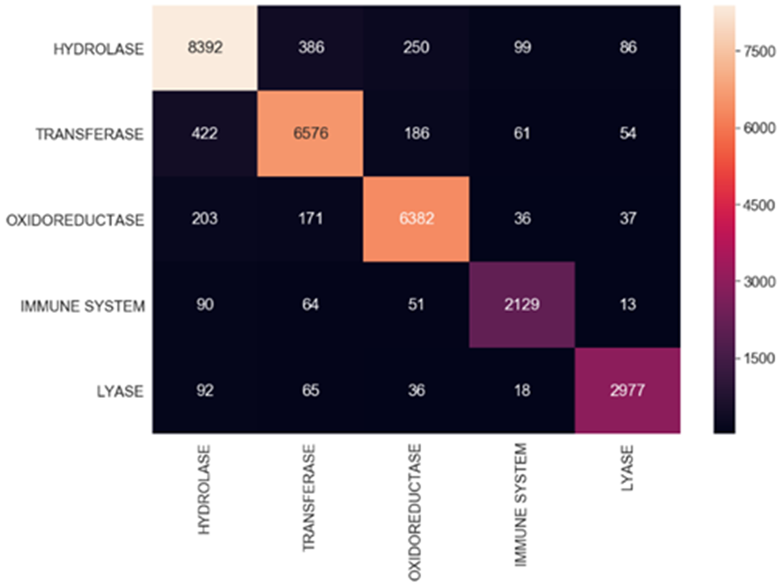
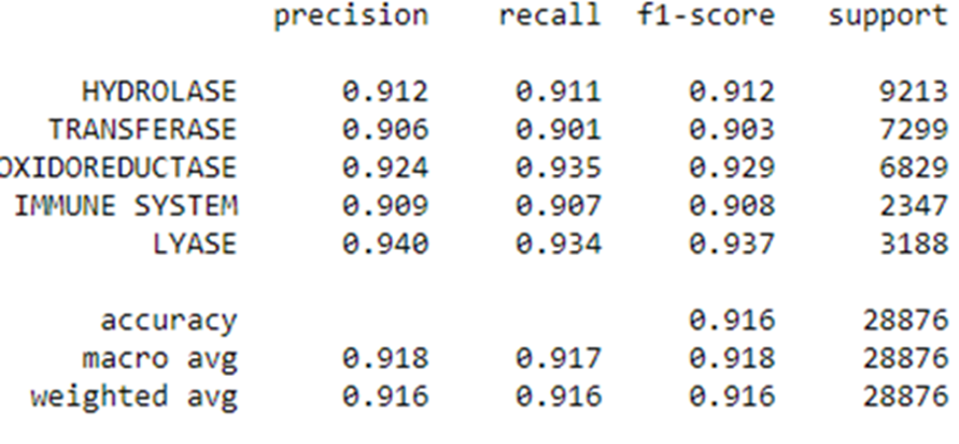
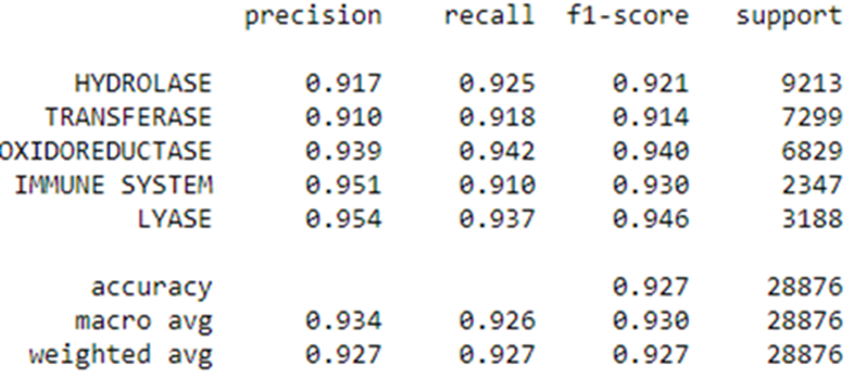
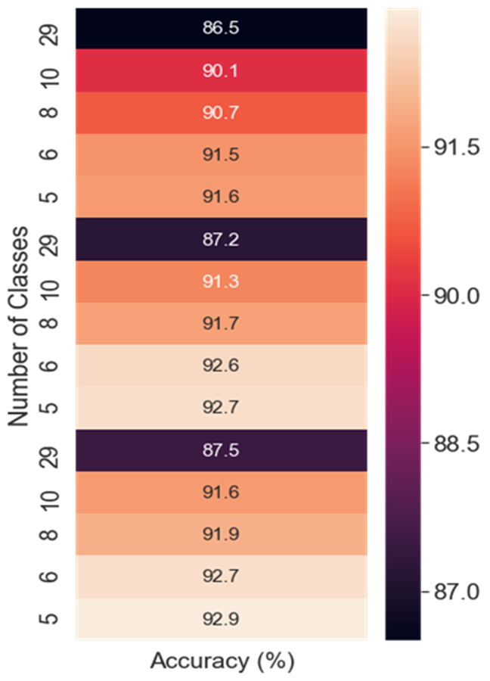
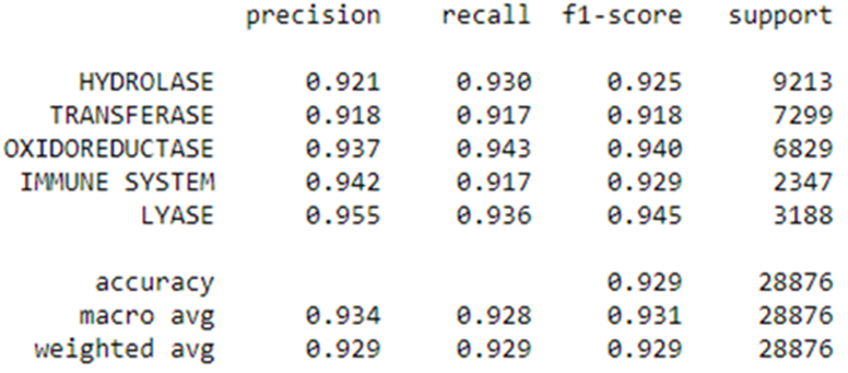
Machine Learning Models to Predict Multi-class Protein Classifications Yash Parikh, Eman Abdelfattah
School of Theoretical & Applied Science, Ramapo College of New Jersey, Mahwah, NJ, 07430
Abstract:
Dataset Description:
Analysis:
This work investigates three machine learning models and a comparison was conducted using different performance measures to determine which algorithm would effectively predict protein classifications based on residue count, structure of molecular weight, and protein sequences. Decision Trees, Random Forests and Extra Trees models are applied on a structural protein sequences dataset. Based on the experiments that were conducted on these models, it was demonstrated that Extra Trees model had comparable results but marginally better than the Decision Trees and Random Forests models.
The dataset used in this paper is collected on the Protein Data Bank (PDB) by the Research Collaboratory for Structural Bioinformatics (RCSB). The dataset includes 467,304 instances with 13 features. Due to visual and computational restraints, protein was the only macromolecule type considered as well as using classes with a count above 2000. Experiments were then conducted on the top 29 highest frequency classes, along with the top 10, 8, 6 and 5 highest frequency classes.
From the heatmap presented in figure 7, the best accuracies are shown when only 5 of the top highest frequency classes were chosen. As presented in the confusion matrices and the classification reports, the best classifier is the Extra Trees Classifier. Extra Trees is comparable to the Random Forest and is slightly better than the Decision Trees in terms of accuracy, precision, recall, and F₁ score.
Conclusion:
Three machine learning algorithms are examined and compared for their ability to correctly classify protein based on residue count, structure of molecular weight, and protein sequences. Extra Trees Classifier demonstrated the best multiclass classifier that has F₁ score at 92.9% throughout all of classes. The next step would be to apply Convolution Neural Networks (CNN) to obtain a higher F1 score. Logistic Regression and Support-Vector Machines (SVMs) can also be applied to obtain more findings for this research.
Experimental Results:
Figure 1. Classification Report of Decision Trees for top 5 highest frequency classes.
References:
Figure 6. Extra Trees Confusion Matrix of the top 5 highest frequency classes.
[1] John D. Westbrook, Stephen K. Burley, “How Structural Biologists and the Protein Data Bank Contributed to Recent FDA New Drug Approvals,” Structure, vol. 27, No. 2, pp. 211-217, 2019.
[2] Costanzo Luigi, Dutta Shuchismita, K. Burley Stephen, “Amino acid modifications for conformationally constraining naturally occurring and engineered peptide backbones: Insights from the Protein Data Bank,” Biopolymers. 109(10): e23230, 2018.
[3] Jianjiong Gao, Andreas Prlić, Chunxiao Bi, Wolfgang F Bluhm, Dimitris Dimitropoulos, Dong Xu, Philip E Bourne, Peter W Rose, BioJava-ModFinder: identification of protein modifications in 3D structures from the Protein Data Bank, Bioinformatics, Volume 33, Issue 13, pp. 2047–20491, July 2017.
[4] Pedro J. Ballester, John B. O. Mitchell., “A machine learning approach to predicting protein–ligand binding affinity with applications to molecular docking,” Bioinformatics, Volume 26, Issue 9, pp. 1169–1175, 2010.
[5] Kundu Indra, Paul Goutam, Banerjee Raja, “A machine learning approach towards the prediction of protein–ligand binding affinity based on fundamental molecular properties,” RSC Advances. 8. 12127-12137. 10.1039/C8RA00003D, 2018.
[6] Amidi A., Amidi S., Vlachakis D., Paragios N., Zacharaki E.I., “A Machine Learning Methodology for Enzyme Functional Classification Combining Structural and Protein Sequence Descriptors,” Bioinformatics and Biomedical Engineering, IWBBIO 2016.
[7] S. Mullane et al., "Machine Learning for Classification of Protein Helix Capping Motifs," 2019 Systems and Information Engineering Design Symposium (SIEDS), Charlottesville, VA, USA, pp. 1-6, 2019.
[8] H.M. Berman, J. Westbrook, Z. Feng, G. Gilliland, T.N. Bhat, H. Weissig, I.N. Shindyalov, P.E. Bourne, “The Protein Data Bank Nucleic Acids Research,” 28: 235-242, 2000.
Figure 4. Decision Trees Confusion Matrix of the top 5 highest frequency classes.
Figure 2. Classification Report of Random Forests for top 5 highest frequency classes.
Figure 3. Classification Report of Extra Trees for top 5 highest frequency classes.
Figure 5. Random Forest Confusion Matrix of the top 5 highest frequency classes.
Figure 7. Heatmap of accuracies of Decision Trees, Random Forest, and Extra Trees, respectively.

