Slide 1
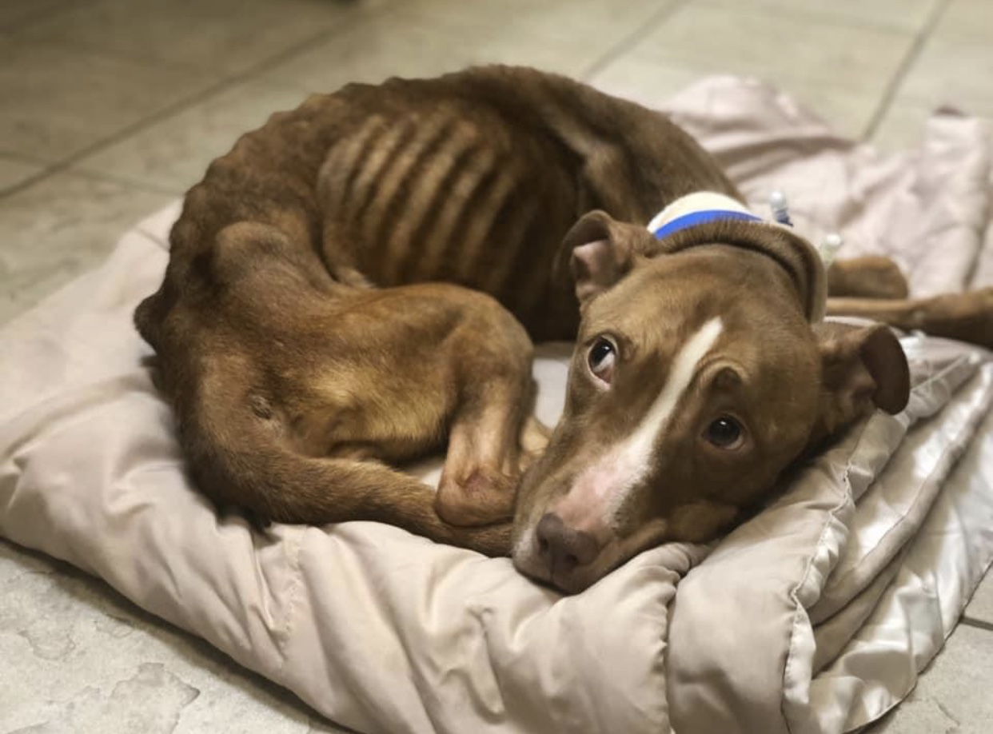
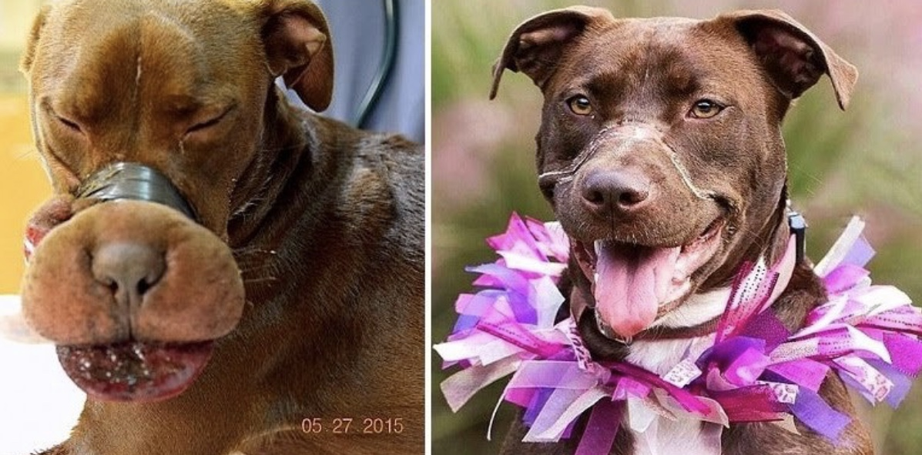
Establishing Protections for Muzzled Victims: Confronting the Link By Taylor Puluse
Faculty Mentor: Professor Sanghamitra Padhy Law and Society, SSHS, Ramapo College of New Jersey
Muzzled Victims:
Project Overview:
The phrase “muzzled victims” is used in the title of this project as it depicts what happens to both victims of domestic and animal abuse. To be muzzled means to be forcefully stopped from free expression. Victims of domestic abuse are silenced by their abusers as a form of control. Victims of animal abuse are in many ways speechless entities fighting for protections and representation often from the same domestic abusers. Addressing the Link more diligently has the ability to not only protect muzzled victims, but promote a safer world for humans and animals alike. Through the recognition of the right to legal guardianship for companion animal the lives of numerous muzzled victims can be saved.
This study analyzes various legal, ethical, qualitative, and empirical studies to evaluate the underlying factors that contribute to the crime of animal cruelty in the United States. In my analysis of the Link between animal abuse and domestic abuse a phenomenon that occurs at micro-levels against companion animals is unveiled. Factors such as masculine power structures, psychological disorders, exposure to domestic abuse, subjection to corporal punishment, and the lack of recognition for animal rights are all addressed within my work, as they each possess an inherent causality of animal cruelty. Moreover, my study claims a right to legal guardianship for companion animals and offers recommendations on how animal abuse against the family pet can be prevented.
Reese was rescued by the Ramapo Bergen Animal Refuge (RBARI) in a local high crime area. When rescued, Reese was extremely emaciated weighing a mere 17 pounds. Numerous medical tests revealed that Reese’s condition was a direct result of starvation. Under the care of the RBARI and their partner Jersey Pit Rescue, Reese now has a clean bill of health and now weighs over 30 pounds.
The Link’s Conceptualization:
The connection between animal abuse and domestic abuse is referred to by many animal advocates as the Link. In 2014, the National District Attorneys Association defined the Link as
...the coexistence of two or more of the intra-familial crimes: child abuse (including physical and sexual abuse) or neglect, domestic violence (including stalking and rape), elder abuse or neglect (including financial exploitation), and animal abuse or neglect (including sexual assault, animal fighting and hoarding).” In addition to the disturbing acts listed above, the Link also includes the concurrence of animal abuse with other types of crimes such as: homicide, weapons offenses, drug offenses, sexual assault, arson, assault or other violent crimes.
The Right to Legal Guardianship:
The right of companion animals to possess legal guardianship has been debated since the 1980’s. As more individuals recognize the presence of the Link in society, legislation has also transformed to address the issue. Although the following acts display some progression in protections for companion animals, it is clear that awarding the right of legal guardianship offers a better means of protection.
Pet and Women Safety (PAWS) Act of 2018: enacted to “amend federal criminal code to broaden the definition of stalking to include conduct that causes a person to experience a reasonable fear of death or serious bodily injury to his or her pet. In addition the PAWS Act also included a clause on interstate violations of protective orders.
The Prevention of Animal Cruelty and Torture (PACT) Act: Added new provisions to the Animal Crush Video Prohibition Act of 2010 to criminalize the actual act of intentionally crushing an animal. Violaters of the Act would be subject to a prison term up to seven years and/ or a generous fine.
Legal Guardianship For Companion Animals Model: One way to award better protections to companion animals is to allow for stronger legal representation to be established through law guardians (guardian ad litems) An argument can be made that companion animals should in fact be considered under the list of wards of law guardians. Since companion animals cannot convey to authorities the abuse and neglect they experience, they are forced to suffer as silent victims.
Transforming Legislation for Further Protection:
Legislation regarding the rights of companion animals is ever-changing and slowly becoming more progressive. The following legislation displays a transformation in animal rights law as legal protections for animals evolved from preventive to proactive through the twenty first century.
18 U.S.C. § 48: In 1999, the United States Congress reacted to a growing popularity within the fetish video industry known as “crush videos.” Crush videos featured women wearing high heels, being filmed from the waist down, “grinding” small animals to death under their feet. Congress enacted a bill criminalizing the visual and auditory depictions of animals being intentionally mutiliated, tortured, wounded, or killed.
U.S. v. Stevens: Robert J. Stevens was indicted for violating 18 U.S.C. § 48 by distributing various dog fighting videos. Stevens was argued through various circuit courts up until 2010. The Defendant Robert Stevens argued that 18 U.S.C. § 48 violated his First Amendment rights. The United States Supreme Court found that 18 U.S.C. § 48 was unconstitutional as it was severely overbraod and recommend that more specific legislation be passed.
Animal Crush Video Prohibition Act of 2010: In reaction to the ruling on U.S. v. Stevens was aimed directly at defining crush videos as “obscene” which in turn, curtailed the First Amendment’s protections.
The pictures above are of Caitlyn the Pitbull, who is recognized as the inspiration for this project. Caitlyn was found with her muzzle bound so tightly that the blood circulation to her tongue was entirely cut off. Caitlyn’s assailant was a man described by authorities as a “career criminal” possessing well over 31 convictions. Caitlyn is just one of many muzzled victims.
“The victims that animal advocates represent possess no socioeconomic power, no political clout, no voice to express their torment, and no means to participate in their own movement. They also do not possess the capacity to assert their historical significance to our society. And they are significant. Whether or not we believe they have rights, animals are central to our lives, past and present.”
- Diane Beers, For the Prevention of Cruelty
Special Acknowledgements:
The executive director of the Ramapo Bergen Animal Refuge, Megan Brinster, was interviewed for this project. The findings gained from the interview reiterated the underlying point of this project that companion animals desperately need better legal protections and representation. Animal rescues are recognized as frontline protectors for the muzzled victims of animal abuse.

