Slide 1
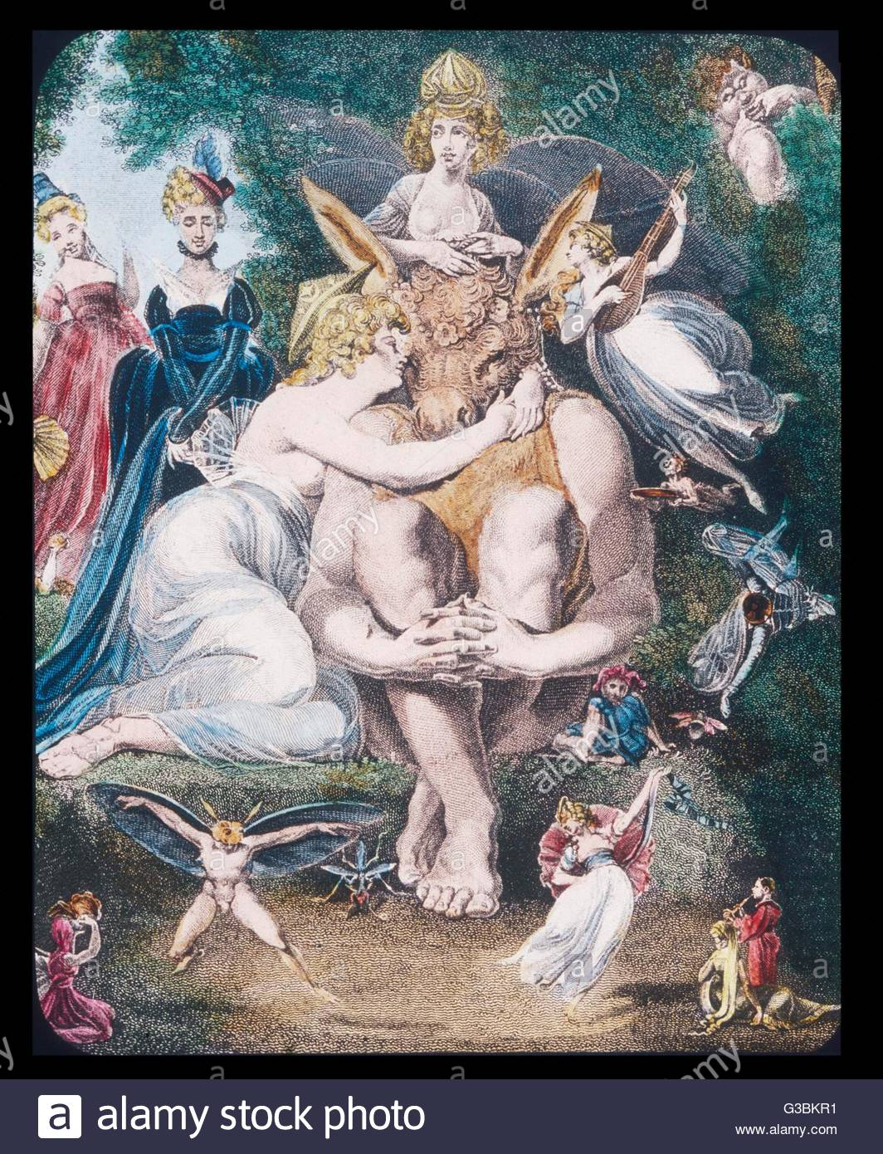
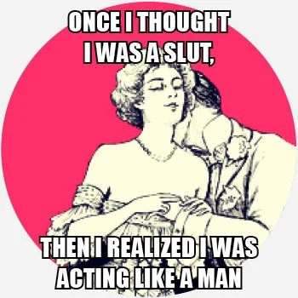
The Monster that is A Man: A Feminist View of William Shakespeare’s Much Ado About Nothing and A Midsummer Night’s Dream
Trisha Mehta : School of Theoretical and Applied Sciences
All images were obtained from google images
Abstract
“The Monster that is A Man: A Feminist View of William Shakespeare’s Much Ado About Nothing and A Midsummer Night’s Dream” is an essay that addresses various feminist aspects and ideals hidden within William Shakespeare’s comedic plays. His promotion of feminism through the female characters in these works exposes the ongoing issue of gender equality for women and shows that a woman’s struggle for freedom from men is truly timeless.
Thesis
Shakespeare’s use of symbolism through his characters’ words and actions as well as the metaphorical verbiage used throughout the plays Much Ado About Nothing and A Midsummer Night’s Dream reinforce Shakespeare’s feminist views that were certainly ahead of his time.
Examples & Quotes
The heroine of the play, Beatrice, “had rather hear [her] dog bark at a crow / than a man swear he loves” her (Shakespeare, Much Ado 1.1.129-130) . . . her response to even the thought of being bound in marriage shows that she full well knows how much freedom she will lose once she says “I do.”
Oberon says to ¨watch Titania when she is asleep / And drop the liquor of it in her eyes. / The next thing then she, waking, looks upon / (Be it on lion, bear, or wolf, or bull, / On meddling monkey, or on busy ape) / She shall pursue it with the soul of love. / And ere I take this charm from off her sight¨ (Shakespeare, Midsummer Night 2.1.184-190).
Supporting Arguments:
A woman’s right to marry by choice rather than force
Women can disrespect powerful males
Promotion of the complete rejection of men
Female refusal to give up ownership of themselves
Why women don’t speak out: consequences of defying men
Being manipulated
The idea of “paying the price”
The double standard in society for gender
Female vs. Male virginity
Women’s pristine behavior vs. Men’s sloppy track record
Female intelligence
How women use societal restrictions to their benefit
Beatrice openly and unashamedly insults Benedick, and in response, the Prince scolds “You have put him down, lady, you have put / him down” (Shakespeare, Much Ado 2.1.278-279). Yet when Benedick speaks ill of Hero by insulting her beauty, he is not chastised for it.
Hermia shows her wits in A Midsummer Night’s Dream when she avoids sleeping with Lysander in the forest by hinting that it may lead to her losing her virginity. Hermia replies “Nay, good Lysander. For my sake, my dear, / Lie further off yet. Do not lie so near” in response to Lysander’s pleas to sleep together (Shakespeare, Midsummer Night 2.2.49-50).
Beatrice not only openly states her opinions but also insults the men whom she does not like, going so far as to say that Benedick is “the prince's jester, a very dull / fool; only his gift is in devising impossible slanders. / None but libertines delight in him, and the com- / mendation is not in his wit but in his villany, for he / both pleases men and angers them, and then they / laugh at him and beat him” directly to his face (Shakespeare, Much Ado 2.1.135-139).

