Slide 1
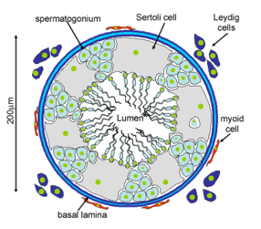
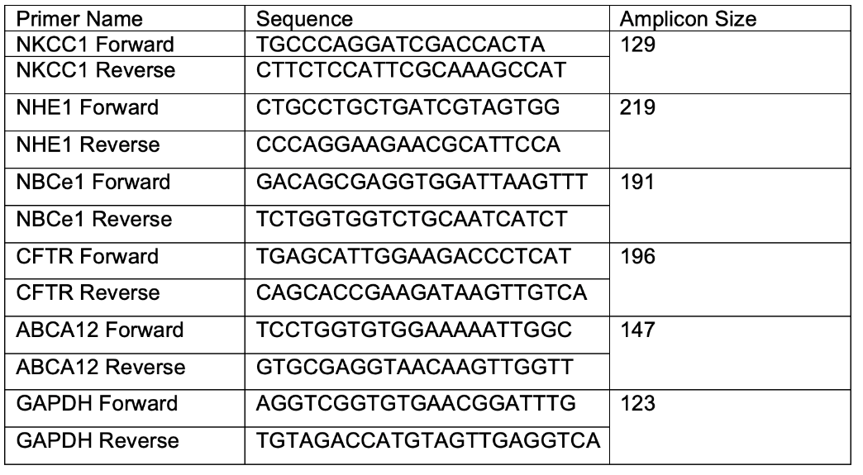
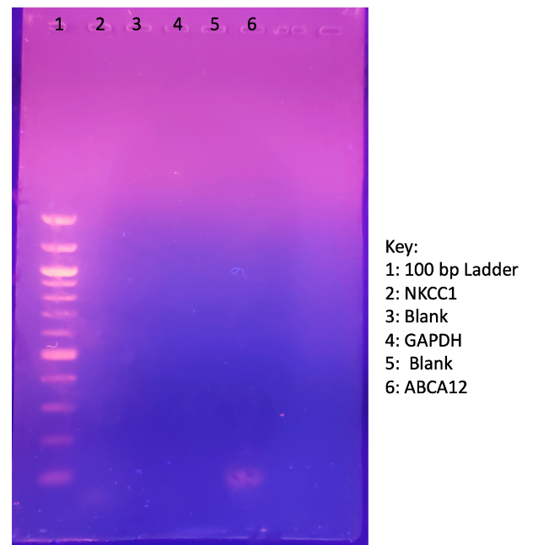
Expression of Membrane Transporters in Sertoli Cells
KAELEA COMPOSTO , JONATHAN GAJEWSKI AND SUMA SOMASEKHAREN
School of Theoretical and Applied Science, Ramapo College of New Jersey, Mahwah, NJ, U.S.A.
Introduction
Experimental Design
Methods
Sertoli cells are epithelial cells that line the seminiferous tubules in the testes where they play a pivotal role in the development of viable mature sperm cells. The Sertoli cells provide the nutrients –carbohydrates, lipids, growth factors, signaling molecules and other vital nutrients for the spermatids. Sertoli cells also play a key role in maintaining the environment necessary for the developing sperm. They are responsible for generating the K+ rich fluid that carries the sperms in the seminiferous tubules. Sertoli cells are tightly regulated by FSH and testosterone.
Although there have been studies
in exploring membrane transport
in the Sertoli cells, the role of
several key membrane transporters
is poorly understood. Studies
have shown that mice deficient
in NKCC1 (Sodium Potassium
Chloride cotransport) have Sertoli
cells with poor NKCC1 expression
that fail to produce sperm. NKCC1 is a transporters ubiquitously expressed in secretory epithelia where it plays a critical role in fluid secretion and cell volume regulation. NBCe1 and NHE1 are other key transporters, which along with NKCC1, are important in maintaining electrolyte composition and pH. Lipid transport is crucial in Sertoli cells. So far, ABCA1 has been shown to have a role in maintaining cholesterol levels in Sertoli cells. However, there is evidence that glucosyl ceramide plays a crucial role in the cytoskeletal dynamics of Sertoli cells during spermatogenesis. ABCA12 is responsible for glucosyl ceramide transport within the cell and it is expressed in the testes.
The long-term goal is to understand the relative expression patterns and the role of NKCC1, NHE1, NBCe1, and the ceramide transporter ABCA12. Once we have a definite understanding of expression patterns both at the RNA and protein level, we will explore how hormones FSH and Testosterone impact the expression and function of these proteins. We will also explore if these transporters especially, NKCC1, NHE1 and possibly ABCA12, are involved in cytoskeletal changes in Sertoli cells during spermatogenesis. Ultimately, we will elucidate the signaling pathway mechanisms involved in coordinating the function of these transporters during spermatogenesis.
Cell Culture Methods: Murine Sertoli-like cell line TM4 cells, originally derived from mouse testis, were obtained from American Type Culture Collection (Manassas, VA, U.S.A.). Cells were grown in T25 and T75 flasks with medium consisting of DMEM -F12 medium (Dulbecco’s modified Eagle’s medium and F-12, Gibco, U.S.A.) 5% fetal bovine serum (HyClone, GE, USA ) and 2.5% Penicillin +Streptomycin (Gibco, USA) in a humidified incubator at 37 °C under 5% CO2. To extract RNA, cells were grown to near confluence, washed with Phosphate buffered saline (PBS), removed from flasks with 2.5% and treated with 2.5% Trypsin-EDTA (Gibco, USA) for 3-4 mins at 37°C. Once cells detached from the surface, they were suspended in cell culture media and centrifuged at 3000 rpm for 5 min. Supernatant was discarded and pellet was used for RNA extraction
RNA Isolation and RT-PCR Methods: Once the adherent cells are confluent, the cells are trypsinized and pelleted. The cells are lysed in the presence of β-mercaptoethanol to reduce any disulfide linkages on the nucleic acids. The lysate is filtered through a GeneJet RNA Purification column and the contents are separated via differential centrifugation. The total RNA is eluted off the filter with sterile H₂O.
The total RNA from the –TM4 cells was used as a template
to amplify specific cell membrane transporters using designed
primers. The total RNA can rapidly degrade and it typically
in a low concentration. The reverse transcriptase SuperScript IV
was chosen because of its ability to transcribe up to 100X more
cDNA from RNA. The thermocycler was programmed with the
following protocol below, with an annealing temperature within
the primers’ T_{m} and ideal temperature for SuperScriptIV to
function.
TM4 Mouse Sertoli Cells
RNA Extraction
Total RNA
RT-PCR
cDNA
of ABCA12, NKCC1, NHE1, NBCe1 and CFTR
ABCA1
NHE1
CFTR
Initial Results:
RT-PCR amplicons were run on a 1% agarose gel as shown in the gel image. We conducted RT-PCR for NKCC1, ABCA12 and GAPDH. We obtained a transcript only in the case of the NKCC1 lane. A challenge we encountered is the amplicon sizes for GAPDH and NKCC1, based on primers we used were much smaller than ABCA12 and most likely ran out of the gel. This was our first attempt and overshot the time for running the gel slightly. We ran out of time (due to the current pandemic) to run another attempt.
Next Steps:
1) We will continue working on THE RT-PCR protocol for NKCC1, NBCe1, NHE1, ABCA12, CFTR and GAPDH.
2) Once we have established-PCR protocols for all the transporters , we intend to work on isolating primary Sertoli cells from Rats and study expression patterns in a primary cell line.
3) Subsequently we will explore the effect of FSH and Testosterone on the expression of these transporters.
Cholesterol
Na⁺
Cl⁻
Gel Electrophoresis
Glucosyl
ceramide
H⁺
Lamellar Granule
ABCA12
100 bp ladder
2Cl⁻
1500 bp
K⁺
Na⁺
NBCe1
NKCC1
1000 bp
Na⁺
3HCO₃⁻
500 bp
300 bp
NHE1
1% Agarose gel showing well 2 with a faint band of amplified NKCC1 cDNA and well 6 with amplified ABCA12 cDNA from RNA extracted from –TM4 mouse cell line. Well 1 contains size markers (NEB 100 bp ladder)
200 bp
NKCC1
NBCe1
CFTR
GAPDH
100 bp
ABCA12
1% Agarose Gel of expected RT-PCR result using primers designed specifically for each selected transporter
Acknowledgements
We would like to acknowledge the continuing support of Dean Saiff, Carol Ichinco, Chemistry Convening group and the TAS staff at Ramapo College.

