Slide 1
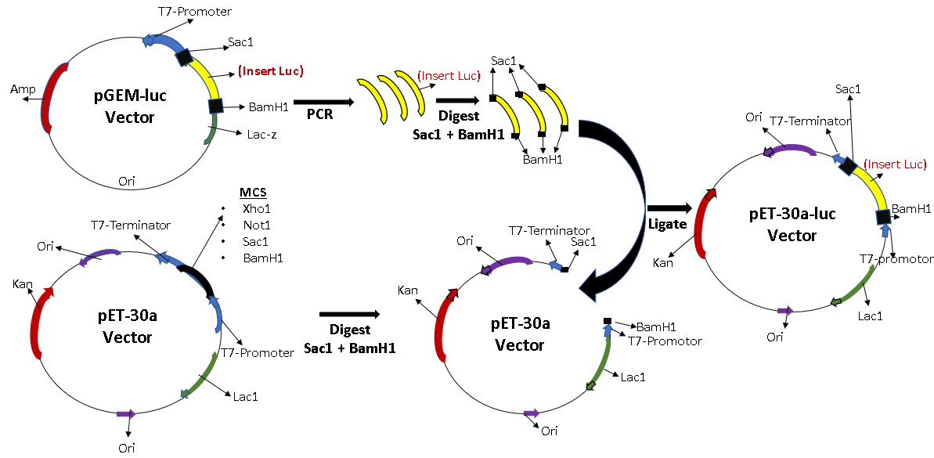
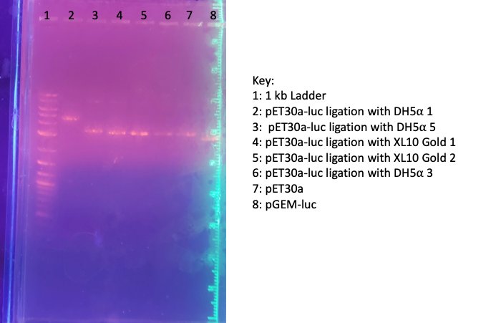
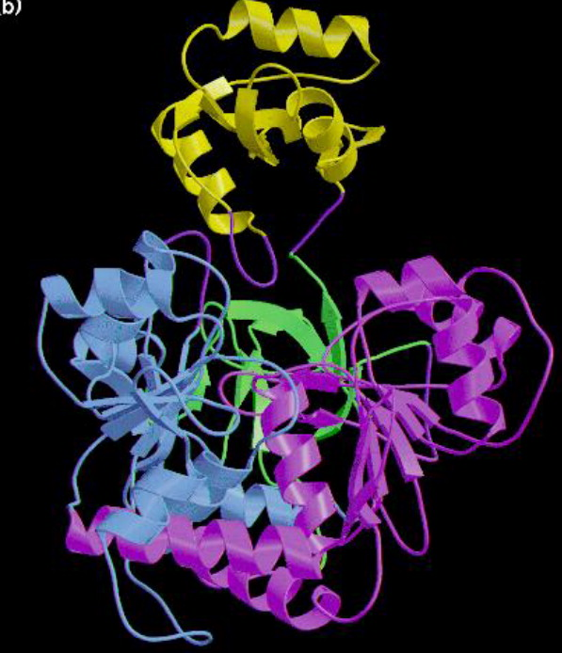
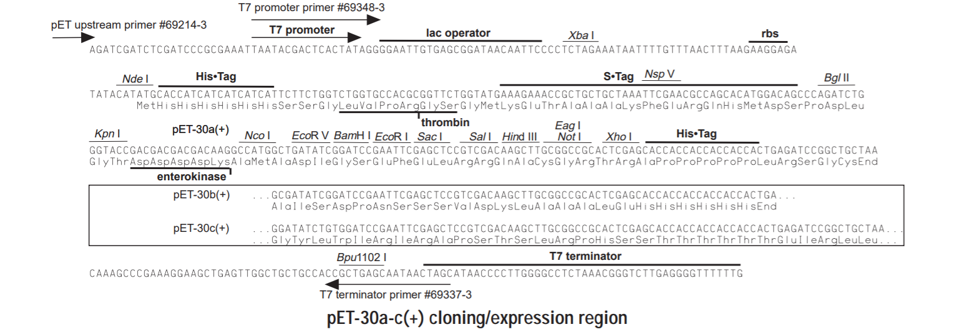
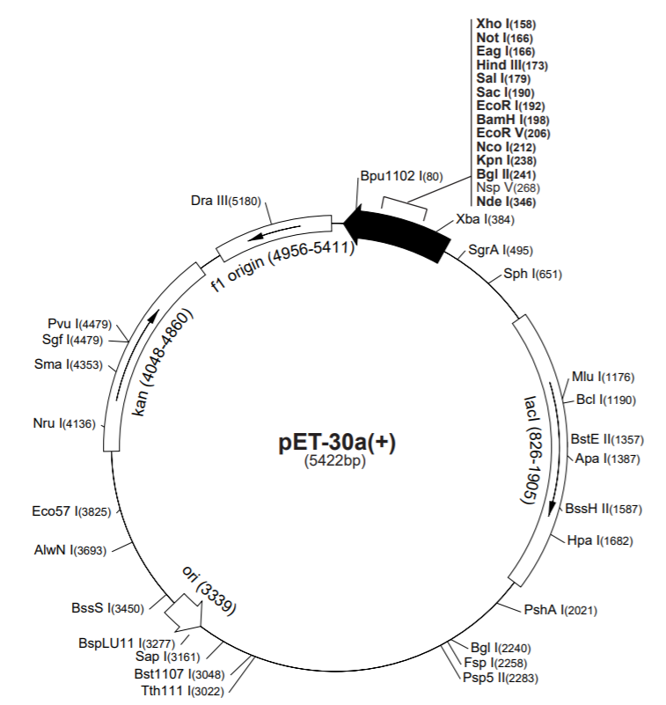
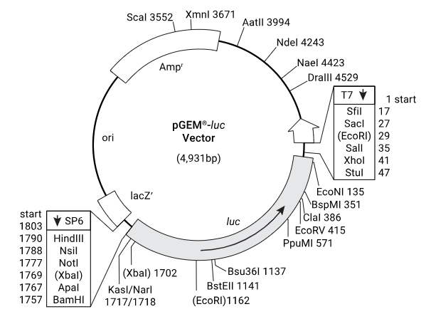
Cloning of His-Tagged Firefly Luciferase Gene into a pET Expression Vector
JONATHAN GAJEWSKI , KAELEA COMPOSTO AND SUMA SOMASEKHAREN
School of Theoretical and Applied Science, Ramapo College of New Jersey, Mahwah, NJ, U.S.A.
Introduction
Firefly luciferase is the enzyme responsible for the phenomenon of bioluminescence in insects such as firefly (Photinus pyralis), glowworm beetles and click beetles. Luciferase catalyzes the oxidation of luciferin resulting in the emission of yellow light 550nm to 620 nm). Firefly luciferase is a 62 kDa protein whose structure reveals a protein with two domains N and C. The active site lies in the C terminal domain. The large N terminal domain is made up of a β barrel and a αβαβα structure. The C-terminus has a fold called the α +β fold found in many hydrolases. The enzyme belongs to a superfamily of adenylate forming enzymes which depend on ATP in the adenylation reaction¹.
The goal of the project is to generate a recombinant DNA construct of a His-tagged luciferase gene in a pET expression vector that can be overexpressed in E.coli and the luciferase protein purified using Affinity purification.
We are developing a project that can be introduced in our curriculum for Experimental Biochemistry students as it encompasses a range of technical and intellectual skills.
Experimental Methods
Results
Fig A: Image of gel showing plasmids obtained after selection of ligation transformed E.coli.
Once the ligation was transformed and plated, we selected colonies that were likely to carry the pET30a-luc plasmid. After the plasmids were extracted from bacterial cultures, about 100-200 ng of plasmid was loaded onto a EtBr gel and run for 30 mins. The Figure A shows a gel with lane1- 1kB DNA ladder, lane2-6- are plasmids from selected colonies, lane 7 –pET30 a plasmid and lane 8- pGEM-luc.
Figure 2. Firefly luciferase structure-Yellow is the smaller C term domain and the remaining is N term¹.
Figure 1. Firefly Luciferase Bioluminescence Reaction.
.
Only few colonies were obtained from the ligation with both DH5 alpha and XL-10 gold. We selected between 6-12 colonies. After DNA extraction, we ran a few of the purified plasmids on the gel shown above. The plasmid in lane1 is distinctly larger than pET 30a plasmid without luc.
Experimental Design
pET plasmids are strong expression vectors. PET 30 vectors have T7 promoter, N and C-terminal Histidine (His) tags, transcription initiation site, ribosome binding site (Shine Delgarno) for translation and are IPTG (Isopropyl β-d-1-thiogalactopyranoside) inducible. IPTG overrides inhibition of the lac promoter by the lac repressor protein and allows for inducible expression of the gene These features allow for good expression of His-tagged proteins that can be purified using Affinity chromatography. We used pGEM-luc (Promega) as a source of the luciferase gene.
We designed the primer pair as follows: forward primer- with a BamH1 restriction (in green) site- GA G G AT C C ATGGAAGA CGCCAAAAAC
and reverse primer with a Sac1 restriction sites (in green)-
GTGAGCTCTTACAATTT GGACTTTCCG
so as to be able to insert the coding sequence of luciferase into pET30a using the restriction enzymes Bam H1 and Sac1. PCR is essential to insert the gene into pET30 in the right orientation and reading frame.
Conclusion and Further Study
The gel images show that the plasmid in Lane X is a larger size than the pGEM luc or pET30a. pET 30a -5.4 kb is a larger plasmid than pGEM-luc (4.7kb) result ishence the consistent with what we expect for pET30a-luc. However the caveat in the gel is that vectors are circularized making it impossible to accurately estimate size.
Next steps is to carry out diagnostic digest of both this plasmid in Lane X and plamids form other colonies we have selected followed by sequencing to confirm that we have succeeded in making pET30a-luc.
Once we have a recombinant construct of pET30a-luc, we will transform it into BL-21 E.coli cells which are suitable for expression of proteins. Transformed BL-21 cells will be grown in large volumes in liquid culture.
The expressed His-tagged Luciferase protein will be isolated and purified by affinity chromatography.
Experimental Methods
The pGEM-luc and pET30a vectors were each isolated from E.coli DH5⍺ cells. pGEM-luc was then used as a template to amplify the luciferase gene in PCR using the protocol outlined below.
The luc PCR fragment and pET30a vector were cut with BamHI and SacI in a Restriction Digest. Previously, a traditional T4 ligation was performed, but too much sample was lost during this process. To reduce sample loss, we switched to an in-gel ligation, where the samples were independently run on a 0.5% Agarose gel and excised. Once melted, the insert was added to the vector in a 2:1 ratio to improve chances of pET30a up taking the luc insert. T4 ligase was still used for ligation and incubated overnight. The ligations were transformed into two cell types: DH5⍺ and XL-10 Gold ultracompetent cells. The XL-10 Gold cells were used because of their superior ability to uptake plasmids, and there was concern about the amount of recombinant plasmids.
To confirm the presence of the recombinant plasmid in the E.coli cells, a plasmid prep was performed, and the isolated DNA was run on a 1% Agarose gel.
Acknowledgements
We would like to acknowledge the continuing support of Dean Saiff, Carol Ichinco, Chemistry Conveying group and the TAS staff at Ramapo College.
References: 1) Crystal structure of firefly luciferase throws light on a superfamily of adenylate-forming enzymes, https://doi.org/10.1016/S0969-2126(96)00033-0

