Slide 1
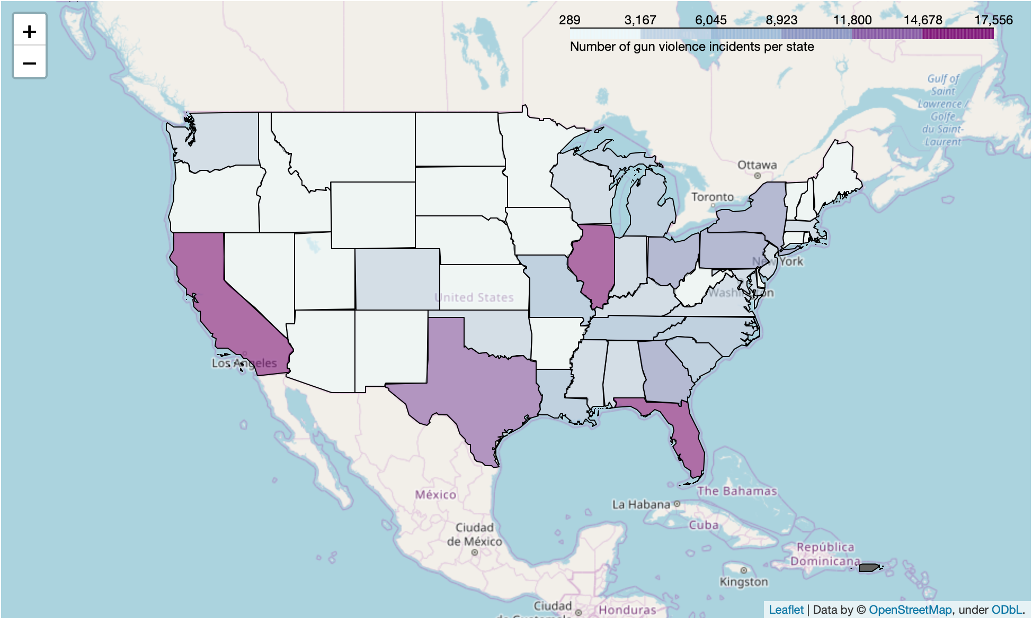
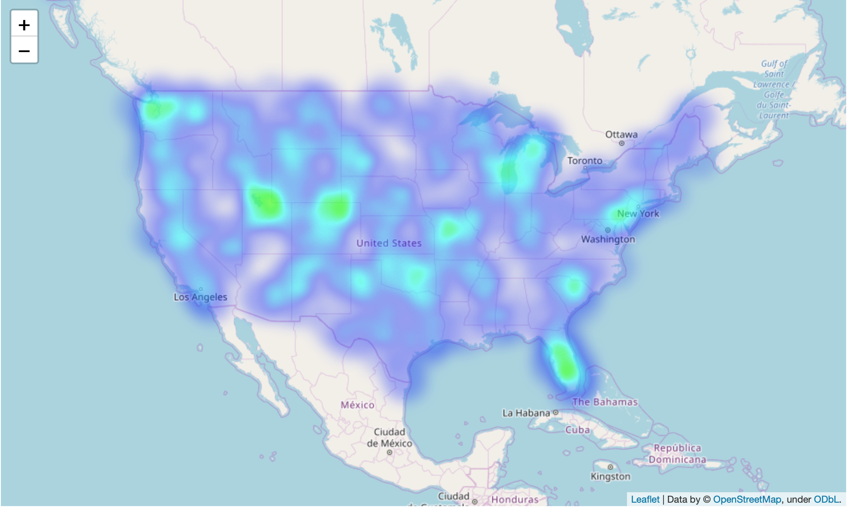
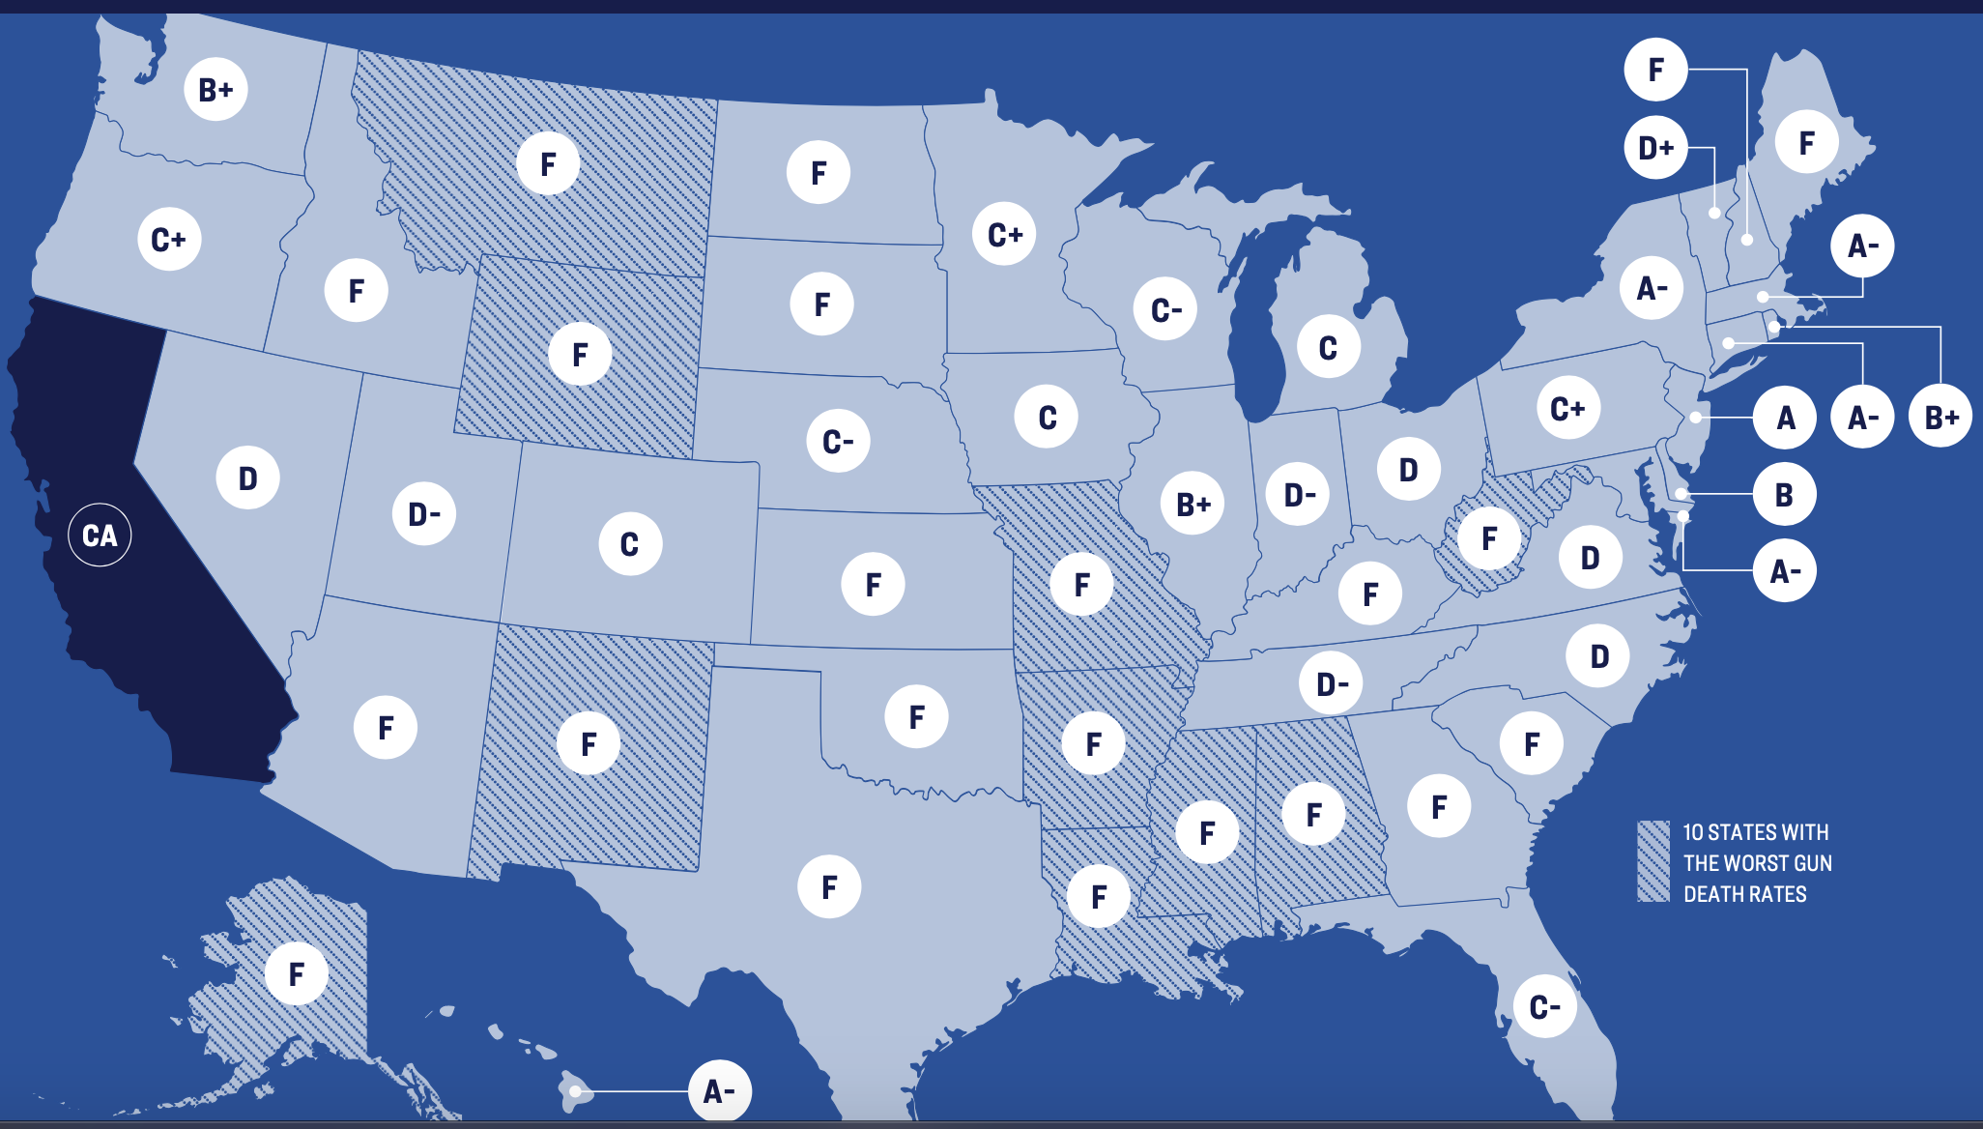
Analysis of Gun Violence in the United States (2013-2018) Justina Celentano, Gagan Namburi, Eman Abdelfattah
School of Theoretical & Applied Science, Ramapo College of New Jersey, Mahwah, NJ, 07430
Abstract:
Gun violence is a subject that receives widespread news coverage across the United States and is something that can affect the quality of life of American citizens adversely. This study focuses on the geographical and sex-related trends of gun violence in the United States. A dataset provided by the US Gun Violence Archive (GVA) was analyzed for the years 2013-2018 and findings were visualized using the pandas, folium, and matplotlib libraries in Python 3. This study found that although some states have strict gun laws, it does not mean there are fewer gun violence incidents in those states. It was also observed that gun violence deaths are generally present in cities and densely populated areas. Additionally, a majority of gun violence involves males.
Dataset Description:
The dataset used for this research was found on Kaggle but originally sourced from the US Gun Violence Archive (GVA) at gunviolencearchive.org. The GVA is a nonprofit corporation founded in 2013 with the main goal of providing free, online, public access to accurate information regarding gun-related violence in the United States. This organization collects comprehensive and relevant information and then checks it for accuracy. The dataset is a CSV file containing data for all recorded gun violence incidents in the US between January 2013 and March 2018, inclusive. There were over 200,000 records of gun violence.
Analysis:
The frequencies of all 50 states and Washington DC were extracted and with that information, a choropleth map was created detailing which states had the most recorded incidents of gun violence.
The numbers of those killed in gun violence incidents was correlated with the locations of the gun violence incidents and a heatmap was created using this data, showing where gun violence was more prevalent.
The total numbers of males and females involved in gun violence were extracted and a waffle chart was created, visualizing the difference between the sexes’ involvement in gun violence.
Experimental Results:
Conclusion:
More men than women were found to be participants in gun violence.
The states with the highest number of gun violence incidents are California, Illinois, Florida and Texas.
States with stricter gun laws may not necessarily mean less incidents of gun violence.
Cities tend to have more gun violence.
There are other variables that can potentially impact the findings of this research such as population density of each state, how the sources define “strict” gun laws, etc.
Choropleth map based on the number of individual incidents of gun violence.
Heat map based on the number of individuals killed through gun violence.
Gun law scorecard from Gifford Law Center, for comparison.
References:
“Giffords Law Center's Annual Gun Law Scorecard.” Gun Law Scorecard, https://lawcenter.giffords.org/scorecard/#CA.
“Gun Violence Archive.” Gun Violence Archive, https://www.gunviolencearchive.org/.
Jing, Eric. “US_Gun_Violence.” Kaggle, 6 Oct. 2019, https://www.kaggle.com/ericking310/us-gun-violence.
LCPGV. 2012 ‘Ranking State Gun Laws.’ Gun Laws Matter 2012: Understanding the Link
Between Weak Laws and Gun Violence. San Francisco, CA: Law Center to Prevent
Gun Violence. 14 November.
Maloney, Carolyn. “Gun Violence in the United States.” Joint Economic Committee, https://www.jec.senate.gov/public/_cache/files/8442a070-6f67-4309-a880-460c03a0d93f/gun-violence-in-the-us---a-nation-in-a-league-of-its-own---final.pdf.
Oppel, Richard A., and Tim Arango. “Guns Across Borders: California Has Strict Laws, but Nevada Doesn't.” The New York Times, The New York Times, 30 July 2019, https://www.nytimes.com/2019/07/30/us/california-gun-laws-gilroy.html.
Comparison of males to females involved in gun violence.
Notes:
1

