Slide 1
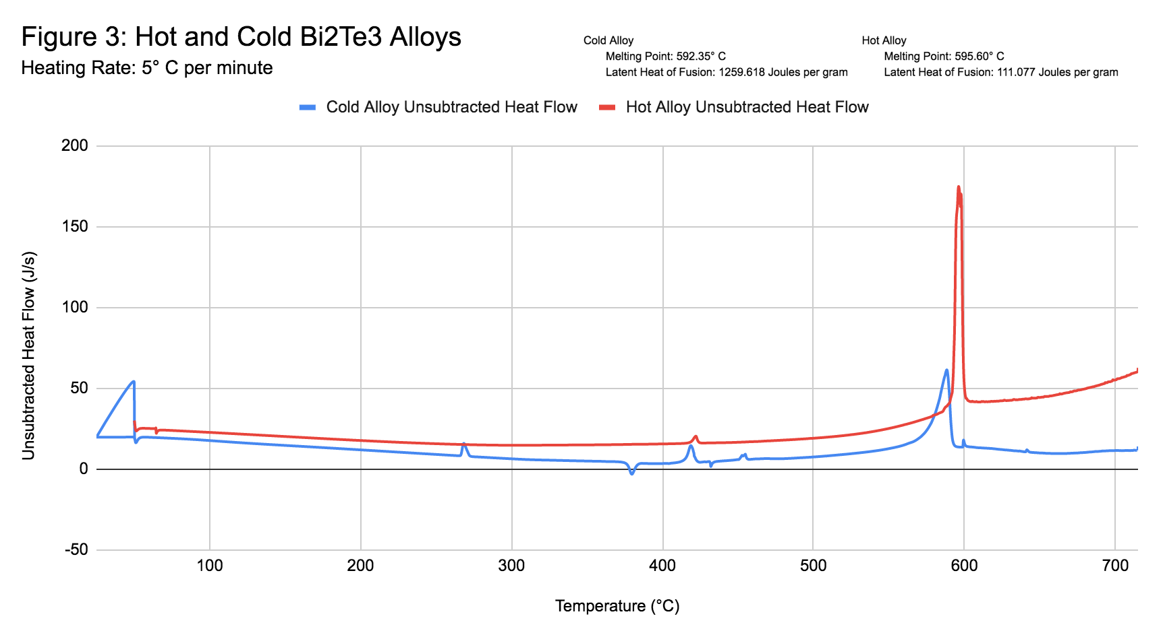
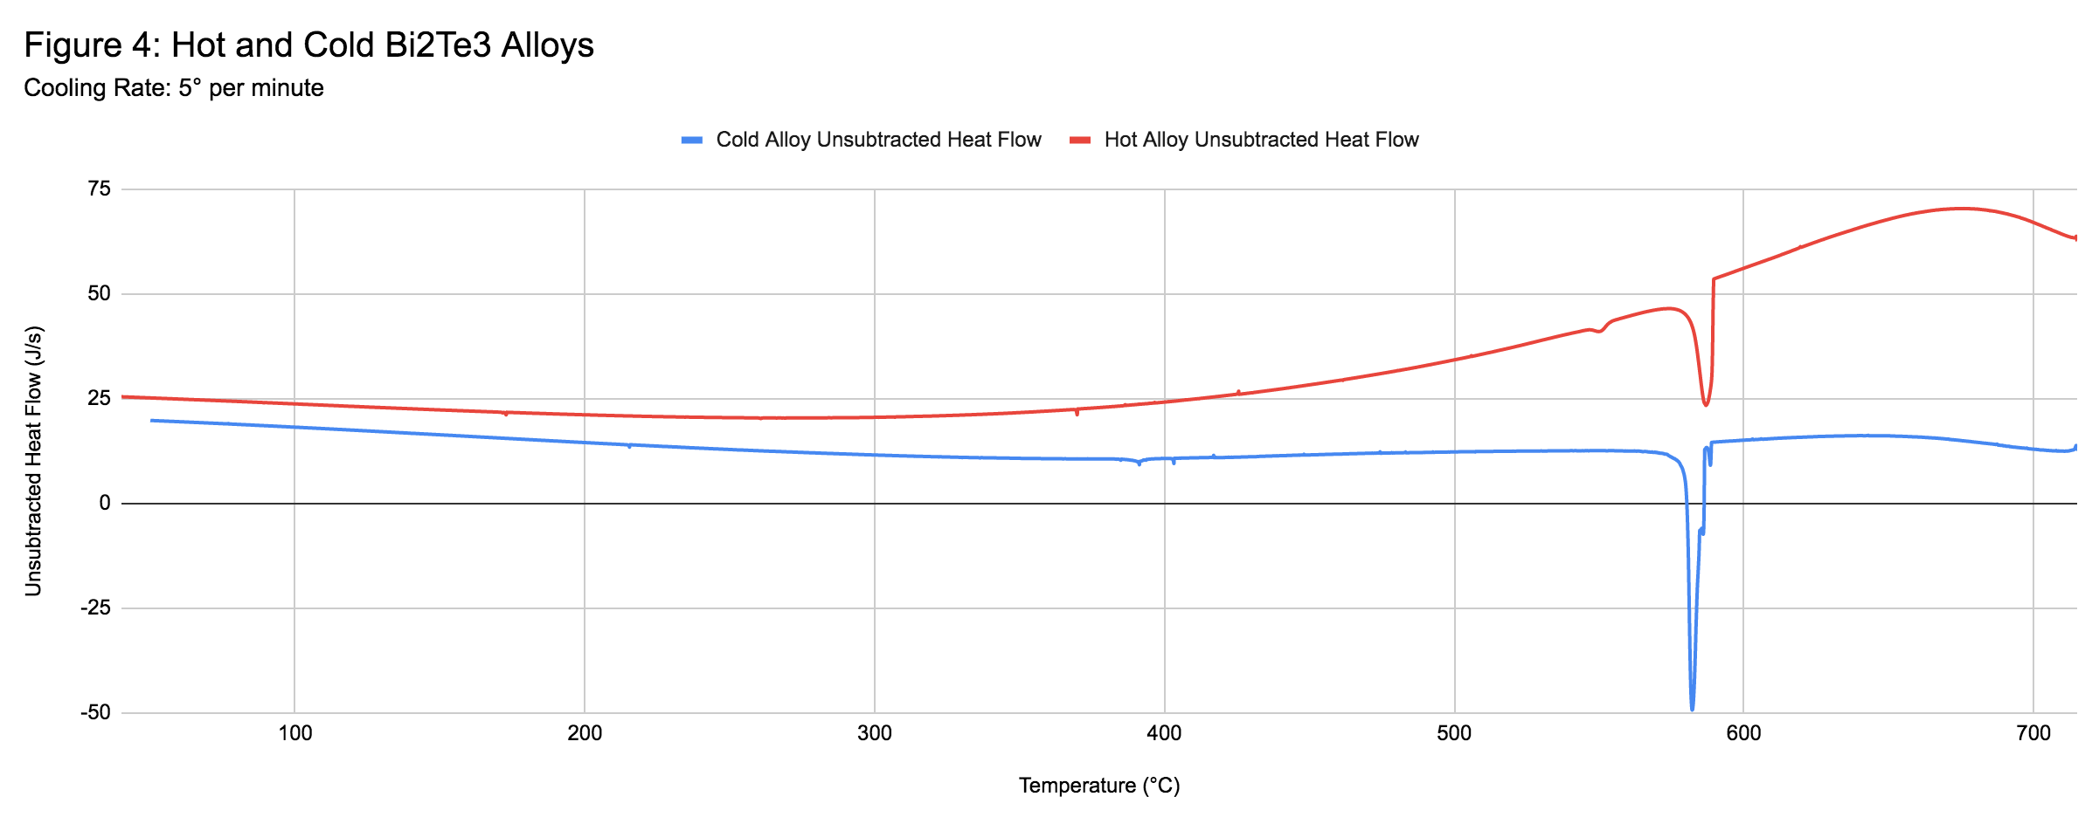
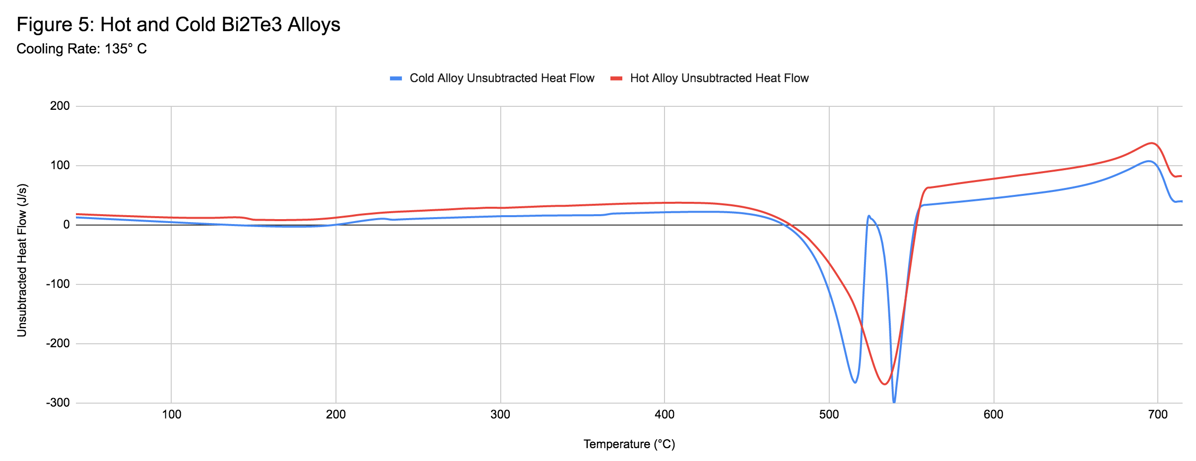
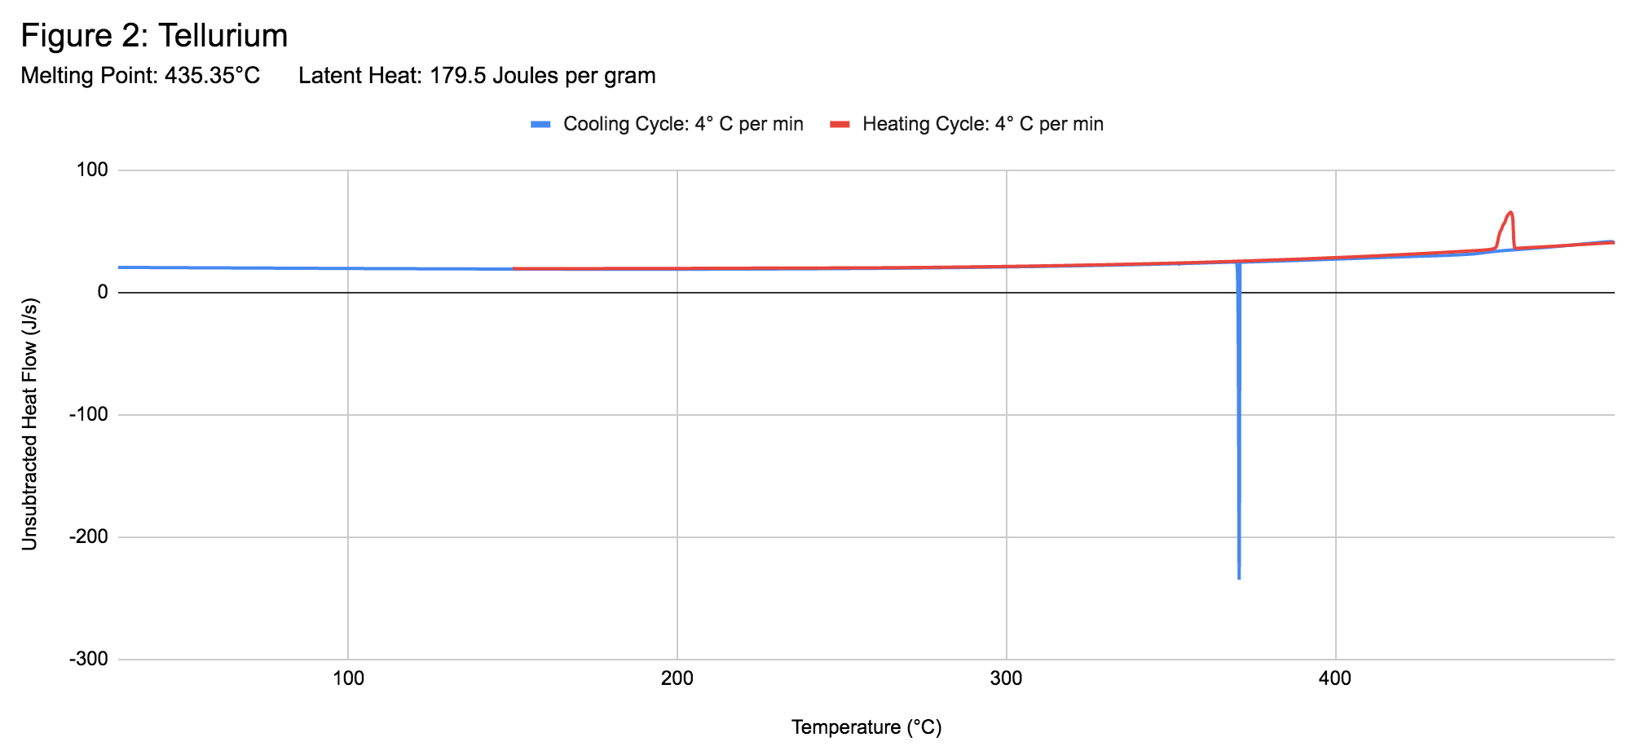
*
*
*
Thermal Characterization of Semiconductor Bi₂Te₃ Alloys using Differential Scanning Calorimetry- preliminary study Luke Connell, Narayan Pokhrel, Michael Logan, Craig Voss, Dr. Daniela Buna School of Theoretical and Applied Science, Ramapo College of New Jersey, Mahwah, NJ, 07430
Abstract
Thermoelectric generators are a simple, robust and attractive option for harvesting thermal waste. Due to the increasing global demand for energy, climate change and a need for sustainable energy solution, thermoelectric generators are a very appealing, clean option. Despite their relatively low efficiency, recent developments in nanotechnology prove that their response can be improved. Therefore, a resurgence of research projects have been dedicated to increasing their thermopower while reducing the thermal conductivity and increasing the Seebeck coefficient and electric conductivity of the electrical contacts. The most common thermoelectric material is Bismuth Telluride Bi2Te3 doped with various impurities such a Selenium, antimony, etc. Numerous fabrication and characterization methods have been studied in order to increase the Seebeck coefficient. Two of the most common start with a hot alloy of Bi2Te3 (most common) or a mechanical (cold) alloy of Bi2Te3. The goal of this work is to test whether various fabrication methods of cold alloys lead to similar heat capacity values for the alloy, therefore offering a simpler, less expensive method of fabrication.
The goal of this preliminary work was to:
record the onset and melting point of each component
calculate the latent heat of each component
compare the cooling cycles, fast versus slow, for each material and identify the phase change temperature
identify, if any, additional re-crystallization processes, etc
Identify areas of further research and fabrication
All measurements were performed with a Elmer-Perkin DSC7 that stayed in storage for well over 20 years at RCNJ. Faculty and students spent most of the Fall semester cleaning, recalibrating and testing the unit and the software. While further adjustments will be pursued, the data presented below is within 15% of the standard values.
DSC Measurements:
Bismuth is a rare metal found in the Earth’s crust found in veins associated with lead, zinc, tin, and silver ores in Bolivia, Canada, England, and Germany. It’s naturally found in compounds mainly oxide (bismite Bi2O3), the sulfide (bismuthinite Bi2S3), and two carbonates (bismutite, (BiO)2CO3, and bismutosphaerite. Naturally occuring bismuth is composed entirely of the isotope bismuth-209 whose atoms contain 83 protons and 126 neutrons. Atomic number - 83; atomic mass - 208.9804 amu; melting point - 271℃; vaporization point - 1560℃; heat of vaporization - 104.8 kj/mol; latent heat of fusion - 11.3 kJ/mol. The thermal profile of Bi is shown below and the measured values for the melting point and latent heat of fusion are in good agreement with the literature.
Background: In a nutshell, a thermoelectric material generates a current when subject to a temperature gradient (Seebeck effect) and a temperature gradient when a voltage gradient is applied (Peltier effect), according to the equation ∆V = - S∆T where ∆V is the Voltage induced or applied and ∆T is the temperature difference applied or induced.
The efficiency of a TE material is defined by the figure of merit quantity, zT, defined as:
where σ is the electrical conductivity, S is the Seebeck coefficient, k is the thermal conductivity and T is the absolute temperature. Therefore a low k and a high σ are highly desirable. In addition the thermoelectric has to be mechanically and thermally stable over a high range of temperatures. Therefore, thermal characterization of thermoelectrics is a valuable tool in investigating their properties.
Tellurium is an odorless, dark-gray to brown, amorphous powder or grayish-white, brittle solid, mostly obtained as a byproduct of mining and refining copper in U.S., Canada, Peru, and Japan. Tellurium is very popular semiconductor used in electronics (phones, computers, and cameras) and electronic components like motherboards. Atomic Number- 52; Atomic Mass- 127.6g/mol; Melting Point- 449.51°C; Heat of Vaporization- 46.0kJ/g; Boiling point- 988°C; Specific Heat- .2 J/gK; latent heat of fusion - 17.8kJ/mol. The thermal profile of Bi is shown below and the measured values for the melting point and latent heat of fusion are in good agreement with the literature.
Conclusions: While further refinement and measurements of the acquired data was stopped short by the College closing, a few observations can be made. The cold and hot alloys show a very close melting point with the hot alloy value slightly higher. Since the cold alloy does not show individual melting for Bi and Te it is clear that the process of mechanical grinding with a High Speed Ball Mill lead to a stable alloy. A small peak of re-crystallization is seen in the heating spectrum of the cold alloy as well as small individual melting for Bi and Te close to their elemental temperatures of 265⁰C and 435⁰C indicating that not all Bi and Te is bonded. The behavior at fast versus slow cooling rate indicates that both alloys fuse at temperatures very close to their melting temperature values. However, in the fast cooling rate, we see two individual phases solidify at two distinct temperatures near the 535⁰C melting temperature of the hot allow. This measurement will be repeated once we get access to the laboratory and investigated further. Additionally, the cold allow shows a small re-crystallization peak at 370⁰C not present in the hot alloy heating cycle.
References
Sanderson, R. Thomas. “Bismuth.” Encyclopædia Britannica, Encyclopædia Britannica, Inc., 12 Dec. 2019, www.britannica.com/science/bismuth.
Walker, John. “Barely Radioactive Elements.” Fourmilab, www.fourmilab.ch/documents/barely_radioactive/.
Author. “Bismuth - Melting Point - Boiling Point.” Nuclear Power, 19 Dec. 2019, www.nuclear-power.net/bismuth-melting-point-boiling-point/.
“Metals - Latent Heat of Fusion.” Engineering ToolBox, www.engineeringtoolbox.com/fusion-heat-metals-d_1266.html.
Materials and Methods: Bismuth (99.99% pure), Tellurium (99.95% pure), commercial hot alloy Bi_{2-x}Sb_{x}Te₃ doped with antimony (x = 0.1), and a mechanical alloy of Bi₂Te₃ fabricated in our laboratory by grinding a mixture of Bi and Te powders to 100 nm nanoparticle size for 3 hours with a High Speed Ball Mill. Two samples of each material was weighed with an analytical scale and sealed in an aluminum or alumina pan with a crimper. Each material was heated at 40⁰C/min from 50⁰C to 710⁰C in a differential scanning calorimeter (Elmer-Perkin DSC TGA7). Following the heating cycle, all materials were cooled along two distinct cycles: first time at a slow 4⁰/min rate and the second time at a fast 135⁰C/min rate.
All data was processed with the Pyris software and transferred to Excel for additional graphing extensions.
*

