Slide 1
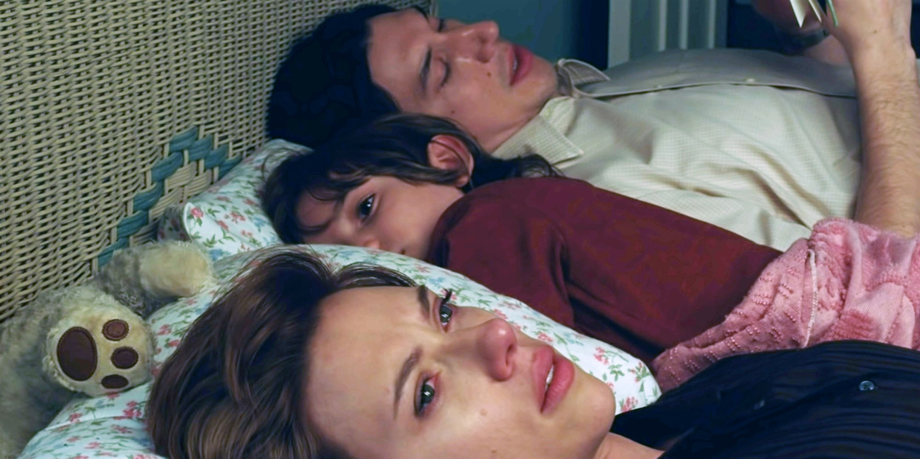
Ethically Managing Power Imbalances in Divorce Mediation
Audrey Grace Miller
Faculty Mentor: Dr. Marta Vides Saade
School of Humanities and Global Studies, Ramapo College of New Jersey, Mahwah, NJ, 07430
Introduction:
Divorce is a life-changing, often emotional time. Some couples desire compassion and kindness that is lacking in a competitive, adversarial justice system. Alternative dispute resolution processes, like collaborative law and mediation, are alternatives in practice and taught in law schools. Power imbalances could allow the more powerful party to influence the negotiation unfairly. Mediators may elicit the parties to communicate with each other and practice active listening, but also may need to direct the conversation at times for the session to be constructive.
Power Imbalances that Affect Mediation: Wealth and income, level of education, involvement in parenting, level of risk aversion, commitment to maintain a cordial relationship, and a history of abuse.
Tactics to Manage Power Imbalances in the Mediator Role:
Explain the goal to make the mediation equitable.
Conduct the sessions in a neutral setting.
Acknowledge the risk that the information shared in the mediation could be used against each other in court.
Educate parties about finances.
Affirm that both parties are equal.
Elicit their desires, define the issues, and manage emotions.
Encourage collaboration to create hypothetical packages and then tweak them.
Manage possible deception.
Know when to stop a toxic mediation to prevent an unfair deal.
Netflix’s The Marriage Story (2019) is a fictional drama about a divorce.
Partial Research Biography:
Lewicki, Saunders, and Minton. “Ethic in Negotiation.” Negotiation. Irwin McGraw-Hill, 1999, pp. 219-263.
Mirzaie, Rose. “Divorce Mediation for Women: An Examination of Feminist Critiques.” Dispute Resolution Journal, vol. 71, no. 3, 2016, pp. 161-170. ProQuest.
Riskin, Leonard L. “Decision-making in Mediation: The New Old Grid and The New New Grid System.” Notre Dame Law Review, vol. 71, no. 1, Dec. 2003.
Hypothetical Case Study:
Jane is stay-at-home mom and part-time babysitter. John is full-time independent plumber. They have a son and similar educations. There was no abuse. There are no lawyers present. Their motivation for divorce is individual happiness.
Conclusion: Being directive may limit the parties’ self-determination, but it prevents coercion and is constructive. With these tactics, each party addresses their mutual interests and their own needs.

