Slide 1
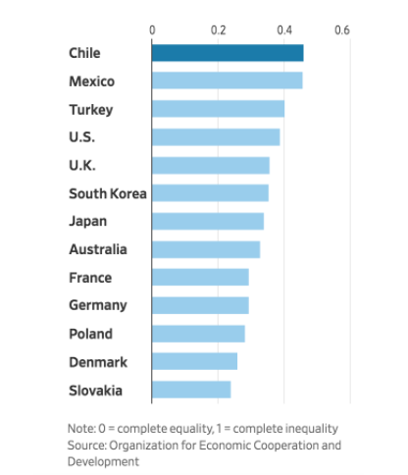
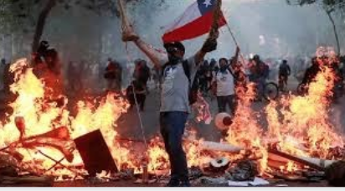
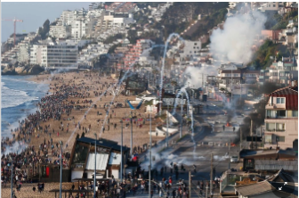
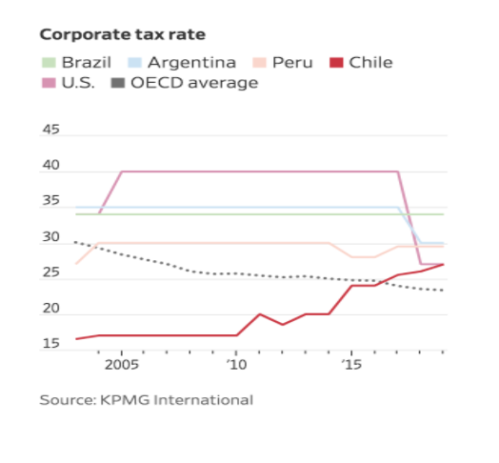
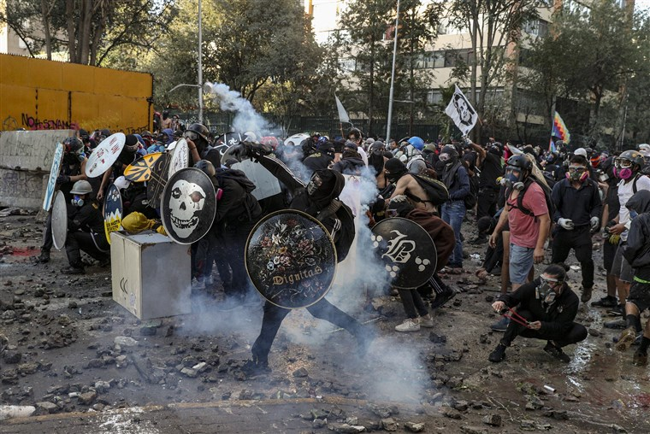
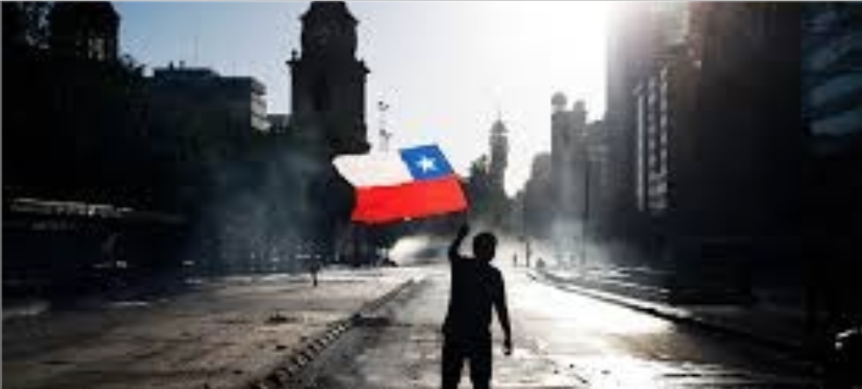
Chile Ongoing Crisis: A History of Social Class Inequalities
Nicole Ceballos
Faculty Mentor: Natalia Santamaria Laorden
School of Humanities and Global Studies, Ramapo College of New Jersey
Overview
On October 18, 2019, high school students in Santiago, Chile initiated a revolt that was triggered by the government's transportation fare increase of thirty pesos to travel by metro. What began as a student protest quickly extended to violent protests across the country that led to the death of 36 people, 2,500 injuries and 2,840 arrests. These protests go beyond the transportation fare increase; in fact, Chileans’ anger originates from decades of social class inequality in Chile. Chilean citizens found themselves struggling to pay their bills and expenses each month. My presentation will compare Chile's past and present economic situation and evaluate the social class disparity in Chile.
Chile Tortures, Violates and Kills
Since the protest has begun, there has been an increase in police brutality against the citizens.
So far there has been:
384 legal cases of sexual assault, violent attacks and torture against women.
2,840 arrests.
2,500 people have been injured.
200 eye injuries affected by rubber bullets
36 people have died.
Sebastián Piñera has acknowledged that the police committed "abuses" when dealing with the protests that have been shaking the country for the past few months.
No son 30 pesos, son 30 años- Augusto Pinochet’s Military Dictatorship
The end of the Pinochet military dictatorship in the 1990’s gave many Chileans hope for a change in economic development.
Privatization of health care, education, and pensions have favored the wealthy and have left a significant portion of the population in poverty and debt.
The protesters demand much more than a reform in the pension system and a minimum wage increase.
Chileans are fighting for a new constitution to limit the role of the government in the economy and create a plan that will meet the needs of the lower and middle classes.
The President’s Response to the Protests
Nation wide vote to reform the Constitution which has not been changed since the dictatorship.
He promised an immediate 20 percent increase in government-subsidized pensions.
New insurance programs to cover catastrophic illnesses and medication.
Chileans continue to peacefully protest. Many strongly feel that if the government is not meeting their promises to the people they are willing to march once again to see the changes they were promised and hope for a better future.
Chile- Latin Americas Economic Model ?
For many years, Chile was an example of a advanced economy in Latin America.
Politicians and the business elite described Chile as an ideal economy.
However, according to the OECD, 38% of Chileans find it difficult to live off their current income.
Chiles inequality rates are among the highest in the OECD.
Corporate Tax Rates
Chile is known for its low corporate tax rates in South America. The graph to the right demonstrates the different corporate tax rates in other countries compared to Chile. Since the protests escalated, Piñera has already raised the corporate tax rate from 23% to 27%.
Chileans feels that the economic model that was introduced by Augusto Pinochet, the military dictator that ruled Chile for 17 years, has been the cause of the people relying on the private sector. While the rich grew their wealth, the poor struggled to make ends meet.
The richest 1% of the population earns 33% of the nations wealth. According to the 2017 UN report makes Chile the most unequal country in the OECD.
OECD (Organization for Economic Co-Operation and Development) Report

