Slide 1
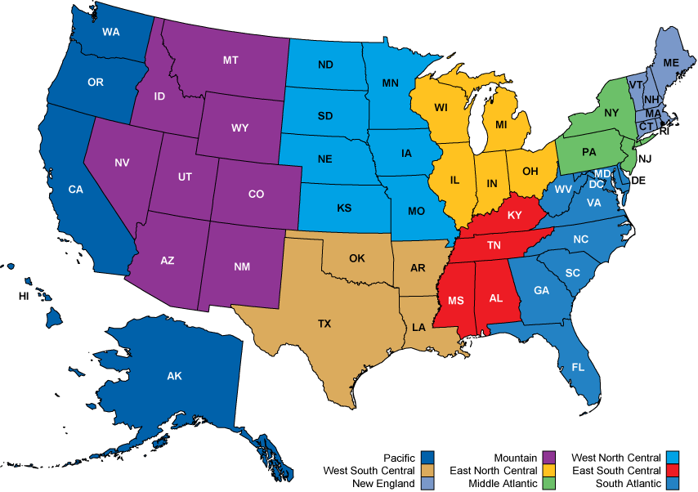
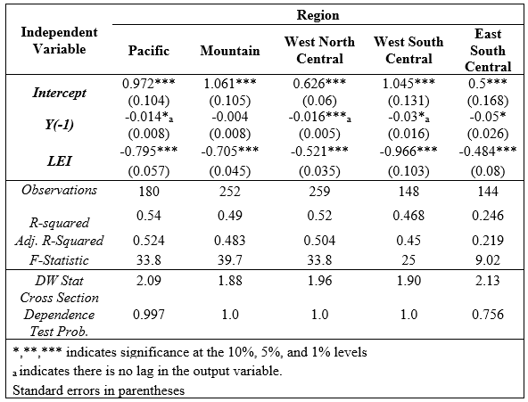
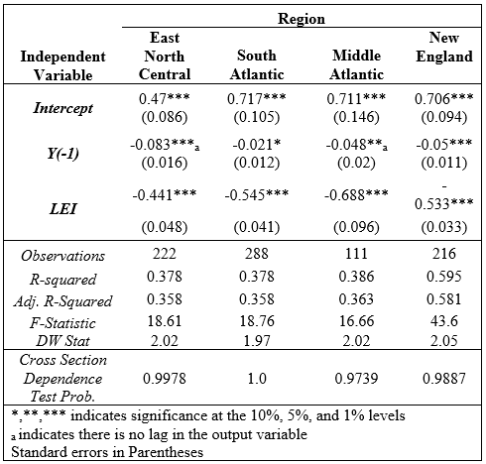
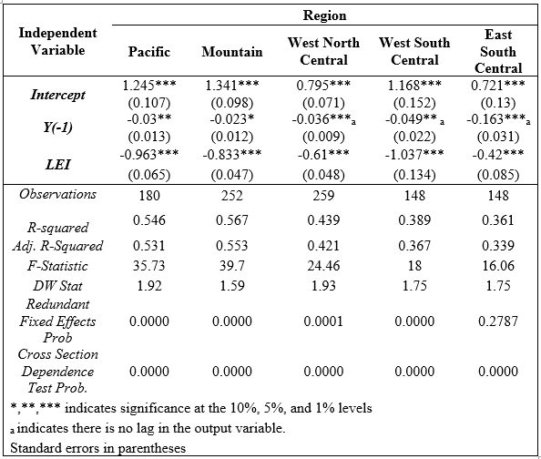
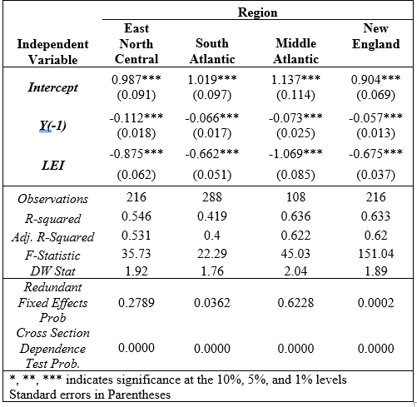
In the four regions of the eastern United States, they all still have highly significant RGDP and LEI variables. The only ones that aren’t significant at the 1% level is the South Atlantic and the Middle Atlantic’s Y. These two variables are significant at the 10% and 5% respectively. They all explain a significant portion of the variation the unemployment rate differences with r-squares varying from 0.378 to 0.595. The F statistics show that every region in table 4 and table 5 has at least one explanatory variable that is statistically different from 0. The DW stats continued to be around 2 in table 5. The cross section dependence test indicates that the problem of invalid test statistics has been addressed using SUR estimation. The four eastern regions have p-values close to 1 in table 5.
All the coefficients for each parameter align as expected with a negative relationship between U and Y, plus U and LEI. The Middle Atlantic region’s Y became insignificant when it was lagged with SUR so the lag has been removed as done previously. This is another region that the unemployment rate takes less time to adjust as changes in output occur.
Can State-Level Leading Economic Indicators Explain
Okun's Law? Eric Sorger Ramapo College of New Jersey, Mahwah, NJ, 07430
Introduction
Data and Methodology
Seemingly Unrelated Regressions
In 1962, the macroeconomist Arthur Okun published a famous study analyzing the statistical association between changes in the unemployment rate and changes in inflation-adjusted or "real" GDP. Okun uncovered a significant inverse relationship between the unemployment rate and output. Okun (1962) found that there was a 3:1 trade off between real GDP and the unemployment rate. In other words, for every 3% increase in GDP the unemployment rate will decrease by 1%. Okun supports this is in his studies because as output decreases firms lay off employees which thus increases the unemployment rate.
In this paper, I address the magnitude changes of Okun’s Law on a more specialized scale of individual regions within the United States. Regions throughout the United States are reliant on different industries and they react differently to certain stimuli. This is especially seen with the manufacturing sector which is usually the first sector to experience a rising unemployment rate with a decrease in GDP. Instead of focusing directly on one state’s specific GDP-unemployment rate relationship this paper focuses on multiple states in their respective regions by paneling and pooling together these states. I will test Okun’s law in a different way than previously done with a regional panel analysis in the United States. I will estimate the GDP-unemployment rate relationship for the nine census divisions that are established by the BEA. These nine divisions are included in Figure 1 as a reference. Each region or division has economic interactions between them and are reliant on each other. Also, I examine the statistical differences between states in a region to determine if there is strong economic evidence to suggest that there is a different fixed unobservable effect between states based on these economic interactions. In other words, I compare the economic data to determine if the states are uniquely different from one another within a region. Preliminary results suggest that some states have a unique effect based on their region however others are homogeneous within their respective region. In addition, I examine whether the states within a region have a significant underlying economic relationship. Lastly, I not only include GDP as an explanatory variable for the unemployment rate, but I use a newer series developed in 1982 called the leading economic index (LEI). Results show that the LEI is a significant deterministic factor in explaining the unemployment rate first differences.
The economic data that I use was gathered directly from the Bureau of Economic Analysis (BEA). For this analysis, I investigate the nine census divisions to look at differences across each division and within each division for Okun’s Law.
LEI for each region is a weighted average based on the state’s contribution to regional GDP. The unemployment rate for each region is aggregated already. The rates are seasonally adjusted which means they have removed the effect of seasonal patterns on unemployment. LEI is also seasonally adjusted to remove the effect of unemployment. Annual data back to 1982 is used for the unemployment rate, real GDP, and the LEI. The regression is a balanced panel since there is a complete data set for all the states. I expand upon the first-differences specification of Ball, et al. (2012).
ΔUt = α + β ΔYt + ωt
SUR solved the overstatement of significance in the variable and the biasedness of these variables as shown with the cross-section dependence test now. All 5 regions in table 4 do not reject cross section dependence test using the Breusch Pagan LM method. This signifies that there is no evidence that the cross-section residuals are correlated and there is no evidence of a violation in the ordinary least squares assumptions. Using SUR allowed the correlation to be squeezed out of the model. The r-squared for every region fluctuated but it is still very strong for most regions around 0.5 however the East South Central region’s r-squared dropped to 0.246.
In the four regions of the eastern United States, they all still have highly significant RGDP and LEI variables. The only ones that aren’t significant at the 1% level is the South Atlantic and the Middle Atlantic’s Y. These two variables are significant at the 10% and 5% respectively. They all explain a significant portion of variation in the unemployment rate differences with r-squares varying from 0.378 to 0.595. The DW stats continued to be around 2. The cross-section dependence test indicates that the problem of invalid test statistics has been addressed using SUR estimation. The four eastern regions have p-values close to 1 in table 5. All the coefficients for each parameter align as expected with a negative relationship between U and Y, plus U and LEI.
Ordinary Least Squares Model
Conclusion
Okun’s Law is a relationship that originally identified that a 3% increase in GDP would accompany a decrease in the unemployment rate by 1%. This inverse relationship has been extended through various forms of literature since Okun’s original paper in 1962. Research has expanded on Okun’s law by focusing on the changes in magnitude and the mathematical specification of the relationship. Better understanding of this relationship aids policymakers in determining the overall health of the economy; these metrics and this well-established relationship supplies them economic support to determine future changes in macroeconomic health. The overall conclusion that researchers have uncovered is the relationship can have large magnitude shifts depending on the region or country in question. There are many socio-economic factors that impact the relationship, but it is a consistent law.
Ultimately, I extended Okun’s Law into the regional sphere with the LEI to explain changes in the unemployment rate. These results show that LEI and real GDP are highly significant indicators of future changes in the unemployment rate and could be leveraged by state officials to slow down decreases in GDP and the ensuing increase in the unemployment rate. These officials can use policies to limit the impact of downturns in the business cycle by using LEI indicators and real GDP to predict the next change in the unemployment rate. As the LEI decreases, they can enact pro spending policies to get consumers to increase their demand and improve economic health. Okun’s law remains a stable relationship that can used for policy making on a regional basis to limit the impact of declines in the business cycle.
Background Literature
Okun’s Law is a widely accepted macroeconomic relationship and has provided ample space for extensions in the literature. Many economists extend this in different ways and have tested the strength of Okun’s law to keep it current and accurate. For example: Harris and Brian (2001) conducted cross-country comparisons between western countries; Guisinger (2018) compared US states; and Freeman (2000) tested Okun’s Law on different US regions. These studies extend Okun’s law through different specifications and scope changes. Some economists analyze the symmetry of the law and whether the magnitude changes for different economic landscapes.
However, it varies in strength depending on the time period and the country in question. There are many factors that also influence changes in the unemployment rate besides the changes in real GDP. Additionally, there are numerous methods that can be used to estimate Okun’s Law. This paper draws upon these areas to more accurately estimate Okun’s law incorporating additional economic information and adapting for residual correlation.
The results of each region panel with their states proved to have similar results but also had a variation between the regions. Most regions had highly significant real GDP parameters with a one-year lag, however there were 3 regions that did not. These 3 regions had significant real GDP changes when there were in the same time period as the unemployment change. The fixed effects were insignificant for 3 regions which means those regions were very interconnected and did not have a separate state influence. These regions have some unknown economic interactions that link the states together compared to the other 6 regions. All regions had real GDP and LEI variables with a negative coefficient aligning to expectations. The coefficients varied from -0.023 to -0.163 for real GDP and -0.42 and -1.069 for LEI. All regions had the issue of cross equation residual correlation and it was corrected in the SUR models for every region.

