Slide 1
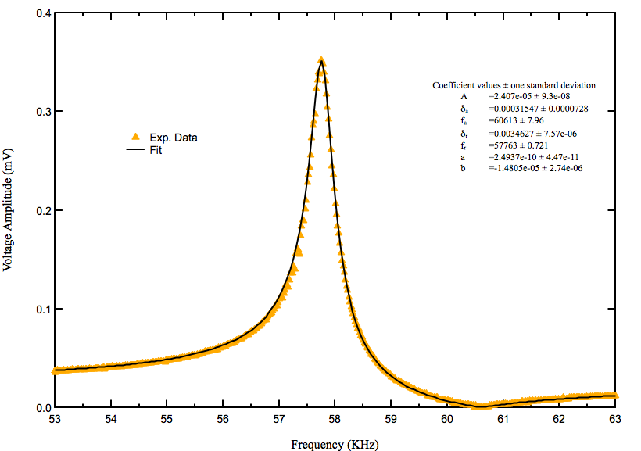
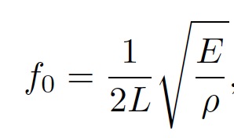
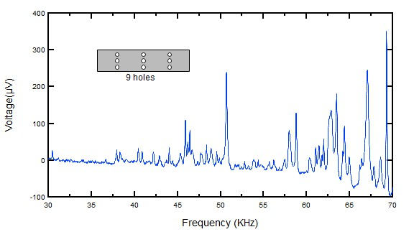
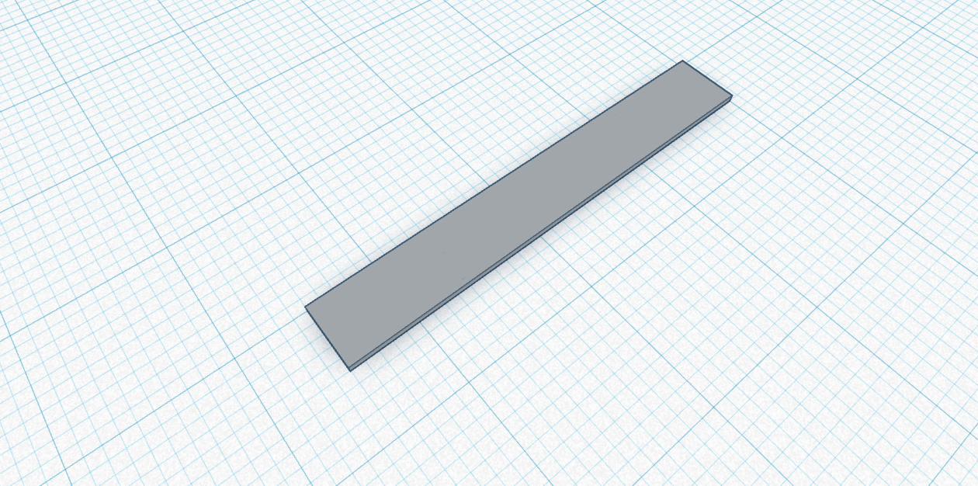
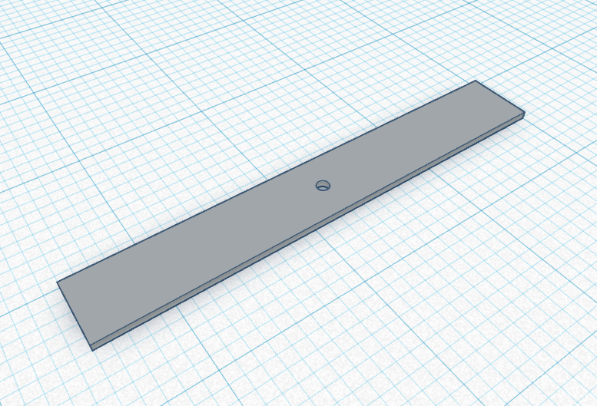
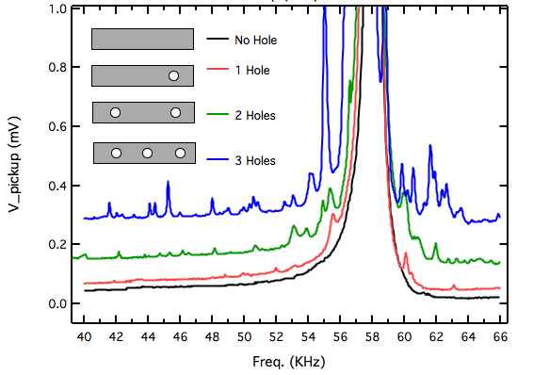
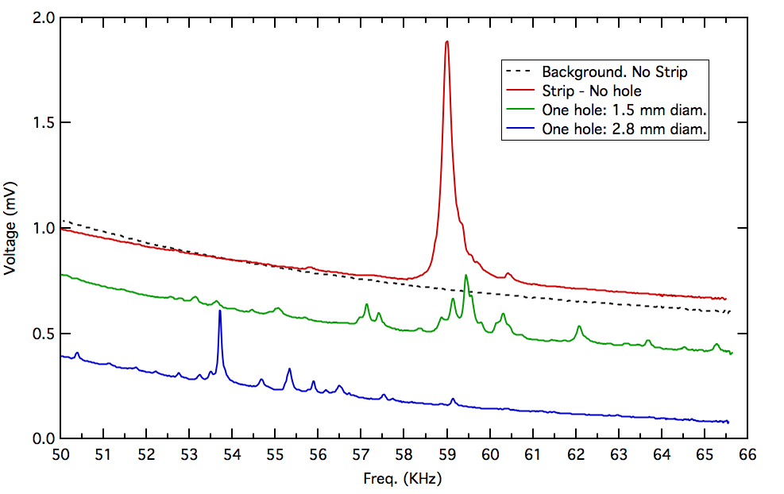
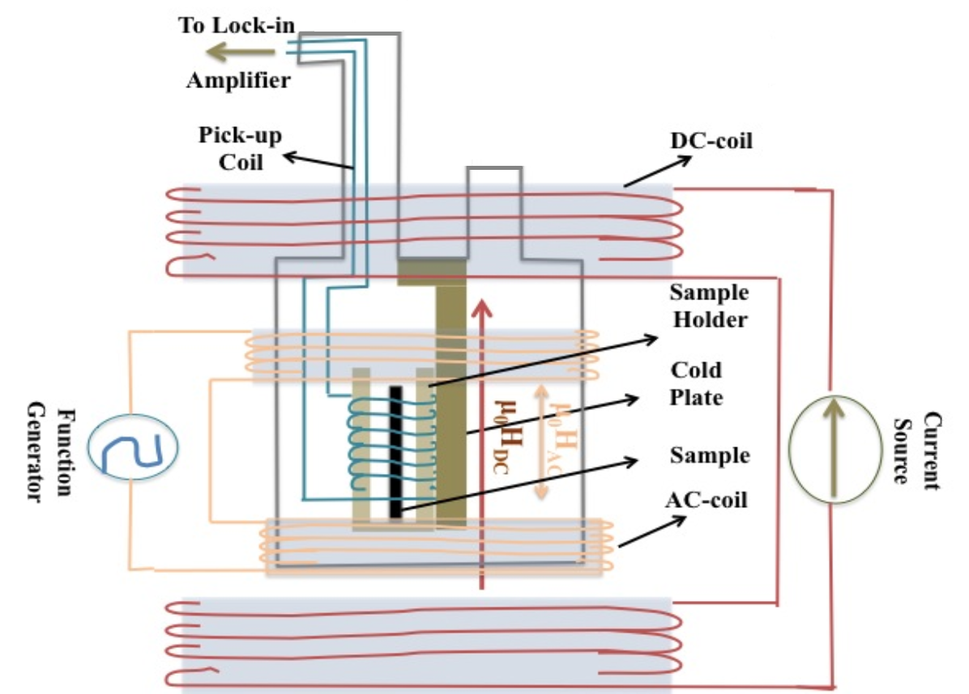
Effect of Topological structures on the spectrum of a magneto-elastic ribbon
Subin Mali, Dr. Catalin Martin
School of Theoretical and Applied Science, Ramapo College of New Jersey, Mahwah, NJ, USA
Abstract
Soft ferro-magnetic materials are well known and much used in the current technology and industry. High malleability and low coercivity of amorphous ferromagnetic alloys allow for a wide range of applications in electronics. Due to these properties, soft ferro-magnetic materials can also be used to study the effects of defects or regulated imperfections on a resonant frequency spectrum. Currently, the study of surface and bulk defects in crystals or regular periodic systems is becoming a major subject of theoretical and experimental investigation. Emergent phenomena induced by the defects have multiple practical applications ranging from development in topological materials to advancements in electronics. Hence, new adaptable and inexpensive methods to probe the effects of the defects on a system may be of interest. In this experiment, we induce controlled defects and create regulated patterns in the ferro-magnetic strip to study their effects on the frequency spectrum. We propose a new adaptable and inexpensive method to explore the effects of topological structures. We present here examples of such structures and their effects on the resonant spectrum of the ferro-magnetic strip.
Results
Our experiment rely on the resonance property of the ferro-magnetic strip. Hence, to find the resonant frequency peak, f₀, a measurement was taken with a regular strip (figure 1(a)).
The equation above shows that resonant frequency primarily depend on the elasticity(E) and density(ρ) of the strip. Figure 3 shows a sketch of the setup used to find the resonant frequency and figure 4 gives the graph of the measurement. We find that the measurement fits well with the following equation:
Figure 3.
Figure 4.
Figure 5 shows the signature main peak at around 58 kHz in addition to many more peaks before and after it. The peaks left of the main peak correspond to lower frequencies, hence longer wavelengths than that of the main peak. The existence of longer wavelengths can be explained by studying reflection (or diffraction) of waves on discontinuous boundaries, as shown in figure 6. The interference of reflected waves inside the boundaries causes different peaks of long wavelengths.
In addition, figure 5 shows a wide variety of peaks and valleys. Adding more holes on the strip adds a lot of more subtleties caused by interference of waves diffracting with the holes. The peaks and valleys are vaguely periodic. These repeating structures resemble the band-structure of metals which could be made more evident by increasing the scale of the experiment.
Figure 6. A schematic diagram of a wave travelling through the 1 mm hole strip. The hole region can be regarded as a region where the wave travels with different speed than that of other regions. The dotted lines correspond to interfaces between different media.
Experimental Method
Figure 5.
(a)
(b)
(c)
Figure 1. (a) The regular ferro-magnetic strip used in previous experiments plotted in a 3D CAD software. (b) The strip with a hole in the middle. (c) The strip with a 3×3 patterned 0.8 mm hole distributed evenly across the area
Our experiment used an amorphous Fe-based strip of dimensions [35mm, 5mm, 0.5mm]. In this experiment, the amorphous strip was punctured with a pattern and demagnetized with a demagnetization coil. The strip was then placed on the steel bar of a string vibrator. The string vibrator was powered by a sinusoidal alternating voltage through the output of a lock-in amplifier. The amplitude of the voltage is kept uniform to induce small mechanical vibrations in the strip. The strip vibrated transversely with respect to the metal rod. A pair of Helmholtz coils was installed around the strip to magnetize the strip in the longitudinal direction by applying a uniform magnetic field.
Figure 7 and figure 8 demonstrates more measurements of the strip with different hole patterns.
In figure 7, we can observe that the frequency sweep curve gets more jagged as the number of holes increases. This is because with a greater number of holes, we increase the interferences of waves in the strip.
In figure 8, we can compare strips with different size of holes in the middle with respect to a regular strip. Even with holes at the same position, the energy of the resonance gets distributed differently. For instance, in 1.5 mm hole strip we observe the trace of the main 58kHz resonance, however this disappears in 2.8 mm.
Figure 7.
Figure 8.
The strip was then kept inside a 50-turn solenoid which is connected to an input channel of a lock-in amplifier. The strip acts like a thin vibrating magnet which, by Faraday’s law of induction, produces electric current that is picked up by the solenoid and measured. Figure 1 shows the strip patterns used in this experiment and Figure 2 shows a schematic diagram of the setup.
Conclusion
References
Romano, Joseph, and Price, Richard. A simple graphical method for calculating the standing wave frequencies on a rectangular membrane, AAPT, 2020.
Garcia-Arribas, Alfredo, et al. Sensor Applications of Soft Magnetic Materials Based on Magneto-Impedance, Magneto-Elastic Resonance and Magneto-Electricity, MDPI, ISSN 1424-8220, 2014.
Grimes, C, et al. Theory, Instrumentation and Applications of Magnetoelastic Resonance
Sensors: A Review, MDPI, ISSN 1424-8220, 2011.
Joe, Yong, Satanin, et al. Classical analogy of Fano resonances, IOP science, 2006
In this experiment, we explored a simple and adaptable experimental method that utilizes the properties of the ferro-magnetic strip. We presented a new experimental procedure for investigating the effects of topological structures on the ferro-magnetic strip. We showed and studied the effects of a few defects on the frequency spectrum of the strip. Our results create a potential prospective for new methods of studying defects in an otherwise pristine periodic system.
Figure 2. A labeled diagram of the setup used to conduct this experiment

