Slide 1
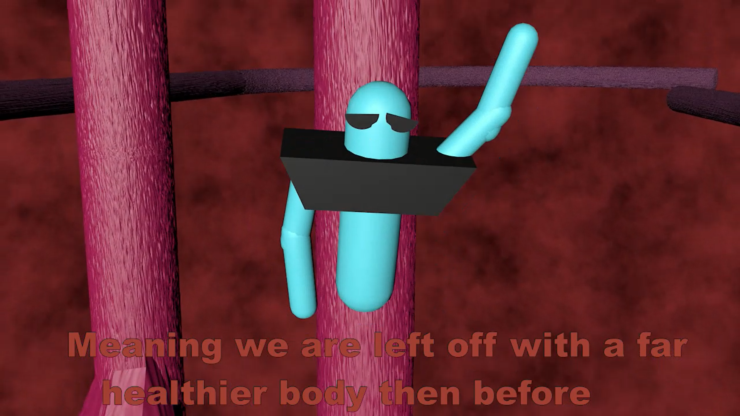
Drugs Vs. Cancer
Created by:
Sean Morgan
Ramapo College 2021
Link to Video:
https://vimeo.com/519787544
Link to Article:
https://news.yale.edu/2020/04/15/new-cancer-drug-shrinks-tumors-reduces-side-effects-animal-studies

