Slide 1
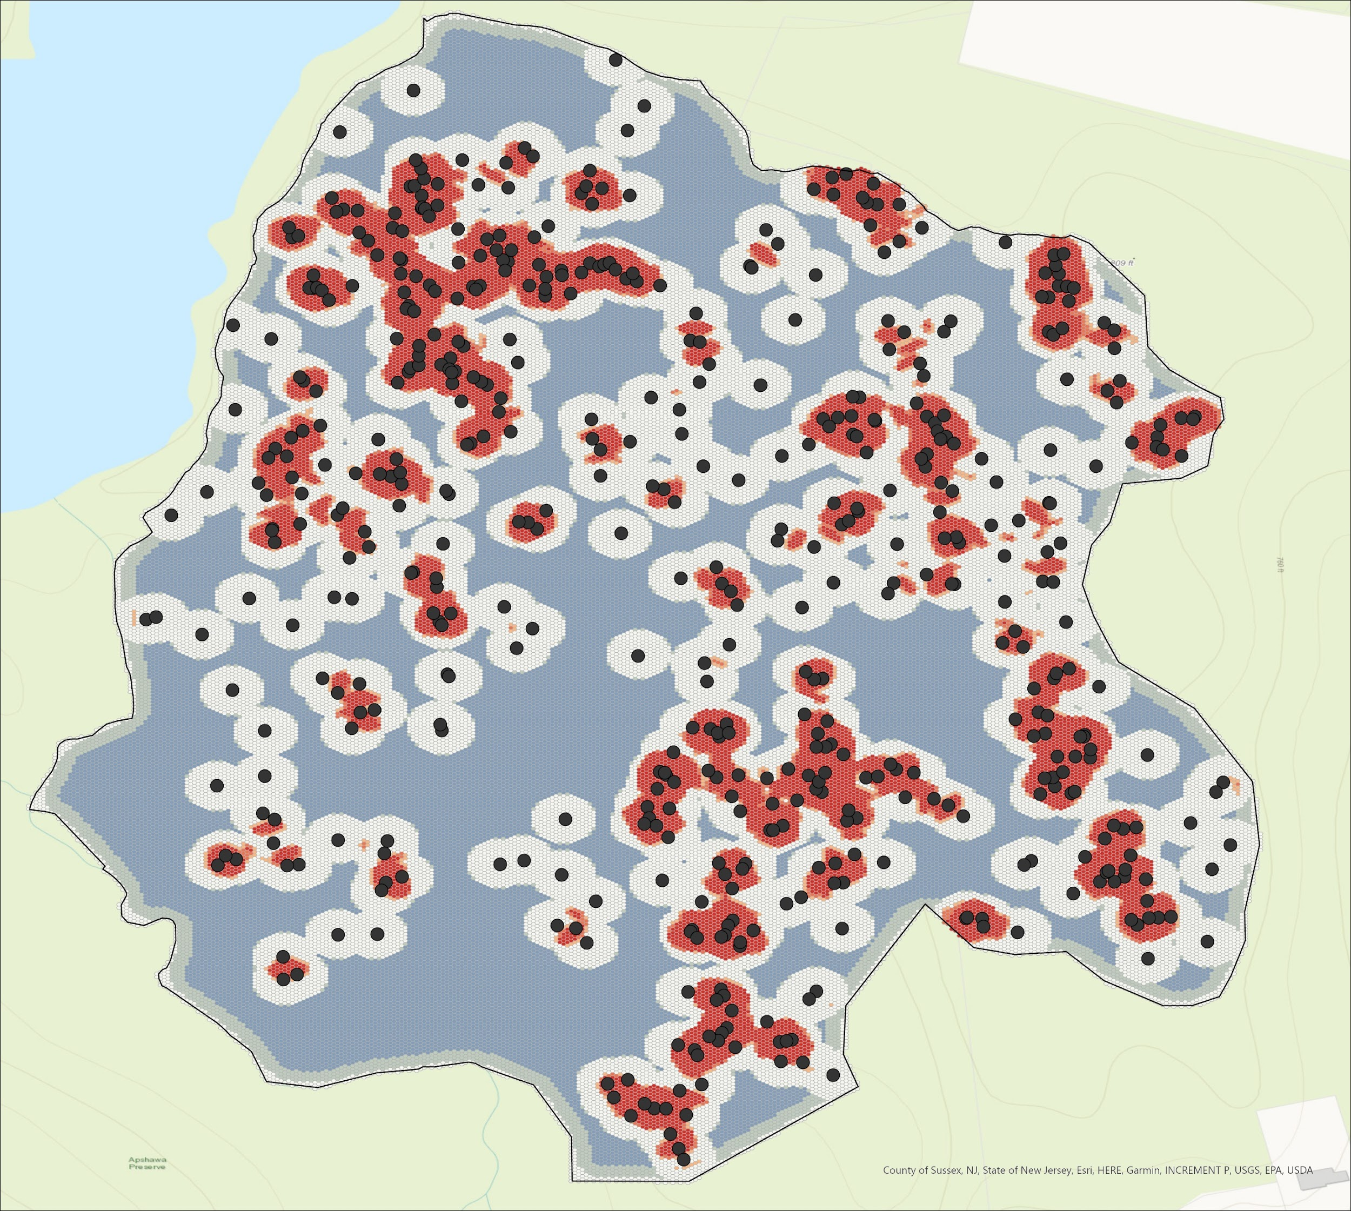
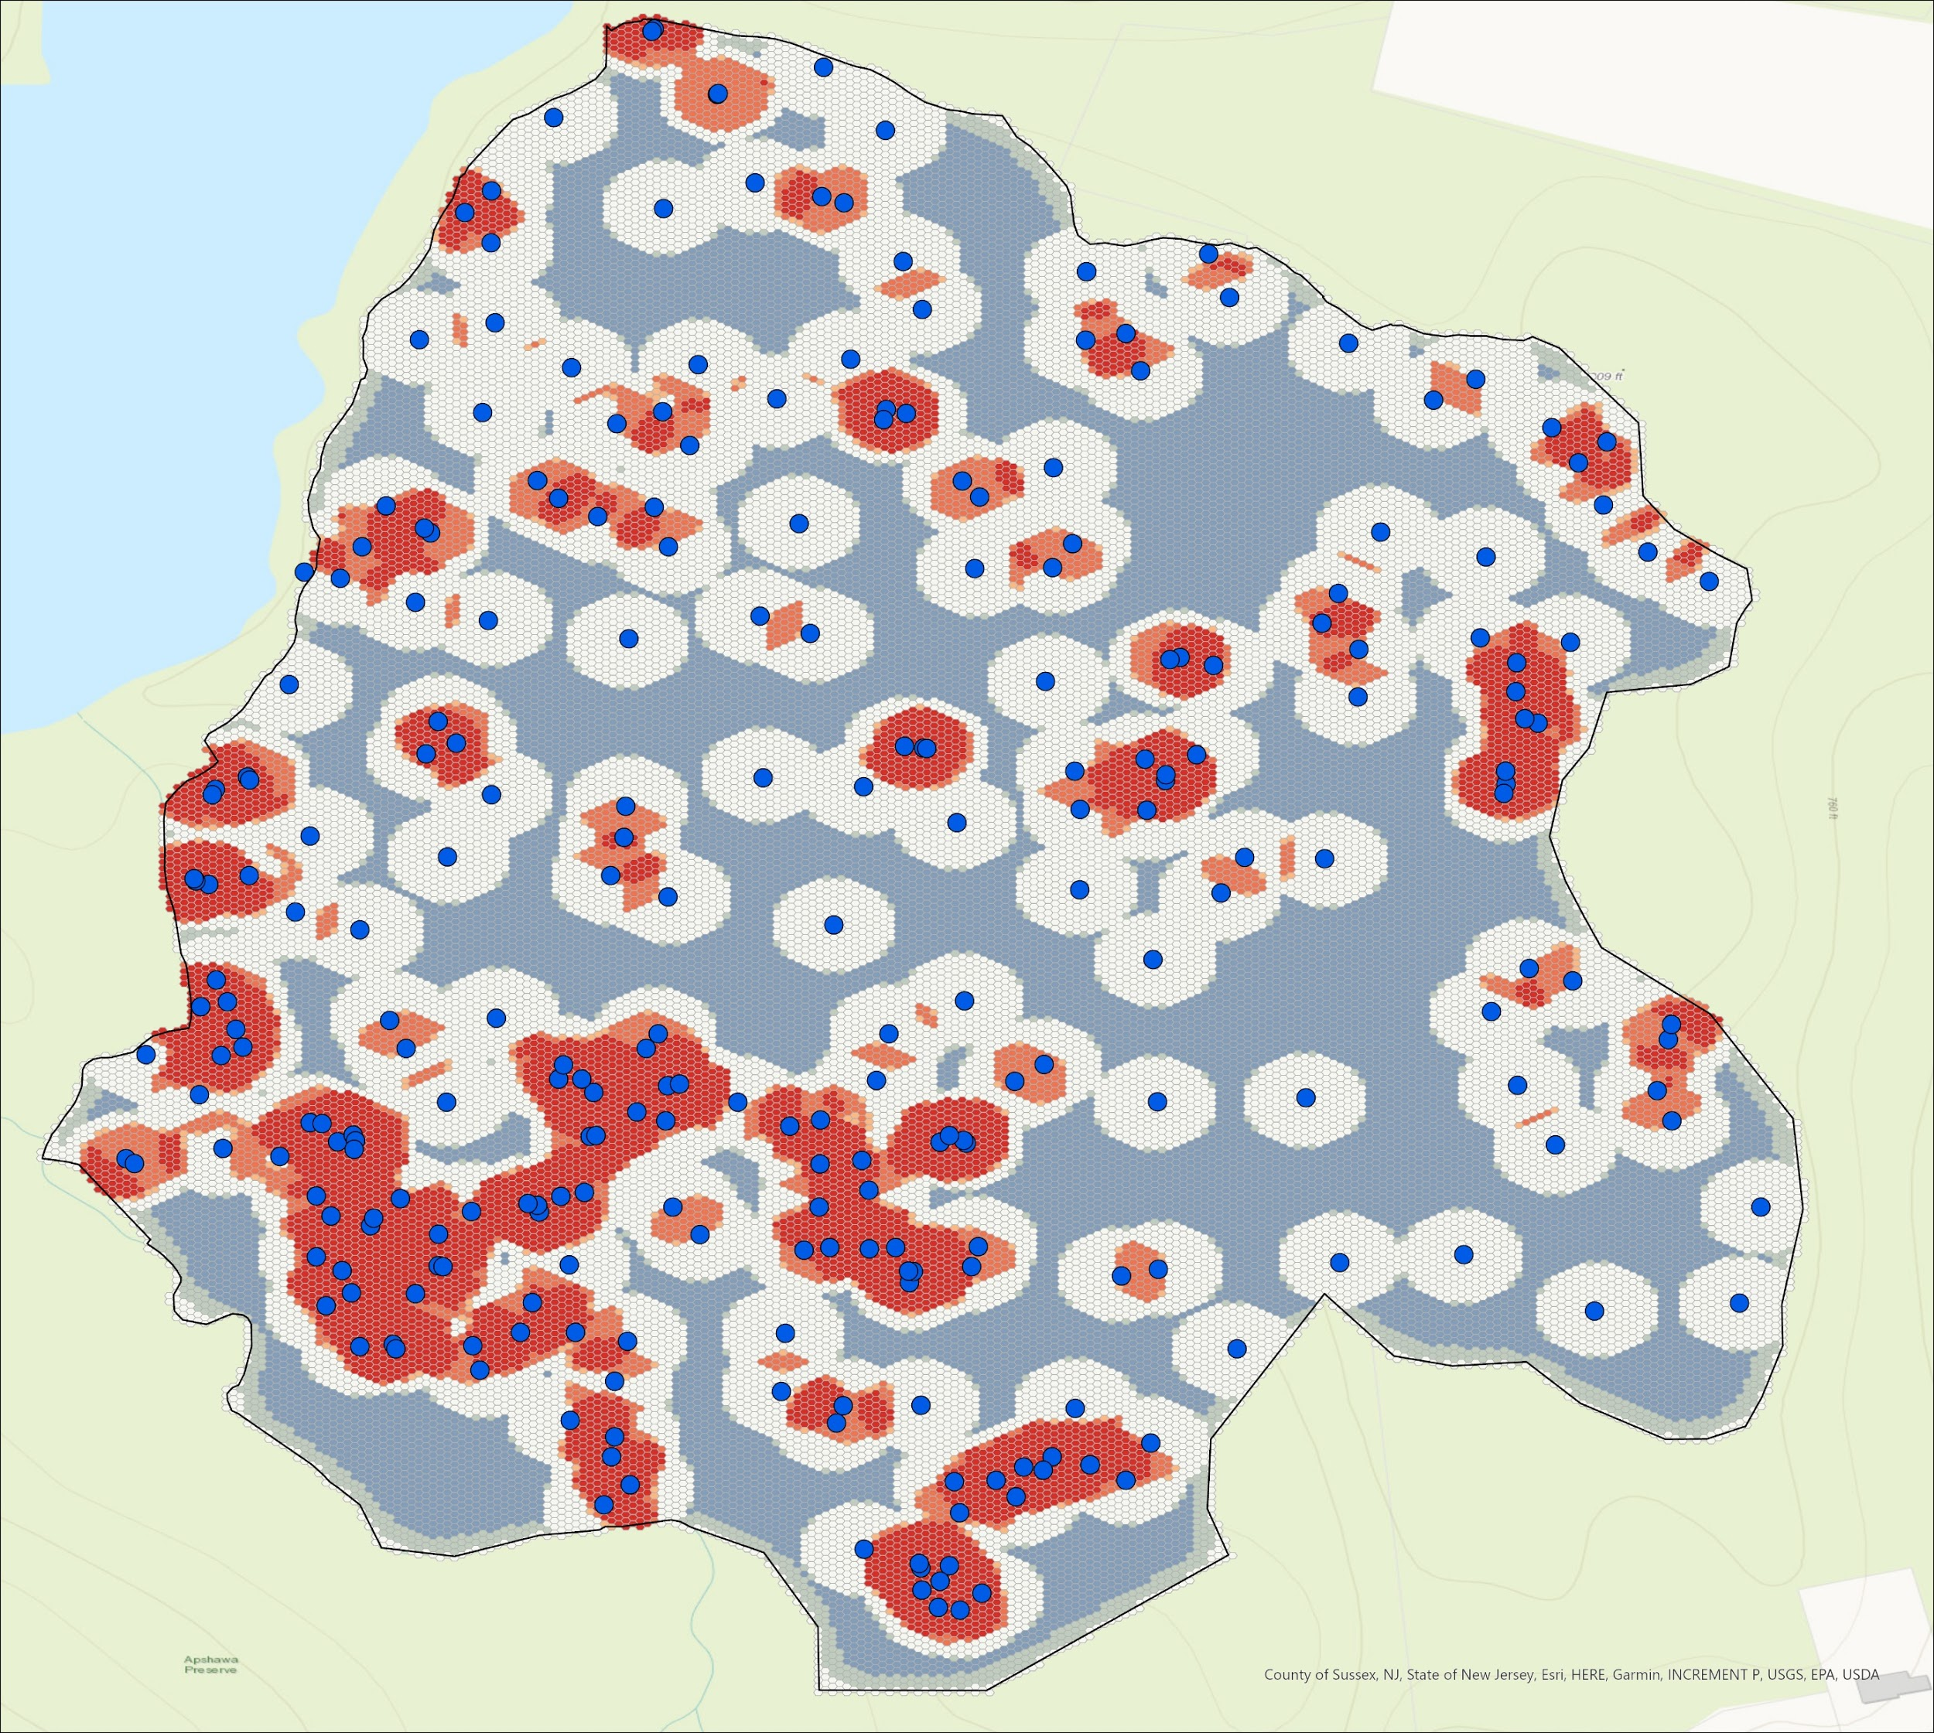
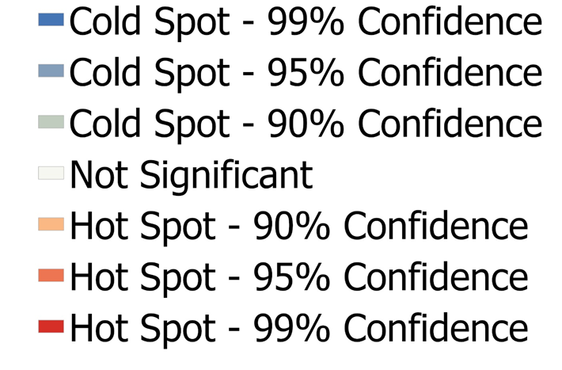
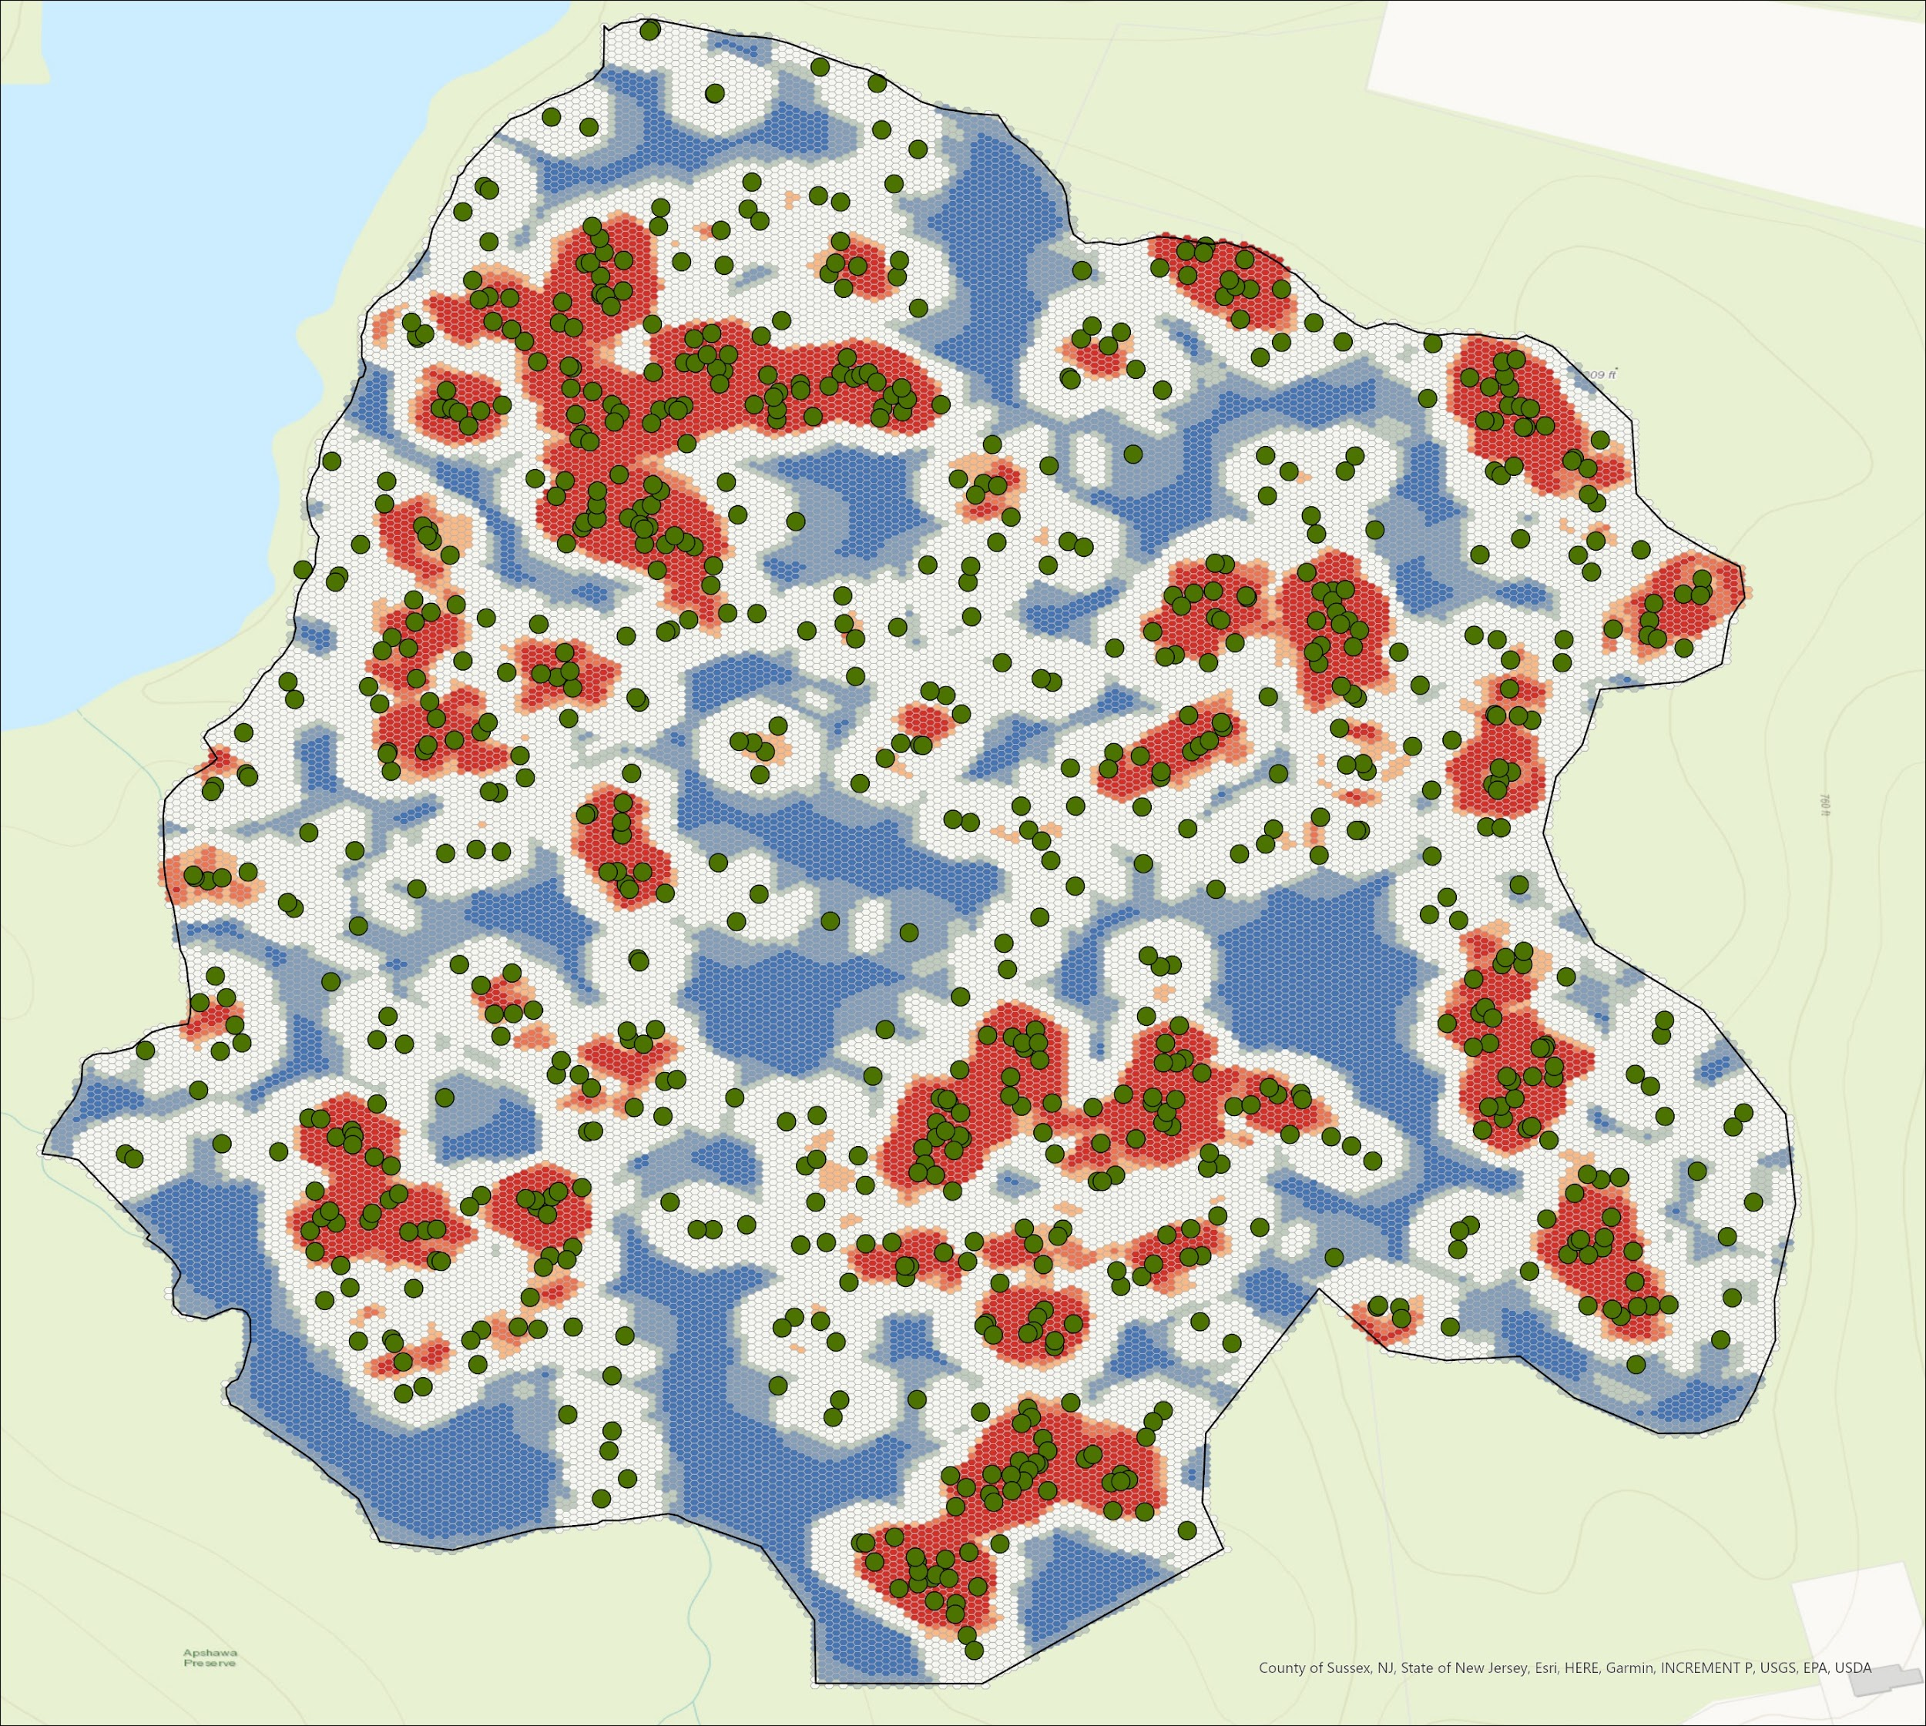
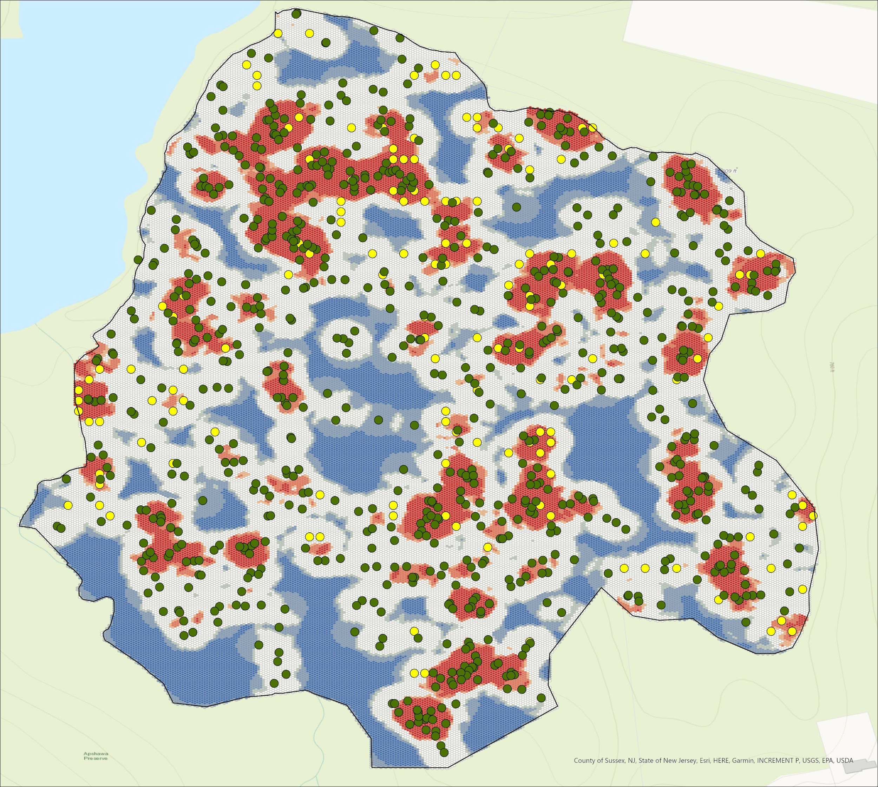
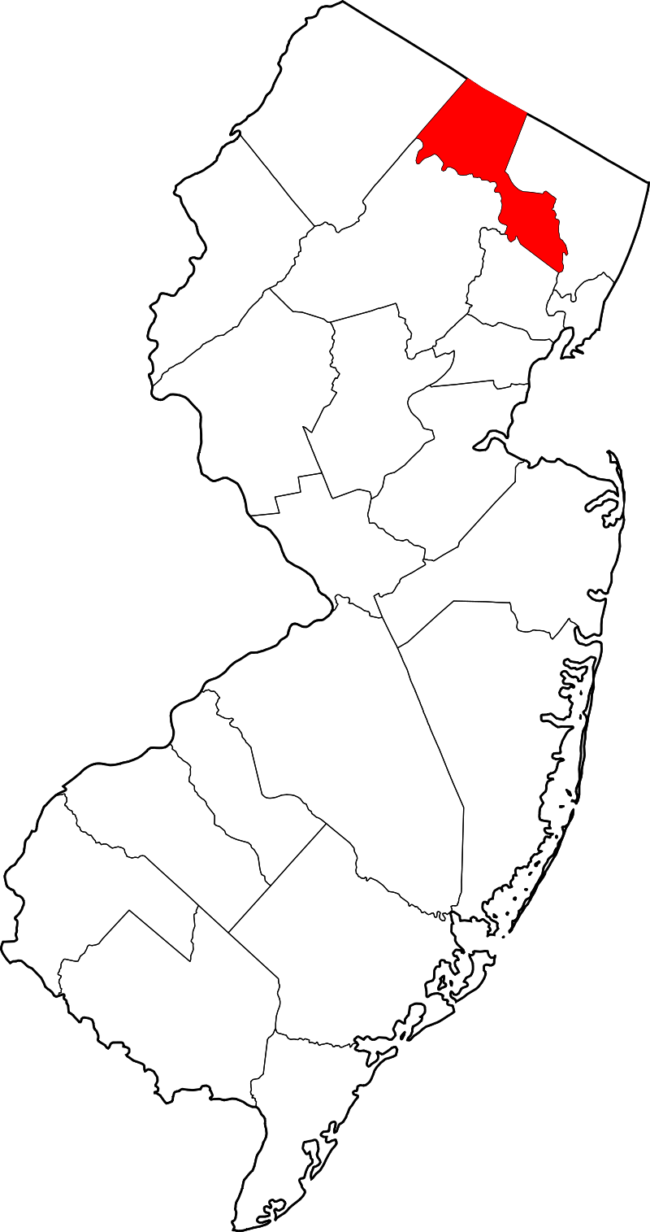
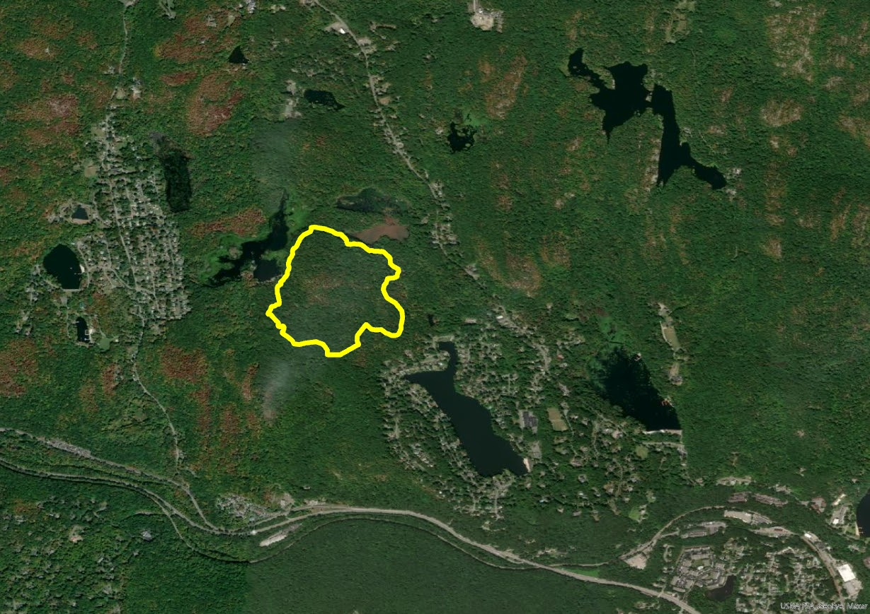
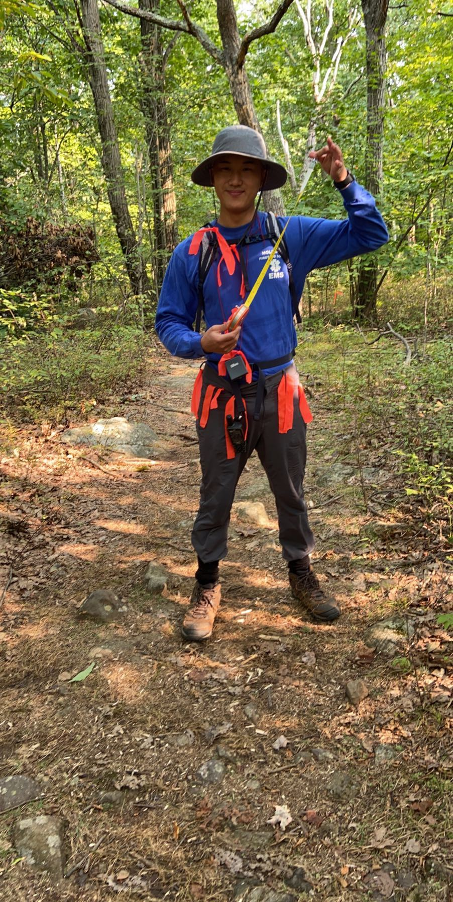
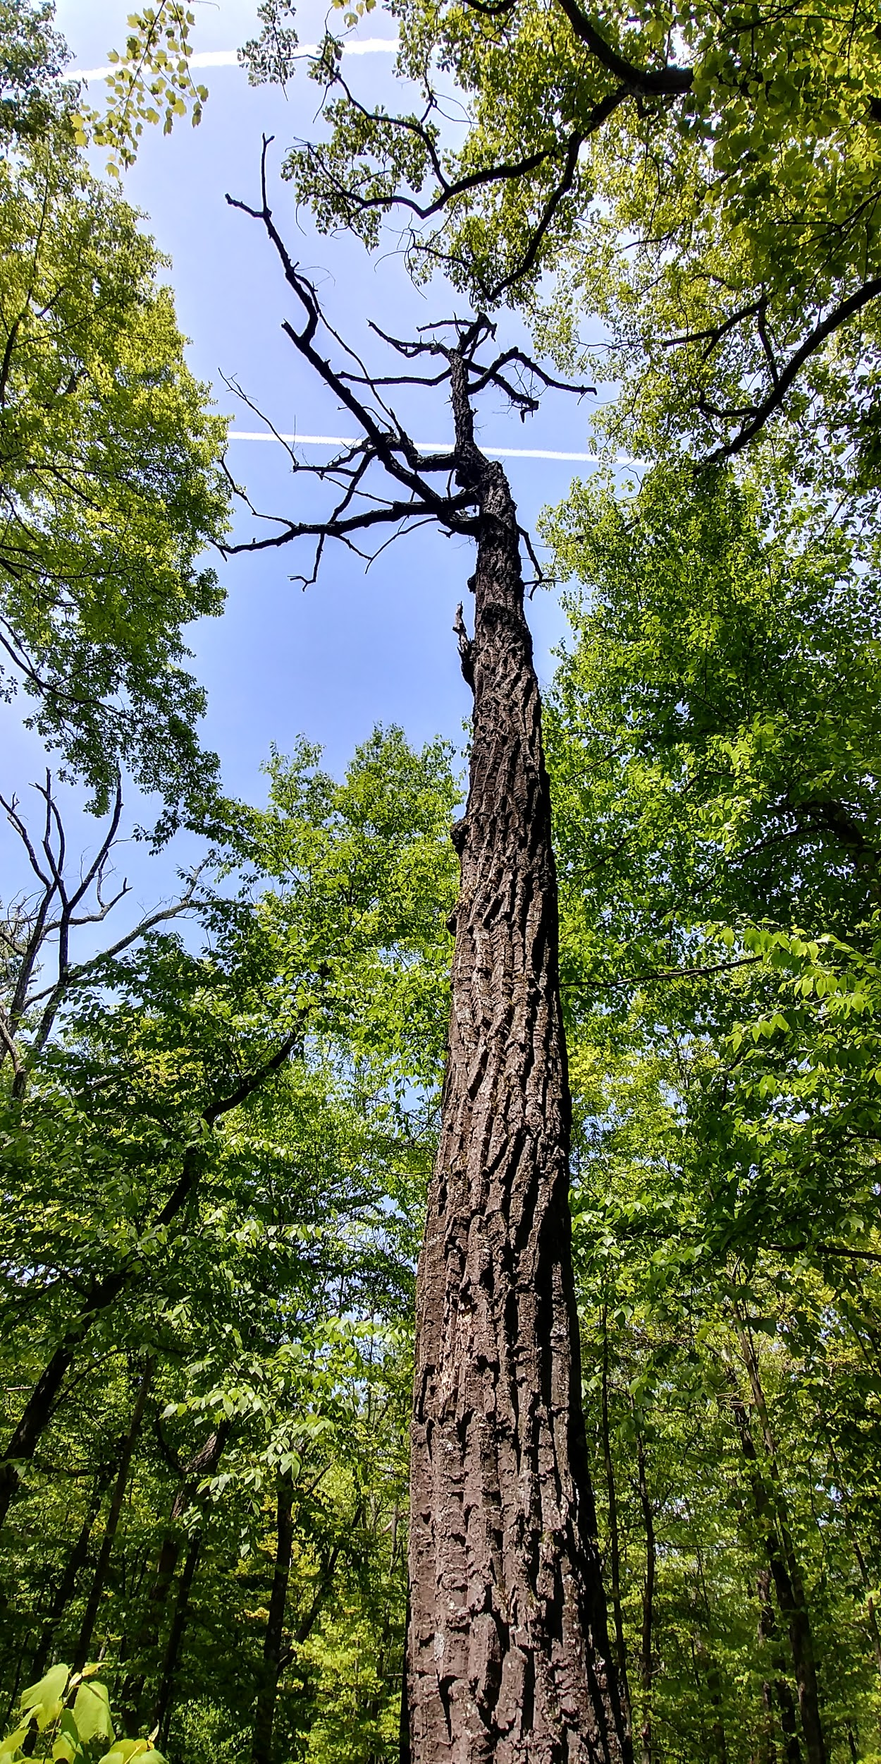
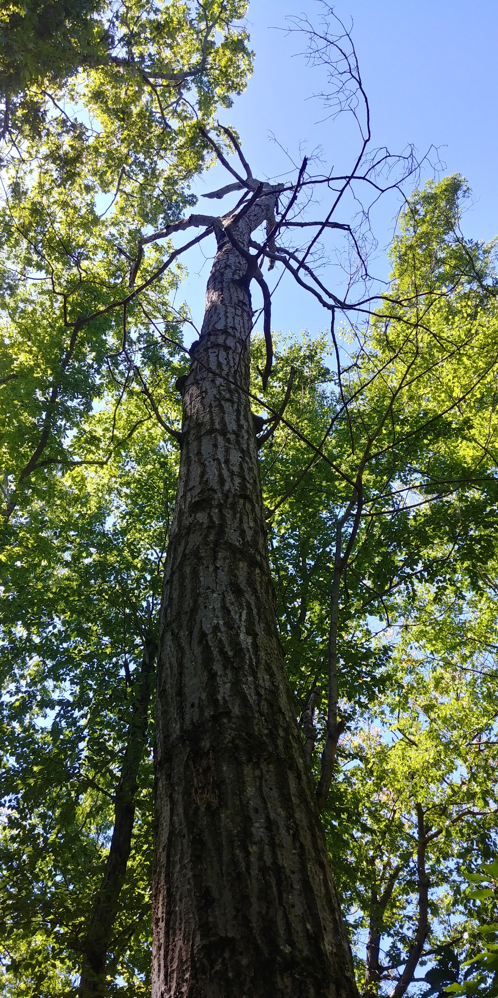
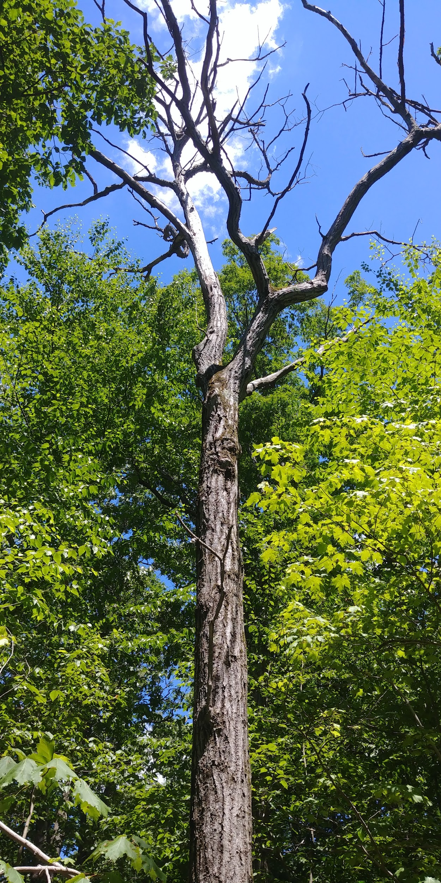
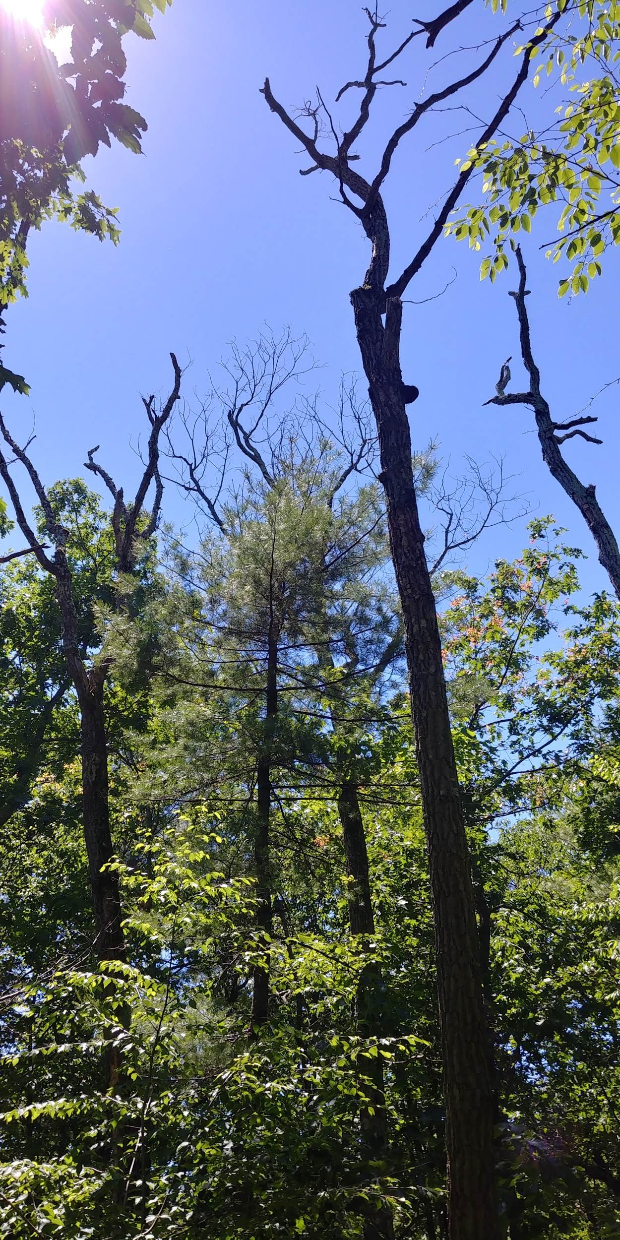
Patterns of Forest Tree Mortality in a Mixed-Hardwood Forest Following a Native Insect Outbreak in the New Jersey Highlands
James Liao and Eric Wiener, School of Theoretical and Applied Science - Ramapo College of New Jersey
Introduction
Map 1: Dead chestnut oaks
Map 2: Dead trees of other species
Results and Discussion
In recent decades, invasive insects, diseases, and severe weather have led to increased rates of disturbance due to tree mortality in forests of the northeastern United States (Fischer et al. 2013).
In 2015-2016, many chestnut oak trees (Quercus montana) were defoliated during an unusual outbreak of oak leafroller insects (Archips semiferanus) in the New York / New Jersey Highlands.
The purpose of this study was to document the extent of forest canopy disturbance caused by mortality of chestnut oaks following the oak leafroller outbreak in one mixed-hardwood forest site in the New Jersey Highlands.
Results of the survey conducted in autumn, 2020 revealed 544 dead chestnut oaks and 264 dead trees of other species, most of which were other oak species that died due to other natural causes (Table 1).
The estimated combined canopy area of all dead chestnut oaks was 56,963 m², which represents a substantial portion (11.8 %) of the forest area surveyed (Map 1 and Table 1).
The scale of disturbance is remarkable, given that the estimated total canopy area of all other dead trees suggested an approximate background mortality rate of only 0.9 % canopy disturbance per year.
The spatial distribution of the dead trees in the survey was statistically significantly clustered for Maps 1 - 4 (Nearest Neighbor Analysis; p < 0.0000005 for each map).
The clustered dispersion patterns suggest that canopy openings created by mortality of large trees are particularly prevalent in some areas of the forest, while other areas remained relatively undisturbed.
Interestingly, the dead trees in the survey conducted in autumn, 2020 do not appear to be spatially correlated with the previous survey of tree mortality following a spree of severe storms in 2011 - 2012 (Map 4).
Overall, results of this study revealed substantial disturbance in the study forest due to tree mortality that was mostly caused by an insect herbivore outbreak and a spree of severe storms. In combination with background tree mortality, only a relatively small area of the forest went without disturbance over the course of the past decade.
Such extensive prevalence of canopy openings where trees have died is concerning because many invasive plant species thrive where abundant sunlight penetrates to the forest floor (Heubnera et al 2018).
The increased light availability is also likely stimulating juvenile tree growth which can potentially accelerate shifts in tree species composition that has been documented in forests throughout the region (NJ Forest Service 2020).
Objectives
The specific objectives of this study were to:
document the species composition of dead trees;
determine the area of canopy openings created by the dead trees on a per species basis;
examine the spatial distribution of all dead trees;
compare the spatial distribution of disturbance caused by background tree mortality, chestnut oak tree mortality due to the oak leafroller outbreak, and tree mortality surveyed in a previous study following a spree of three severe weather events.
Map 3: Dead trees of all species
combined
Map 4: Dead trees of all species combined plus trees killed
by storms
Methods
Study Area:
33.4 hectare plot in Apshawa Preserve, West Milford, NJ
Field Methods:
In the autumn of 2020, data were collected for all dead trees > 10 cm in trunk diameter:
GPS waypoints (Garmin 64-ST)
species and trunk diameter
Calculations: Canopy area of each dead tree was estimated by inserting the trunk diameter into an allometric equation that was derived from field data collected for live trees in a previous study at another forest site in the NJ Highlands.
Analysis:
ArcGIS hot spot analysis (Getis-Ord Gi*) and Nearest Neighbor Spatial Dispersion Analysis were run for the dead chestnut oak trees, dead trees of all other species, dead trees of all species combined, and all dead trees surveyed in 2020 plus all dead trees surveyed in 2014 following Tropical Storm Irene (2011), a severe late-October snowstorm (2011) and Superstorm Sandy (2012).
Maps 1-4: Summary maps of an ArcGIS hot spot analysis (Getis-Ord Gi*) of: 1) the dead chestnut oak trees (2020), 2) the dead trees of all other species (2020), 3) dead trees of all species combined (2020), and 4) all dead trees surveyed in 2020 plus all dead trees surveyed in 2014 following Tropical Storm Irene (2011), late-October snowstorm (2011), and Superstorm Sandy (2012). Legends indicate the colors that correspond with each confidence interval.
Acknowledgements
species | common name | # of individuals | relative density (%) | canopy area (m²) | relative area (%)
Quercus montana | chestnut oak | 544 | 67.33 | 39,233 | 69.07
Quercus rubra | red oak | 90 | 11.14 | 6,915 | 12.17
Quercus velutina | black oak | 58 | 7.18 | 4,514 | 7.95
Quercus alba | white oak | 44 | 5.45 | 2,331 | 4.10
Acer saccharum | sugar maple | 37 | 4.58 | 2,283 | 4.02
Nyssa sylvatica | blackgum | 7 | 0.87 | 360 | 0.63
Quercus coccinea | scarlet oak | 7 | 0.87 | 269 | 0.47
Betula lenta | black birch | 6 | 0.74 | 76 | 0.13
Fagus grandifolia | American beech | 5 | 0.62 | 325 | 0.57
Sassafras albidum | sassafras | 4 | 0.50 | 156 | 0.28
 | Total | 808 | 100.00 | 56,804 | 100.00
map | 95 % CI Hot Spots (% of total area) | 90 % CI Hot Spots (% of total area) | 90 % CI Cold Spots (% of total area) | 95 % CI Cold Spots (% of total area)
Map 1: dead chestnut oak trees | 17.4 | 1.7 | 5.0 | 33.6
Map 2: background mortality trees | 19.4 | 1.0 | 4.1 | 31.4
Map 3: dead trees of all species combined | 18.8 | 3.8 | 6.3 | 24.6
Map 4: all dead trees surveyed in 2020 plus dead trees surveyed following 2011-2012 storms | 19.2 | 2.4 | 4.7 | 23.2
We would like to sincerely thank Sevan Asadurian for assistance with field work and data analysis. We are grateful to the New Jersey Conservation Foundation and Passaic County for access to the study site. We also thank the School of Theoretical and Applied Science at Ramapo College of New Jersey for institutional support.
Table 2: Summary of the areas of high density (hot spots) and low density (cold spots) of dead trees in Maps 1 - 4;
CI = confidence interval; column colors correspond with hot spot and cold spot colors in Maps 1-4.
Literature Cited
Study area within Apshawa Preserve, West Milford, Passaic County, New Jersey.
Fischer, A., Marshall, P., Camp, A. 2013. Disturbances in deciduous temperate forest ecosystems of the northern hemisphere: their effects on both recent and future forest development. Biodiversity Conservation 22:1863–1893.
NJ Forest Service. 2020. New Jersey State Forest Action Plan - December 2020 draft. New Jersey Department of Environmental Protection.
Huebnera, C. D., Regulab, A. E., McGillc, D. W. 2018. Germination, survival, and early growth of three invasive plants in response to five forest management regimes common to US northeastern deciduous forests. Forest Ecology and Management 425:100-118.
Study Area
Table 1: Summary of the autumn, 2020 survey of all dead trees > 10 cm trunk diameter in the 33.4 hectare forest plot. Species are listed in descending order of abundance.

