Slide 1
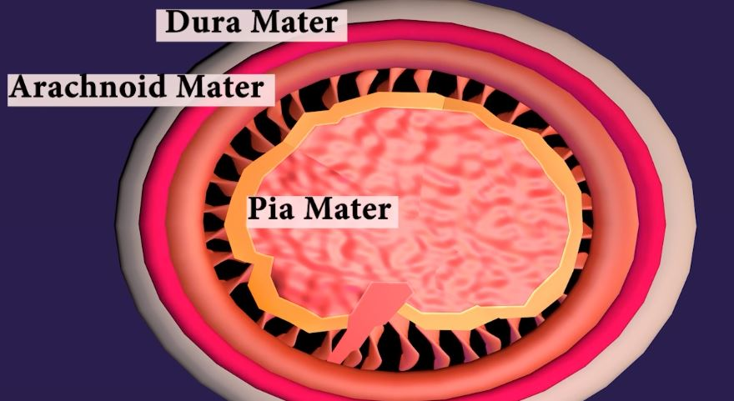
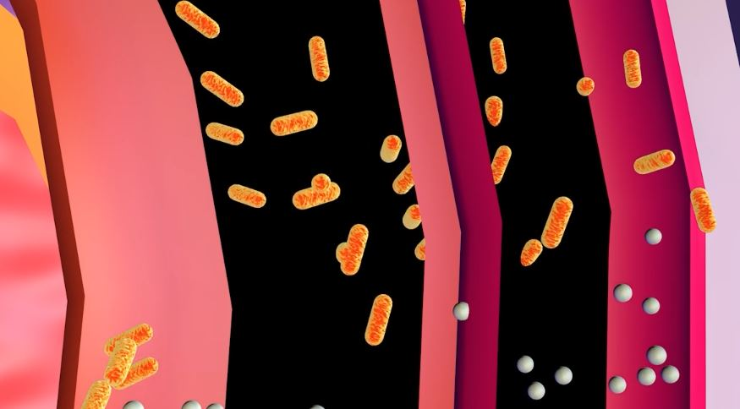
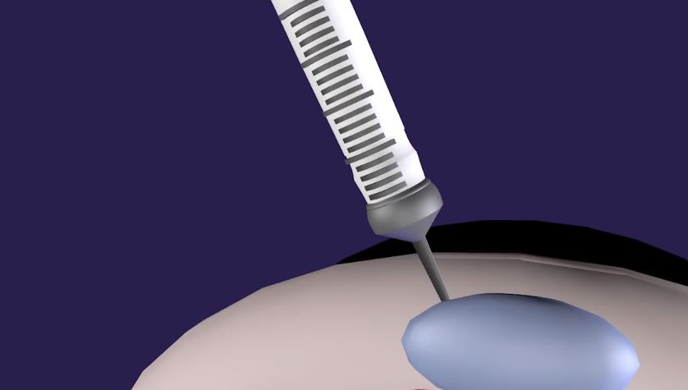
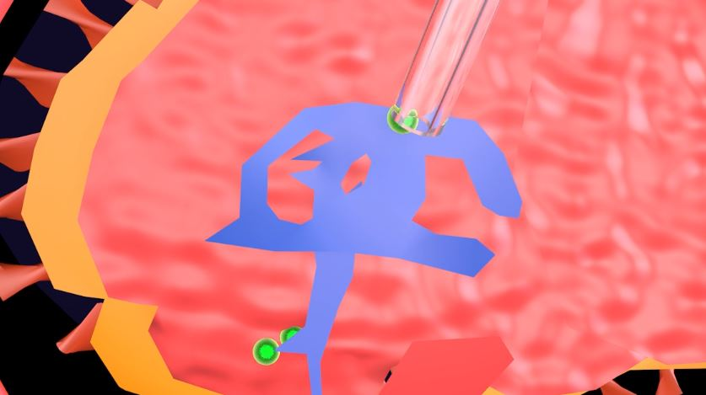
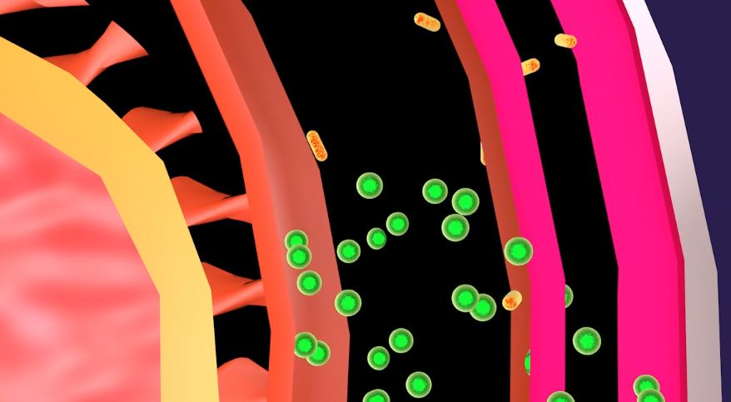
ESBL Producing Enterobacteriaceae found in Postoperative Meningitis
By Jennifer Holland / Faculty Mentor: Ann Lepore
Introduction:
Postoperative meningitis infects the membranes surrounding the brain. (1) ESBL is found within the disease. It is a type of Enterobacteriaceae (2). This bacteria easily mutates and avoids antibiotics, and if not properly treated the results are often deadly.
Treatment:
Polymyxin B is given through an intraventricular injection (IVT). A reservoir is placed inside the skull and a catheter is inserted into the upper lateral Ventricle. (4)
Figure 1: Dura mater, Arachnoid mater, and Pia mater become inflamed
Figure 2: ESBL bacteria avoiding treatment
Results:
The ventricle is needed because it produces cerebrospinal fluid (CSF).
CSF flows through the brain and the membranes. The antibiotics exit the bottom fourth ventricle and enter the subarachnoid between Pia and Arachnoid. (4-5)
Objective:
To illustrate how the disease enters the membranes and how treatment is given.
Data Analysis:
Postoperative Meningitis enters the protective layers of the brain. These layers are called Dura mater, Arachnoid mater, and Pia mater. (1) ESBL is found within the disease, and is a type of Enterobacteriaceae. This bacteria comes from a large family of other germs. The bacteria easily mutates and bypasses treatment. (2)
Figure 3: How an IVT is given.
Figure 4: The IVT injecting into the Upper Lateral Ventricle.
Conclusion:
Giving an IVT injection of Polymyxin B is the most direct treatment for postoperative meningitis. This form of treatment gives a stronger amount of the antibiotics to the infected areas ,which can be extremely difficult because of how easily ESBL mutates.
Figure 5: Polymyxin B treating the infected membranes and removing the bacteria.
LITERATURE CITED
See attached pages

Slide 2
Works Cited
Shamim, Muhammad Shahzad, et al. “Intrathecal and Intraventricular Antibiotics for
Postoperative Gram-Negative Meningitis and Ventriculitis.” Surgical Neurology
International, 26 Sept. 2017, doi:10.4103/sni.sni_81_17.
Zheng, Guanghui, et al. “Phenotype, Molecular Characterisation and Risk Factors for
Postoperative Meningitis Caused by ESBL-Producing-Enterobacteriaceae: A Six Years Multi-Centre Comparative Cohort Study.” BMC Infectious Diseases, 19 Jan. 2021, doi:10.1186/s12879-021-05784-7.

