Slide 1
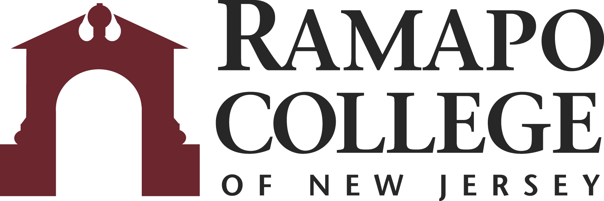
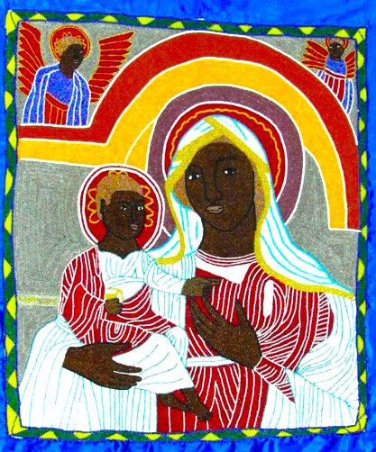
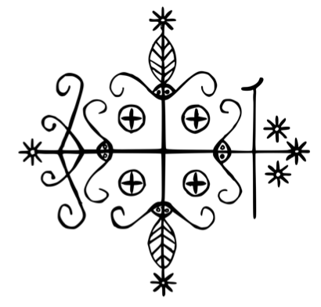
Haitian Vodou as a Crossroads: Symbolism and the Intersection of Place, Time, and Space Courtney Alonzo
Faculty Mentor: Iraida López School of Humanities and Global Studies, Ramapo College of New Jersey, Mahwah, NJ, 07430
Introduction
While it is evident that Haitian Vodou is the product of creolization, that is, transculturation in the new world, analyzing the symbolism, syncretism, history, and spirituality of Vodou reveals that the religion functions as an intersection of segments within various planes. Vodou is not only the product of collisions between cultural groups, but also of timelines and spiritual realms. Visualizing this compound intersection as a crossroads emphasizes fluidity, movement, and travel. As an example of creolization, the layered history of Vodou and its interwoven religious elements allow for the description of the religion as a union between regions, periods, and states of being.
Place: Regional & Religious Syncretism
Syncretism refers here to the combination and fusion of elements from different cultures within which the ethnic and religious components are emphasized to identify the most relevant points of convergence.
I. An ancestral religion without:
Creeds
Prescribed liturgies
Organization or formal theology
Tracked membership
II. Evolution - alignment of holidays
From using Catholicism as a disguise to establishing legitimacy
Example: the lwa Ezili as the Virgin Mary
III. Parallel universes: Catholicism and Vodou
Connecting bridges such as baptism link practitioners to both worlds
III.
Creolization:
Haiti
II.
Sincretism:
French
Catholicism
I.
Foundation:
Africa
Symbolism
The image of a crossroads is prominent within Vodou iconography and is worth examining in connection with this argument.
Terms
lwa: the spirits of Vodou considered hierarchically inferior to their creator, the superior god, Bondye
vèvè: religious symbols drawn to praise, summon, or embody their corresponding lwa
Legba
Lwa who guards the crossroads between the spirit and human worlds
Time: Periods of Haitian History
The history of Haiti provides the lens through which to view its syncretism, as well as the simultaneous and progressing evolution of Vodou as a means of survival and resilience.
Liberation theology: Vodou has served as a catalyst for revolution providing motivation and morale
Artifacts - Catholic churches abandoned after the revolution provided aesthetic and liturgical materials that were incorporated into ceremonies
Ancestry - Practitioners look to those who have passed for assurance of survival in their lifetime
Space: Spirituality & States of Being
The spiritual aspect is the final intersecting dimension that demonstrates how fluidity through space and time is an integral part of how Vodou practitioners are able to interact with higher beings.
Gine: nuanced term indicating both the spirit world and, simultaneously, ancestral Africa
Parallels the African continent as the hidden island of the lwa
Not desired as an eternal resting place, but rather as a long-awaited homecoming from the ancestral relocation brought on by slavery
Capable of intersecting with the human realm
Vodou flag portraying the lwa Ezili as the Virgin with the Christ Child
Conclusion
The crossroads between the realms of existence is personified by Legba and visualized by his vèvè.
The alteration of African Voodoo by French Catholicism has resulted in a creole religion which promotes the intersectional identities of its followers. It is a product of the syncretism that has permeated the Americas.
As a liberation theology, Vodou has helped Haitians through historical times of survival and artifacts from these periods advance their rituals.
Spirits and ancestors can interact with followers through the functionality of Gine.
His vèvè is a syncretized version of the cross and also represents a compass or crossroads
The compass is symbolic of how Legba guided enslaved people stolen from their homelands
Vèvè of the lwa Legba

