Slide 1
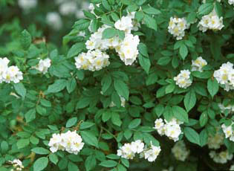
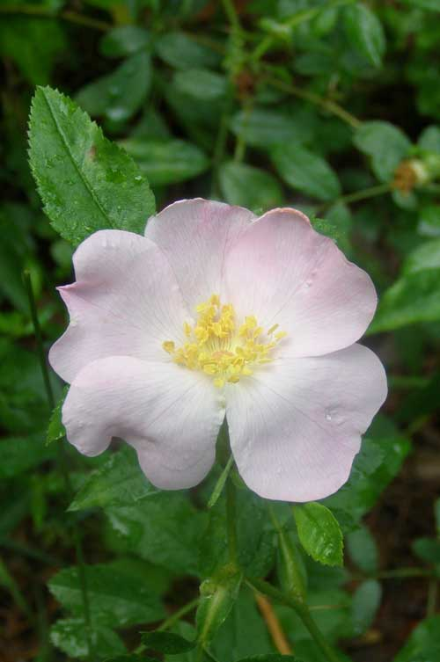
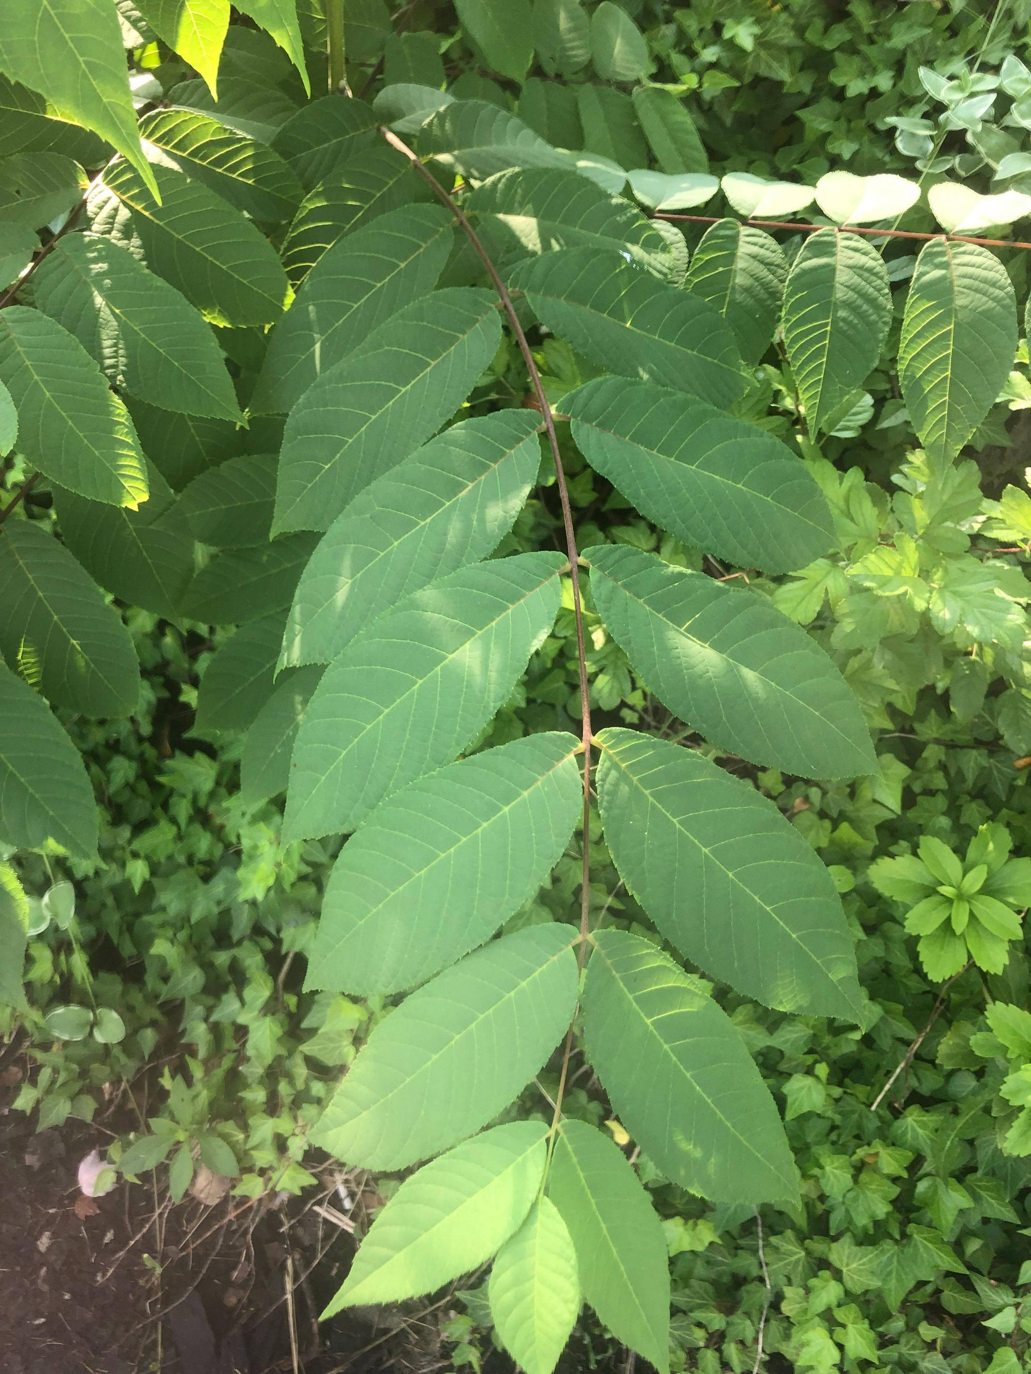
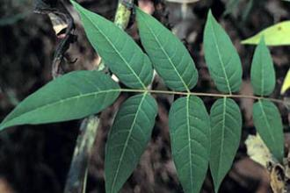
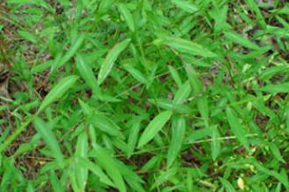
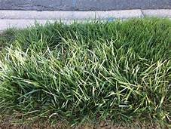
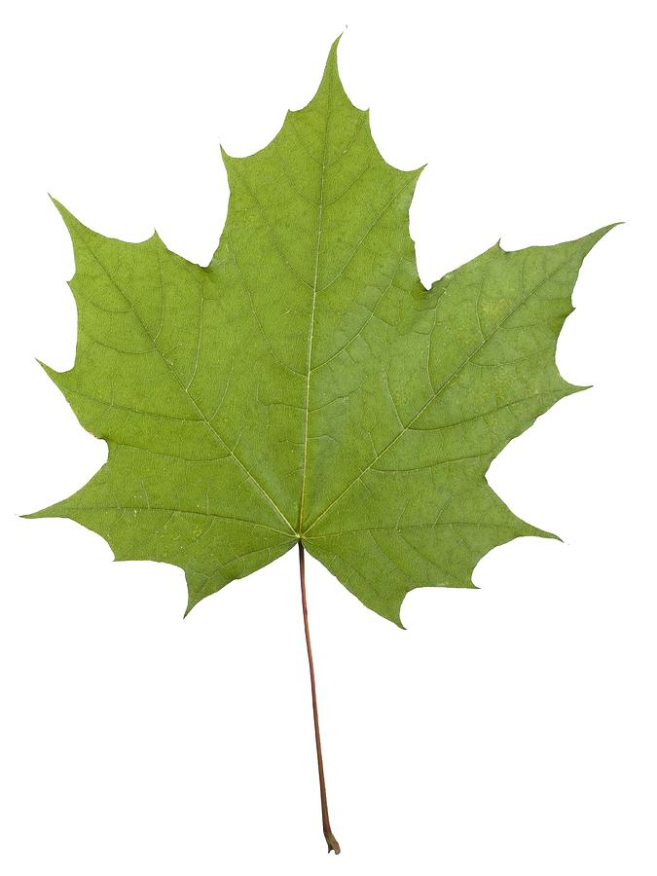
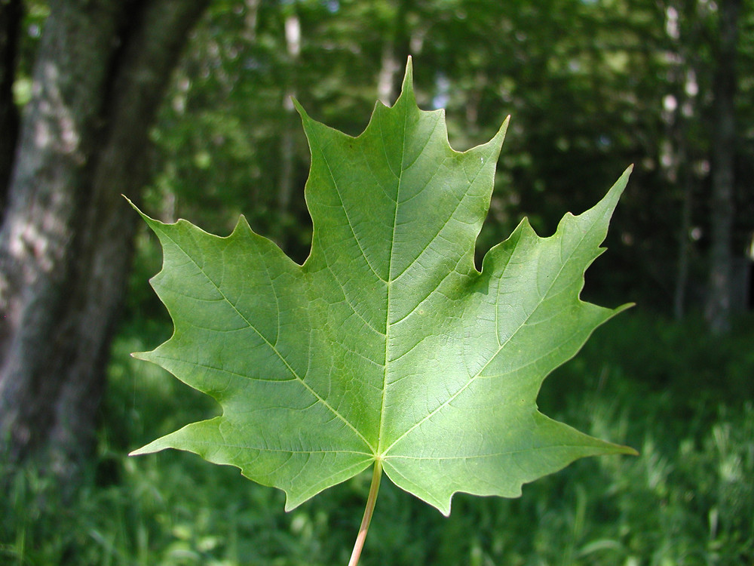
A Systems View of Terrestrial Invasive Species: Problem, Prevention, and Management Cory W. Fichtenbaum
Faculty Mentor: Professor Ashwani Vasishth School of Theoretical and Applied Science, Ramapo College of New Jersey, Mahwah, NJ, 07430
.
Terrestrial Invasive Species Native Look-Alikes
MultiFlora Rose Carolina Rose
Systems Thinking
Systems thinkers uses a long-range view of a problem rather a linear one, while looking
for relationships or feedback loops between elements and delays. They are concerned
with the whole, the process, underlying dynamics, patterns, and interactions, beginning
with its history. Using a systems approach facilitates finding solutions for the problem of
plant invasive species and impact of their spread into native or minimally managed plant
systems.
Invasive plants like all complex systems are robust, self-sustaining, and self-organizing.
Their reinforcing feedback loops allow them to recover and bounce back more than
native plants over which they dominate.
Since native and non-native plants are connected looking at their relationship, allows us
to predict when, where, and how to intervene to prevent future invasions and control
and manage present ones.
In nature, the systems trap of success to the successful occurs with competition. When
two different species, for example invasive and native plants, compete for the same food
and resources, one species will get an advantage and will either deplete the available
resources, until none is left for the weaker competitor who will either adapt or become
extinct. In other words, success of the invasive plants leads to the failure of native plants.
The model of intervention involves limiting the invasive
plants that are causing the problem or making the losers, in this case native plants, more
resistant, for example, through genetics.
It is only through a systems perspective can we learn and solve a complex system
problem such as invasive plant species. Quick fixes, such as an attempt to eradicate
an invasive plant species that are entrenched, will result in negative consequences over
time. Like cancer cells, leaving a few plants behind, will result in their reappearance
and invasion. Short successes that focus on prevention and control of areas with
limited invasives may yield leveraged results. Restoration of robust plant native
communities is key once the invasive plant species problem is solved.
Problem
In the USA invasive or non-native plants cover 100 million acres and spread an average of 14% per year. Invasive plants species compete and crowd out native plants. This leads to ecosystem degradation, and loss of habitats and biodiversity. They also alter fire regimes, and hydrology and impact ecological processes through competition, herbivory, bio- geochemical disturbances, and geomorphological processes such as surface process erosion, sedimentation, marsh surface elevations, and landforms
History
Invasive plant species which threaten natural ecosystems in the US were introduced to
the US as early as the 1700’s for either ornamental, erosion control, or medicinal
purposes. Knowing invasive species history will expose their vulnerability early
when they are easier to control through interventions.
Agencies
The USDA, APHIS , USFS and other natural resource conservation services all work to
identify nonnative plants, provide data bases, education and promote efforts to control
them and restore the land. Funding for research is necessary to mitigate threats to plants,
ensure plant diversity and improve restoration efforts.
Education and Financing
The invasive plants have competitive advantages over native species since they come
from nonnative environments. Invasive plants have look-alikes which makes it difficult
to identify without training. They are visually beautiful, and ecological issues are not
immediately apparent. Outreach and education will raise awareness of the extent of
invasive species and our roles in protecting and controlling them. Commercial industries
should phase out those invasive plant species from trading. Education should be funded to
reduce consumer demand. Public and private partnerships should be strengthened as part
of the plan, and regional and national partnerships and source of funding should be
promoted and integrated. Responses to invasive species are limited by economics, and
costs are smaller in the early stages than they are when invasives are firmly established.
Solicitation of funds, private donations, and grants are needed. Finding an agency to
hold the monies or to increase their immediate release when necessary, would
also be helpful. Waiting for government budgets alone slow down the process.
Public education and volunteers are key parts of the program.
Prevention, Control, Management, and Restoration
Prevention, control, and management of terrestrial invasive species requires education
about best practices, early detection, and rapid response to new invasions. Except when
eradication is feasible, control efforts should work towards conservation of resources
impacted by invasive plants and not the invasive plants themselves.
Prevention and protection of land that is relatively invasive free provides greatest
economic return.
Control of moderate infestations and increase in desired species.
Management of heavy infestations without presence of desired species.
Restoration of desired plants is the key to breaking the invasive plant cycle
and planting perennials that are fire resistant and have altered germ seeds to
biologically compete with invasive plants.
Sumac
Tree-of Heaven
L
Conclusions
An invasive species is the appearance of something troubling which rapidly grows and
spreads over large areas. Native species occur naturally in specific locations. They are
needed to sustain indigenous insects, birds, mammals, and reptiles. The vast majority of
non-indigenous species cause harm to the environment, economy, ecosystem, and even
human health in the new environment they invade. Terrestrial invasive species harm native
plants, at times to the point of extinction and their ecosystems. The management of plant
invasives through mechanical, herbivory, or genetic means will only be accomplished
through understanding the system that maintains them. Systems thinking will result in
well-informed decision making based on history, evidence, and data to solve the
problem of plant invasive systems by using efforts from a variety of sources to find
leveraged points of intervention.
Terrestrial Invasive Species Native Look-Alikes
Japanese Stilt Grass White Grass
References
Devoe, N., Nowak, B., & Florence, S. (2009). Effective Management of Invasive Plants. Rangelands,
31(3), 21-24. Retrieved October 4, 2020, from http://www.jstor.org/stable/27735338.
Fei, S., Phillips, J., & Shouse, M. (2014). Biogeomorphic Impacts of Invasive Species. Annual
Review of Ecology, Evolution, and Systematics, 45, 69-87. Retrieved October 4, 2020,
from http://www.jstor.org/stable/24810172
Grebinstein, Emily (19 Sep 2013). Escape of the Invasives: Top Six Plant Invasive Species in the
United States. Smithsonian Blog. Retrieved October 4, 2020 from,
https://www.si.edu/blog/escape-invasives-top-six-invasive-plant-species-united-states.
Goddard, W. (2019. )Systems Thinking: The Vocabulary, Tools and Theory. itchronicles.com
Lehan, N., Murphy, J., Thorburn, L., & Bradley, B. (2013). Accidental introductions are an important source of invasive plants in the continental United States. American Journal of Botany, 100(7), 1287-1293.
Retrieved October 2, 2020 from https://www.jstor.org/stable/23434483
Meadows, Donella, H). Thinking in Systems. The Sustainability Institute.
Rutherford, A. (2018). The Systems Thinker. USA: Kindle Direct Publishing, pp. 117-165, 197-198, 202-207.
Sheley, R., & Smith, B. (2012). Prioritizing Invasive Plant Management Strategies. Rangelands, 34(6), 11-14.
Retrieved November 22, 2020, from http://www.jstor.org/stable/23355963
Strategic Recommendations for Managing Invasive Plants in Massachusetts (2005). Retrieved on
October 7, 2020, from https://www.mass.gov/files/documents/2016/08/tm/invasive-plant-strategicplan.pdf
Norway Maple Sugar Maple
Photos of Invasive species Photos Look-Alikes
USDA National Invasive Species Center Images Search Yahoo.com
https://www.invasivespeciesinfo.gov/terrestrial/plants?

