Slide 1
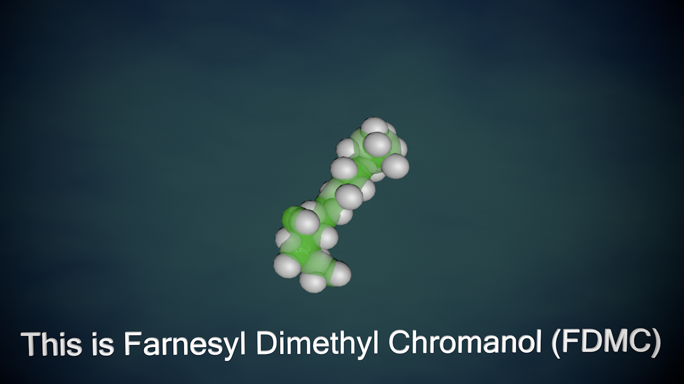
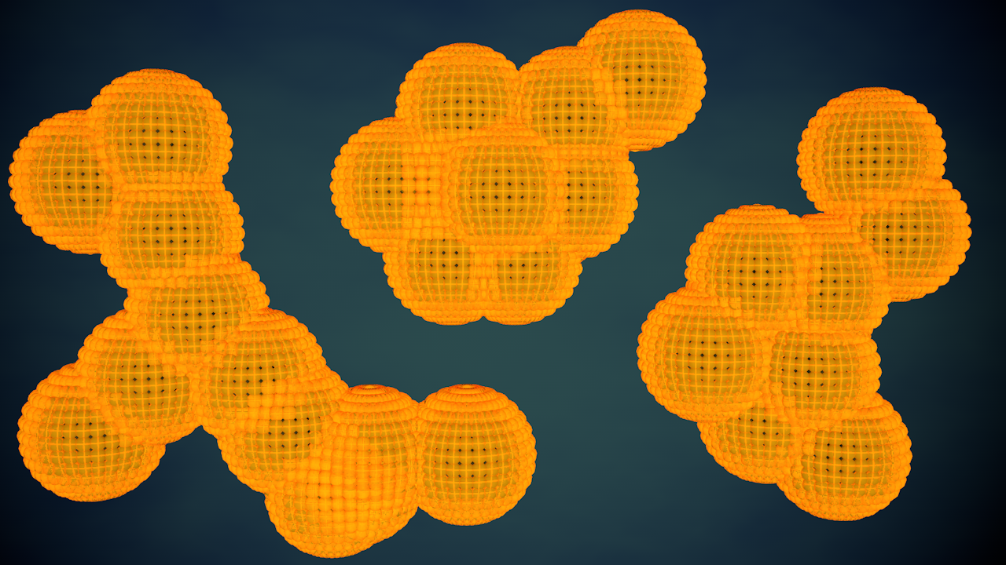
The Visualization of Information
Danielle Opitz
Ramapo College of New Jersey, Mahwah, NJ, 07430
Introduction:
When information is only presented in a written manner, it can be difficult to fully grasp for those both familiar and unfamiliar with the terminology being used. The goal of this project is to provide a process for making imaginative visual representations, for otherwise unseeable events, to make understanding information easier than before.
Process:
When starting this process, it is important to decide how to make a figure or scene, identifiable, clear in action, clear in result, and aesthetically pleasing.
Spheroids are a cell structure that is visible under a microscope, so keeping the imagined visual closely to its actual color and leaves the structure identifiable when looking between the video and original research. The rest of the visuals are imaginary and use complimentary colors along with slow pacing to keep information distinct and aesthetically pleasing. Captions provide clarification for all structures and actions in the video. The use of animation keeps the actions of how things may be happening from being ambiguous and presents a clear ending result.

