Slide 1
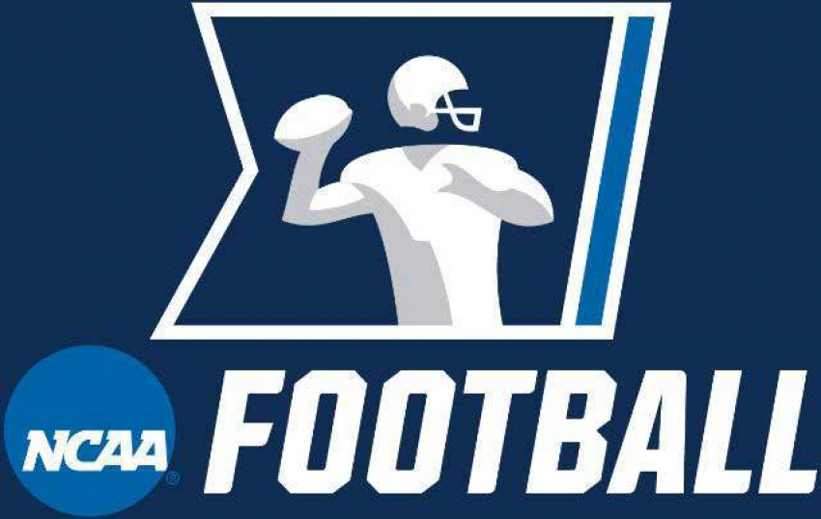
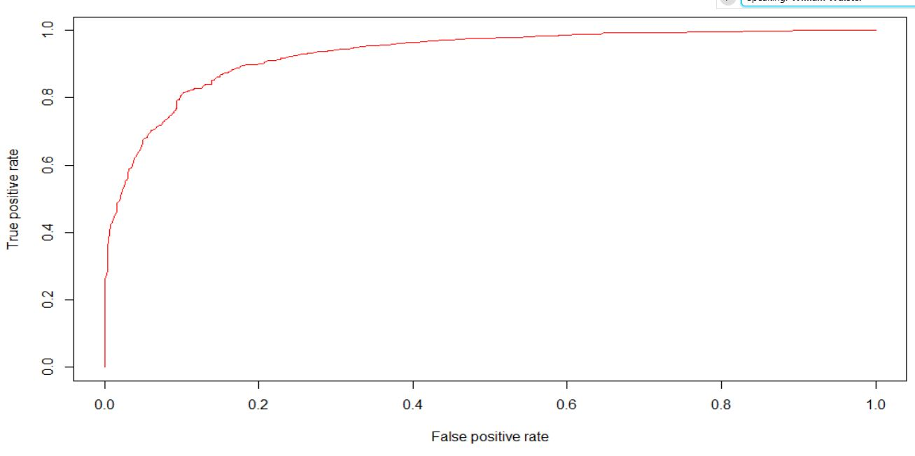
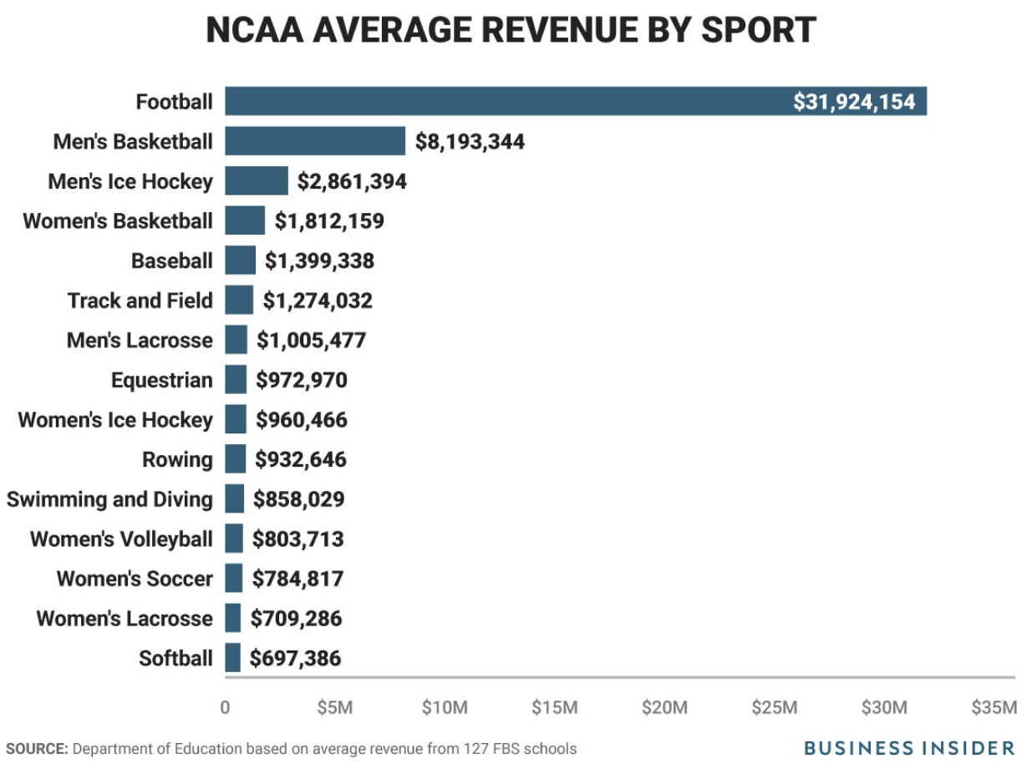
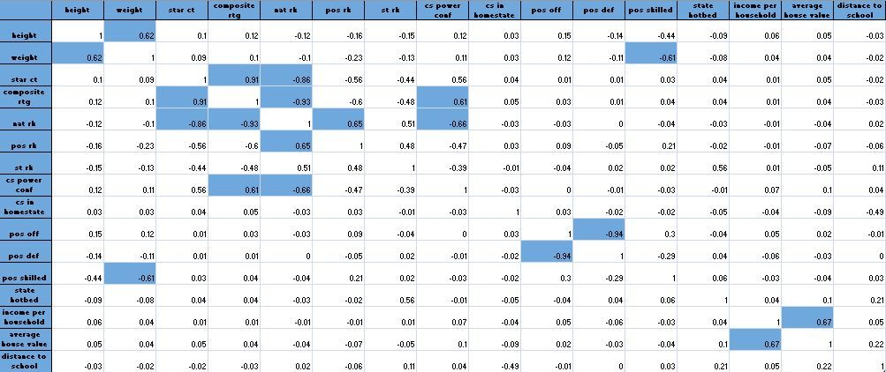
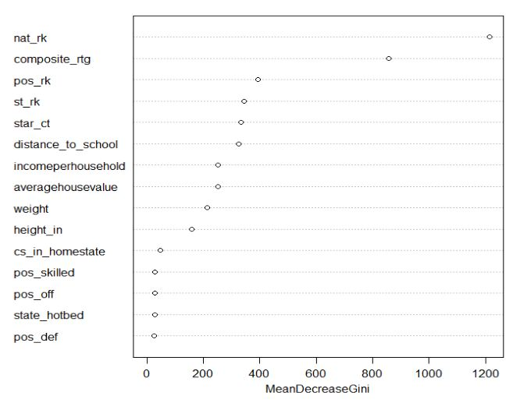
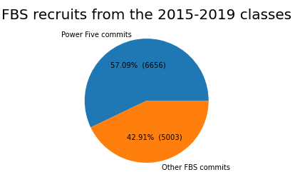
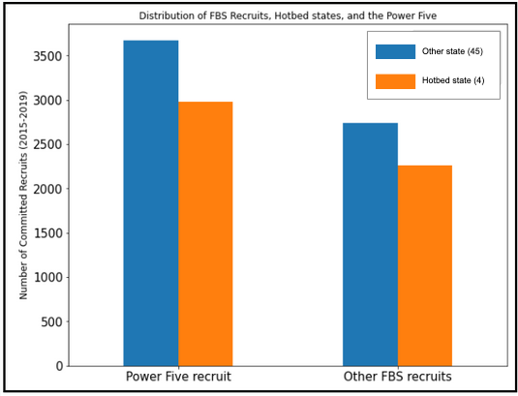
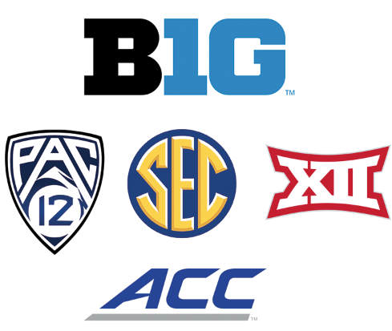
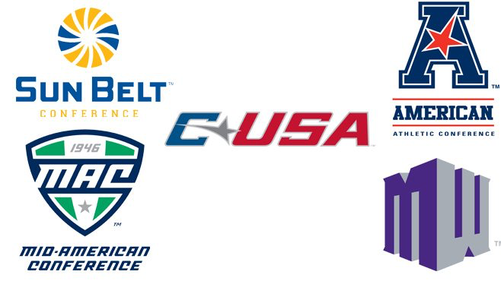
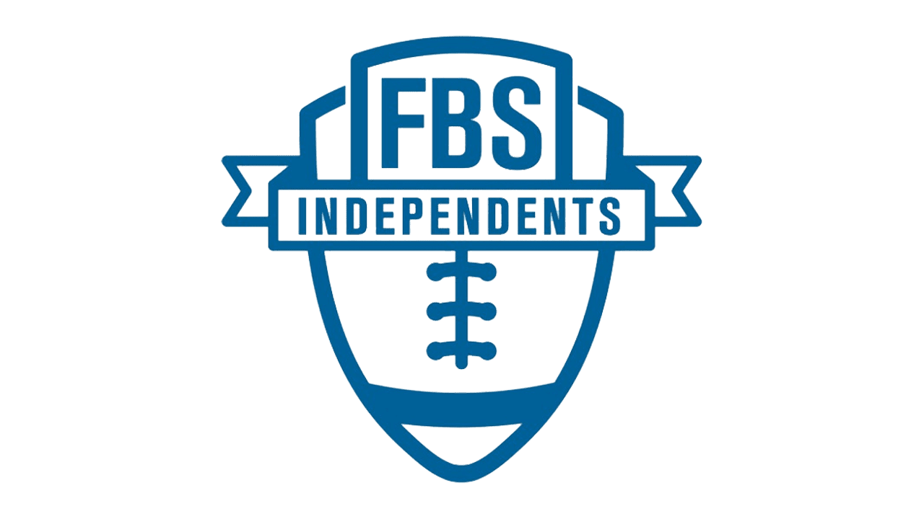
*
*
*
College Football Recruiting Using Machine Learning Techniques Colette Barca, Keith Osani, Nisha Srishan, William Brady Wulster, Osei Tweneboah PhD
Data Science Program, School of Theoretical and Applied Science, Ramapo College of New Jersey, Mahwah, NJ, 07430
Abstract
College football is big business. To create a winning team that will continue to generate revenue, Division I Football Bowl Subdivision (FBS) Power Five schools need to choose their recruits wisely. Recruits are selected based on certain player attributes. Power Five schools are the most frequented schools by NFL scouts, making these schools highly desired by recruits. In this regard, we built a model to predict whether a high school recruit will commit to a school in one of the Power Five Conferences. Such a model could allow a school to optimize its recruiting process, maximizing its return on investment. We used our dataset to fit several machine learning models. We determined the Random Forest model produced the best results when applied to the testing set, as it splits observations using only the most influential predictor from a subset of the predictors for each internal node and decorrelates its produced trees. This model revealed which particular attributes are indisputably the most important predictors of commitment to a Power Five school. Based on our findings, we think this model could be successfully used to improve the recruiting process.
Methodology
Supervised Learning Dataset: Classification Problem
Decision Tree & Ensemble Learning Methods
Support Vector Machines
Logistic Regression
Generalized Additive Model
Results
Based on the performance metrics shown above, Random Forest was the best model. Random Forest model was then applied to the 2019 data.
Holdout Data= 2,391 samples (the class of 2019)
Remaining Data -> split 2:1
Training set = 6,116 samples
Testing set = 3,152 samples
Categorical predictors (5):
“Skilled” position?
Offensive position?
Defensive position?
College in recruit’s homestate?
Recruit’s homestate a hotbed?
Continuous predictors (10):
State ranking
Distance to School
Income per household
Average house value
Height
Weight
Number of stars
247sports composite rating
National ranking
Position ranking (national)
Model | Accuracy | AUC | MSE | Precision | Recall
Unpruned C.T. | 82.11% | 0.8730 | 0.1336 | 0.8451 | 0.8524
Pruned C.T. | 82.11% | 0.8143 | 0.1461 | 0.8451 | 0.8524
Bagging | 84.11% | 0.9075 | 0.1189 | 0.8538 | 0.8809
Random Forest | 83.88% | 0.9091 | 0.1179 | 0.8518 | 0.8793
Boosting | 82.87% | 0.8987 | 0.1343 | 0.8493 | 0.8621
Linear SVM | 83.06% | 0.9017 | 0.1236 | 0.8322 | 0.8922
Radial SVM | 81.85% | 0.8946 | 0.1245 | 0.8374 | 0.8852
Logistic | 82.90% | 0.8173 | 0.1226 | 0.8358 | 0.8831
GAM | 82.90% | 0.9036 | 0.1226 | 0.8358 | 0.8831
Target Variable (Binary):
Power Five school
Introduction
Football garners more revenue than the next 35 other sports combined at Division 1 schools.
On average, football brings in $31.9M in revenue while men’s basketball (2nd highest grossing sport) comes in a distant second at $8.1M
Final Model: Random Forest | 84.94% | 0.9301 | 0.1136 | 0.8231 | 0.9167
Exploratory Data Analysis
Important Variables Plot
ROC AUC Plot
Correlation Matrix
Objective
Can we predict if a recruit will commit to a school in a Power 5 conference?
Which factors contribute to a recruit’s commitment to a Power 5 School?
The highlighted cells indicate a strong correlation between two predictors.
Group of 5 Conferences
Important Variables Plot
Power 5
Conclusions
Based on our findings, a recruit’s national ranking is indisputably the most important predictor of whether a recruit commits to a school in the Power Five conference. These results support intuition, as the highest ranked athletes are most likely to be recruited by Power Five schools, as they want to create a winning team. Since these Power Five schools have the best teams, they are the most frequented schools by NFL scouts, making these schools highly desired by recruits. Consequently, individuals recruited by Power Five schools are highly likely to sign with them. Conversely, students who are nationally ranked lower are less likely to be recruited by Power Five schools, making it unlikely for them to commit to one of these schools.
Distribution of Recruit Commitments
Distribution of FBS Recruits and Hotbed States
References
https://finance.zacks.com/much-money-college-sports-generate-10346.html
https://247sports.com/Article/college-football-recruiting-rankings-spending-budget-134080367/
https://api.collegefootballdata.com/api/docs/?url=/api-docs.json
https://www.bannersociety.com/2020/2/4/21111828/college-football-recruits-by-state
Independents
*

