Slide 1
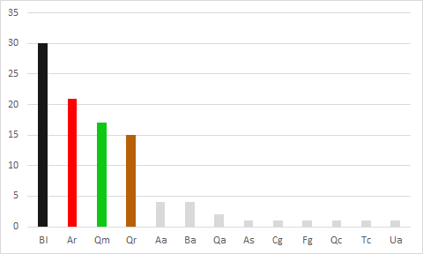
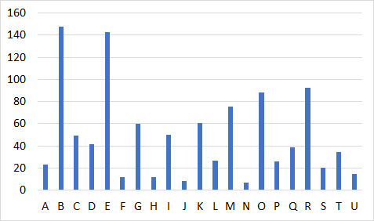
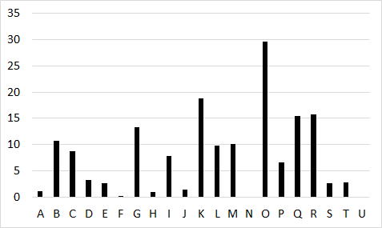
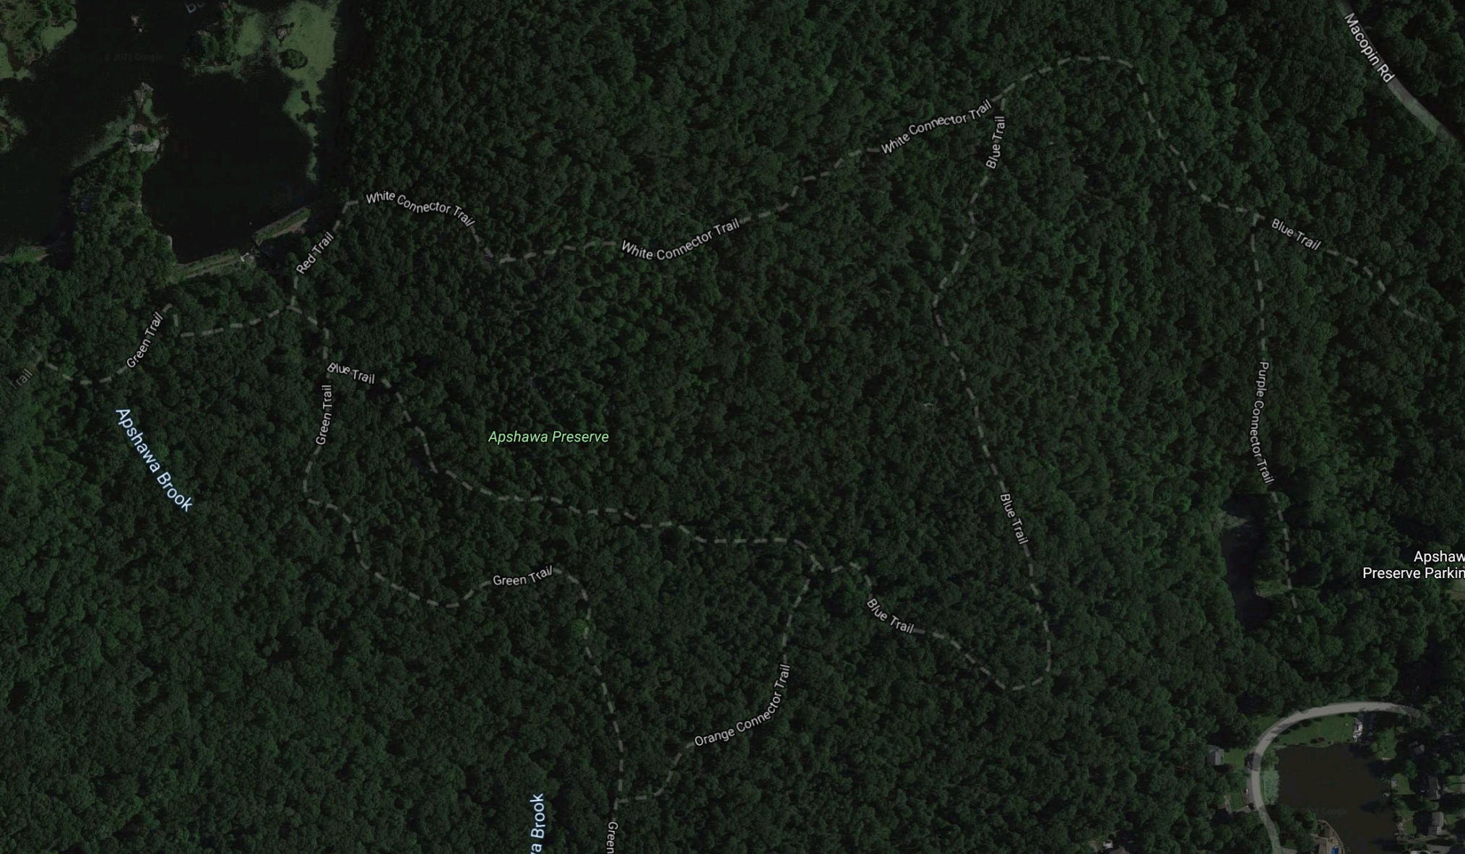
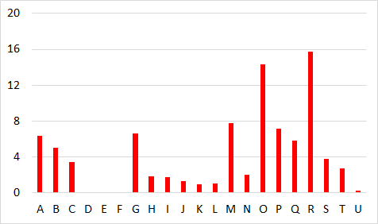
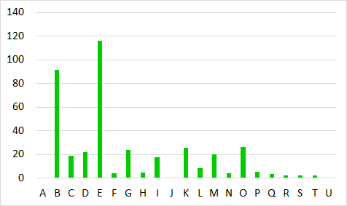
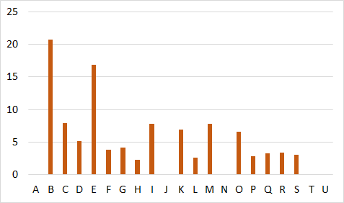
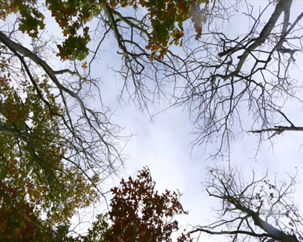
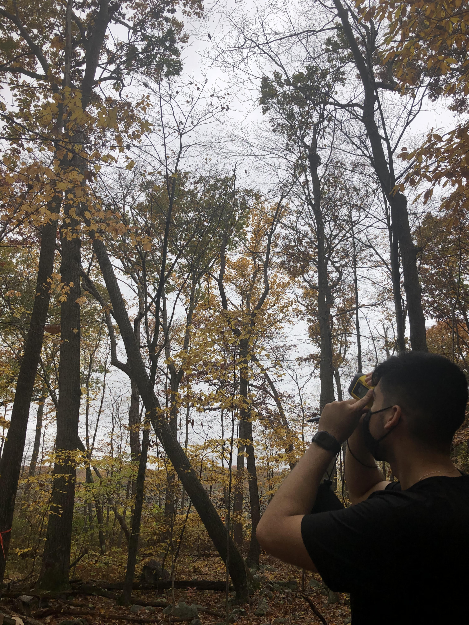
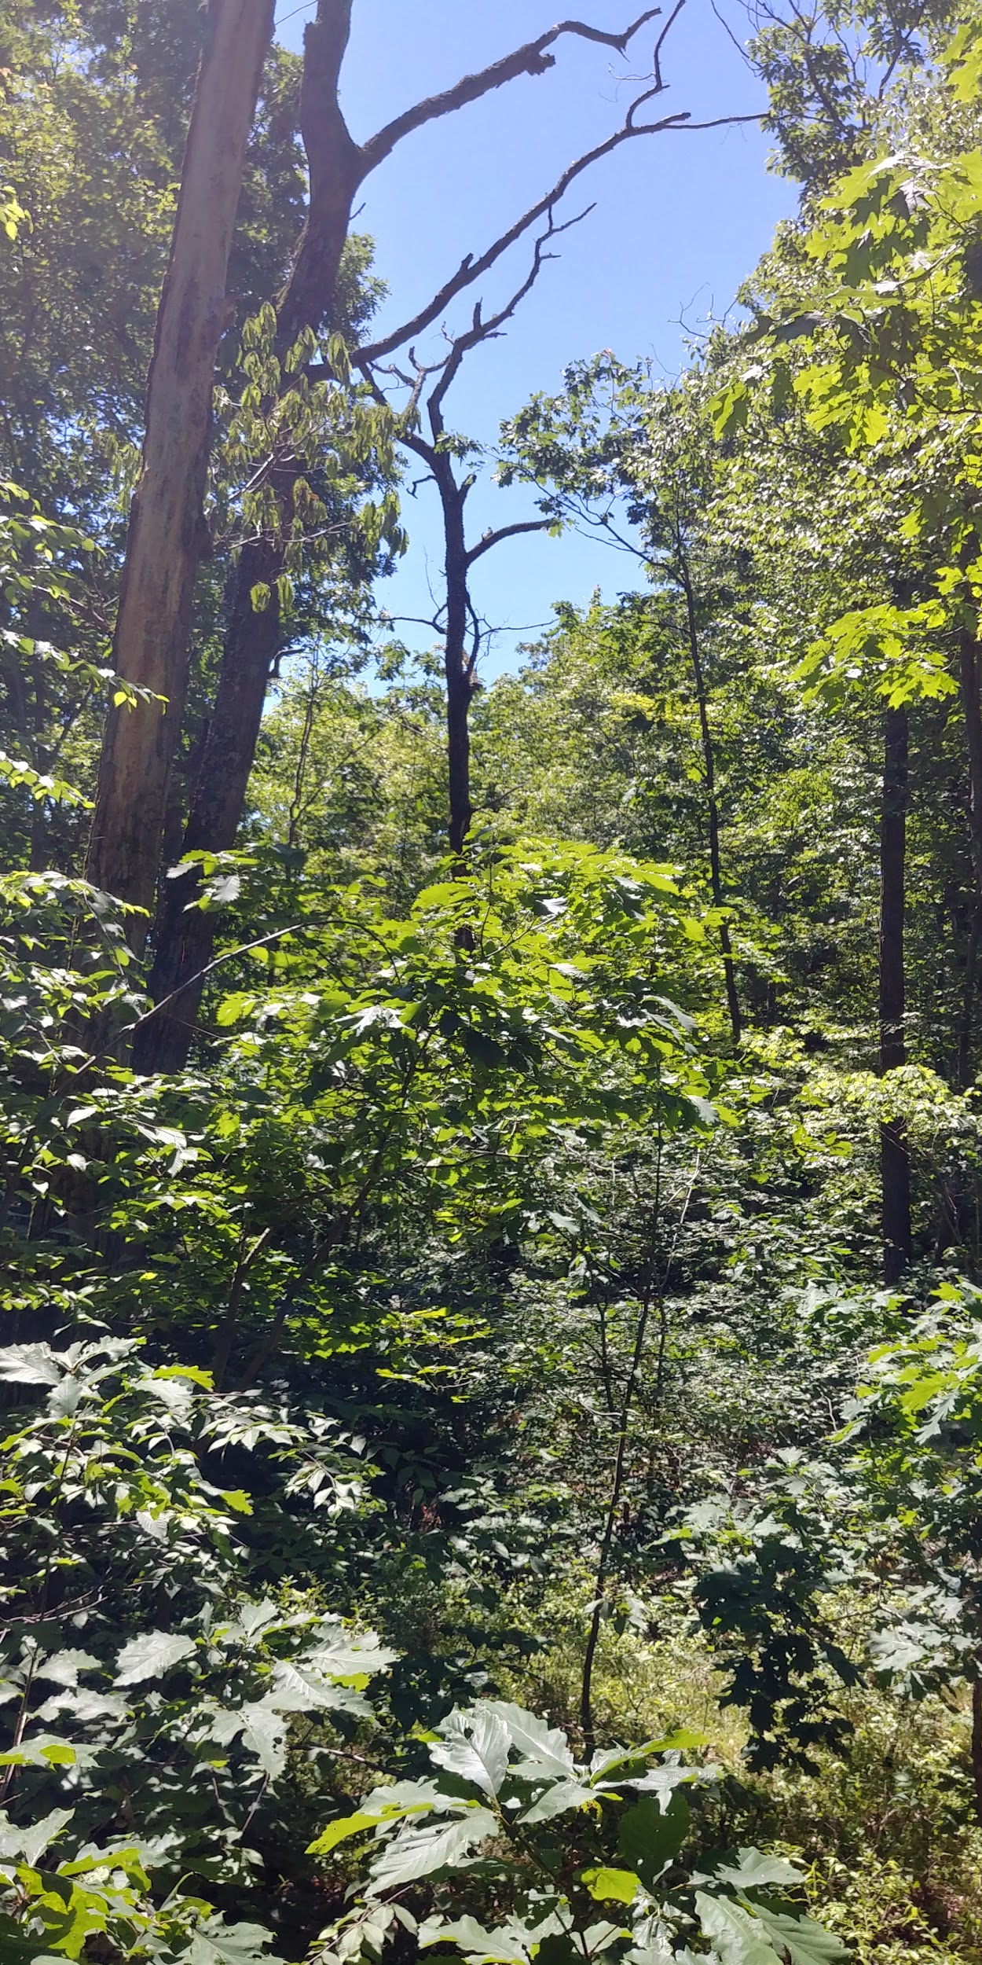
Predicted Shifts in Tree Species Composition in a Mixed-Hardwood Forest
Following a Native Insect Outbreak in the New Jersey Highlands
Anne Ortlieb, Christian Cifuentes, Kathleen Lonnie and Eric Wiener, School of Theoretical and Applied Science, Ramapo College of New Jersey
Introduction
In recent decades, forests of the northeastern United States have been in a highly dynamic state as invasive insects, diseases, and climate change have been causing substantial mortality of a variety of tree species (Lovett et al 2006, Fischer et al 2013).
In 2015 - 2016, an unusual outbreak of oak leafroller insects (Archips semiferanus) led to partial or complete defoliation of most chestnut oaks (Quercus montana) in forests throughout the New York / New Jersey Highlands. Subsequent mortality especially occurred among large trees, which resulted in increased prevalence of openings in the forest canopy, thereby allowing sunlight to penetrate and trigger increased growth of younger trees in lower strata of the forest.
Given the importance of oaks to forest ecosystems in the region, the purpose of this study was to determine whether the tree species composition of the forest canopy is likely to change in one forest stand where substantial tree mortality occurred.
Scientific Name | Common Name | Total # of individuals | Relative Density (%)
Quercus montana (Qm) | chestnut oak | 565 | 34.17
Betula lenta (Bl) | black birch | 283 | 16.71
Quercus rubra (Qr) | red oak | 181 | 10.81
Acer rubrum (Ar) | red maple | 145 | 8.47
Amelanchier arborea (Aa) | serviceberry | 121 | 6.89
Hamamelis virginiana | witch hazel | 106 | 6.19
Fagus grandifolia (Fg) | American beech | 47 | 2.57
Juniperus virginiana | Eastern redcedar | 42 | 2.45
Carya glabra (Cg) | pignut hickory | 29 | 1.64
Quercus alba (Qa) | white oak | 29 | 1.69
Lindera benzoin | spicebush | 26 | 1.58
Carpinus caroliniana | musclewood | 25 | 1.64
Sassafras albidum | sassafras | 19 | 1.11
Carya tomentosa | mockernut hickory | 13 | 0.76
Pinus strobus | Eastern white pine | 13 | 0.82
Betula alleghaniensis (Ba) | yellow birch | 12 | 0.76
Acer saccharum (As) | sugar maple | 4 | 0.23
Cornus florida | flowering dogwood | 4 | 0.06
Quercus coccinea (Qc) | scarlet oak | 3 | 0.23
Nyssa sylvatica | blackgum | 2 | 0.18
Picea abies | Norway spruce | 2 | 0.12
Prunus serotina | black cherry | 2 | 0.06
Tsuga canadensis (Tc) | Eastern hemlock | 2 | 0.12
Quercus velutina | back oak | 1 | 0.06
Ulmus americana (Ua) | American elm | 1 | 0.06
Results and Discussion
Results of the replacement model reveal that black birch and red maple are likely to replace 30 % and 21 % of the dead chestnut oaks, respectively (Figure 1). Only 17 % of the dead chestnut oaks are likely to be replaced by other chestnut oaks, and only 35 % will likely be replaced by oak trees, in general (Figure 1).
For each of the four most common tree species, the relative densities derived from the replacement model were statistically consistently different from the relative densities of saplings in the lower midstory (1 - 3 m height).
The relative densities of chestnut oak were higher in the lower midstory (p = 0.00755), which suggests that a deer fence that was constructed in 2010 may be allowing for more chestnut oak regeneration than forests where white-tailed deer (Odocoileus virginianus) are more abundant.
The relative densities of black birch (p = 0.04272), red maple (p = 0.00029) and red oak (p = 0.02938) were higher among the predicted replacement trees than among lower midstory saplings, which implies that any prediction that these species will become more prevalent as canopy trees at the site may be short-lived.
Substantial variation in the density of regenerating trees existed across the different canopy openings, suggesting spatially complex, tree regeneration dynamics (Figure 2).
Canopy opening area was significantly, negatively correlated with juvenile tree density for saplings of all species combined (p = 0.00021) and for three of the four most common tree species (p < 0.05 for black birch, red maple and chestnut oak). The negative correlations are likely due to intense competition for increased light availability (Nagel et al 2010).
Juvenile chestnut oak and red oak densities were significantly correlated with one another (p < 0.000005), possibly due to spatial correlation among seed-producing adults of the two species or similar regeneration niches for both species. No other species combinations yielded statistically significant correlations.
Overall, this study provides strong evidence that tree species composition at the study site was impacted by the oak leafroller outbreak. Given that oaks produce acorns that are critical for a wide variety of wildlife and oak leaves are host to a great diversity of insect species, declining chestnut oak populations are of particular concern. Furthermore, predicted increases in black birch and red maple populations could be a cause for concern given that these tree species may be especially vulnerable to impacts from climate change (NJ Forest Service 2020).
replacement tree relative density (%)
Figure 1: Model results of relative density of expected tree species replacement based on the largest saplings beneath each canopy opening. Species codes in Table 1.
all species combined
Objectives
The specific objectives of this study were to:
determine which species of trees are most likely to replace the large, dead chestnut oaks;
examine the spatial variation in tree species composition in lower forest strata beneath canopy openings created by clusters of large, dead chestnut oaks.
black birch
Table 1: Summary of the juvenile tree survey across 21 canopy openings caused by mortality of large chestnut oak trees. Species are listed in descending order of abundance.
red maple
Methods and Data Analysis
Study site: Apshawa Preserve, West Milford, New Jersey
Juvenile tree survey: plots (n = 21) established beneath canopy openings where at least four neighboring chestnut oaks had died (Map 1).
surveyed all juvenile trees (n = 1,675) > 1 m height
recorded species and height of each tree
Replacement Model: A model based on the largest saplings beneath each canopy opening was used to predict which tree species will likely replace the dead chestnut oaks.
Wilcoxon Signed Ranks Tests were used to compare the relative densities of predicted tree replacements with relative densities of smaller trees in the lower midstory.
Survey of Canopy Opening Size: Canopy opening area for each plot was estimated by calculating area of an ellipse based on the length and the average of three perpendicular widths.
Spearman’s Rank Correlation was used to determine whether canopy area estimates were predictive of relative density of the most common tree species, as well as to identify correlations between different tree species.
C
E
F
G
I
B
D
juvenile tree density index
A
H
R
APSHAWA PRESERVE
chestnut oak
U
T
Q
O
S
P
J
L
K
Acknowledgments
We would like to thank David Herrera, Joshua Querrazzi and Lauren Zimmer for assistance with field work and data analysis. We are grateful to the New Jersey Conservation Foundation and Passaic County for access to the study site. We also thank the School of Theoretical and Applied Science at Ramapo College of New Jersey for institutional support.
M
N
red oak
Map 1: Map of the 21 study plots labeled A through U. Labels are not to scale.
Works Cited
Fischer, A., Marshall, P., Camp, A. 2013. Disturbances in deciduous temperate forest ecosystems of the northern hemisphere: their effects on both recent and future forest development. Biodiversity Conservation 22:1863–1893.
Lovett, G.M., Canham, C.D., Arthur, M.A., Weathers, K.C., Fitzhugh, R.D. 2006. Forest ecosystem responses to exotic pests and pathogens in Eastern North America. BioScience 56(5):395-405.
Nagel, T.A., Svoboda, M., Rugani, T., Diaci, J. 2010. Gap regeneration and replacement patterns in an old-growth Fagus–Abies forest of Bosnia–Herzegovina. Plant Ecology 208(2):307-318.
NJ Forest Service. 2020. New Jersey State Forest Action Plan - December 2020 draft. New Jersey Department of Environmental Protection.
plot
Figure 2: Juvenile tree density index across 21 plots established beneath canopy openings where > four neighboring canopy trees died. Plot letters coincide with Map 1.

