Slide 1

RSA
September 2025
General Meeting
September 15, 2025

Slide 2
Agenda
RSA & Campus Updates
Holiday Schedule
College Events
RSA Events

Slide 3
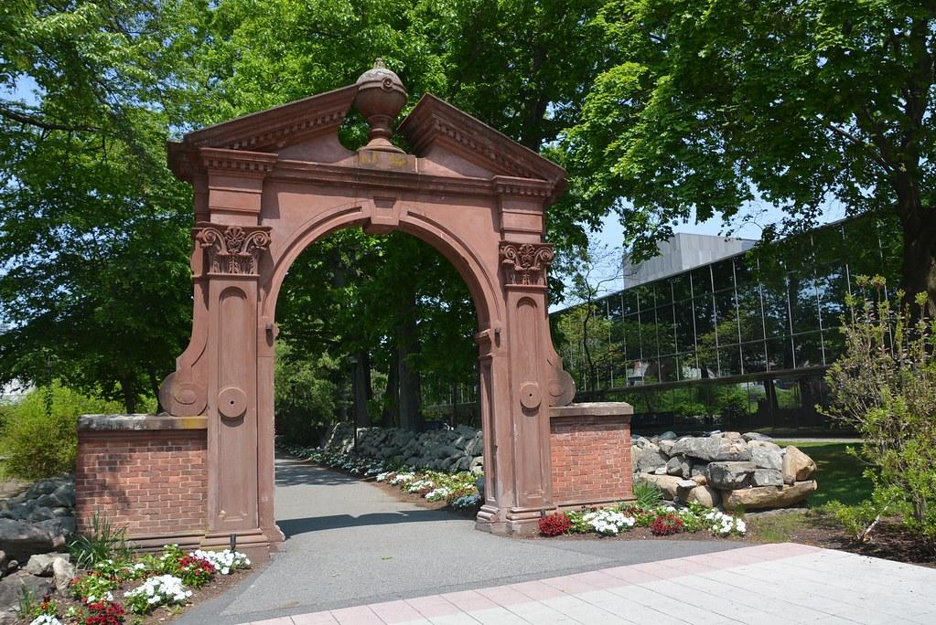
RSA & Campus Updates
Board Introductions
RSA Budget Update
TRIO and Grant Programs
POER Calendar

Slide 4
2025 Holiday Schedule
Thanksgiving: College closed Thursday & Friday, no leave time required
December: College closed 12/24-1/2, leave time required except for 12/25 and 1/1
Optional Adjusted Schedule available again to earn enough comp time to cover holiday closure week
Details at ramapo.edu/poerd/calendar
Notes:
https://www.ramapo.edu/poerd/calendar/

Slide 5
Upcoming Campus Events
Homecoming Weekend: 10/2-10/5
https://www.ramapo.edu/homecoming/
Open House 10/5, 10/26
Board of Trustees Meeting: 10/6 at 6pm
State of the College: 10/22 at 12:00 pm
Employee Wellness Day: 11/25
Staff Holiday Breakfast: 12/4 at 10:15 am
Communications Meeting: 12/8 at 1:00 pm

Slide 6
Any events you want to share?
Berrie Center events this fall
Second City- 9/19 at 8pm, Cab Calloway Orchestra- 9/27 at 8pm, Cat Kid Comic Club: The Musical- 10/11 at 2pm, New York Voices- 12/13 at 8pm.
OSS Arts Expo- 10/29- Berrie Center Lounge
North Jersey Concert Band 10/4 - Berrie Center
Cars and Caffe German Car Show 10/12 (raindate 11/2) - Bandshell

Slide 7
Reminders
Email RSA@ramapo.edu with any ideas, thoughts, or things you want to bring to our attention
Kudos
RSA E-Board attends BOT meetings, committee meetings, shared governance meetings, and monthly meetings with President Jebb.

Slide 8
Upcoming RSA Events
Tabling Event - 10/24 at 2:00 pm
Thankful Thursday - 11/13 at 1:00 pm
Cookie Exchange & General Membership Meeting - 12/5 at 12:00 pm

Slide 9
Questions or things to add?
Thank you for coming!

