Slide 1
Clean Energy
Getting Your Projects Funded in the Current Environment
Andrew Christ
Associate Vice President Facilities & Const. Management
Benjamin S. Parvey II
CEO
BlueSkyPower
Connects Clean Energy

Slide 2
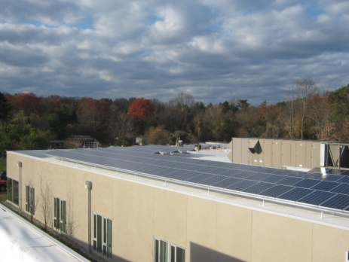
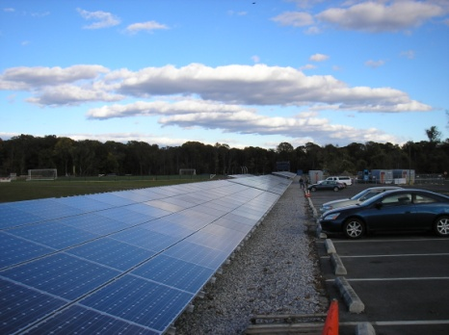
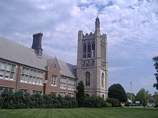
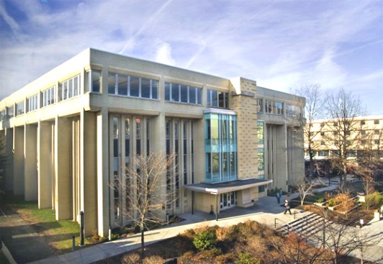
Today’s Topics
Georgian Court University 400kW project
New Jersey City University
What makes for a successful project
Do’s and Don'ts
2012 Clean Energy Marketplace
BlueSkyPower

Slide 3
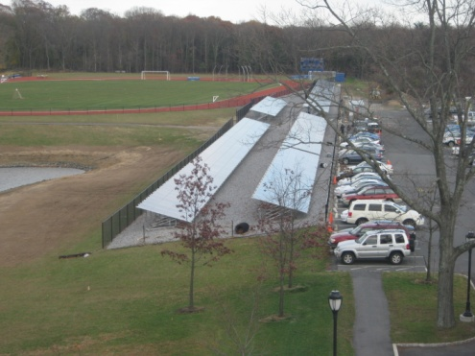
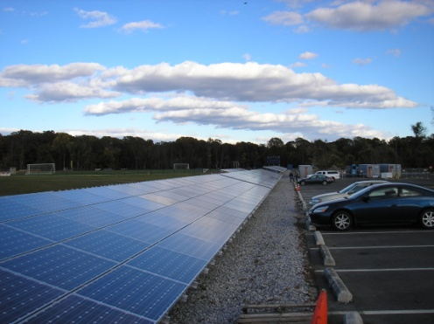
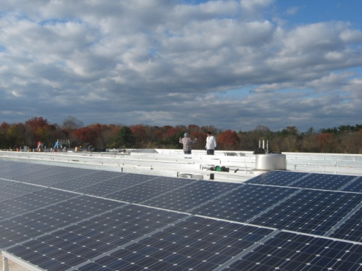
Georgian Court University
Why did this work?
Commitment from University Executives
Leadership from Facilities
Proper Engagement of Professionals
BlueSkyPower

Slide 4
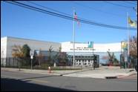
New Jersey City University
Project Challenges
Needed New Roofs on Buildings
Changing Economic Climate
Investor Returns Difficult
BlueSkyPower

Slide 5
Successful Project Components
The Right Professional Team
Reasonable Fees
Engagement of all Parties
A fair RFP
Most importantly
Clear the Runway
(eliminate obstacles)
Realistic Expectations!
BlueSkyPower

Slide 6
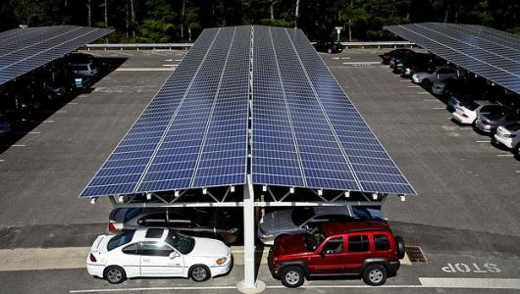
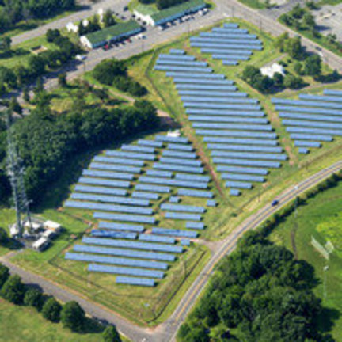
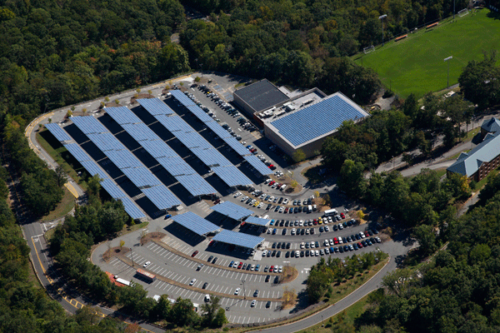
Do’s & Don’ts
Hire the right professionals
Understand how fees impact the projects
Make sure your attorney is familiar with Power Purchase Agreements
Get your house in order (roof, warranty, bills, etc…)
Level the playing field
Do your homework on financiers
BlueSkyPower

Slide 7
2012 NJ Renewable Energy Market
SRECs
Energy Master Plan
Increase RPS
Extension of 1603 Grant
BlueSkyPower

Slide 8
Homework
What You Need To Get a Project Done in 2012
Checklist
BlueSkyPower

Slide 9
Getting Your Projects Funded in the Current Environment
Questions?
Thank You!
Andrew Christ
Associate Vice President Facilities & Const. Management
Benjamin S. Parvey II
CEO
BlueSkyPower
Connects Clean Energy

