Slide 1
“Resilience” as Seen by One Old Guy
Ramapo College
November 1, 2013
David Peifer
ANJEC

Slide 2
The Daily Grind
One of the penalties of an ecological education is that one lives alone in a world of wounds.
Much of the damage inflicted on land is quite invisible to laymen.
An ecologist must either harden his shell and make believe that the consequences of science are none of his business, or he must be the doctor who sees the marks of death in a community that believes itself well and does not want to be told otherwise.” ― Aldo Leopold, A Sand County Almanac

Slide 3
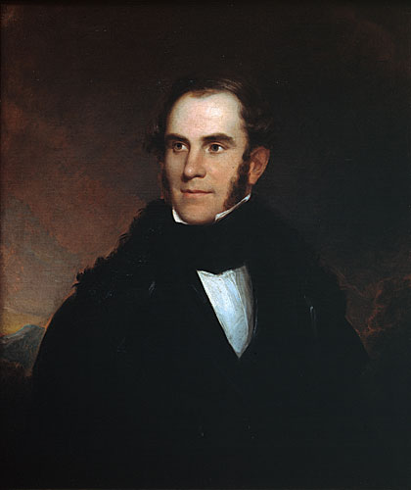
Warnings From the Past
Thomas Cole: American Artist 1801-1848

Slide 4
The Savage State

Slide 5
The Arcadian or Pastoral State

Slide 6
The Consummation of Empire

Slide 7
Destruction

Slide 8
Desolation

Slide 9
Thoughts on Cole’s Imagery
Cole’s imagery anticipates the inevitable course of empires: from the Savage State to Desolation.
These changes were caused by process under man’s control. Cole never anticipated Global Climate Change and assumed that climate was a constant.
Perhaps Desolation would be far worse, with less “healing” had he done so!
But the processes he envisioned continue today while climate change advances!
What stage is your community in?

Slide 10
By The Mid 19th Century….. Some were beginning to notice the changes taking place and man’s role in causing them.
G.P. Marsh,
1801-1882
Author of
Man and Nature: 1864

Slide 11
A Few of Marsh’s Observations…
"Even now...we are breaking up the floor and wainscoting and doors and window frames of our dwelling, for fuel to warm our bodies and seethe our pottage."
Such wanton and heedless use of the planet's forests meant that earth was "fast becoming an unfit home for its noblest inhabitant...Another era of equal human crime and human improvidence...would reduce it to such a condition of impoverished productiveness, of shattered surface, of climatic excess, as to threaten the depravation, barbarism, and perhaps even extinction of the [human] species."
A proto-ecologist, Marsh also said: "The [exact relation]...of animal and vegetable life is too complicated a problem for human intelligence to solve, and we can never know how wide a circle of disturbance we produce in the harmonies of nature when we throw the smallest pebble into the ocean of organic life."

Slide 12
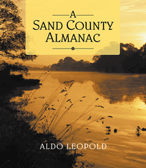
Aldo Leopold : A View From the Mid 20th Century: The Need for a “Land Ethic”
“Examine each question in terms of what is ethically and aesthetically right, as well as what is economically expedient. A thing is right when it tends to preserve the integrity, stability, and beauty of the biotic community. It is wrong when it tends otherwise.” “
“Ethical behavior is doing the right thing
when no one else is watching- even
when doing the wrong thing is legal.”

Slide 13
Cliff Notes to the “Land Ethic”
"The land ethic simply enlarges the boundaries of the community to include soils, waters, plants, and animals, or collectively: the land."
"This sounds simple: do we not already sing our love for and obligation to the land of the free and the home of the brave? Yes, but just what and whom do we love?
Certainly not the soil, which we are sending helter-skelter down river.
Certainly not the waters, which we assume have no function except to turn turbines, float barges, and carry off sewage.
Certainly not the plants, of which we exterminate whole communities without batting an eye.
Certainly not the animals, of which we have already extirpated many of the largest and most beautiful species.
A land ethic of course cannot prevent the alteration, management, and use of these ‘resources,’ but it does affirm their right to continued existence, and, at least in spots, their continued existence in a natural state.
In short, a land ethic changes the role of Homo sapiens from conqueror of the land-community to plain member and citizen of it. It implies respect for his fellow-members, and also respect for the community as such."

Slide 14
Barry Commoner, 1917-2012: Forgotten Prophet
“Carbon dioxide makes a huge greenhouse of the earth, allowing sunlight to reach the earth’s surface but limiting reradiation of the resulting heat into space. The temperature of the earth—which profoundly effects the suitability of the environment for life—is therefore certain to rise as the amount of carbon dioxide in the air increases.”
Barry Commoner: Science and Survival,1963

Slide 15
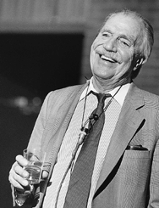
Ian McHarg

Slide 16
McHarg: Hope and Humility
“The world is a glorious bounty. There is more food than can be eaten if we would limit our numbers to those who can be cherished, there are more beautiful girls than can be dreamed of, more children than we can love, more laughter than can be endured, more wisdom than can be absorbed.
Canvas and pigments lie in wait, stone, wood, and metal are ready for sculpture, random noise is latent for symphonies, sites are gravid for cities, institutions lie in the wings ready to solve our most intractable problems, parables of moving power remain unformulated and yet, the world is finally unknowable.”

Slide 17
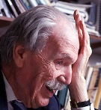
…..and method

Slide 18
What Can We Expect From Climate Change in the Northeastern U.S.?
Alteration of the timing and amount of stream flow, which would create more high-flow events in winter, earlier peak flows.
An Increase in winter precipitation (much of which is expected to fall as rain) 20 to 30 percent by late-century
A reduction in the snowpack and a shortened snow season
An increase the frequency of short-term (one- to three-month) droughts
An increase the frequency of extremely hot days (which can increase water demand) roughly five-fold
An increase the likelihood and severity of damaging rainstorms
Rising sea levels increasing the risk of saltwater intrusion into coastal aquifers and coastal flooding.

Slide 19
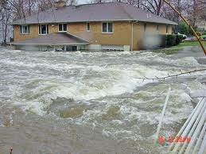
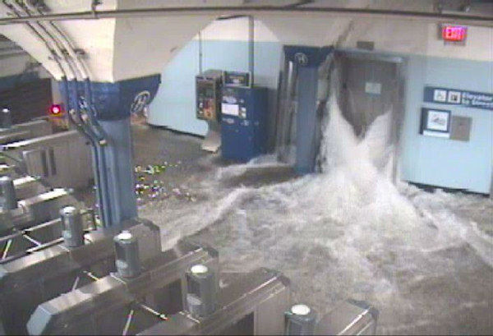
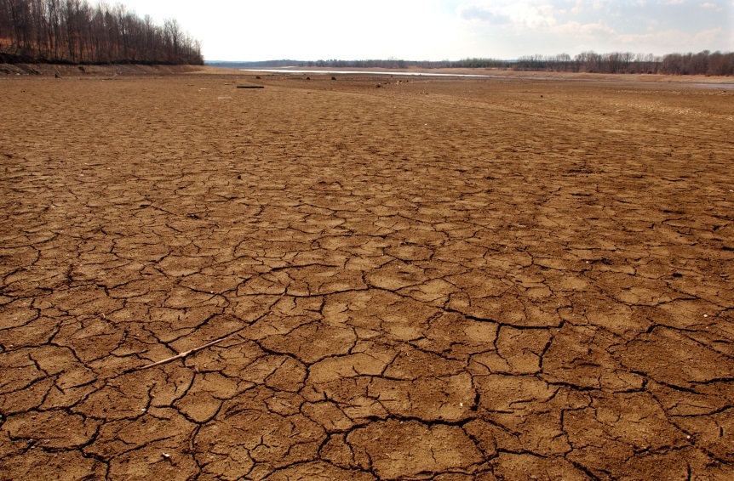
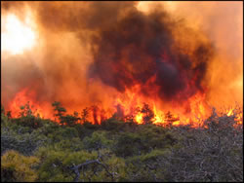
The Future is Here: But Only Beginning!

Slide 20
So, what is to be done?
Traditional protection of natural areas and natural system functions should continue and increase in pace and scale.
Forests
Wetlands
Floodprone Areas
Riparian Areas
Groundwater Recharge Areas
Wildlife Habitat
Steep Slopes

Slide 21
The Environmental Resource Inventory: A Primary Tool
Provides objective basis for policy development and change.
Based on McHarg’s methodology.
Produced by local environmental commissions.
Identifies objective facts about the components of community “natural infrastructure”.
Digital format allows rapid manipulation and analysis of data to meet changing assumptions.

Slide 22
Other Digital Data
In New Jersey we live in a “data rich” environment: Highlands Council, Pinelands Commission, NJ DEP Geo-Web, Meadowlands Commission, Existing Municipal Data, Existing County Data, USEPA. Other agencies: Census, DOT and many more.

Slide 23
In Developed Areas:
Require Green Infrastructure stormwater practices on new construction.
Retrofit Green Infrastructure in areas without controls.
Institute water conservation as a full time practice.
Plant and manage street trees.
Institute “cool street and cool roof” practices.

Slide 24
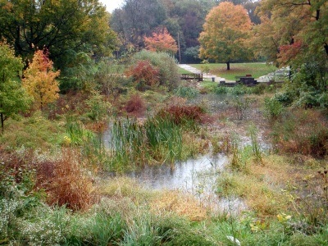
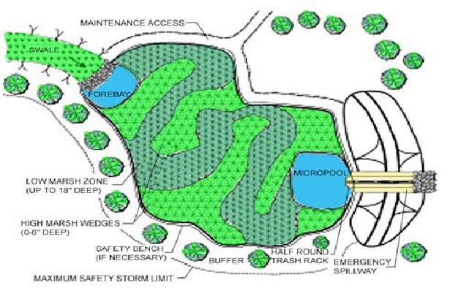
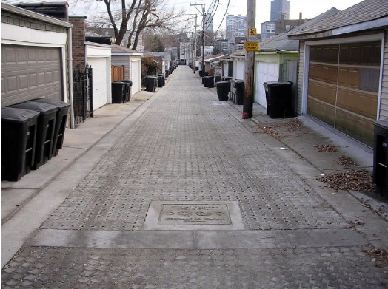
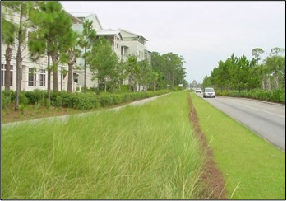
Green Stormwater Infrastructure Techniques

Slide 25
Take Action at Any Scale!
In Bradley Beach a group of dedicated volunteers, including the Bradley Beach Environmental Commission decided to recreate a Maritime forest on a piece of abandoned and neglected land in the wake of Hurricane Sandy.
Resilience can be built in small steps!

Slide 26
Use of Models: Simulating an Uncertain Future
Using theoretical understanding, data, and selected assumptions, future conditions can be simulated by modelling.
By continually observing actual behavior of natural systems models can be “calibrated” to become more accurate.

Slide 28
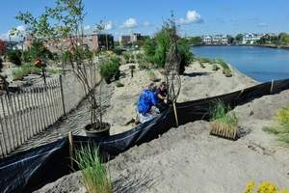

Slide 29
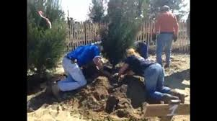

Slide 30
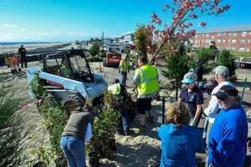

Slide 31
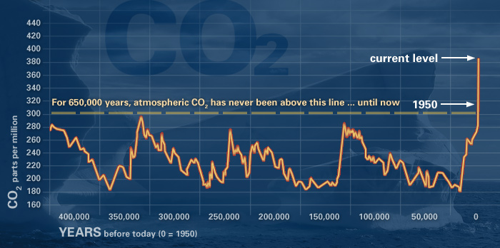
Thank you! Questions?
Contact:
Dave Peifer
ANJEC
dpeifer@anjec.org
973-5397547

