Slide 1
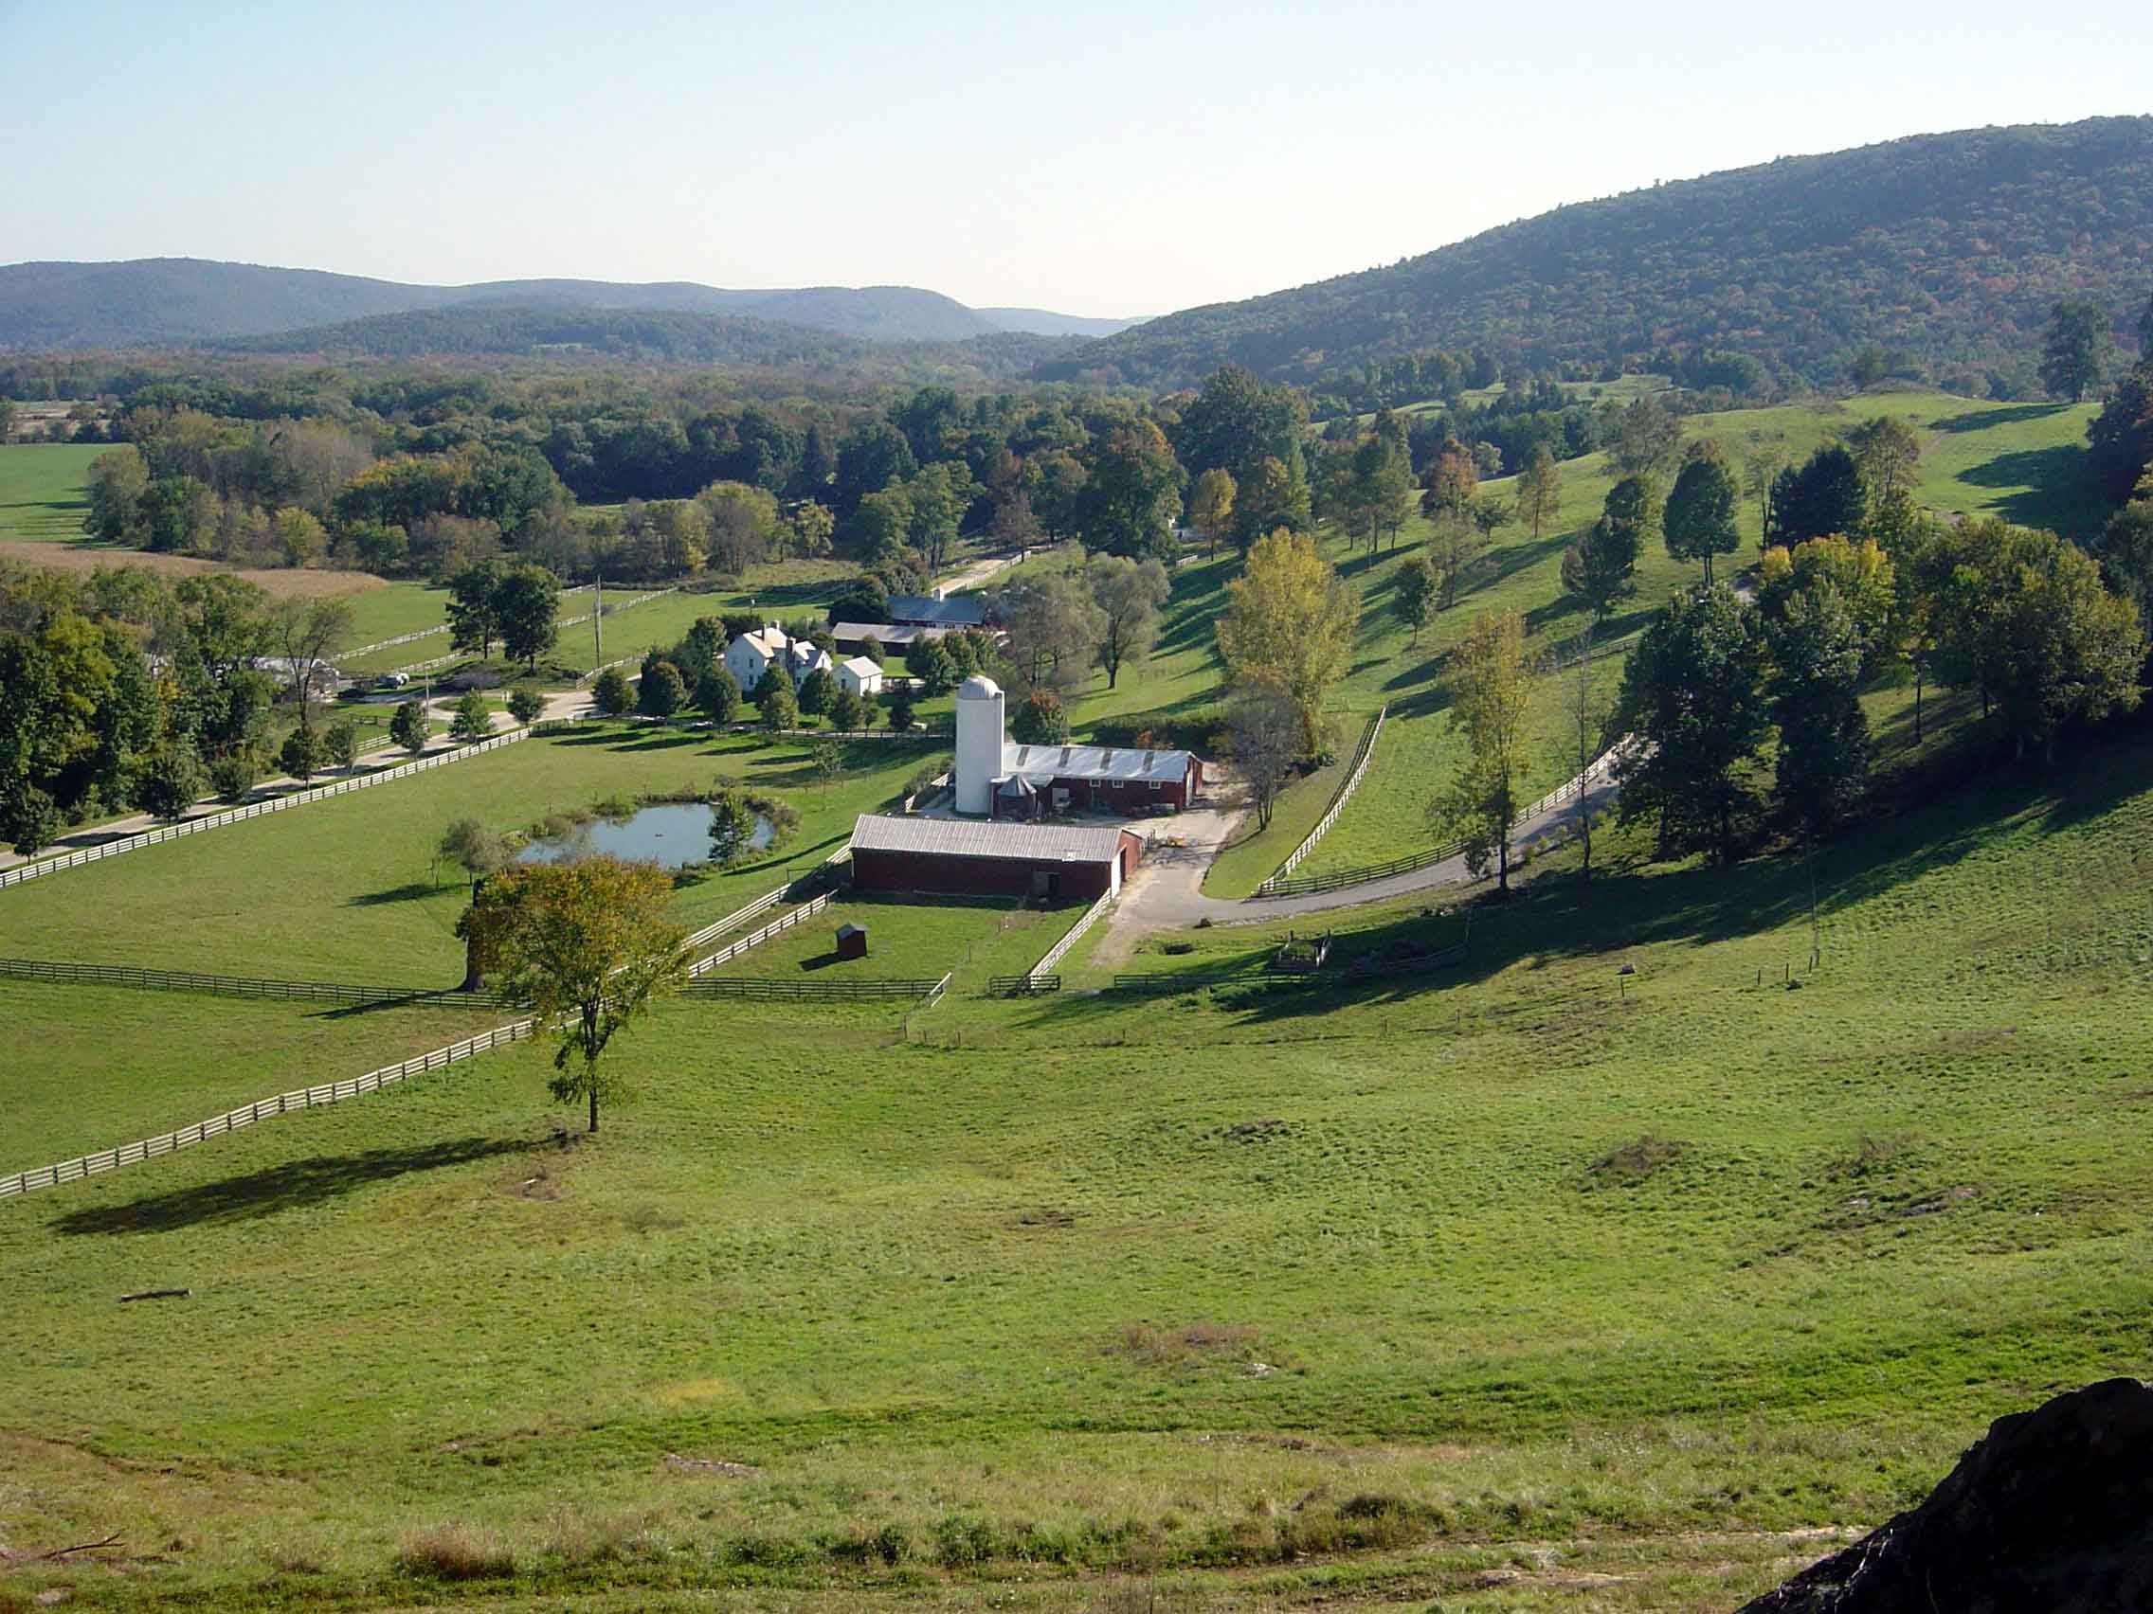
Ecological Audits and Inventories: The Intersection of Science and Policy
Michael W. Klemens PhD
Ramapo College
November 1, 2013

Slide 2
“The environment is not a competing interest to be balanced…rather, it is the playing field, the foundation upon which all human endeavors compete upon.”

Slide 3
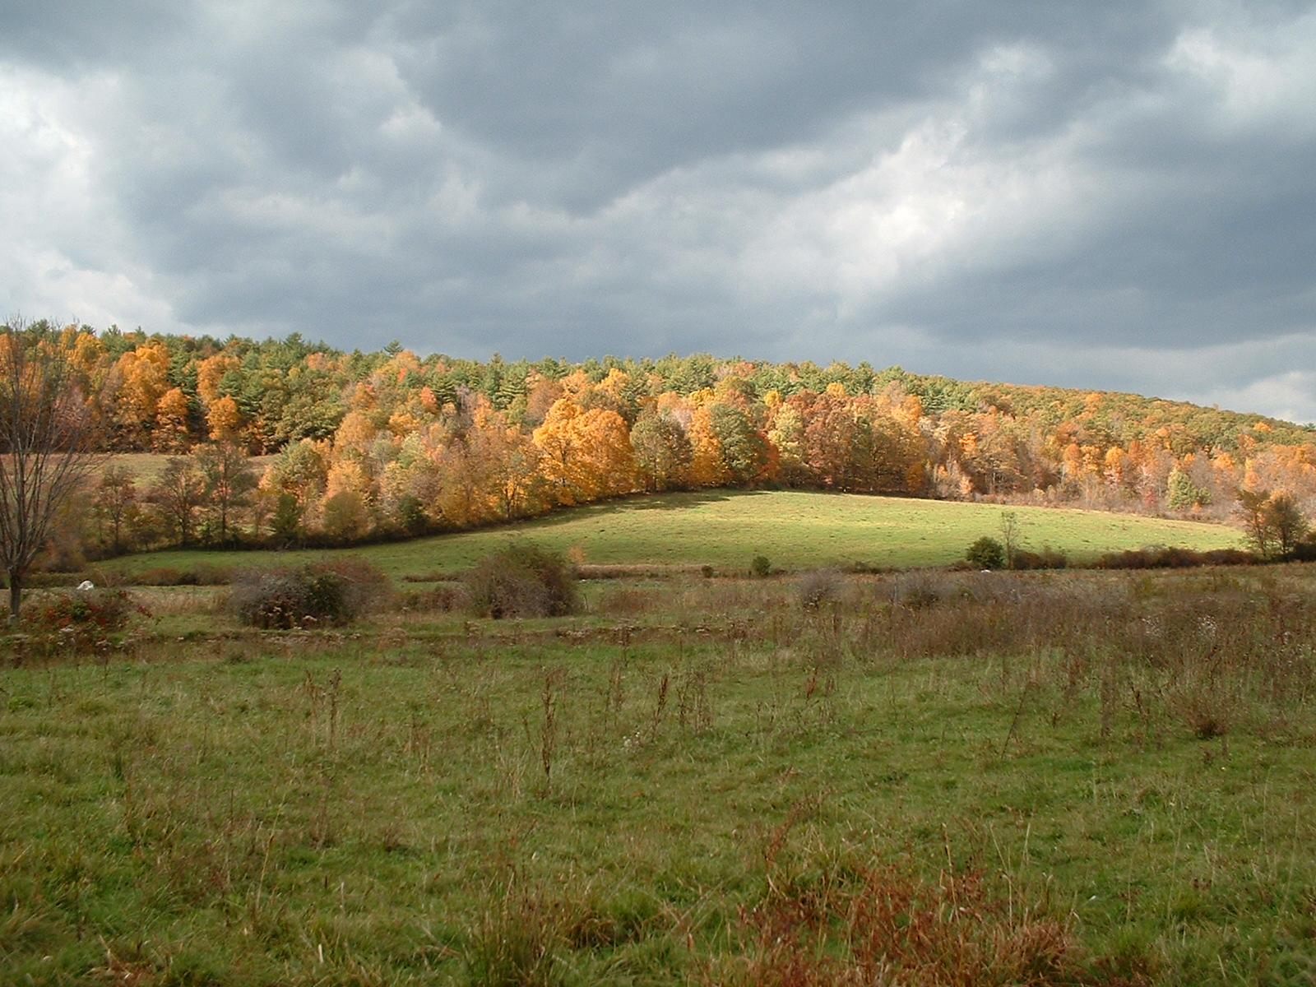
Nature’s Stewardship
Genes…
Species…
Ecosystems…
Sense of Place…

Slide 4
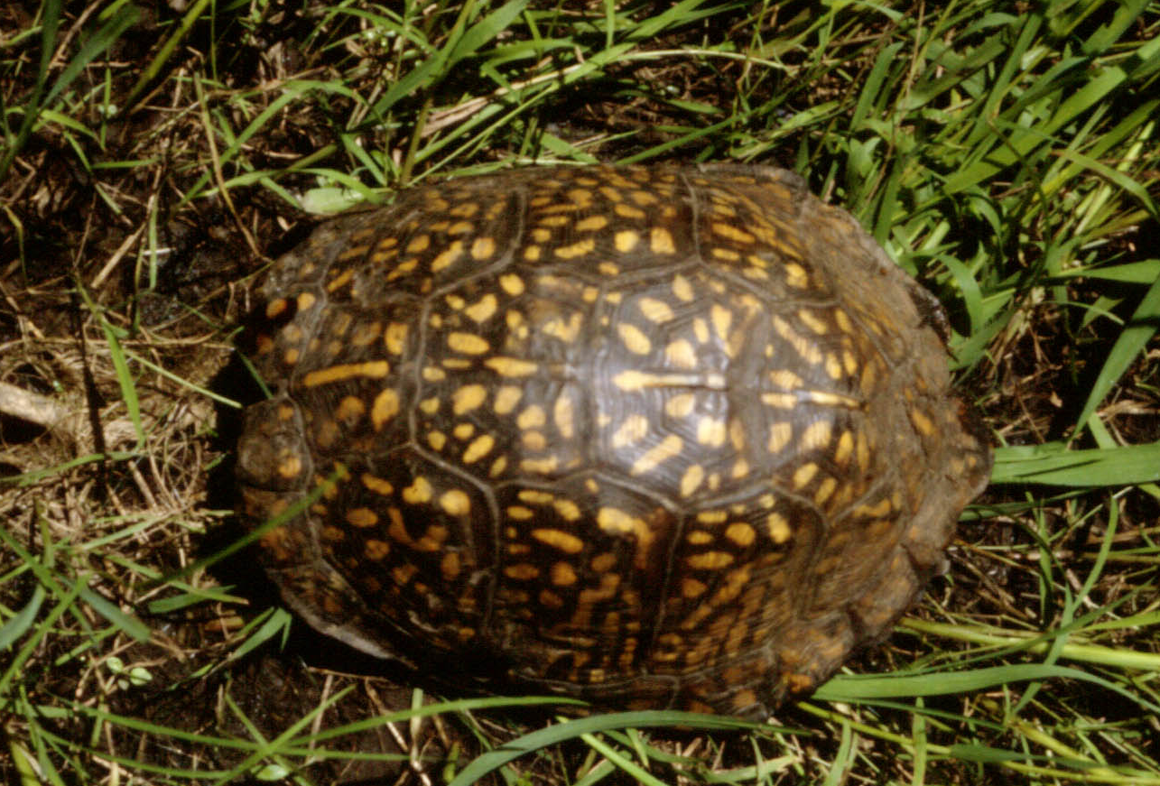
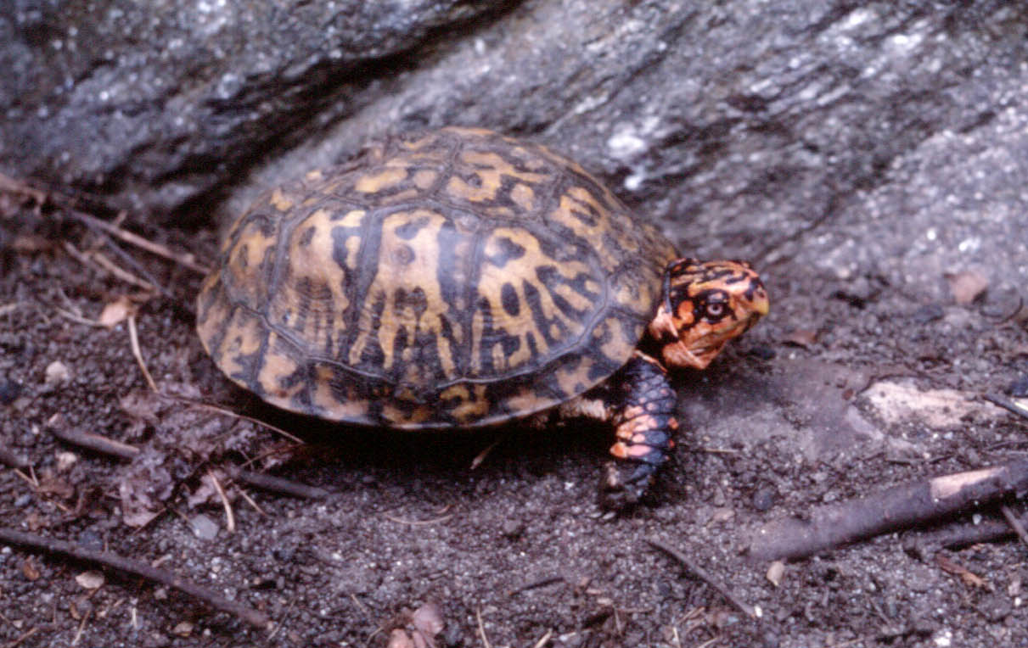
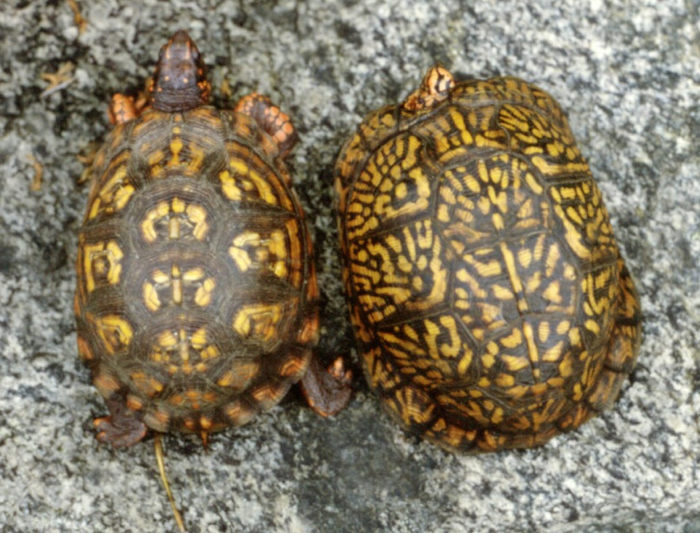
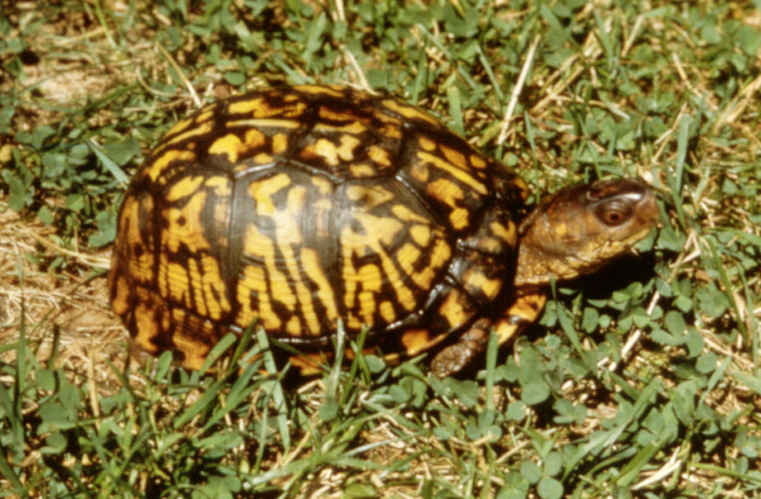
Genetic Variability

Slide 5
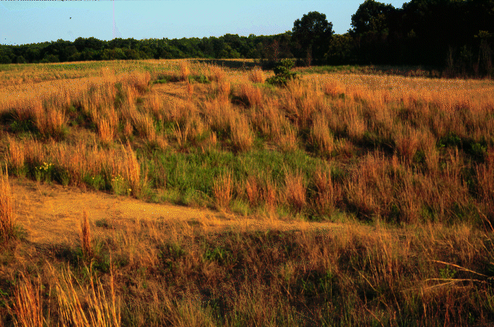
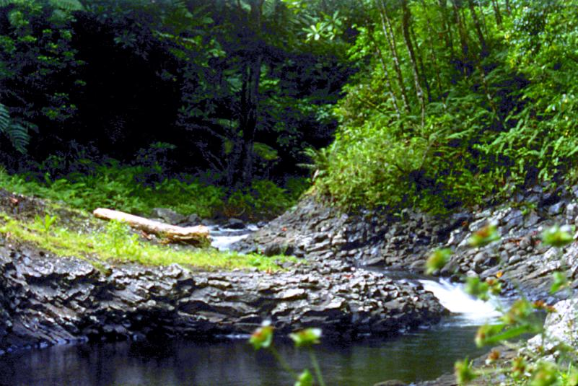
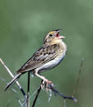
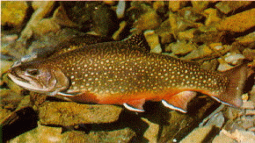
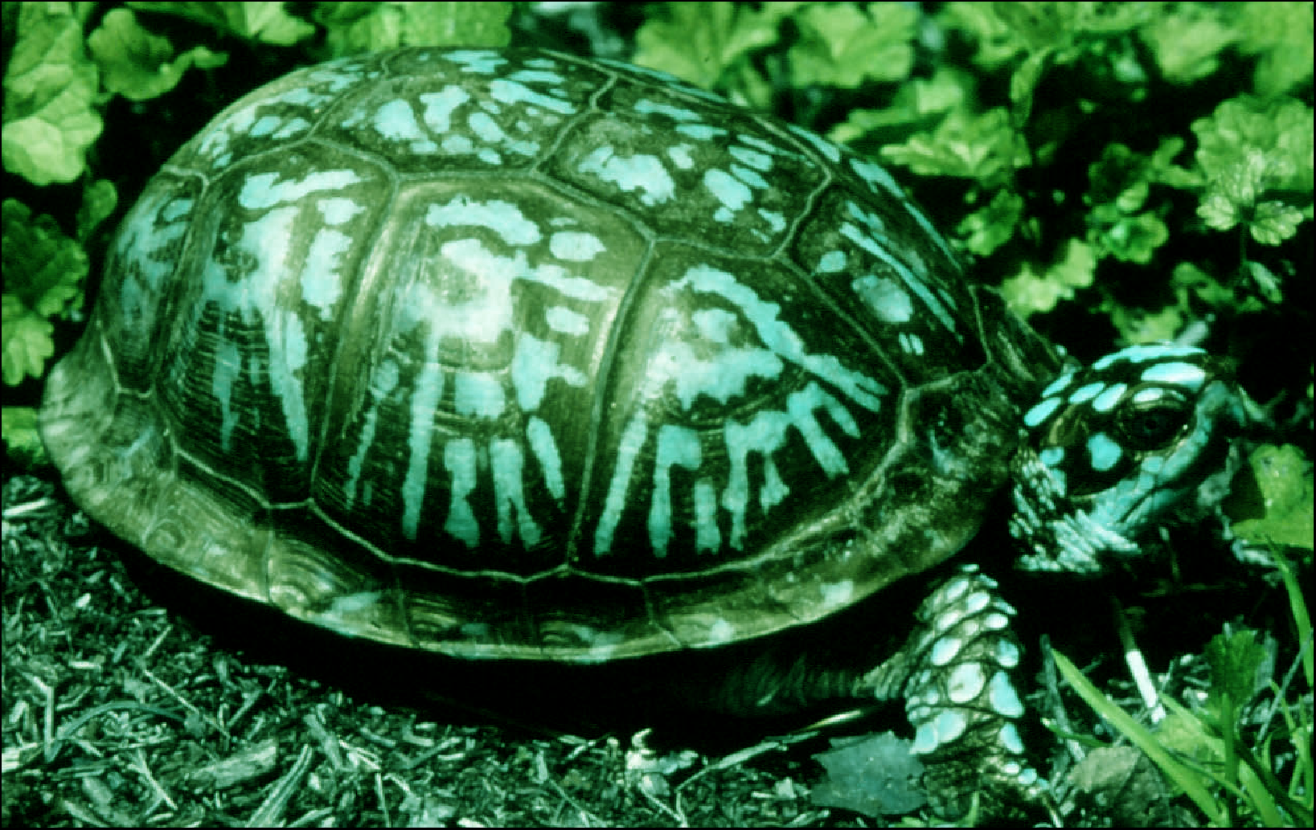
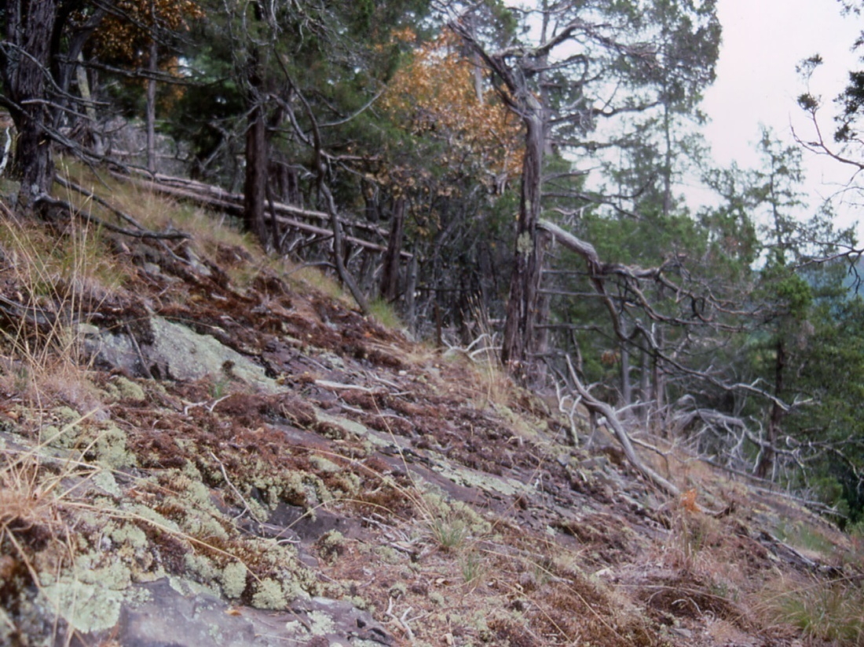
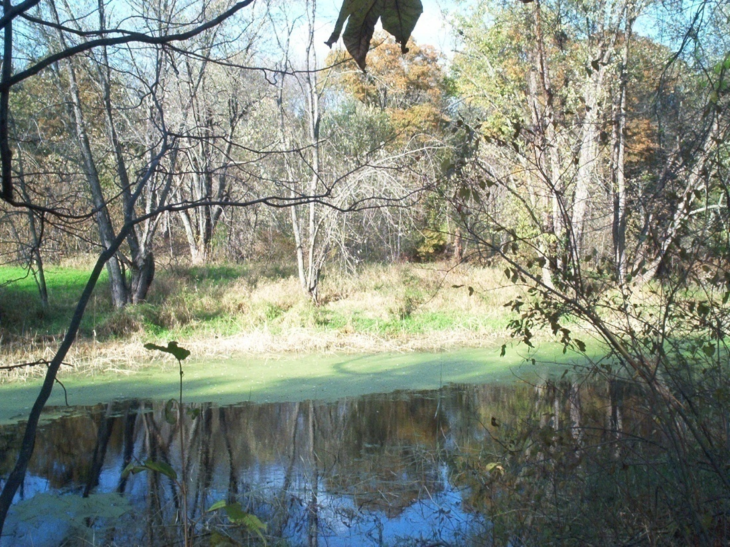
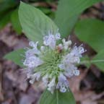
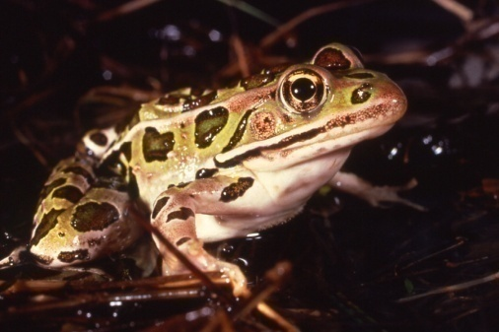
Biodiversity

Slide 6
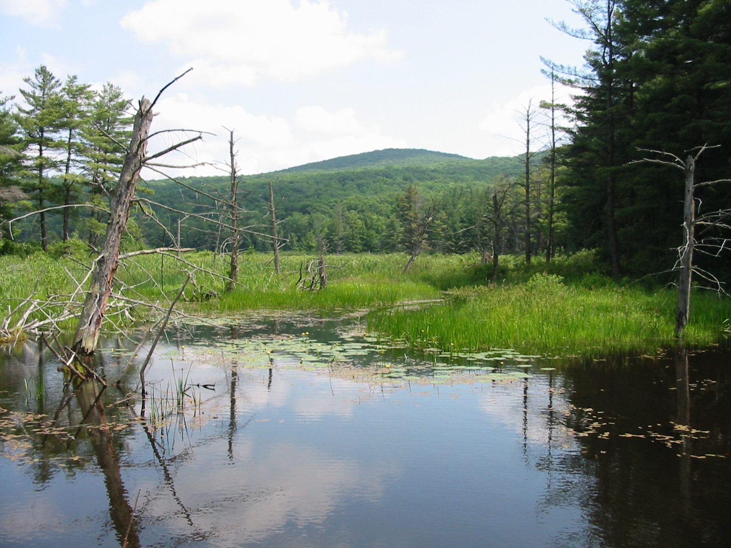
Diversity of Ecosystems
(= Natural Capital)

Slide 7
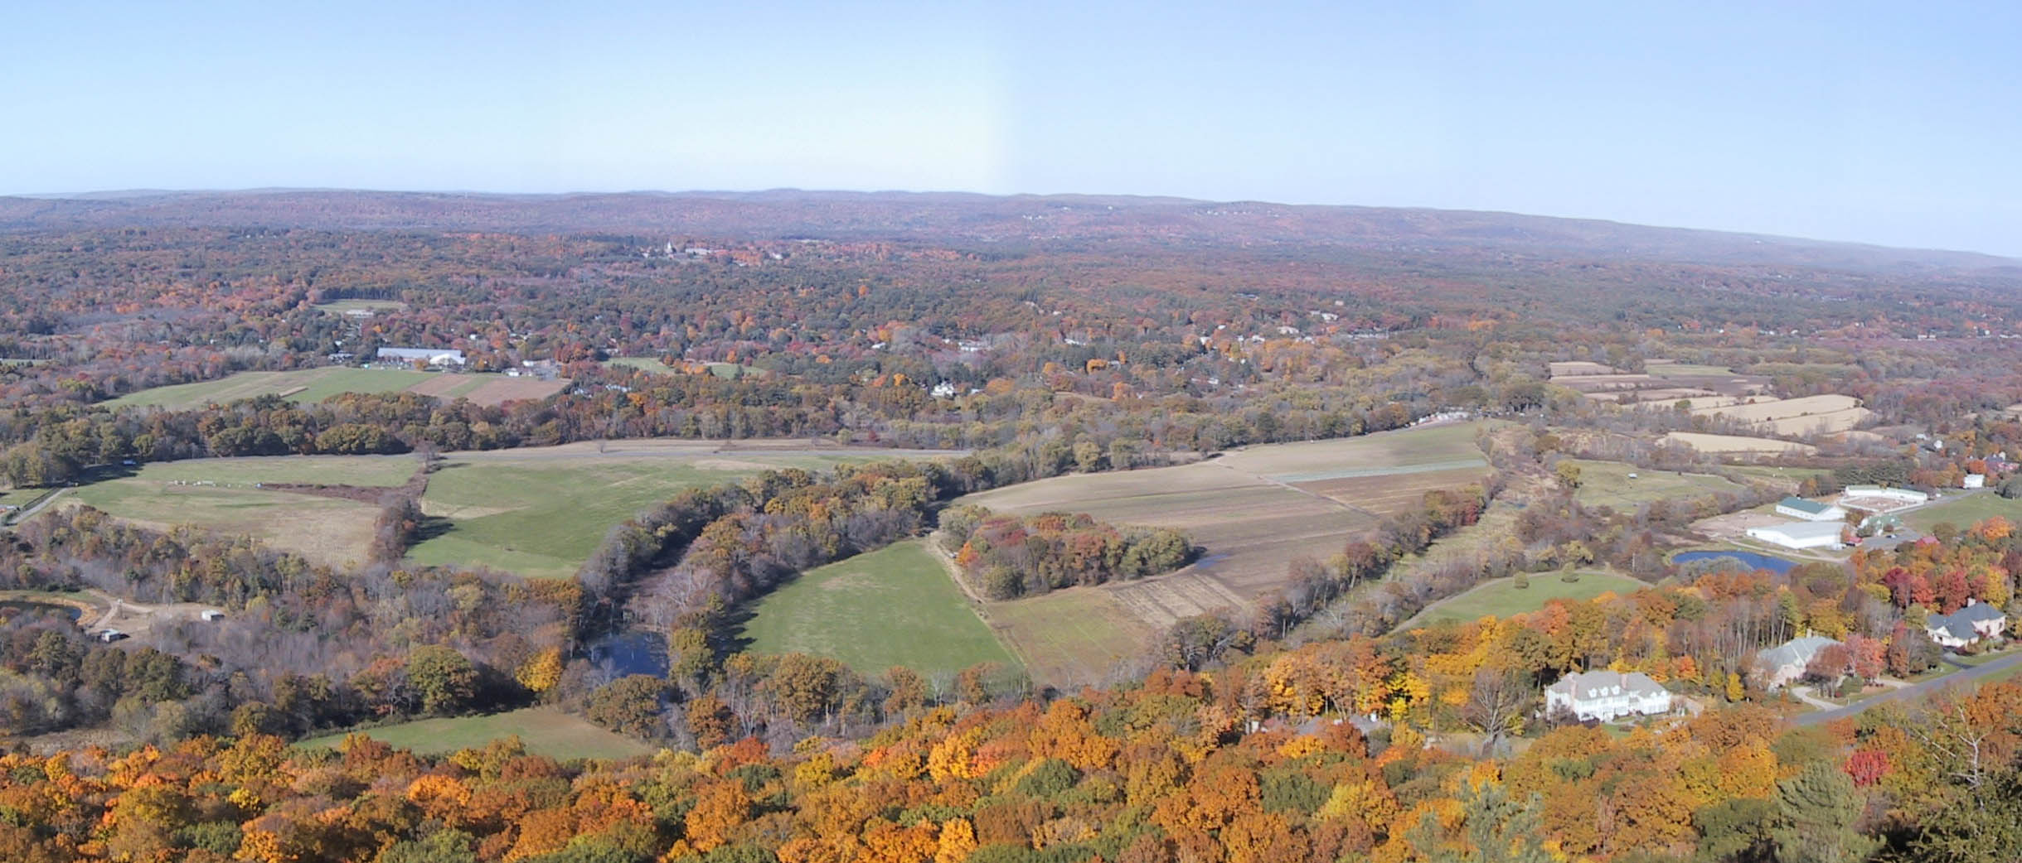
Sense of Place and Community

Slide 8
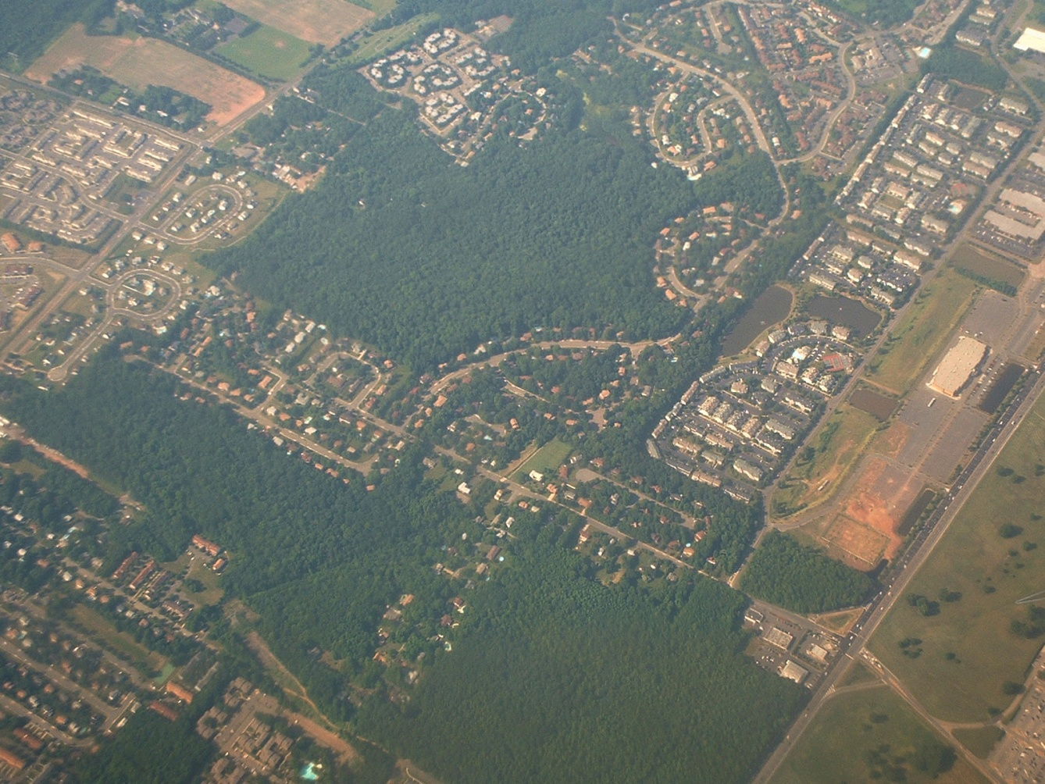
What is the overarching threat to ecological integrity?
Habitat fragments
Notes:
Major threat to biodiversity is habitat fragmentation caused by sprawl development.
The pattern of suburban roads/housing fragments habitat into small islands. These isolated patches cannot support the full complement of species that intact forest supports. They are degraded habitat.

Slide 9
Fragmentation
Reduces ecological diversity and therefore reduces natural capital and resiliency
Increases pollution (e.g., water, light, and noise)
Fosters a disconnect between human communities, as well as between humans and nature
Creates non-sustainable patterns of growth that require continuous infusions of capital
Creates technological dependency increasing societal vulnerability to stochastic events
Compromises human health, both physical and emotional

Slide 10
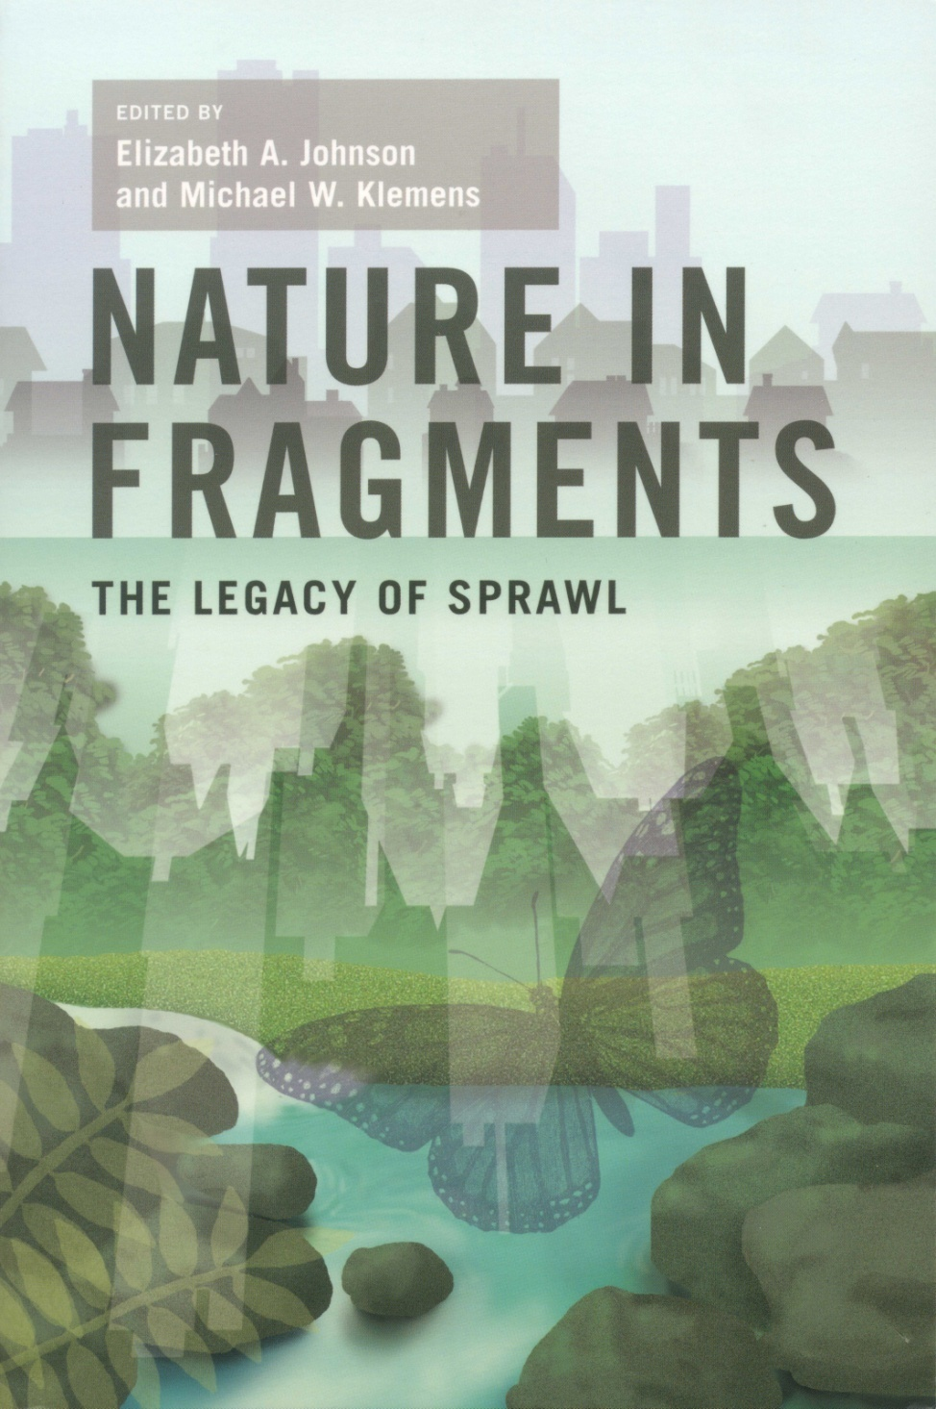
What Drives Fragmentation?

Slide 11
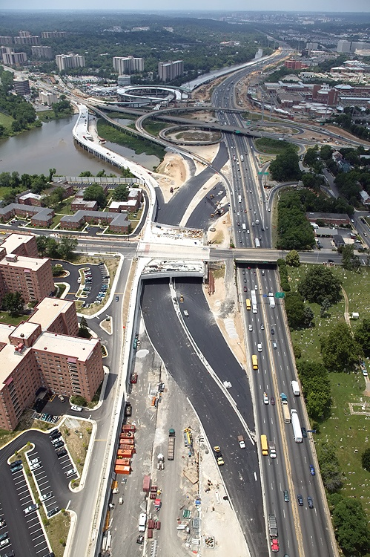
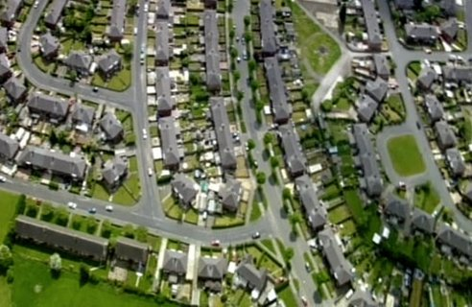
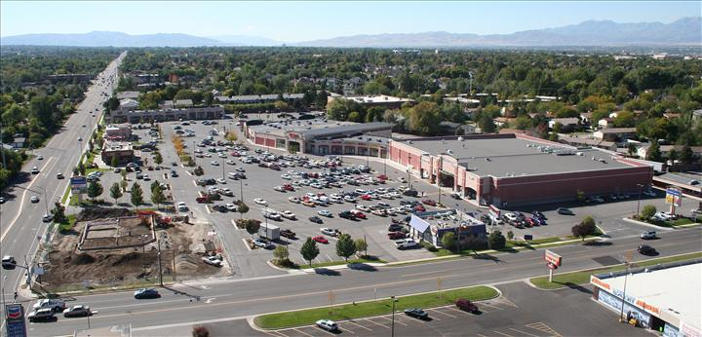
Inappropriate Development

Slide 12
“Long-term costs of inappropriate development are not economically accounted for and dismissed as “externalities”.
These include, loss of “the commons”, i.e. natural capital, costs of pollution
clean-up, diminishment
of drinking water,
increased carbon
footprint, healthcare,
and public services.”

Slide 13
“…in short, inappropriate development fails to account for its true market costs and is heavily subsidized by the public purse.”
“Voodoo economics”
– George H.W. Bush

Slide 14
Developing a New Vision for the Future
Requires leadership and action at all levels of government
Recognizes that the majority of land use decisions occur at the very local level
Requires an informed and engaged citizenry
Provides economically viable and socially acceptable alternatives

Slide 15
Increases in Population and Developed Land Area in the New York Metro Region (1970-1990)*
% Increase
*Regional Plan Association
Notes:
Threatened by sprawl – not a function solely of population growth – but of wasteful land consumption – including large-lot zoning

Slide 16
Overcoming Challenges
Conflicting scales: Ecosystem vs. decision-making
Scientific information not readily available to decision-makers
Incomplete natural resource data
Lack of ecological BDPs and BMPs
A “one size fits all” policy fails to account for ecological complexity
Ecologically-friendly planning techniques are not enabled by local regulations
Notes:
In a region where most land use authority & decisions are vested at the local level – the challenges are significant

Slide 17
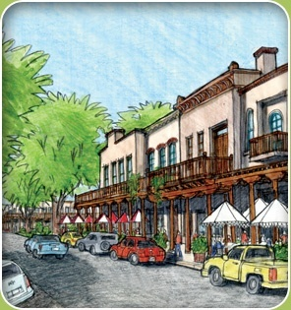
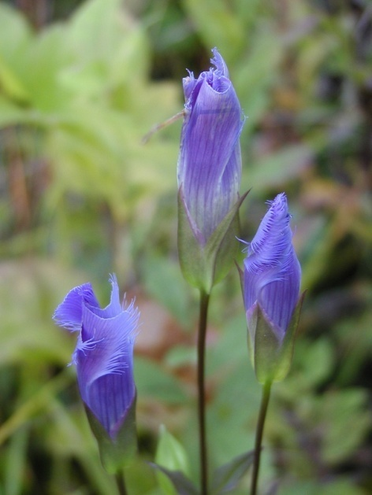
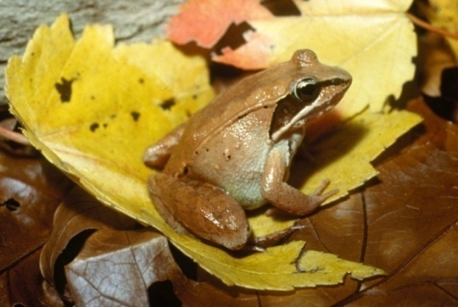
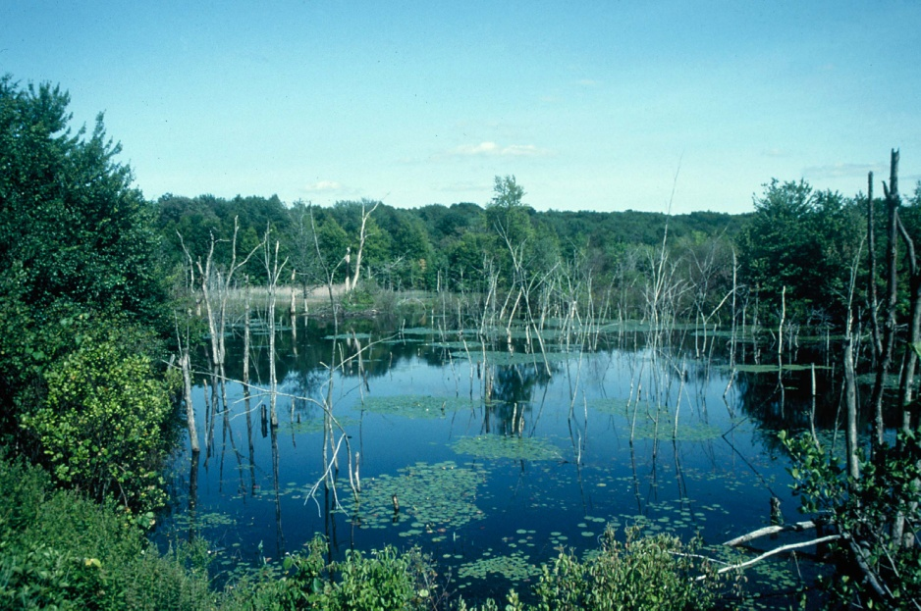
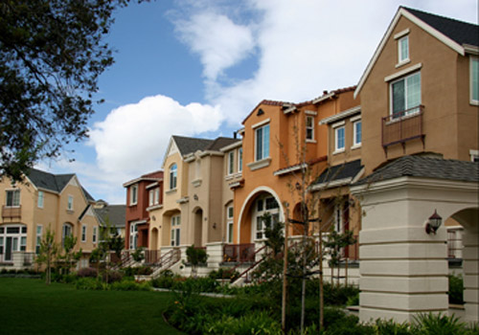
Achieving Balance
Notes:
The process is stepwise and additive…we feel the effectiveness of our approach is that we work at all levels of this process—and stay involved for the long term.

Slide 18
R.A.I.D.E.R.
6 Steps to Sustainability

Slide 19
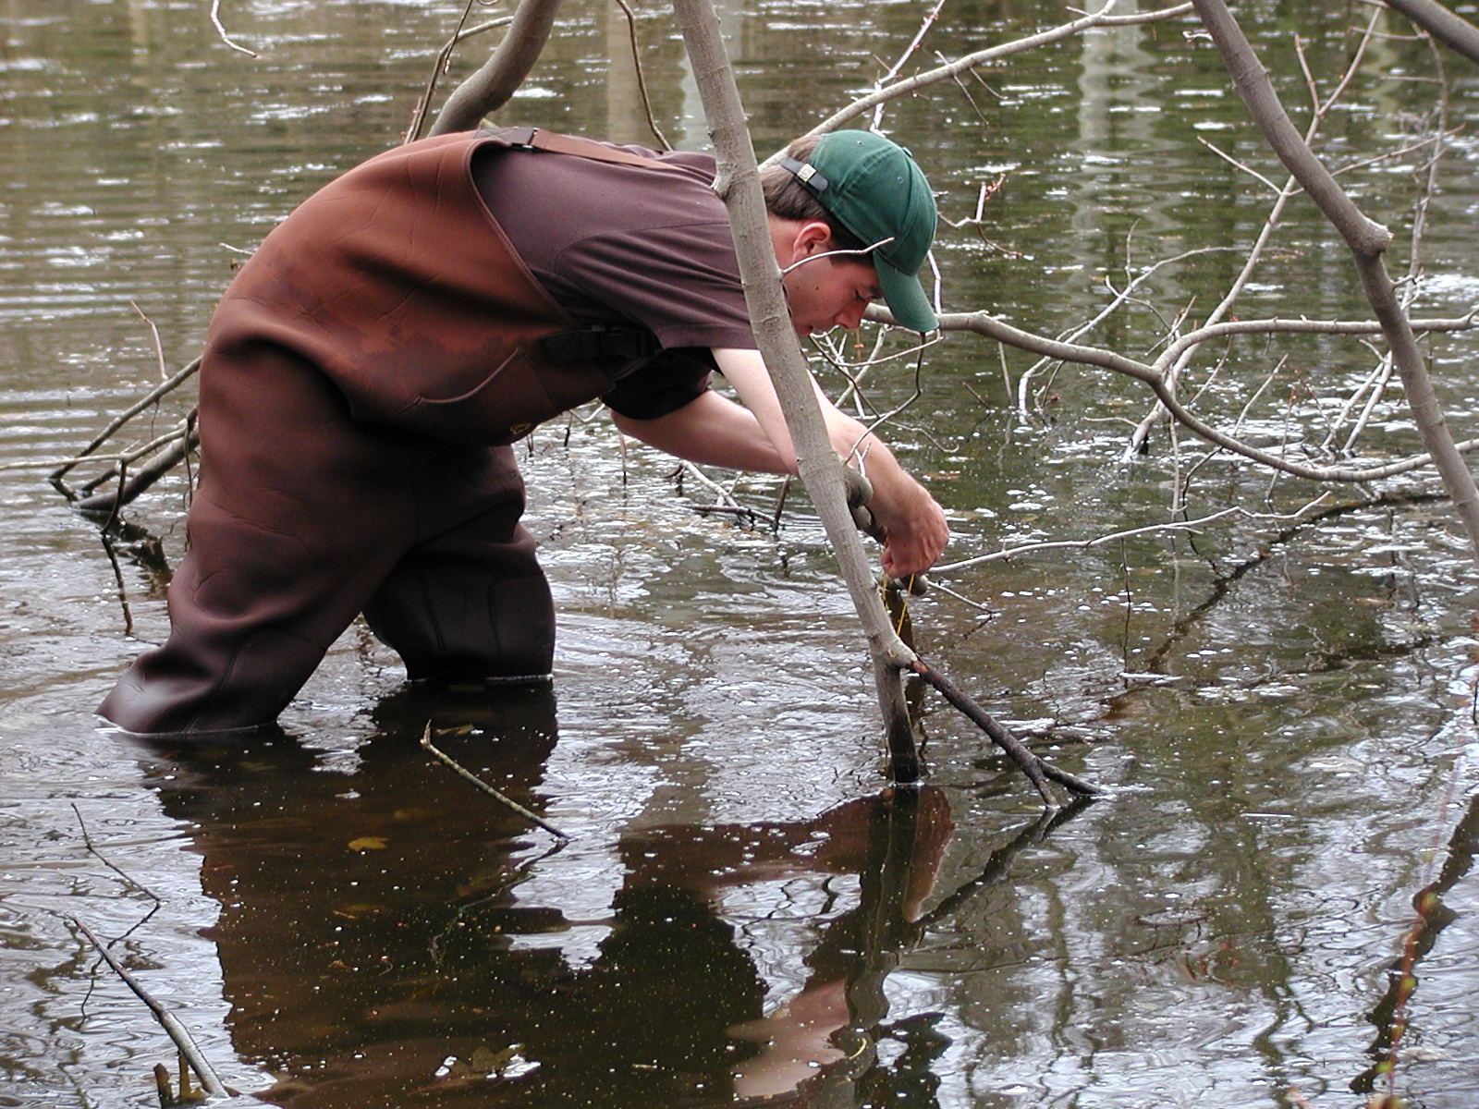
Reconnaissance
Notes:
Field work to develop a biodiversity planning layer.
It provides data and demonstrates the value of key habitats to local decision-makers.
There is a collateral educational component to this work.

Slide 20
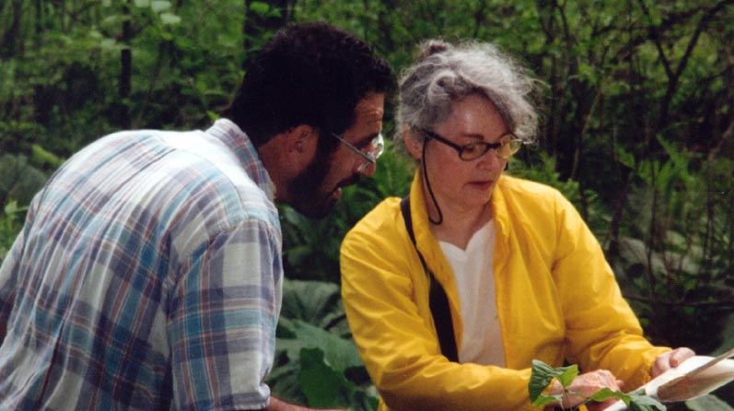
Awareness
Notes:
The complexity of these issues needs to become a commonly understood principle by those making decisions—education of this group is a priority—as is building a constituency for wildlife.

Slide 21
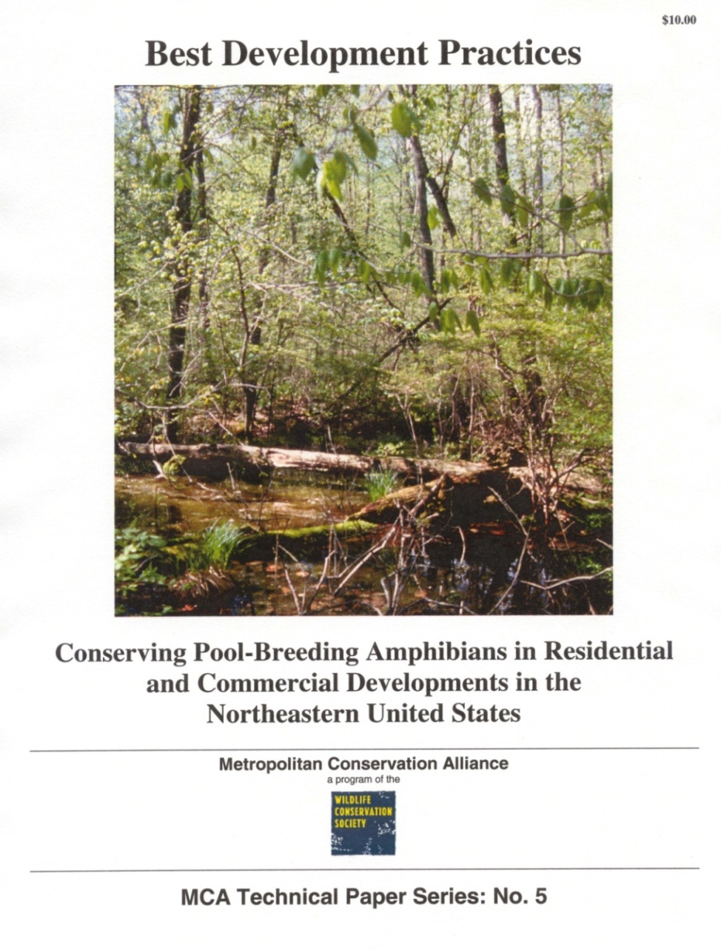
Integration
Notes:
Provide the big picture into which to fold smaller scale decisions into.
This begins to address the dissonance between the scale of decision-making and ecological scale.

Slide 22
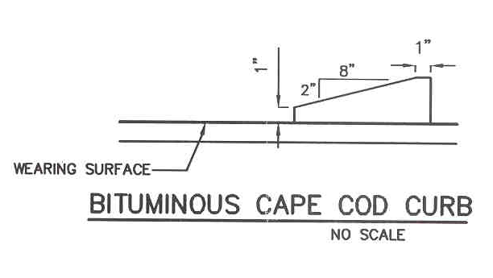
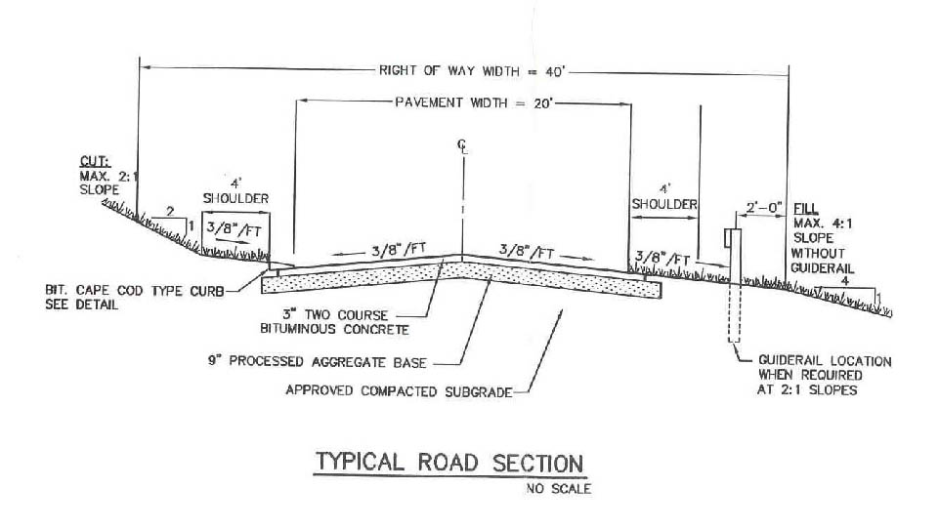
Design
Notes:
Provide actual blues and line drawings of eco-friendly infrastructure Such detail blocks can be readily imported into the plans that are being submitted for review and approved, or redrawn from the template provided The “Cape Cod Curb Detail” has been especially useful and has been replicated extensively.

Slide 23
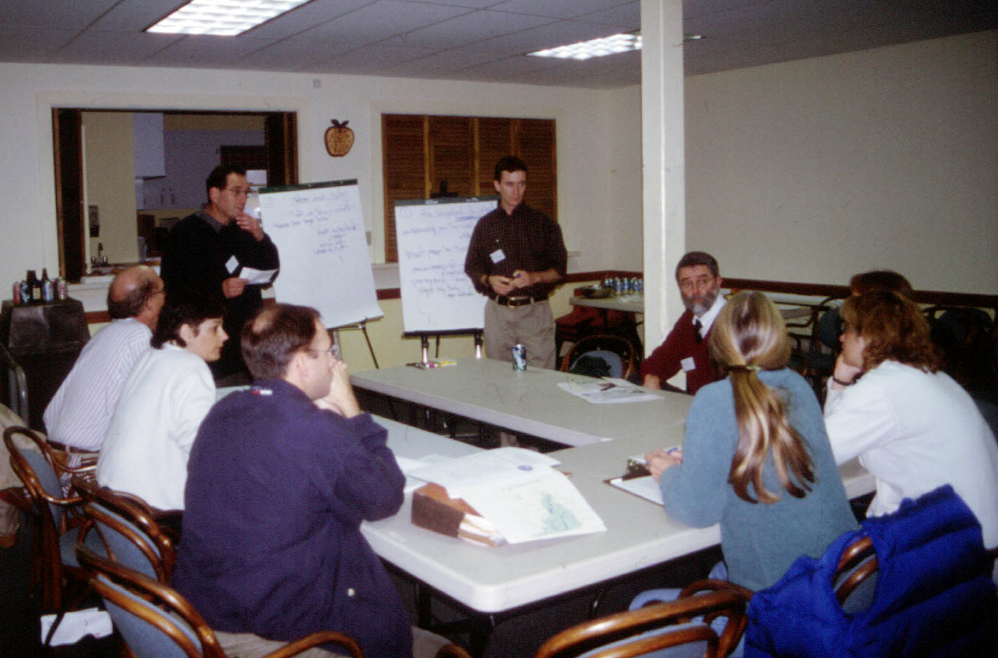
Empowerment
WCS/MCA Program Manager
Town Wetlands Enforcement Officer
WCS/MCA Director
Town First Selectman
Zoning Board Chair
Town Planning Board Chair
Conservation Commission Member
State Biologist
Town Attorney
Notes:
A key component of this is raises the technical competency of those making decisions, and to provide scientific information in formats that are accessible and intelligible, and that can be translated in land-use decisions and policies.

Slide 24
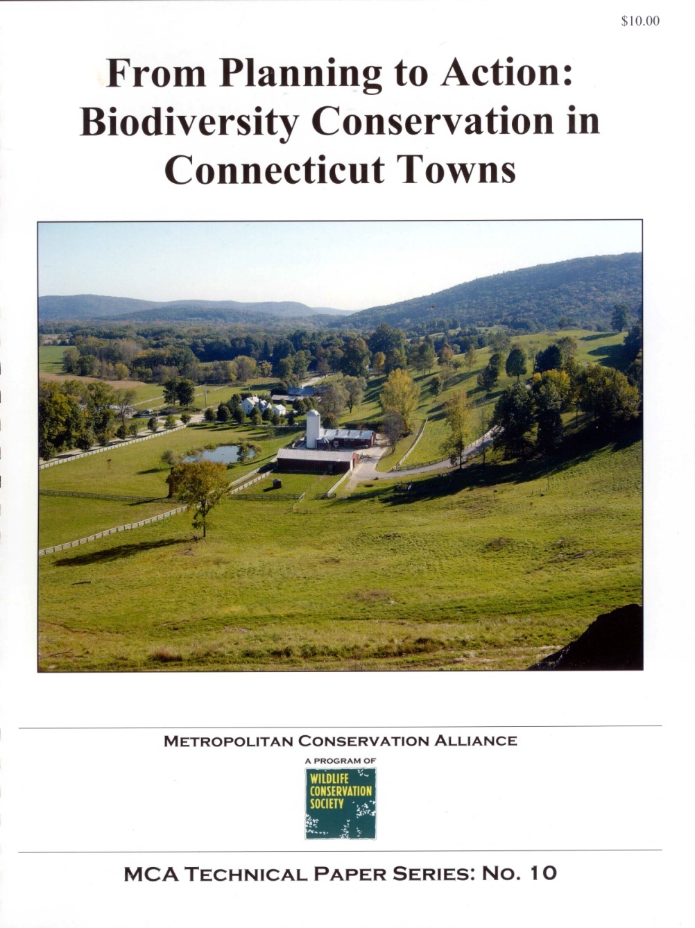
Redirection
Recipient American Planning Association’s 2007 award for “integrating complex ecological systems into local land use decision-making.”

Slide 25
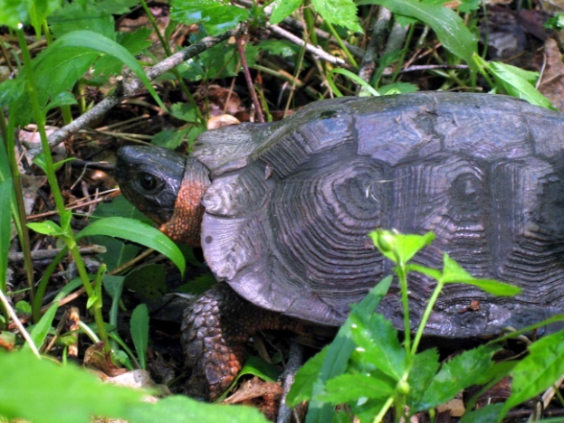
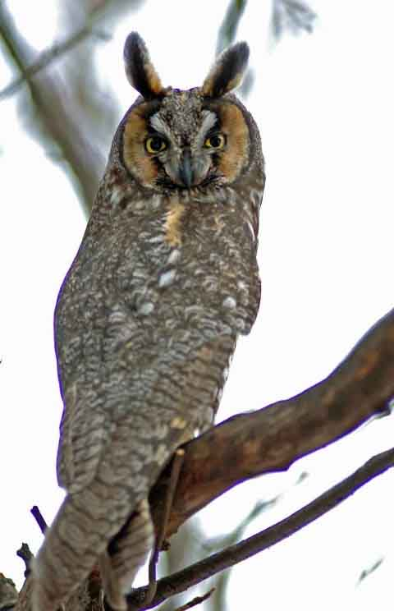
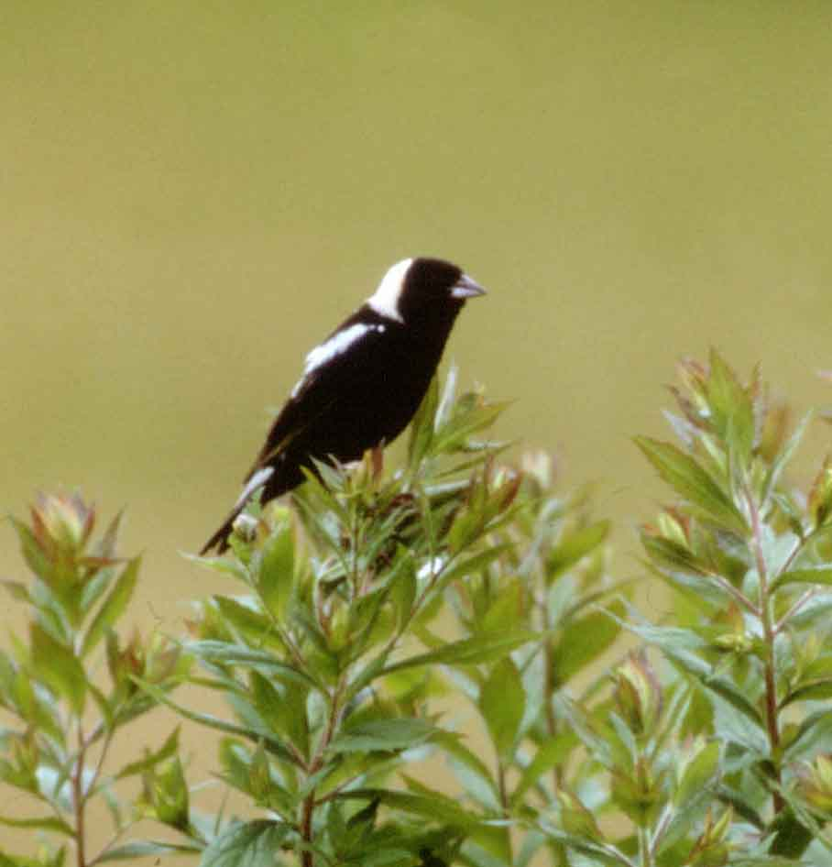
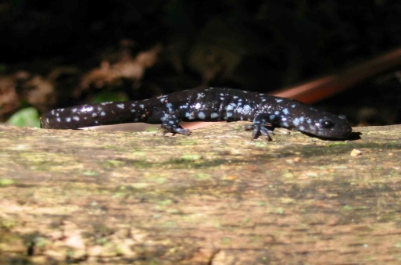
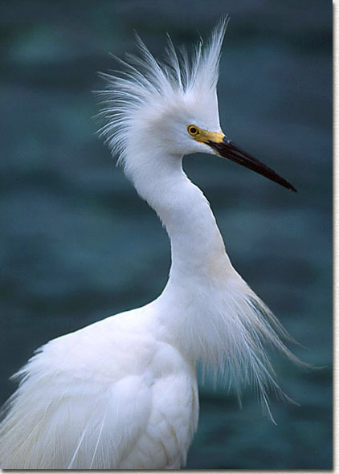
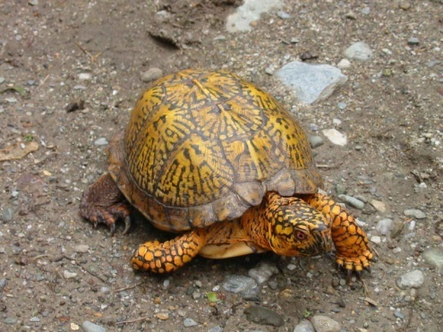
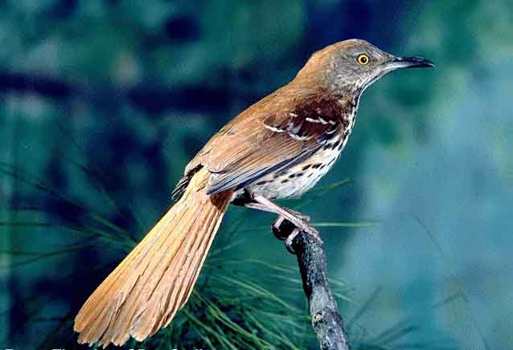
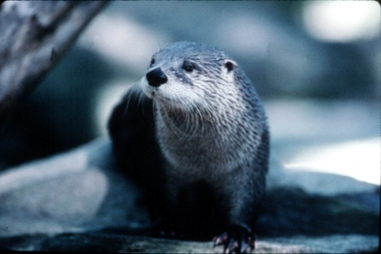
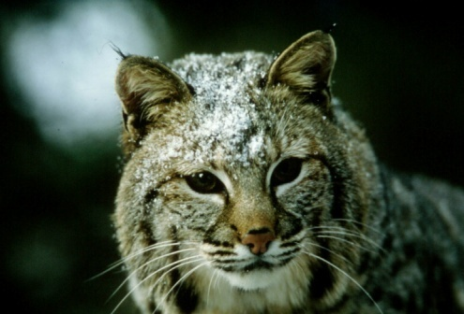
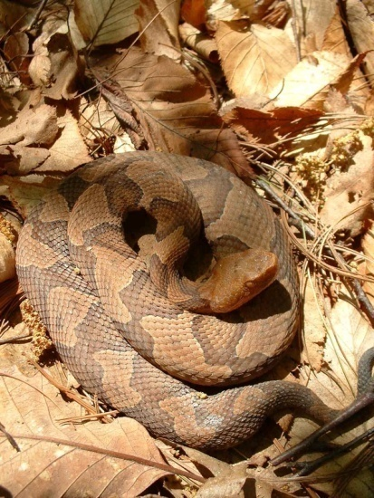
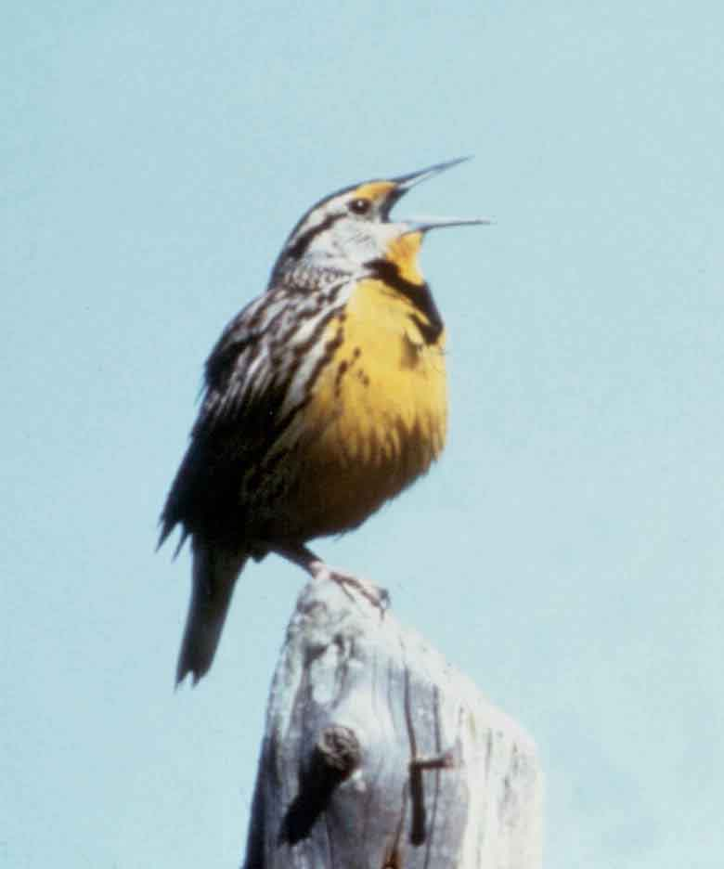
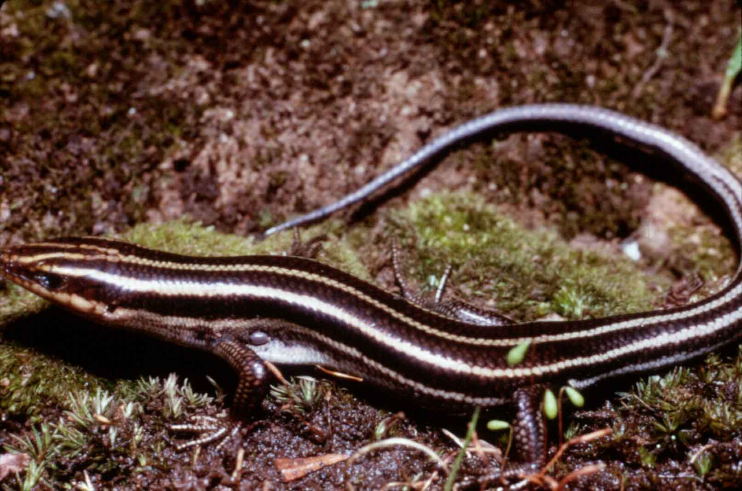
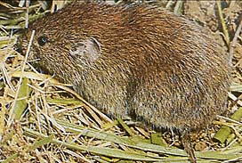
1. Does Biodiversity and Wildlife Protection Fall Within the Town’s Purview?

Slide 26
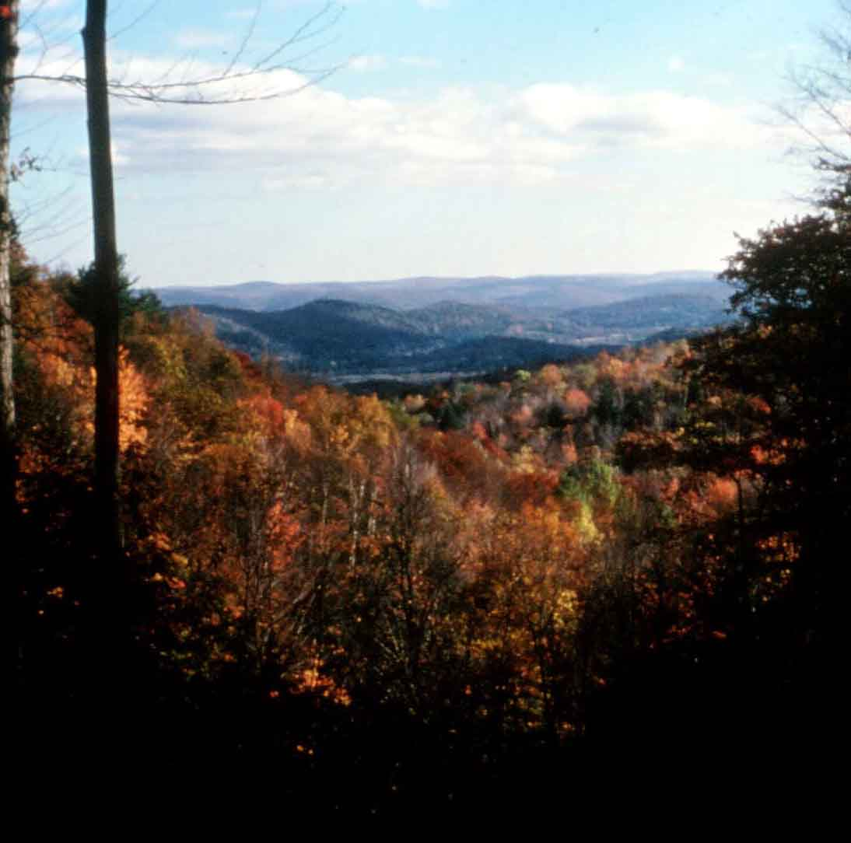
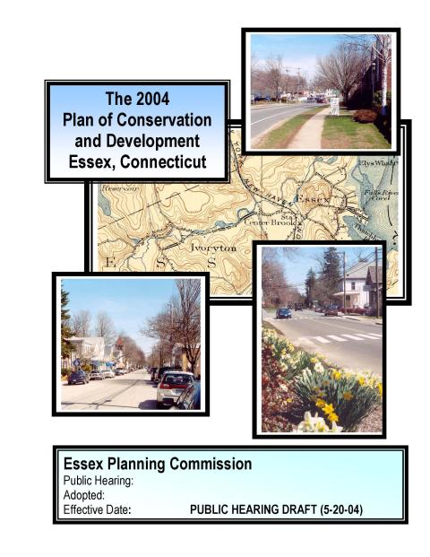
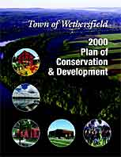
2. How Can a Town Plan at an Ecosystem Scale?

Slide 27
Vernal Pool
Red Maple Swamp
Red Maple Swamp
Sand Bank
Semi-Permanent Pond
Oak-Beech Forest
Notes:
And understand how regulations fail to protect biological complexity and diversity.
This is done by creating build-out scenarios that demonstrate the disconnect between biological complexity and regulatory mandates.

Slide 28
Vernal Pool
Red Maple Swamp
Red Maple Swamp
Sand Bank
Semi-Permanent Pond
Oak-Beech Forest

Slide 29
Vernal Pool
Red Maple Swamp
Red Maple Swamp
Sand Bank
Semi-Permanent Pond
Oak-Beech Forest

Slide 30
The Farmington Valley Biodiversity Project

Slide 31
3. Is Up-Zoning an Appropriate Tool to Protect Natural Resources?

Slide 32
4. Is There a Cookbook Formula to Address Biodiversity Issues?

Slide 33
5. Can Standards for Biological Review be Established?

Slide 34
6. Should a Land Use Agency Solely Rely on the Applicant’s Experts?

Slide 35
7. The Environment is Well-Protected by Regulations. Why Do We Need to Do More?

Slide 36
Notes:
Distances moved from wetlands by wildlife is a key issue…wildlife use is far greater and more extensive in upland habitats than areas set aside as water quality buffers

Slide 37
8. Is Mitigation a Prudent Way to Balance Environmental Protection with Development?

Slide 38
9. If a Town Restricts the Number of Lots, Isn’t That a Taking?

Slide 39
10. Can Regulatory Mandates Thwart Comprehensive Plan Goals?

Slide 40
11. How Can Permit Compliance be Improved and Monitored?
CONDITIONS FOR APPROVAL
Produce detailed native flora planting plans and submit to enforcement officer for approval...
Redesign curbs and catch-basins to make them wildlife-friendly...
Gather baseline data & create template for monitoring site...
Redesign stone walls to comply with historic district commission...
Update and refine grading and erosion control plan...
In coordination with town’s wildlife consultant, produce a wildlife management plan...
Submit for review by town council, a conservation easement plan...

Slide 41
12. How Can a Town Obtain Natural Resources Information for its Comprehensive Plan?

Slide 42
Biodiversity Conservation Checklist
Inventory and map natural resources. Establish priority areas for conservation focus. Include maps and language of intent in Plan of Conservation and Development (POCD). If appropriate, amend to incorporate results of studies and to articulate goals and policies.
Adopt cluster development in the POCD and in the Subdivision Regulations. Establish corresponding conservation requirements and standards.
Review, and amend as necessary, Inland Wetlands, Planning and Zoning and Subdivision Regulations to ensure that they align with the conservation policies and goals expressed in the POCD.

Slide 43
Biodiversity Conservation Checklist
Ensure that commission members are adequately trained and familiar with conservation and development objectives. When in doubt, seek advice from town counsel.
Establish and incorporate standards for the collection of natural resources data by applicants and environmental consultants to facilitate site design review by commissions.
Adopt an ordinance to fund and incorporate independent peer review as needed by commissions.

Slide 44
Biodiversity Conservation Checklist
Adopt a regulation providing for an optional, but recommended, pre-application review process for proposed projects.
Incorporate relevant BMP’s and BDP’s as tools for use by commissions to guide site design review and achieve conservation goals of ecosystem protection.
Provide adequate funding and staff time to effectively monitor permit compliance.
Engage landowners in priority conservation areas to promote ecology-friendly behaviors.

Slide 45
What Can YOU Do??

Slide 46
Educate your local decision-makers to the larger landscape-scale conservation issues.

Slide 47
Advocate for improved development employing a variety of innovative planning and engineering approaches.

Slide 48
Increase awareness that property ownership “rights” come hand in hand with obligations of stewardship of “the commons”.

Slide 49
We do have choices!
Notes:
Our region has two futures:
Do we allow sprawl to replicate across the landscape, destroying habitat and nature’s ability to stay connected, and in turn weakening the capacity of our natural systems to respond to environmental change?
OR
Do we return to our roots? Fostering smart growth, nodes of development—villages and towns—interspersed with fields, wetlands, and forests
maintaining our ecological connections by allowing plants and animals to move across the landscape, as they have for millennia.
Climate change is indeed a major challenge, but we can engage this challenge using innovative ideas and tools, building upon lessons of the past, to chart a more sustainable future for us all.

