Slide 1
Cisco Jabber
iPhone or iPod Device

Slide 2
Install Cisco Jabber
Go to App Store
Search for Cisco Jabber
Install App
Click OPEN
You will be prompted to allow certain permissions. It is recommended that you allow ALL of them.

Slide 3
Sign-In
Enter full Ramapo email address
Select Continue
Click ‘Continue’ if ‘Verify Certificate’ appears
Enter Ramapo password
Select Sign-In
Click ‘Continue’ if ‘Verify Certificate’ appears
Select OK to ‘Biometric authentication’ if you want to sign-in with fingerprint at next sign-in attempt. (optional)

Slide 4
Main Screen
Account Icon (upper left corner within circle)
Green dot within the circle states that your status is ‘Available’
Shows tabs for Contacts, Chats, Calls, Meetings, Voicemail at the bottom of the screen.

Slide 5
Contacts
To add a Contact, click on + in the upper right corner of the screen.
You will see the three options seen here.
Select ‘Add contacts’

Slide 6
Add a Contact

Slide 7
Type name, locate contact and select it. Press Done (upper right corner) to add contact or assign to a group.

Slide 8
Add Contact to a group
Click on ‘Assign to Group’.
If you have a specific group created and want to add a contact to the group, select the group and a blue checkmark will appear.
If you want to add a group, press + in the upper right corner and create a group name. The group will appear and the blue checkmark will appear next to it.

Slide 9
Add Contact to Favorites
Once your contacts are in, you can add them to your Favorites list.
Click on the Contacts tab at the bottom of the screen and select Favorites at the top.
Press Add Favorites at the bottom of the screen.
Search for and select the contact you want to add.

Slide 10
Chats
To start a chat, you can either click on an existing chat or press the blue chat bubble in the upper right corner.
Once you press the chat bubble, you can either select a contact that already exists or type the person you want to chat with in the search box.
When it comes up, select the name and press Done in the upper right corner to start your chat. If you want to add multiple people to a chat, keep adding them to the search box. The number in parenthesis next to Done shows the number of people in that chat message. To leave or end the group chat, press the person icon in the upper right and choose Leave Group Chat.

Slide 11
Type the contact’s name, select it and click on Done.

Slide 12
You can also create a group chat by selecting more than one contact. The total number of members will appear to the right of Done. At LEAST ONE of those contacts MUST be Available or the chat session will fail. Press Done to start chat.

Slide 13
Start Chatting
Type you message in the box at the bottom and click the arrow to send.
You will notice that this particular contact is ‘offline’ therefore she will not see the message until she signs in. If the status shows ‘Available’, then she may respond.

Slide 14
Calls
Any calls made or received while the app is open will appear here.
Missed calls will also appear under the ‘Missed’ tab.
To make a call, press the Keypad tab and enter the digits the same way you would normally; 4 digits for an extension or 9-1-xxx-xxx-xxxx for an off campus number. Press the green phone icon to make the call. Press the red X icon to hang up.
You MUST REMAIN SIGNED IN in order to receive calls through Jabber. The app does not have to remain open. It will function in the background. When a call comes through, the phone will ring and you can ‘Answer’ or ‘Decline’ the call.

Slide 15
Meetings
Your calendar events and meetings will appear here. If you see a message on your screen that states your meetings cannot been shown, it means you need to allow calendar permissions. If you click on the message, it should prompt you to allow it.

Slide 16
Voicemail This tab is where you will find your voicemails. If there is a new message, you will see the red circle icon on the voicemail tab. To listen to the message, click on it and press the play icon.

Slide 17
Forwarding Voicemail To forward the voicemail, press the message. Select ‘More’ and then choose ‘Forward Voice Message’. Type in the name of the person(s) you want to forward to and select it from the list. You can then click on the ‘Attach your voice message’ icon to record an instruction message and then press Send in the upper right corner to send it.

Slide 18
Account Settings
Click on the circle icon in the upper left corner.
To change your status, click on the current status and choose from one of the options.
To adjust settings, click on ‘Settings’. The most popular setting is Call Forwarding. You can set call forwarding for your extension by selecting Call Forwarding, click on ‘new number’, enter a four digit extension or 91xxxxxxxxxx then click Done. To remove forwarding, follow the same steps and select ‘Do not forward calls’.
Click SIGN OUT to sign out of Jabber and stop receiving calls through the app.

Slide 19
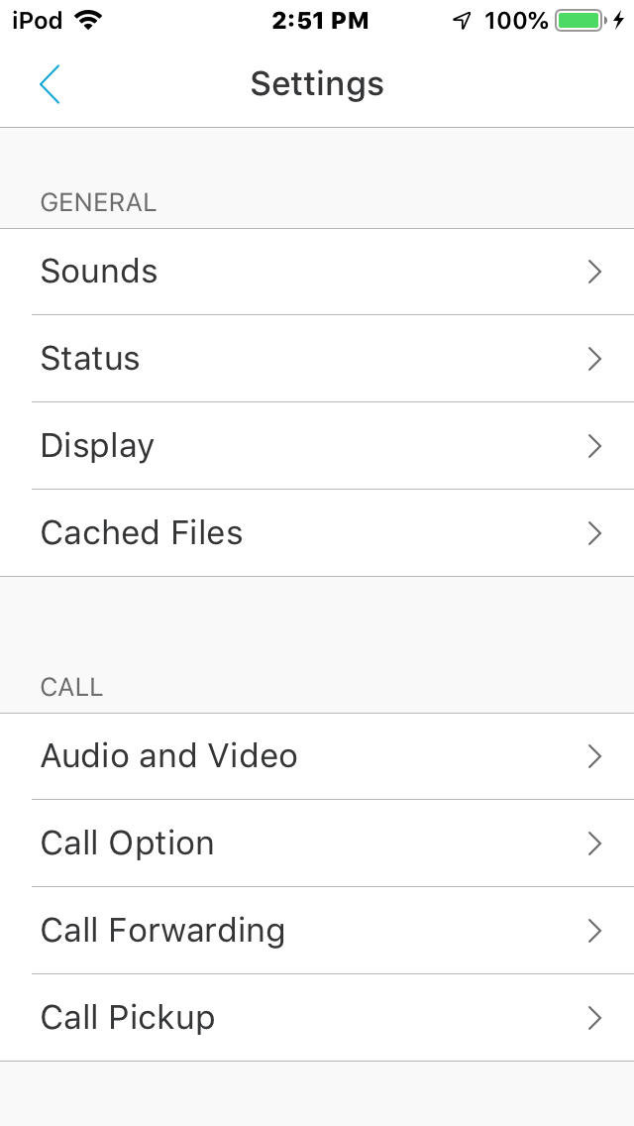
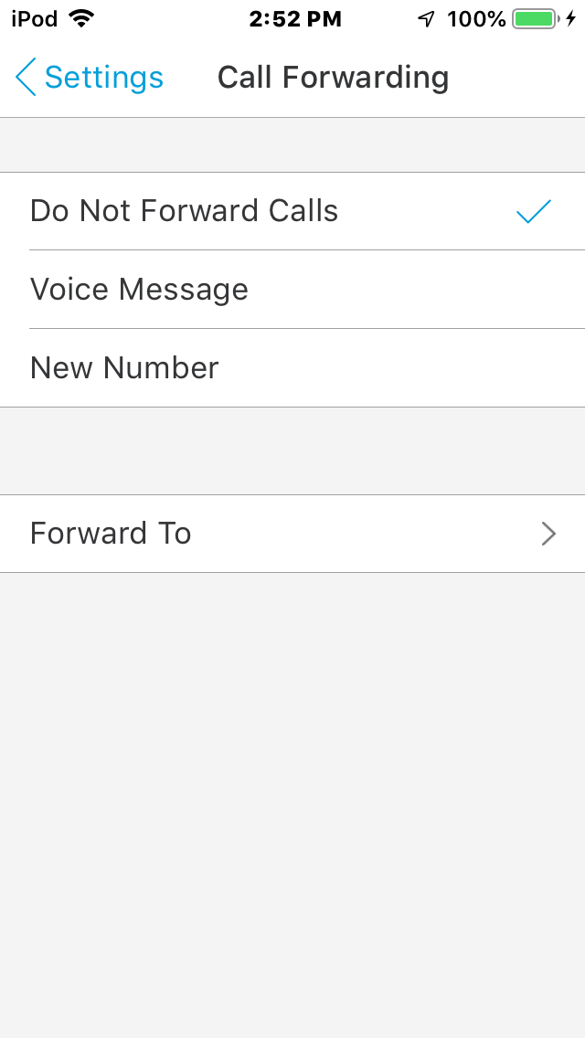
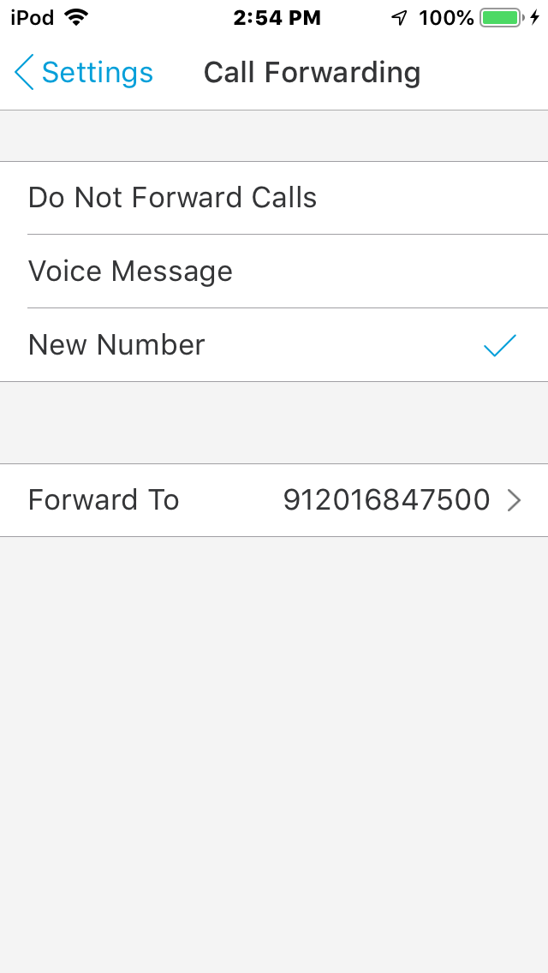
Step 2
Step 4
Step 3
Step 1

