Slide 1
Cisco Jabber
Windows PC or Laptop

Slide 2
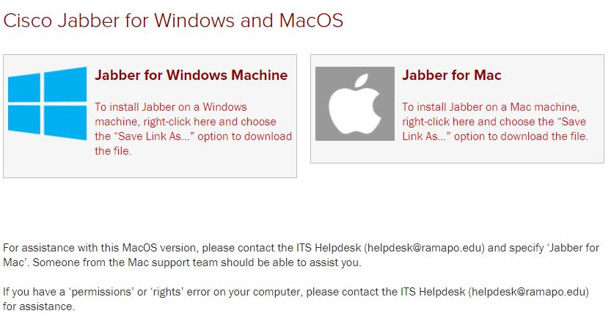
Install Cisco Jabber
Go to the Telecomm website
https://www.ramapo.edu/its/telecomm/downloads/
Right click on Jabber for Windows Machine and choose “Save Link As”
Go to your Downloads folder and open the file to download it.
If you have a ‘permissions’ or ‘rights’ error on your computer, please contact the ITS Helpdesk (helpdesk@ramapo.edu) for assistance.
Once it downloads, open it (It should appear at the bottom of your screen).
As it installs, you may be prompted to allow certain permissions. It is recommended that you allow ALL of them.

Slide 3
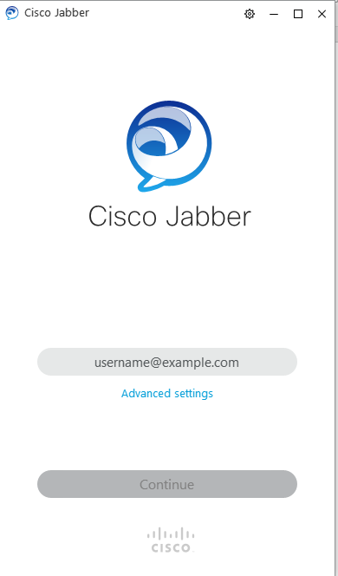
Sign-In
Enter full Ramapo email address
Select Continue
Click ‘Continue’ if ‘Verify Certificate’ appears
Enter Ramapo password
Select Sign-In
Click ‘Continue’ if ‘Verify Certificate’ appears

Slide 4
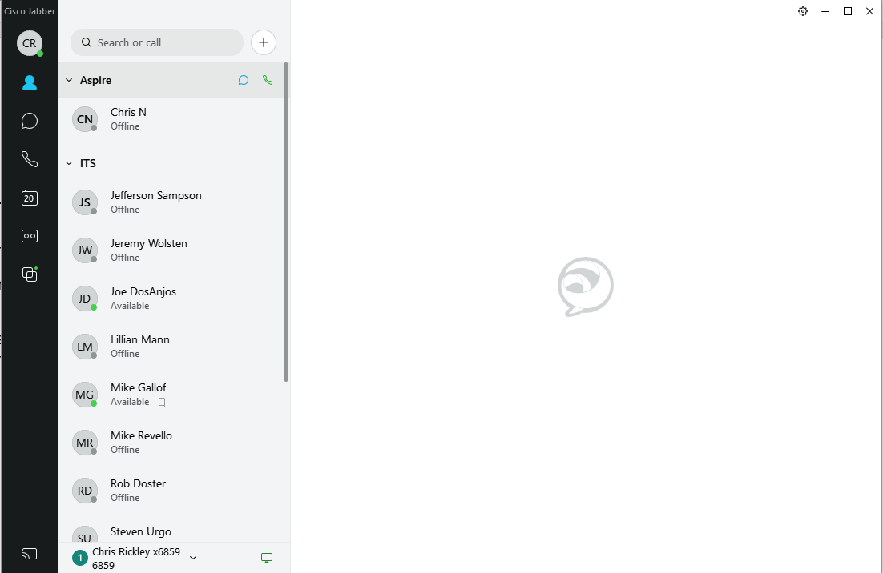
Main Screen
Account Icon (upper left corner within circle)
Green dot within the circle states that your status is ‘Available’
Shows icons for Contacts, Chats, Calls, Meetings, Voicemail on the left side of the screen.

Slide 5
Contacts
To add a Contact, type the name into the search box.
Double click on the name or hit the enter key to select it.

Slide 6
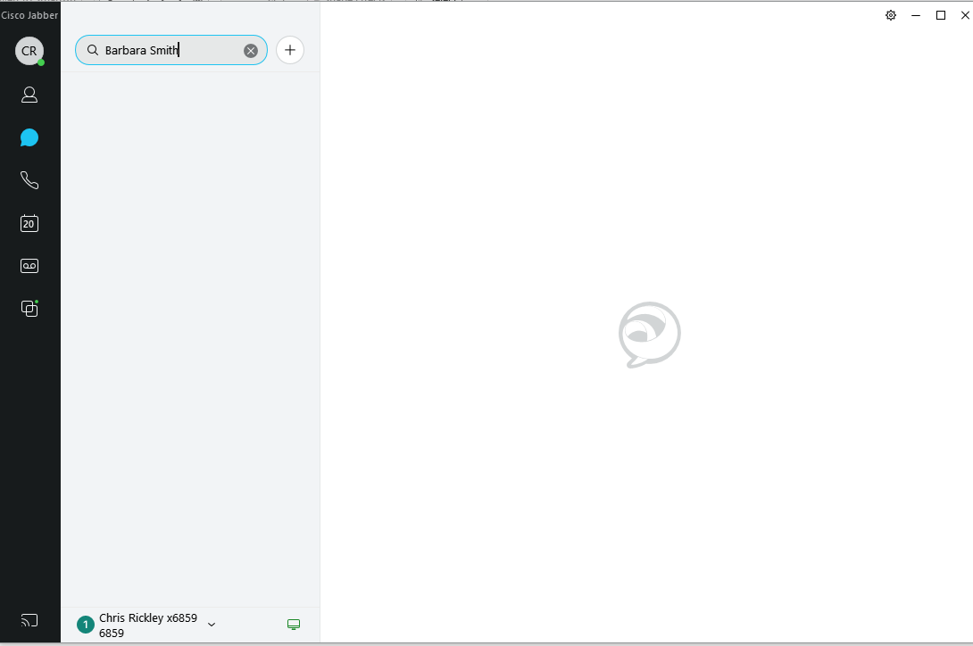
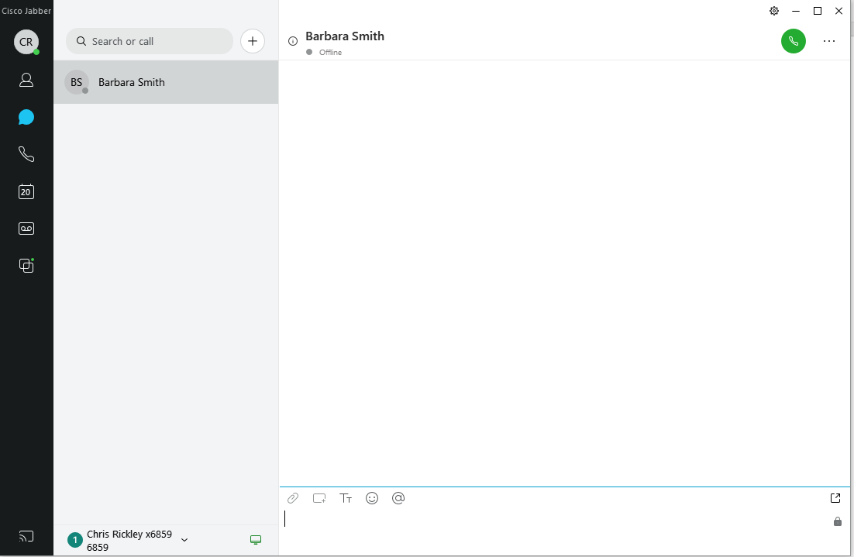

Slide 7
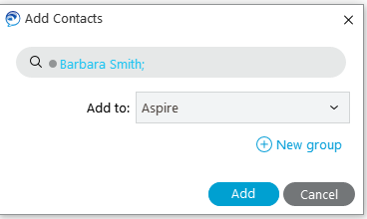
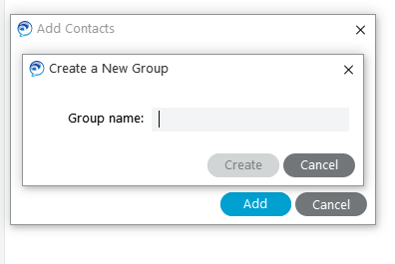
Add Contact to a group
1. Click on the three dots…
2. Click on the person icon shown below…
4. Enter name for New Group if selected then click on Create, then Add…
3. Use dropdown to select an existing group then click on Add or click on New Group…

Slide 8
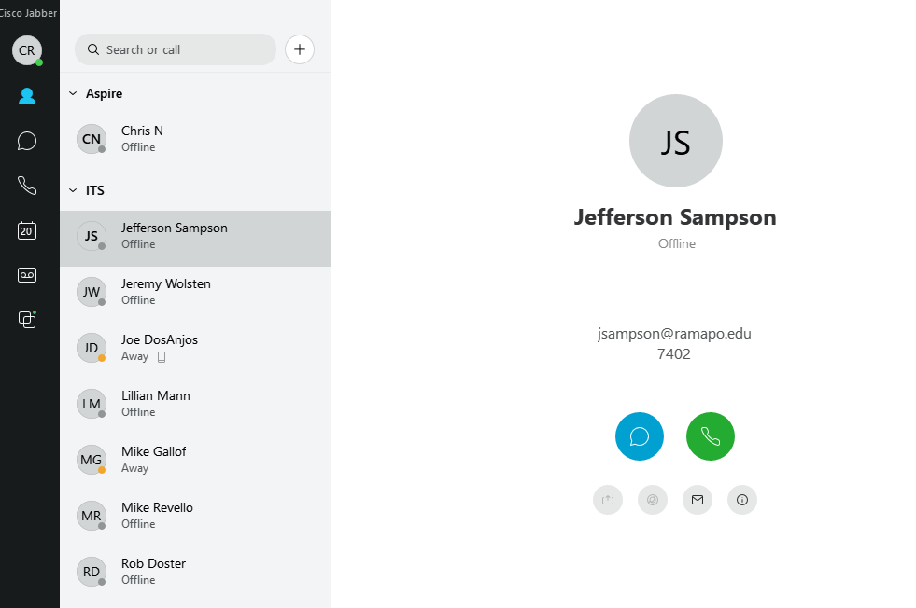
Chats
To start a chat, you can either select a contact that already exists and click on the blue chat icon or you can click on the chat icon in the menu on the left and search for someone.

Slide 9
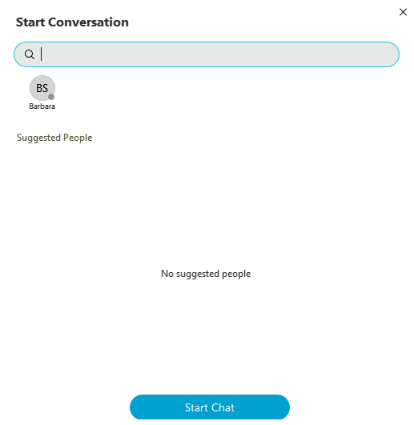
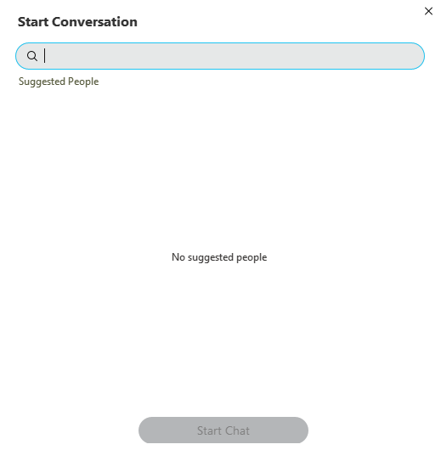
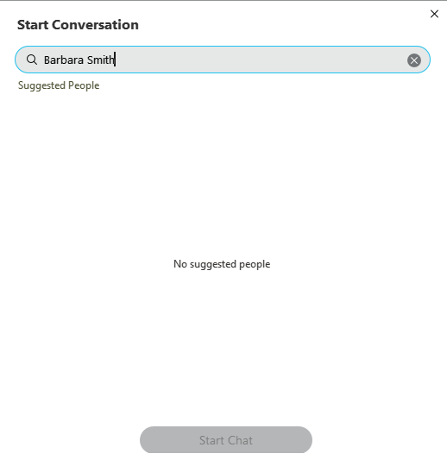
Start a Chat – press +, type name, double click on it to select it, click Start Chat.

Slide 10
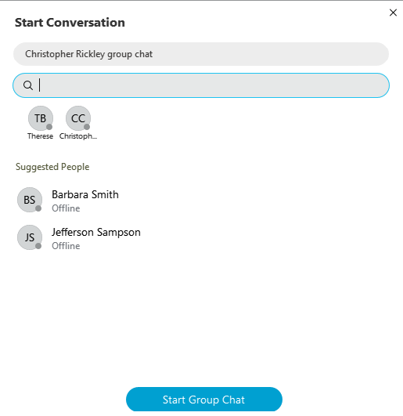
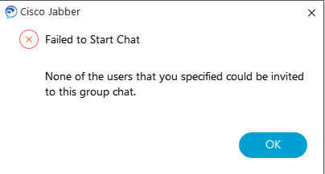
You can also create a group chat by selecting more than one contact. At LEAST ONE of those contacts MUST be Available or the chat session will fail. Press Start Group Chat to start chat.

Slide 11
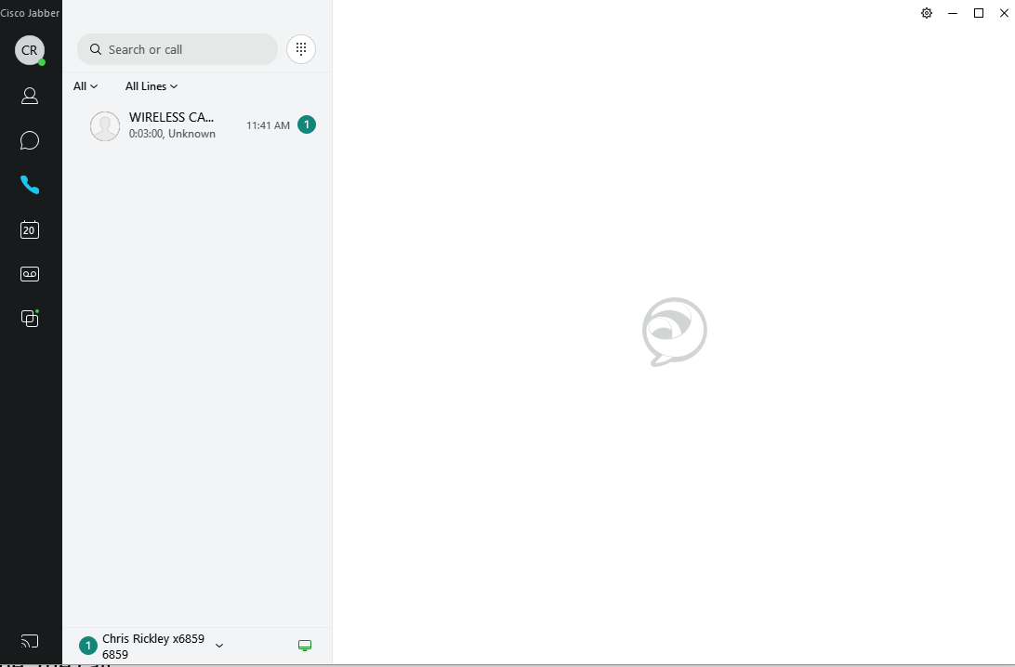
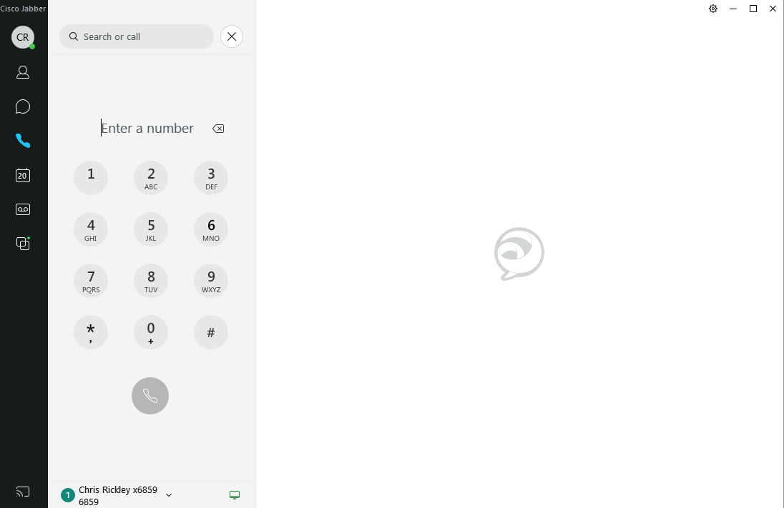
Calls
Any calls made or received while the app is open will appear here.
To view a particular type of call; missed, incoming, etc. click on the ‘All’ dropdown and select the type.
To make a call, press the keypad icon and enter the digits the same way you would normally; 4 digits for an extension or 9-1-xxx-xxx-xxxx for an off campus number.
You MUST REMAIN SIGNED IN in order to receive calls through Jabber. The app does not have to remain open. It will function in the background. When a call comes through, the phone will ring and you can ‘Answer’ or ‘Decline’ the call.

Slide 12
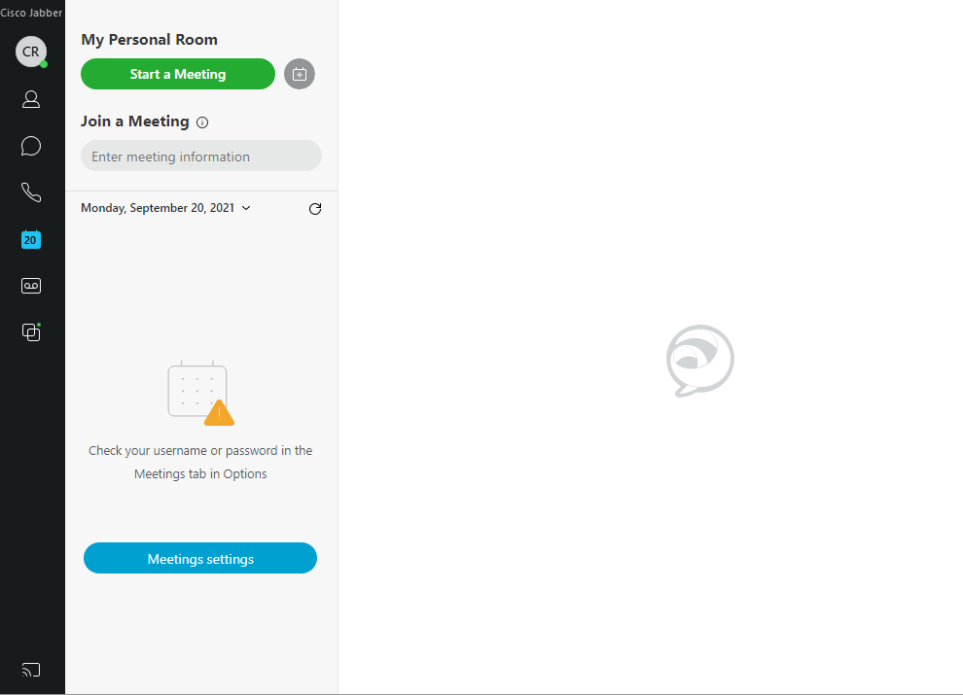
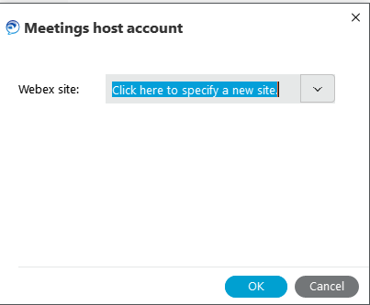
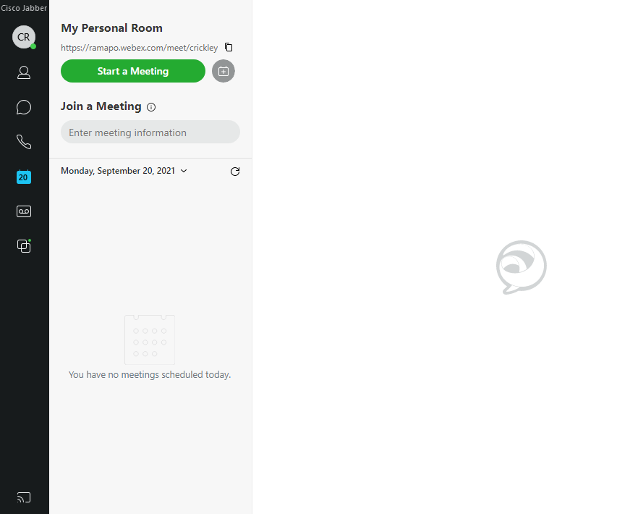
Meetings
Your calendar events and meetings will appear here. If you see an error message on your screen that states your meetings cannot been shown, click on Meeting Settings.
Click on Meetings at the left and then Set up account.
When the Meetings host account window pops up, enter webex.ramapo.com and then enter your email address and password at the Webex login prompts.
Any scheduled meetings should now appear in the meetings section.

Slide 13
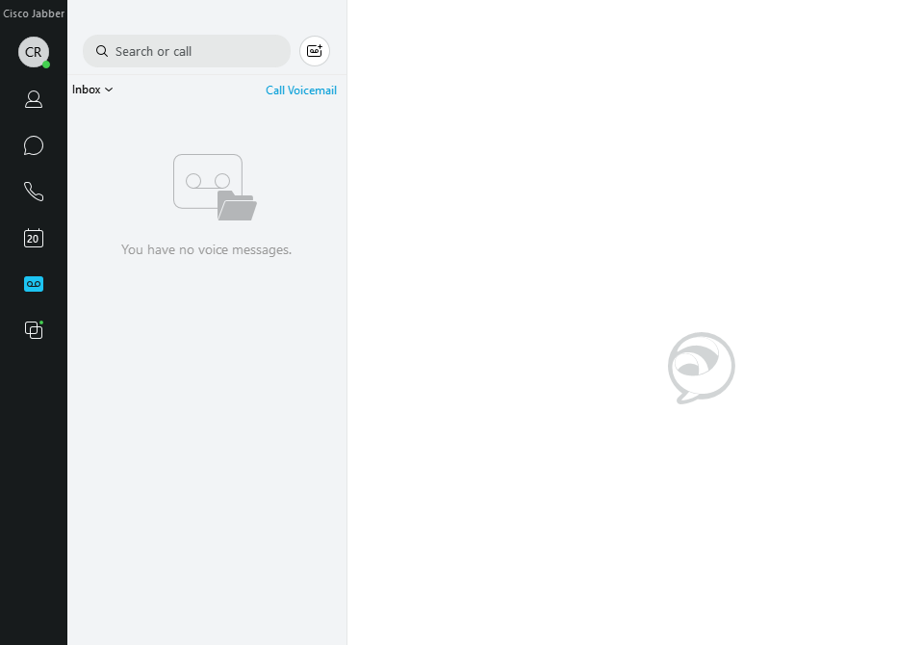
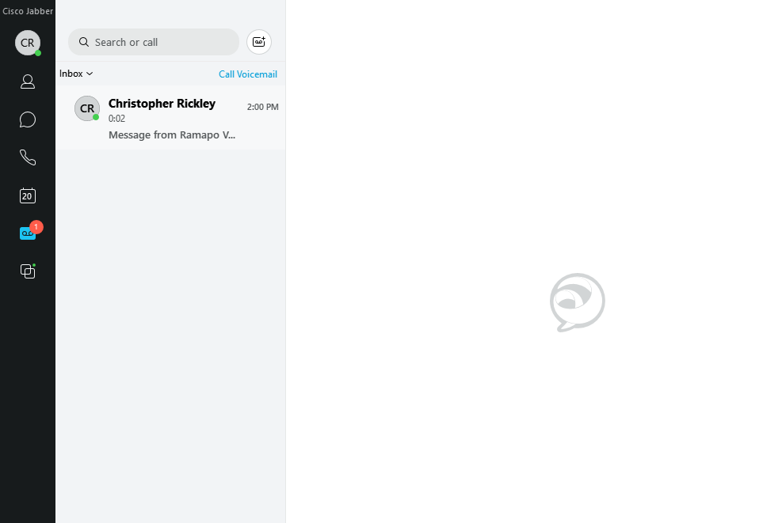
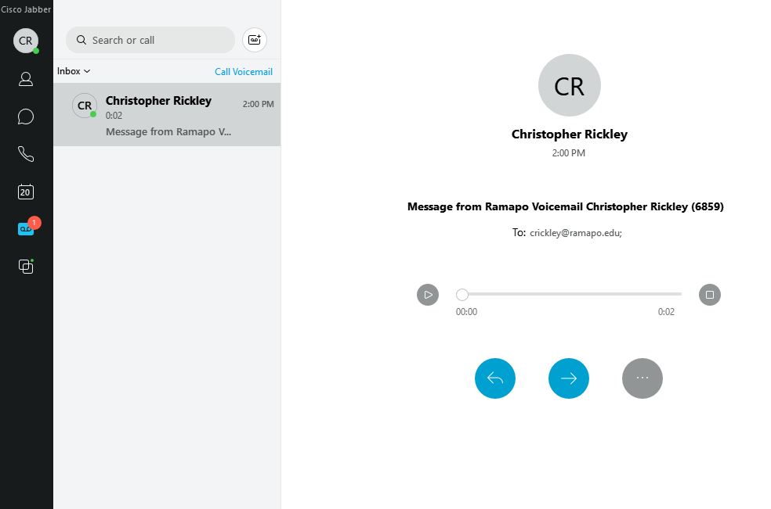
Voicemail This tab is where you will find your voicemails. If there is a new message, you will see the red circle icon on the voicemail tab. To listen to the message, click on it and press the play icon.

Slide 14
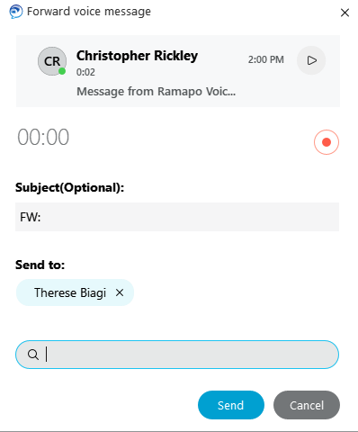
Forwarding Voicemail To forward the voicemail, press the message. Press the blue right arrow icon. Type in the last name of the person you want to forward to, select it from the list, hit Enter. You can then click on the red record button to record an instruction message, add a Subject and then press Send to send it.

Slide 15
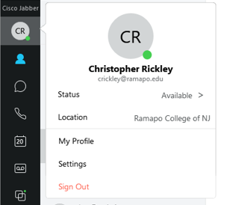
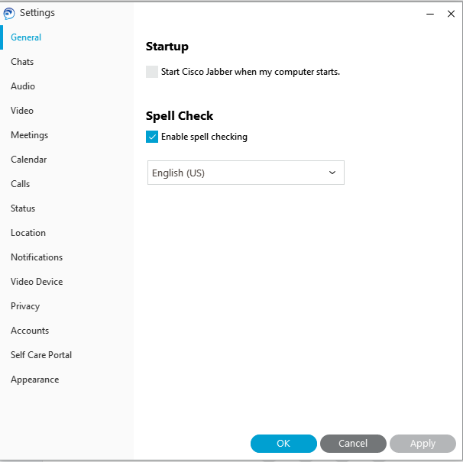
Account Settings
Click on the circle icon in the upper left corner.
To change your status, click on the current status and choose from one of the options.
To adjust settings, click on ‘Settings’. The most popular setting is Call Forwarding. You can set call forwarding for your extension by selecting Call Forwarding, click on ‘new number’, enter a four digit extension or 91xxxxxxxxxx then click Save. To remove forwarding, follow the same steps and select ‘Do not forward calls’.
Click SIGN OUT to sign out of Jabber an stop receiving calls through the app.

Slide 16
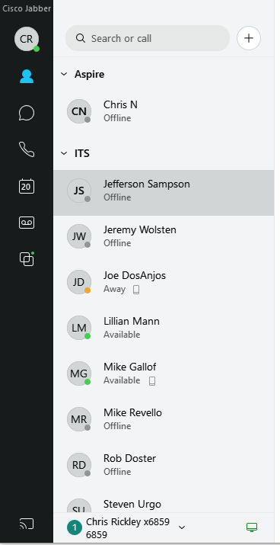
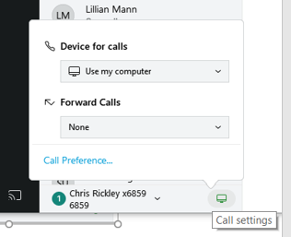
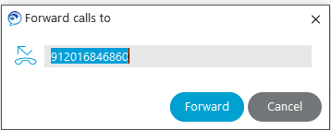
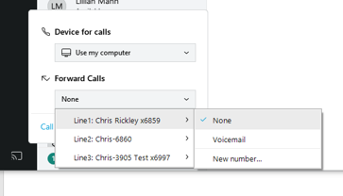
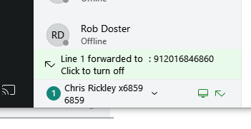
Call Forwarding Process…Step 1, click on phone control icon. Step 2, click down arrow under Forward Calls. Step 3, choose line to forward. Step 4, select Voicemail or New Number. Step 5, enter forwarding number. Step 6, click on Forward.
Step 5
Step 2
Step 6 -->
End Result!
Step 3
Step 1
Step 4

