Slide 1
Cisco Jabber
Android Device

Slide 2
Install Cisco Jabber
Go to Play Store
Search for Cisco Jabber
Install App
Click OPEN
You will be prompted to allow certain permissions. It is recommended that you allow ALL of them.

Slide 3
Sign-In
Enter full Ramapo email address
Select Continue
Click ‘Continue’ if ‘Verify Certificate’ appears
Enter Ramapo password
Select Sign-In
Click ‘Continue’ if ‘Verify Certificate’ appears
Select OK to ‘Biometric authentication’ if you want to sign-in with fingerprint at next sign-in attempt. (optional)

Slide 4
Main Screen
Account Icon (upper left corner within circle)
Green dot within the circle states that your status is ‘Available’
Shows tabs for Contacts, Chats, Calls, Meetings, Voicemail at the bottom of the screen.

Slide 5
Contacts
To add a Contact, click on +
You will see the three options seen here.
Select ‘Add contacts’

Slide 6
Add a Contact

Slide 7
Type name, locate contact and select it. Press the blue checkmark (upper right corner) to add contact or assign to a group.

Slide 8
Add Contact to a group
If you have no groups, you should see ‘Add new group’ under ‘Assign to group’. If so, click on it, create a name for the group and click on Save.
If you have a group created and want to add a contact to the group, select the dropdown arrow, locate the group and select it.
Click on the blue checkmark in the upper right corner to add the contact.
Once your contacts are in, you can add them to your Favorites list by pressing the + button, choose ‘Add favorites’ and select the contact(s) to add. Click on the blue checkmark to save.

Slide 9
Chats
To start a chat, you can either select a contact that already exists or press the clue chat icon.

Slide 10
Type the contact’s name, select it and click on the blue checkmark.

Slide 11
You can also create a group chat by selecting more than one contact. At LEAST ONE of those contacts MUST be Available or the chat session will fail. Press the blue checkmark to start chat.

Slide 12
Start Chatting
Type you message in the box at the bottom and click the arrow to send.
You will notice that this particular contact is ‘offline’ therefore she will not see the message until she signs in. If the status shows ‘Available’, then she may respond.

Slide 13
Calls
Any calls made or received while the app is open will appear here.
Missed calls will also appear under the ‘Missed’ tab.
To make a call, press the keypad icon and enter the digits the same way you would normally; 4 digits for an extension or 9-1-xxx-xxx-xxxx for an off campus number.
You MUST REMAIN SIGNED IN in order to receive calls through Jabber. The app does not have to remain open. It will function in the background. When a call comes through, the phone will ring and you can ‘Answer’ or ‘Decline’ the call.

Slide 14
Meetings
Your calendar events and meetings will appear here. If you see a message on your screen that states your meetings cannot been shown, it means you need to allow calendar permissions. If you click on the message, it should prompt you to allow it.

Slide 15
Voicemail This tab is where you will find your voicemails. If there is a new message, you will see the red circle icon on the voicemail tab. To listen to the message, press the play icon.

Slide 16
Forwarding Voicemail To forward the voicemail, press the message. Select ‘Forward’. Type in the name of the person you want to forward to and select it from the list. You can then click on the ‘Add your voice message’ icon to record an instruction message and then press the arrow in the upper right corner to send it.

Slide 17
Account Settings
Click on the circle icon in the upper left corner.
To change your status, click on the current status and choose from one of the options.
To adjust settings, click on ‘Settings’. The most popular setting is Call Forwarding. You can set call forwarding for your extension by selecting Call Forwarding, click on ‘new number’, enter a four digit extension or 91xxxxxxxxxx then click Save. To remove forwarding, follow the same steps and select ‘Do not forward calls’.
Click SIGN OUT to sign out of Jabber an stop receiving calls through the app.

Slide 18
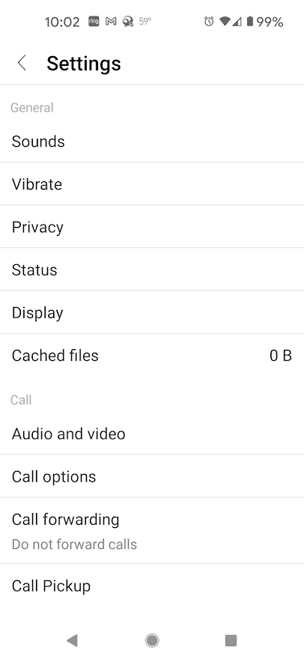
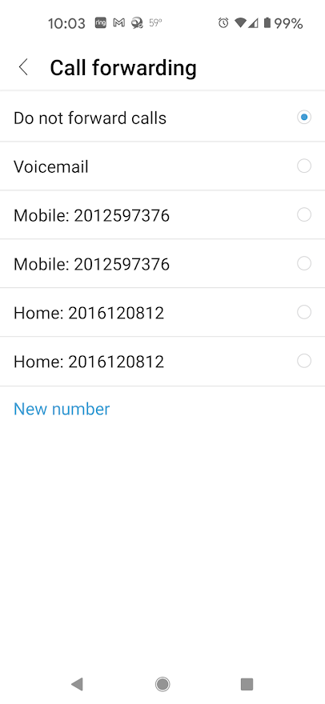
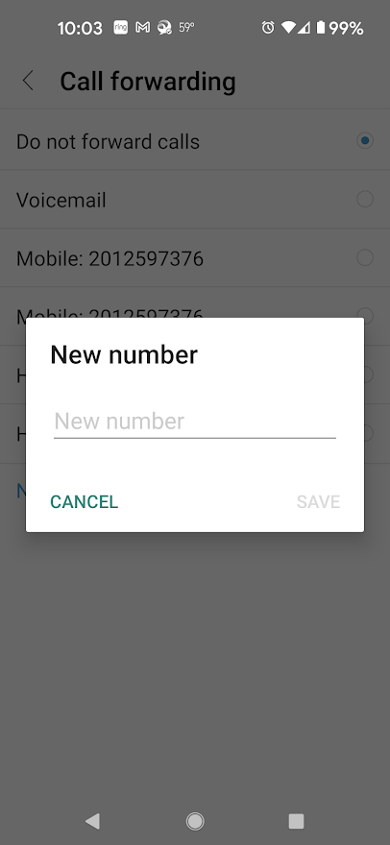
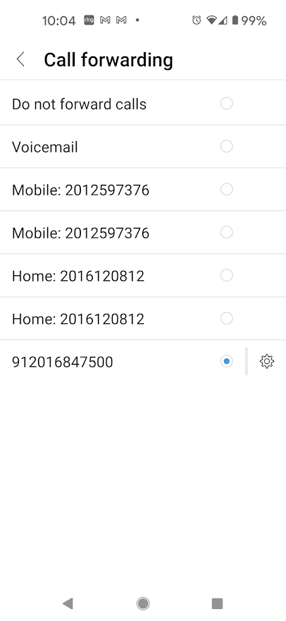
Step 3
Step 2
Step 4
Step 1

