Slide 1
K! Canvas LTI End User Instructions
November 2024

Slide 2
Great news - Kahoot! EDU now supports Canvas LTI!
Kahoot! now supports the LTI 1.3 Advantage specification, supporting deep linking and resource launching.

Slide 3
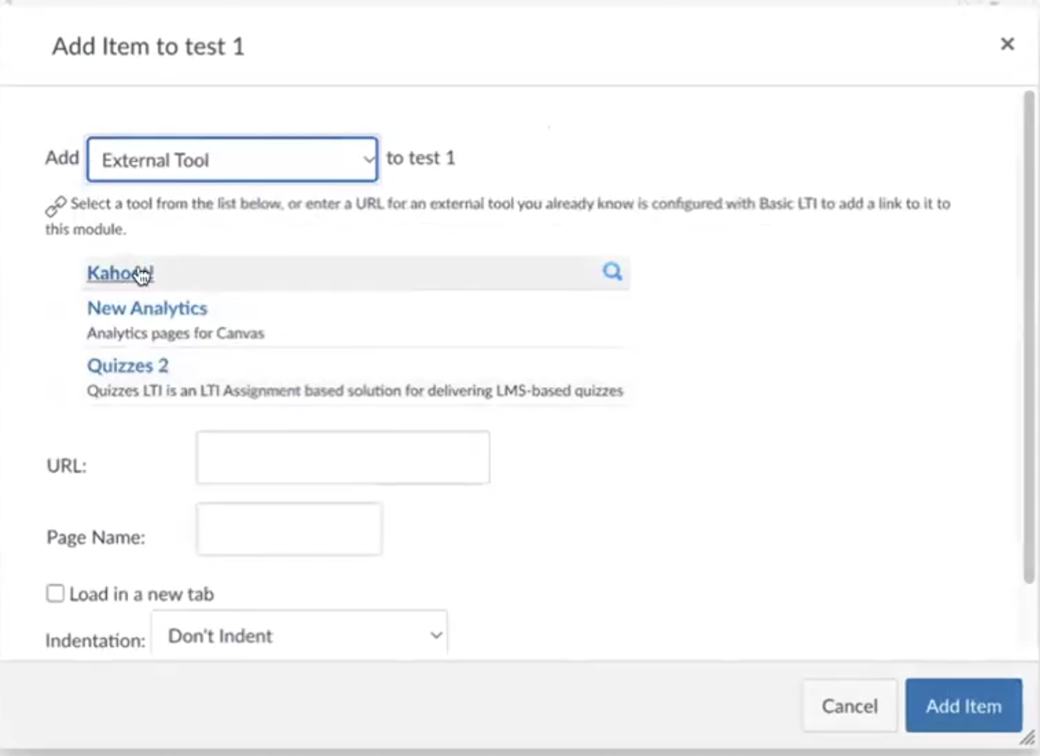
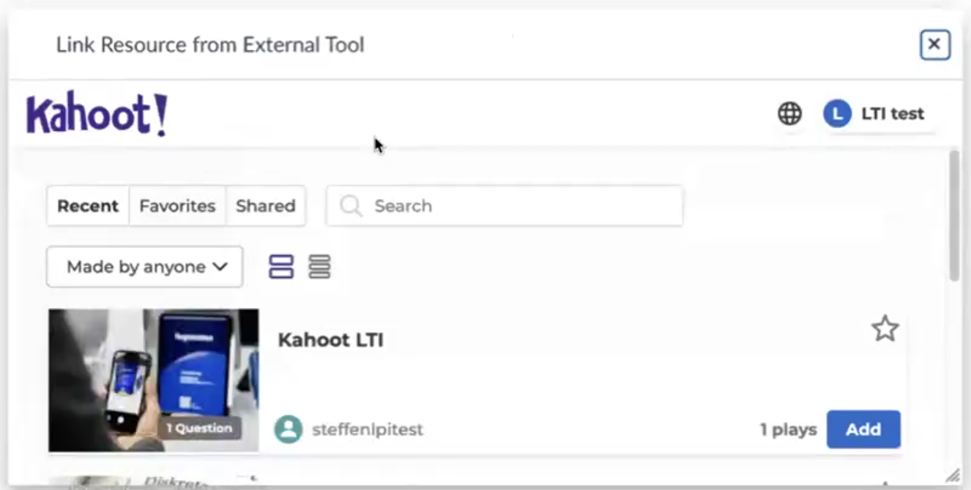
Kahoot! now appears as a dropdown option when you add an External Tool to a module.
*Please note that this must be done within a module, not under Assignments.

Slide 4
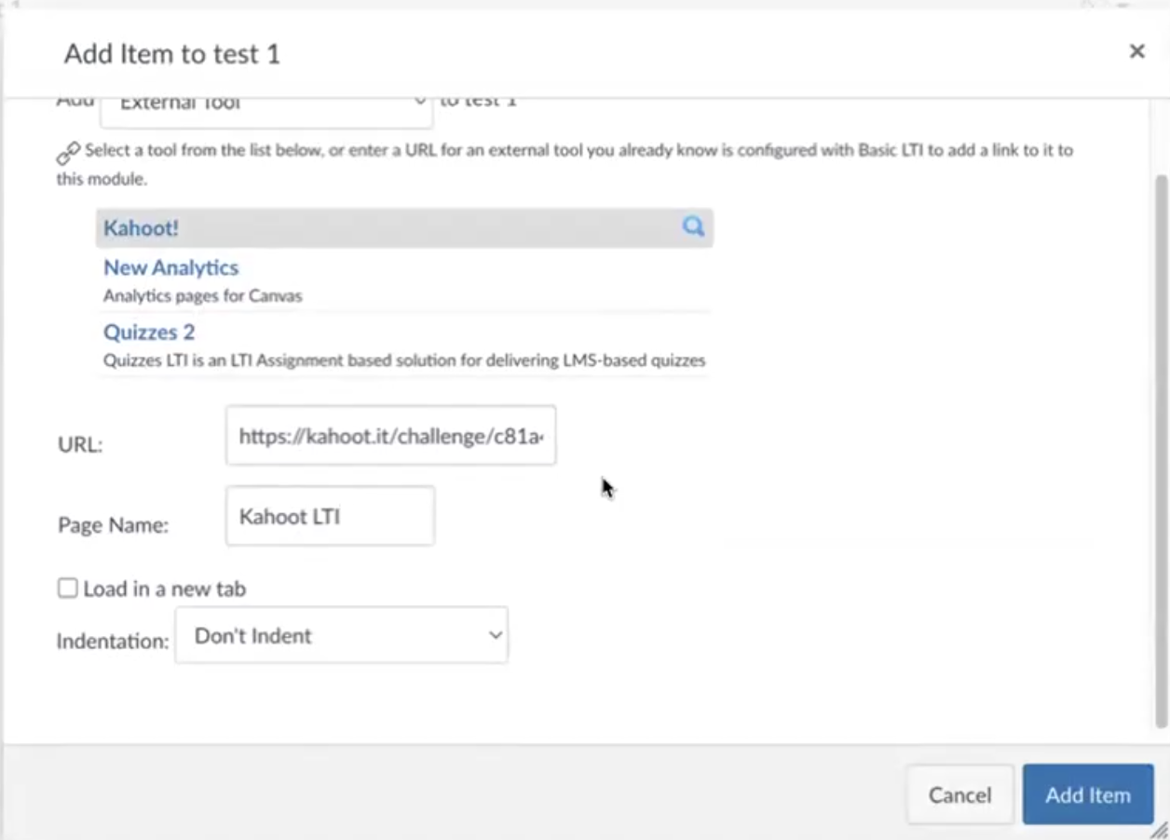
After you select a Kahoot! quiz from this window, the Canvas fields will autofill accordingly. Now, you can select “Add Item”.

Slide 5
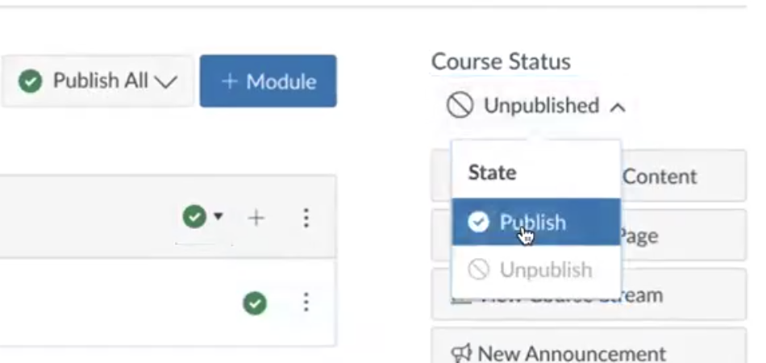
On the Module screen, change the status to “Published” for both the Kahoot! Item and the course itself.
Once published, you can view the content as a student to check and make sure everything looks correct!

Slide 6
The student view will show you how Kahoot! content appears as assignments - including the due date, assigned points, etc.
Student names will autofill based on LMS data.

Slide 7
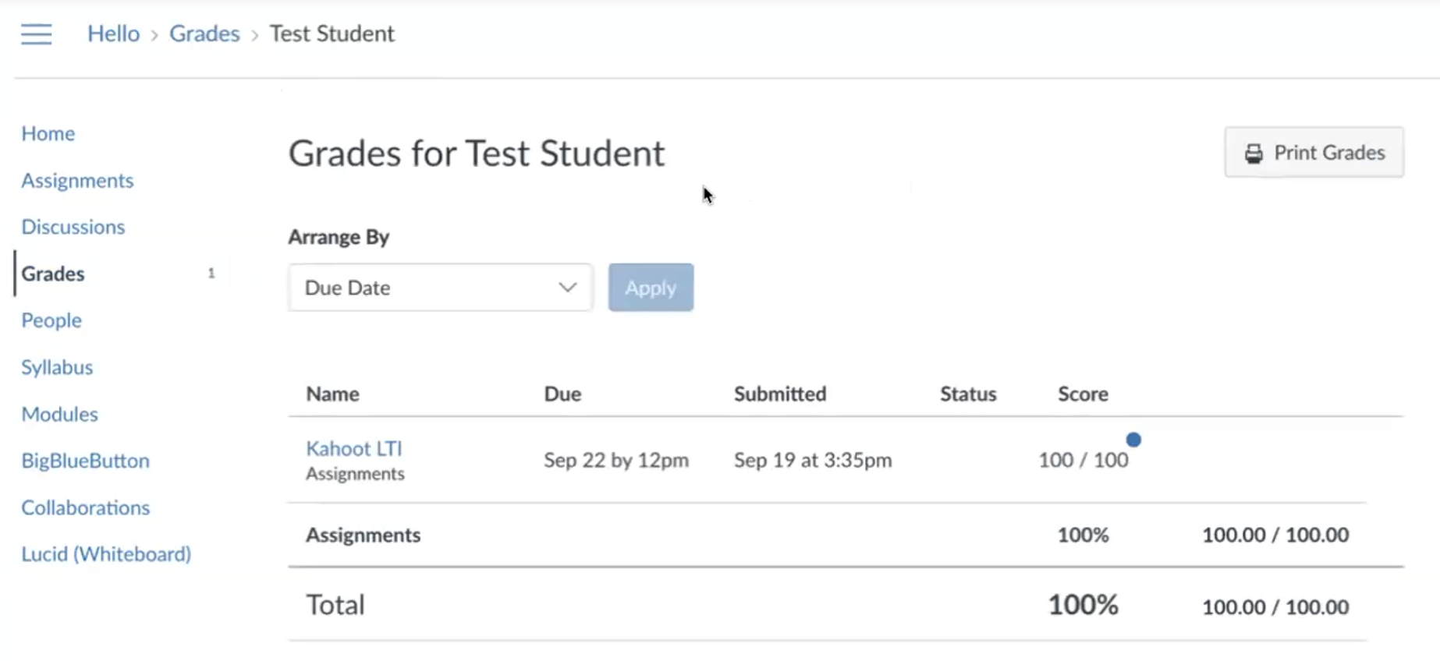
After students complete the Kahoot! assignment, a new grade will appear in Canvas based on their performance.

Slide 8
You’re ready to begin using Kahoot within your Canvas courses!

