Slide 1
Challenges of a Hybrid Course: How do we accommodate in-person and remote students at the same time?
Fariba Nosrati | PhD, MBA, MSc, BEng
Assistant Professor of Information Technology Management
Anisfield School of Business
May 24, 2021
Notes:
In this presentation, I will share my experience teaching hybrid format using WebEx and WebEx room kit.

Slide 2
Agenda
Introduction & Background
Hybrid Delivery
Challenges
Lessons Learned

Slide 3
Introduction & Background
Class type
Variety of backgrounds
Info 311: Business Analytics II
Courses
Info 224: Principles of IT
Computer labs
80 students in three classes
Hands-on practice with various tools
Audience
Class discussions & case studies
Group work
Student presentations
Mixed levels
INFO 224 & INFO 311

Slide 4
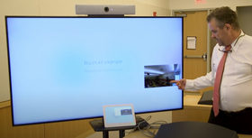
Hybrid Delivery
Teaching on campus using a WebEx room-kit to accommodate students who chose to participate remotely
Before COVID-19
Traditional F2F
Spring 2020
Fall 2020
Spring 2021
Hybrid (F2F/Synchronous/ Asynchronous)
F2F → Asynchronous
Virtual (Synchronous/Asynchronous)
In a computer lab
Notes:
Since the start of the pandemic, most of us have experienced various course delivery modes, transitioning from traditional face-to-face classes to remote modalities such as synchronous, asynchronous, or a mix of both.
A more recent option that became available last spring was teaching in-person while using a WebEx room kit to accommodate students who chose to participate remotely.
This hybrid model seems to be one of the critical course modalities in the following fall semester. However, having students online and in-person simultaneously brings new challenges to the course activities and structure. In this session, we will brainstorm about the challenges we faced last semester and possible strategies to structure a course.

Slide 5
Course structure
Asynchronous
Overview of the topic
Hands-on lab demonstration/practice
Self study
Readings (textbook, slides with embedded short videos)
Virtual labs (short tutorials)
Deliverables
Weekly group activities
Weekly individual assignments
Weekly quizzes
Group term paper/project
Synchronous
Discussion/Case studies
Student presentation

Slide 6
Course structure: Grade breakdown
Team contract
Group activities
Group term paper/project
Proposal
Check-in
Presentation
Final paper
Quizzes
Lab exercises
Assignments Participation

Slide 7
Tools
Canvas
TechSmith Knowmia
Announcements
Quiz
Labs
Assignment
Survey
Create & share video tutorials
Synchronous sessions
Hands on exercises
Student presentations
Online polls
LucidChart
Concept maps
Venngage
Infographics
WebEx
Course material
Discussion
Concept maps
Import and share YouTube short videos & tutorials
Office hours
G-Suite
Communication
Teamwork
Sharing
Room-kit

Slide 8
Context
Room: computer lab (capacity was reduced to 14 students + instructor)
Students were able to choose their participation mode (in-person/remote) at the beginning of the semester
In each class:
10-12 in-person students
14-20 remote students
Set-up the sessions using WebEx & WebEx room-kit
Three back-to-back sessions in the same room

Slide 9
Overall feedback
No complaint from remote students (felt like usual synchronous sessions)
“Always making the online students feel like there in class”
“Best feature of this course is that it can be online”
In-person students were happy
“Having class in person and online at the same time was a great thing!”
“Best features of the course: Taught online and in person”
“What works well: Being able to come to class in person and learn in person”
“To be able to go to class in person is the best experience for me. I love it when I have the chance to get to the ASB building to attend my class in person”
“This class is very hard for online delivery. We use Excel practice files to reference and follow along during class. It is difficult to follow along on WebEx and do our own work using Excel. But it is much easier in-class with extra screen.”
From the instructor perspective
A different experience
Technology was the least challenging issue
Learning curve to structure and manage the class
The in-class student were less distracted
Top students were more likely to choose in-person participation

Slide 10
Benefits
Flexibility
Possible to have students in-person and online simultaneously
Ease of access to course material
Record the class and share

Slide 11
Challenges
Technical
Class management
Group work
Student engagement
Health & safety

Slide 12
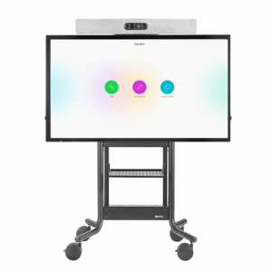
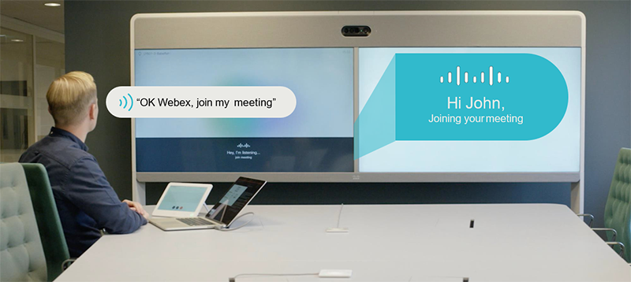
Technical Challenges
Meeting invitation
Google calendar: need to add participants one by one
Starting the class
Start the meeting using instructor station
Then, use room kit to join as a participant
Make sure participants are not muted!
Some participant receiving the message that “The meeting has not started yet” while some others were in the meeting! → remind & invite from the meeting session after starting the meeting
Audio
A little low
Difficult to hear in-class students at home
Some audio glitches specifically when moving
Other
Whiteboard/projector screen not visible at home

Slide 13
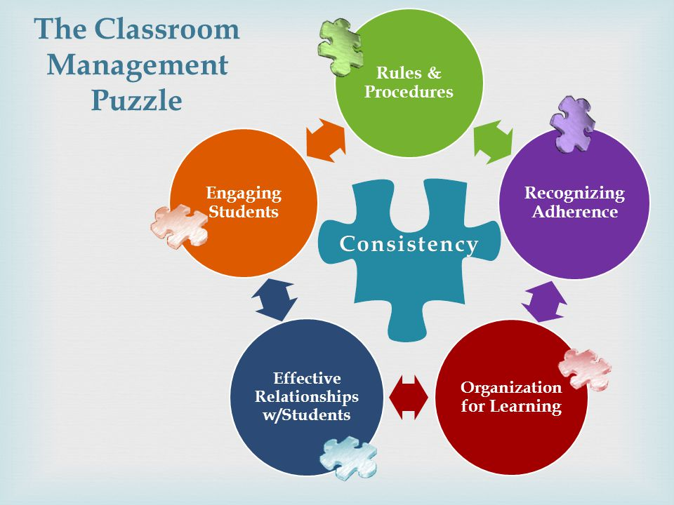
Class management and student engagement
Need to start the class early (computer set up, start meeting, send reminder, connect room-kit, …)
Difficult to monitor the chats, raised hands, and students in class at the same time
Had students open their mic to comment/ask question
Student participation/discussion
Students who usually speak up, will talk either in-person or online
Students who usually do not participate will not talk anyway!
The student who tends to use chat to participate will be missed
Had to repeat/summarise class discussion for online students
To share students’ work, had to ask all students to login into WebEx even if they are in the classroom
Need some class time to track attendance (the WebEx participant list is not enough)

Slide 14
Group work
In-class group work is very difficult in a hybrid setting
Group members were in-class and online
Breakout rooms are not practical
Had to ask all students to login into WebEx even if they are in classroom, to share their group activity results
Group presentations were feasible (even with mixed online and in-person group members)
However, fully online and fully in-class presentations were easier and more effective

Slide 15
Health & safety
Wearing mask while teaching
Students wearing mask all the time
Very quiet campus: hallways and classes were very quiet and clean
Cleaning between classes
Each class had a cleaning log sheet on the door
Sanitizer & wipes were available in each class
Inconsistent communication regarding students getting exposed/infected
Stressful to monitor students who cannot attend and when they are clear to attend
Vaccination will resolve most health & safety concerns

Slide 16
Lessons Learned
Key challenges
Class audio
Group work
Student interaction/engagement

Slide 17
Lessons Learned
Try the WebEx room-kit once before the start of semester
Be flexible!
Have a technical routine (e.g., start session early, send invitation reminder after starting the meeting, record the meeting, share recordings, …)
Communication is the key (lots of communication!)
Provide detailed guidelines (use several formats: Canvas, email, announcement, in-class, ...)
Involve students in fine-tuning the course delivery
Monitor the class progress/delivery constantly

Slide 18
Q&A

