Slide 1
Fulbright Scholar Program Opportunities
^{24 May 2021}
^{Ramapo College of New Jersey}

Slide 2
Presentation Overview
Introduction
Core Fulbright U.S. Scholar Program
Additional Fulbright U.S. Scholar Opportunities
Ramapo College Summer Workshop Opportunity

Slide 3
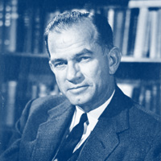
Senator J. William Fulbright
“International education exchange is the most significant current project designed to continue the process of humanizing mankind to the point, we would hope, that nations can learn to live in peace.”
Established 1946
Sends U.S. academics and professionals overseas and brings scholars and professionals from abroad to the U.S.
Sponsored by U.S. Department of State’s Bureau of Educational and Cultural Affairs
Administered by the Institute of International Education’s Council for International Exchange of Scholars (CIES)

Slide 4
Mission
In partnership with 160 countries worldwide, Fulbright offers passionate and accomplished faculty, administrators, artists, journalists, lawyers and other professionals from all backgrounds an unique opportunity to study, teach or conduct research.
The mission is to foster mutual understanding between nations, advance knowledge across communities, and improve lives around the world.
75th Anniversary
Visit Fulbright75.org to participate in anniversary events.

Slide 5
Diversity and Inclusion
Fulbright strives to ensure that it reflects the diversity of U.S. society and societies abroad. We encourage the involvement of people from traditionally underrepresented audiences in all our grants, programs and other initiatives.
Opportunities are open to people regardless of their race, color, national origin, sex, age, religion, geographic location, socioeconomic status, disability, sexual orientation or gender identity.

Slide 6
Why Fulbright?
Fulbright is transformational
Foster relationships that are real and lasting
Expand your publishing network
Become more multicultural in the classroom
Serve as an ambassador for international exchange
Gain the professional recognition as being identified as a ’Fulbright Scholar’
Join a vibrant alumni network
Fulbright is family-friendly
Approximately 60% of our awards provide dependent support
Many Fulbright dependents go on to have international careers
Fulbright is supportive
Alumni share experiences
Domestic and in-country support

Slide 7
Fulbright, by the Numbers
The Fulbright Program funds over 8,000 awards annually:
800 U.S. scholars and administrators
900 visiting scholars
2,200 U.S. students
4,000 foreign students
400+ language teaching assistants
Approximately, 400,000 “Fulbrighters” have participated in the program since its inception in 1946

Slide 8
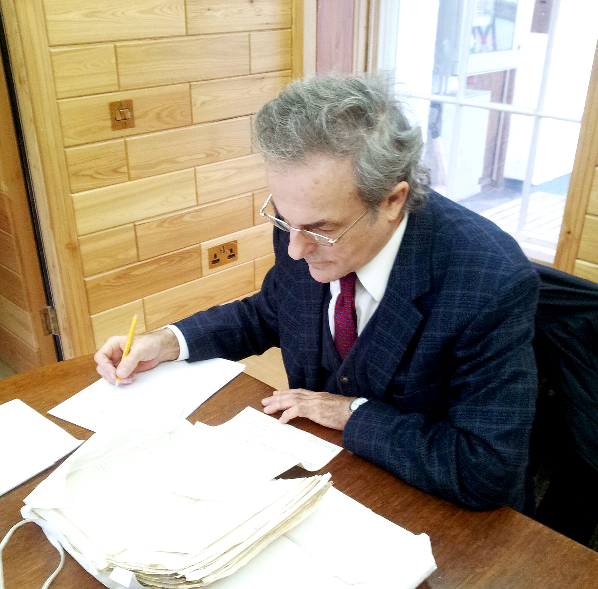
Academic Production
Left: Jack Hill, 2013-2015 Scholar to the UK, conducts research at Blair Castle.
Right: 2014-2015 Scholar to Thailand Bruce Svare collected essays on Fulbright and cross-cultural understanding.
>60%
of Fulbright alumni surveyed published articles in peer-reviewed academic journals
39%
of Fulbright alumni surveyed published books or book chapters
Survey respondents were from the 2012-2013 and 2013-2014 cohorts.

Slide 9
Technical Skills & Knowledge
95.1% of respondents reported gaining valuable field-specific knowledge as a result of Fulbright.
95.1%
92% of respondents reported a deeper understanding of their research area and discipline as a result of Fulbright.
92%

Slide 10
Intercultural & Communication Skills
95.1% of respondents reported that the Fulbright Scholar Program increased their intercultural skills.
95.1%
93.9% of respondents reported that the Fulbright Scholar Program increased their ability to function in a multi-cultural environment.
93.9%

Slide 11
Who Are Fulbrighters?
Grantees from nearly 500 institutions
50 states, the District of Columbia, Puerto Rico and Guam
All levels and ranks of academe
Tenured and untenured; Postdoc and new faculty
Artists, writers, independent and retired scholars, professionals
All academic fields and many professional fields are eligible
Traditional Humanities and Social Sciences
Hard and Applied Sciences
Technology
Engineering and Mathematics
Performing and Visual Arts

Slide 12
Eligibility for U.S. Scholar Programs
U.S. citizenship
A Ph.D. or professional/terminal degree
Professionals and artists outside academia - recognized professional standing and substantial accomplishments
Teaching experience as required by award;
Language skills may be required or recommended
Preference is given to candidates who have not previously received a Fulbright Scholar grant
Not eligible if significant time spent abroad recently

Slide 13
Fulbright U.S. Scholar Programs
Programs are active in over 160 countries for faculty, administrators and professionals
Core Fulbright U.S. Scholar Program - Annual competition; teaching and/or research; two to twelve months
Fulbright Specialist Program – Rolling deadline; teaching and development; two to six weeks
Administrators, Seminar & Special Initiative Programs - Annual competitions; teaching, seminar, and/or research; vary from two week to two month exchanges

Slide 14
What Have U.S. Grantees Been Doing?
U.S. Scholar Grants by Program Activity

Slide 15
What are the Fulbright Grant Benefits?
Some countries add travel for dependents, dependent schooling, research allowance, book allowance
Stipends and living allowances vary considerably from country to country
Country benefits are found with the award descriptions at http://catalog.cies.org/
Package includes stipend, in-country living allowance, travel for grantee

Slide 16
Overview of Application Process – CORE awards
Required
Project Statement
CV/Resume
Letters of Recommendations
Short Essays
Country Selection
Career Trajectory
Cultural Preparation
Teaching Preparation
May be Required
Bibliography (Research or Teaching/Research activities)
Syllabi (Teaching or Teaching/Research activities)
Portfolio (Arts disciplines only)
Letter of Invitation
Language Proficiency
Notes:
Hilary H.

Slide 17
What is the Review Process and the Timeline?
31 MARCH
Applications open
15 SEPTEMBER
Applications closed
OCTOBER - NOVEMBER
U.S. peer review committees discuss applications for a single geographical region
Grant packets sent to grantees
Applicants notified of status - Recommended applications are sent to host countries and to the J. William Fulbright Foreign Scholarship Board
Grantees notified of final approvals
FEBRUARY-MAY
MAY-JUNE
NOVEMBER-JANUARY

Slide 18
Fulbright U.S. Scholar Programs
Core Program
Supports teaching and/or research activity for three to 12 months; Flex (multi-visit) option
Open to all disciplines
Apply to specific award with proposed project
Application deadline: September 15, 2021
Most hosts are higher education institutions.
Eligible hosts vary by award, may include universities, research centers, museums, etc.
Specialist Program
Teaching and consulting projects for two to six weeks
24 eligible disciplines
Apply to join Specialist roster
Rolling deadline
Institutions overseas develop projects, request Specialists from roster.
Host can be higher education institutions or non-academic institutions.
Does not support research projects
Notes:
Hilary H.

Slide 19
Fulbright Flex Awards
The Flex Award is designed for scholars who require multiple visits to the host country over short segments
Applicants must indicate plans for Flex in their project statement, including a project timeline.
Flex grantees may be asked to give public talks, mentor students, and engage with the host-country academic community
Opportunities in some country and some regional awards

Slide 20
Core Multi-Country Opportunities
Global Scholar Award
Sub-Saharan Africa Regional Research Program
Middle East and North Africa Regional Research Program
East Asia and the Pacific: Cross-Strait Studies
South and Central Asia Regional Research Program
Europe: Fulbright-Schuman European Union Affairs, Austrian-Hungarian Research Award
Western Hemisphere: Fulbright-Carlos Rico Award for North American Studies

Slide 21
Additional Opportunities
Distinguished Scholars
Global Scholar
Public Policy Fellowship
Fulbright Arctic Initiative

Slide 22
Distinguished Scholars
Most prestigious of Fulbright awards
Minimum of 7 years experience in discipline or area of expertise
Additional restrictions dependent on particular award
Currently 51 unique opportunities
For more general information: https://awards.cies.org/search?search_api_views_fulltext=&field_award_multi_country=All&field_award_type_list%5B%5D=1793&field_award_grant_length=All&field_award_degree_reqs=All

Slide 23
Fulbright Global Scholar Award
Multi-country, trans-regional projects
Research or teaching/research
Individual trips can be spread over a longer period of time
For more general information:
http://www.cies.org/program/fulbright-global-scholar-award
For the award itself:
http://catalog.cies.org/viewAward.aspx?n=7001&dc=02
Deadline: 15 September 2021

Slide 24
Trans-regional research activity or combined teaching/research activity
All disciplines and from those with an interdisciplinary focus
Global perspective and demonstrate why residence in each of the proposed host countries is needed to accomplish the project.
Two or three countries representing two or three world regions
One multi-country trip, two or three single country trips or two dual-country trips
Three to six months - minimum of one month in each country each visit
Within one academic year or spread over two consecutive years

Slide 25
Public Policy Fellowship
Targeted at early and mid-career professionals
Placed in foreign government ministries or institutions
Includes independent research component
For more general information:
https://cies.org/us-scholar-awards/FPPF
Deadline: 15 September 2021

Slide 26
Arctic Initiative
Brings researchers together from the Artic region to address critical issues
Cohort based program
For more general information:
https://cies.org/arctic

Slide 27
Ramapo College Summer Workshop
Objectives
Choosing the right award
Crafting a competitive application
Building a supporting cohort of Ramapo faculty applicants
Establish greater structure of support
Workshop Design
Focused workshop meetings every two weeks
Guidance documents and prompts
Opportunity for ‘blind’ or non-anonymous review of application
Who Should Participate?
Faculty with intention to apply in the next round
Faculty interested in future application
Interested?
Please send an e-mail to Ben Levy, blevy1@ramapo.edu and he will provide you the details.
Notes:
Hilary H.

