Slide 1
Mapping as Pedagogy:
Using ArcGIS StoryMaps in the Classroom
FRC Workshop
May 24, 2021

Slide 2
What is ArcGIS?
A Geographic Information System.

Slide 3
What is ArcGIS?
A Geographic Information System.
  Computer program that allows users to create, modify, analyze, and map spatial and non-spatial information.

Slide 4
What is ArcGIS?
A Geographic Information System.
  Computer program that allows users to create, modify, analyze, and map spatial and non-spatial information.
  → i.e. to create digital maps

Slide 5
How are GIS programs used?
Some examples
Environmental science (mapping wildfires, wetlands, erosion, invasive species.)
Public health/epidemiology (mapping disease hotspots, effects of pollution)
Urban planning and city management (identifying sites for new developments, tracking traffic patterns)
Digital humanities (mapping historical sites, census data, locations mentioned in a work of literature)

Slide 6
What is ArcGIS StoryMaps?
Allows users to create simple maps and contextualize them with text, images, and video.
No coding needed.

Slide 7
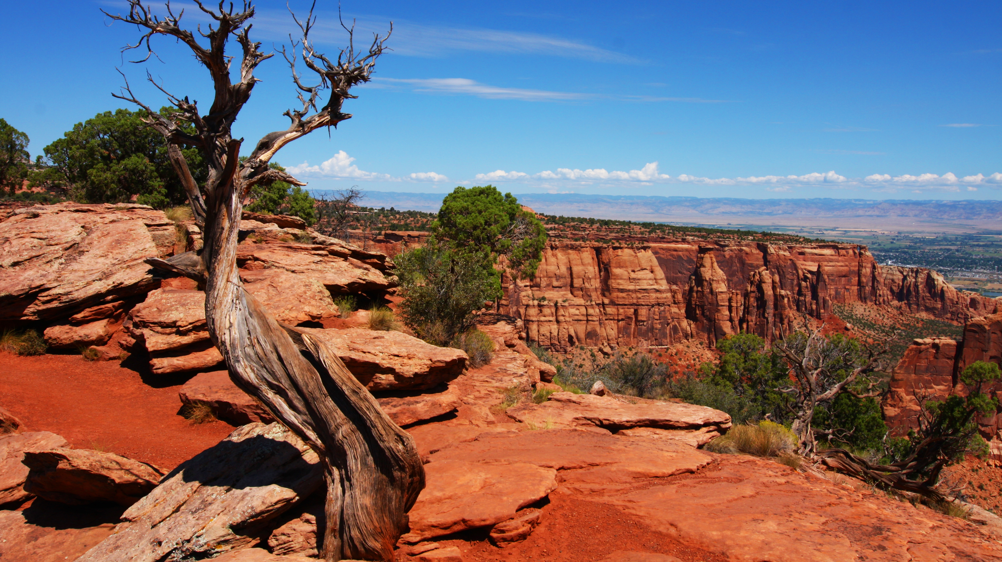
Course Profile
HIST 311/The American West
  Writing intensive, seminar-style history course that explores both the history and the popular mythology of the West.
This Photo by Unknown Author is licensed under CC BY-SA

Slide 8
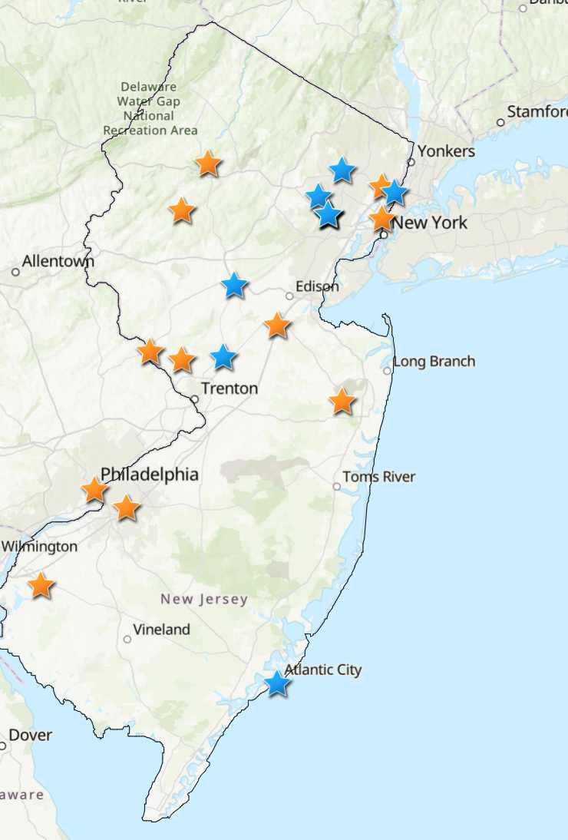
Assignment Overview
“Mapping the Wild West in New Jersey” is an interactive map of people, places, and events that connect New Jersey to the American West. Each site is chosen and researched by a student in HIST 311/The American West.

Slide 9
The Process
Three in-class labs (45 minutes):
  Explore and assess existing StoryMaps
  Identify research topics, place in a shared Google Doc.
  Introduce tools for locating historical information (such as Chronicling America newspaper database) and pictures that are in public domain or licensed under Creative Commons (such as Wikimedia Commons).

Slide 10
The Process
In-class labs (45 minutes):
  Explore and assess existing StoryMaps
  Identify research topics, place in a shared Google Doc.
  Introduce tools for locating historical information (such as Chronicling America newspaper database) and pictures that are in public domain or licensed under Creative Commons (such as Wikimedia Commons).
Students add their topic’s location, a brief description, a link to a properly credited image, and sources to a Google Sheet for entry into ArcGIS.

Slide 11
The Process
In-class labs (45 minutes):
  Explore and assess existing StoryMaps
  Identify research topics, place in a shared Google Doc.
  Introduce tools for locating historical information (such as Chronicling America newspaper database) and pictures that are in public domain or licensed under Creative Commons (such as Wikimedia Commons).
Students add their topic’s location, a brief description, a link to properly credited image, and sources to a Google Sheet for entry into ArcGIS.
Students write a 2-page research report reflecting on their research process.

Slide 12
Assessment
Map Entry: 50% (including accuracy of location data; inclusion of a usable image with credit; clear, proofread description of item).
Research Report: 50% (including an overview of the topic, discussion of research methods, challenges encountered and addressed, and lessons learned).

Slide 13
Results
A majority of students reported that they enjoyed the assignment and felt that they were learning marketable skills.
One student expressed interest in continuing work on the map in the fall as a co-op or student-faculty research position.
Students struggled most with navigating copyright.

Slide 14
Try it!
Link to HIST 311 StoryMap (also available in chat):
https://storymaps.arcgis.com/stories/19aa832bd4224c8c8a0513b1eb756e9b

Slide 15
Getting Started with ArcGIS StoryMaps
Go to https://storymaps.arcgis.com/stories and sign into the practice account created for this session:
  Username: FRCworkshop
  Password: FRCworkshop2021
Or set up your own free StoryMap account using the same link!

Slide 16
Questions?

Slide 17
Thank you!

