Slide 1
The New Classroom
WEBEX instead of Adler
Julie Fitzgerald PhD, RN, CNE

Slide 2
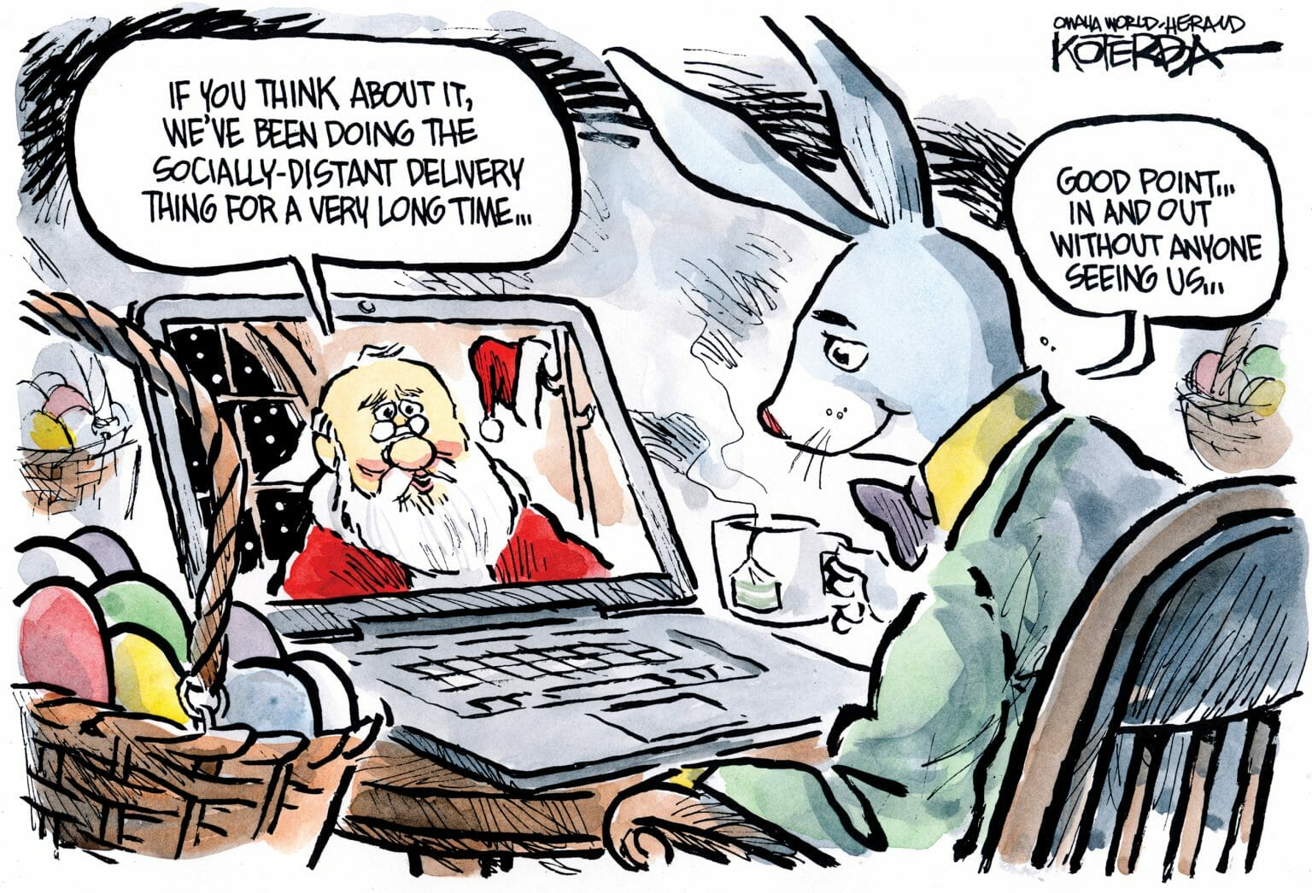

Slide 3
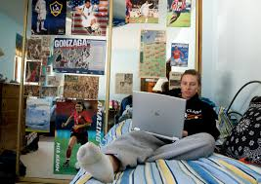
The Virtual Classroom
REAL time classroom lecture with PowerPoints
Case Studies
Quizzes
Polls
Question and Answers

Slide 4
How do we keep them engaged?
Question and Answer
Change activities/pace
Teach in chunks
Case studies
Diagrams
NCLEX type quizzes
Polls
Asking them to share clinical experiences or to bring back searches
Encourage use of video cameras

Slide 5
Activities/themes
Taking a few minutes to ask how they are doing.
Bring your pet to class day
Let’s wear stripes
Picture Day for Seniors
Bringing current Pandemic into the classroom as part of the lecture.
What do you want to do when pandemic ends
Allowing for those awkward times when the toddler wont leave the classroom
Giving them 10 to 15 minute breaks in long lectures
Taking attendance

