Slide 1
Engaging Online Assignments and Assessment Strategies
Focusing on studio-style courses Ann LePore

Slide 2
Who am I to say I have the answers?

Slide 3
Who am I to say I have the answers?
We are educators - and good at constantly assessing a room full of students
Different courses and styles of teaching require different adaptations
We strive to meet the demands of each situation as much as is possible
We are are concerned with fairness

Slide 4
Delivering engaging content
Delivering online content at a pace chosen by students
and/or
Synchronously

Slide 5
Students may arrive with this mindset:
I’m here to be entertained.
S t u d e n t

Slide 6
Usually within their field of study they start here
I’m here to be engaged.
S t u d e n t

Slide 7
Even better
I’m here to be part of this exchange.
S t u d e n t

Slide 8
The Goal
I’m here to participate as a member of this community.
S t u d e n t

Slide 9
Should Studio Courses BE Live?

Slide 10
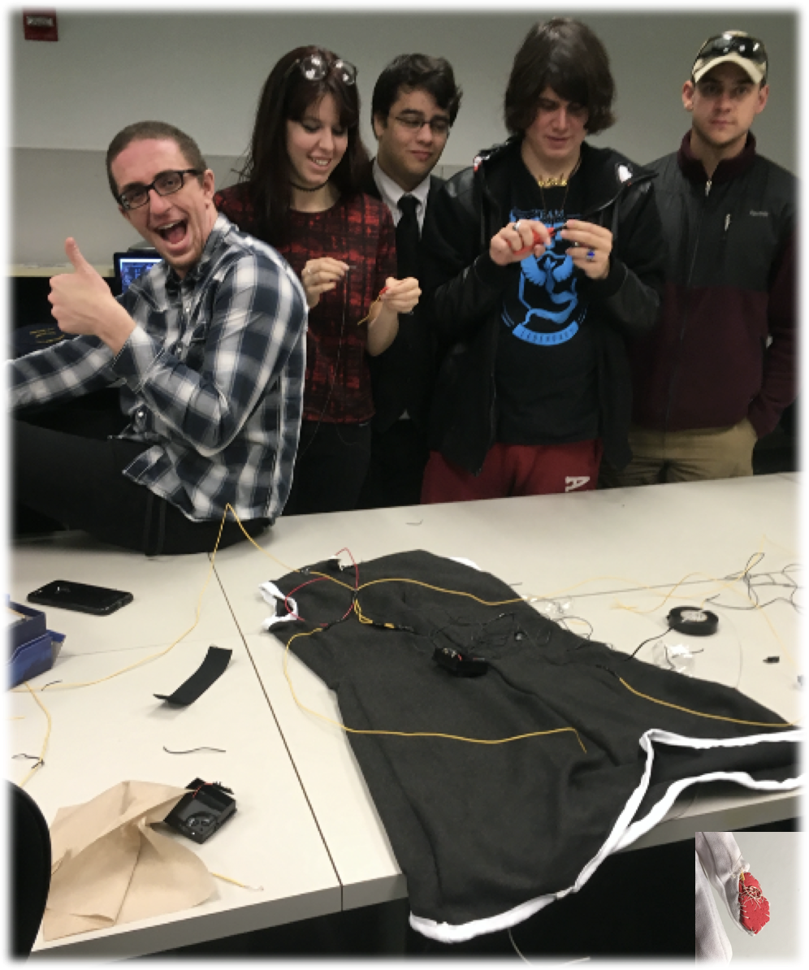
Should Studio Courses BE Live?
Studio courses are hands-on engaged learning.
By default they are very engaging in-person.

Slide 11
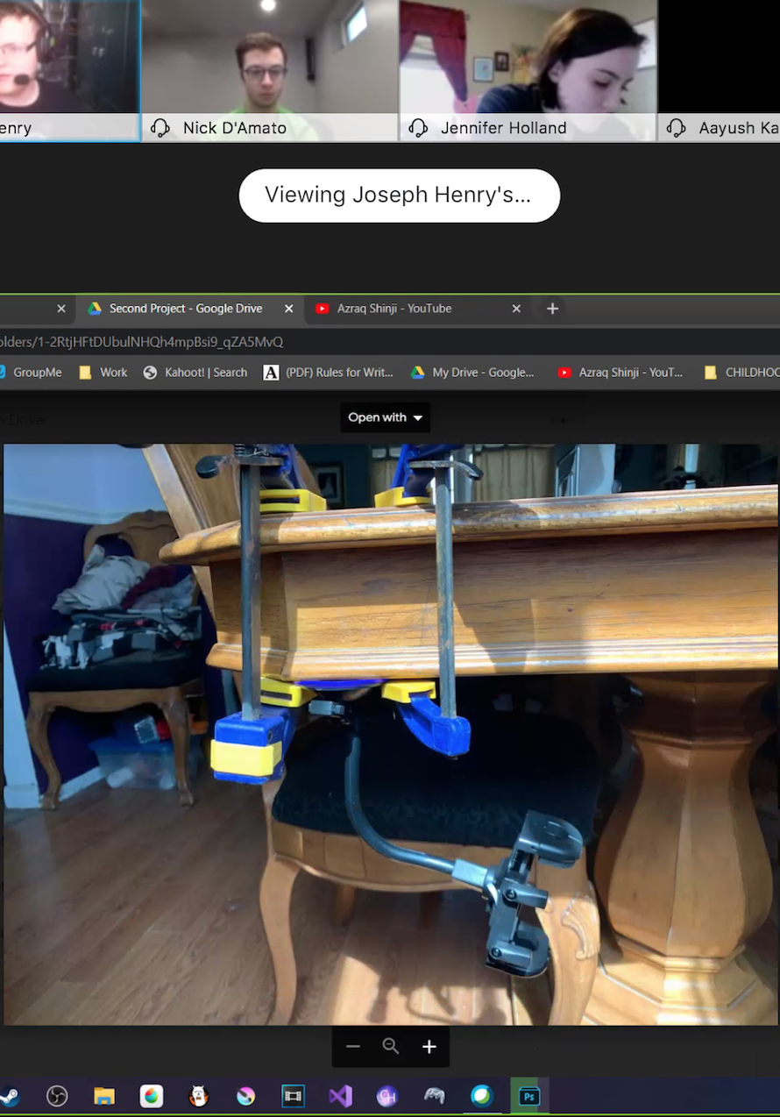
Should Studio Courses BE Live?
My goal is to prevent students from becoming passive viewers when working online

Slide 12
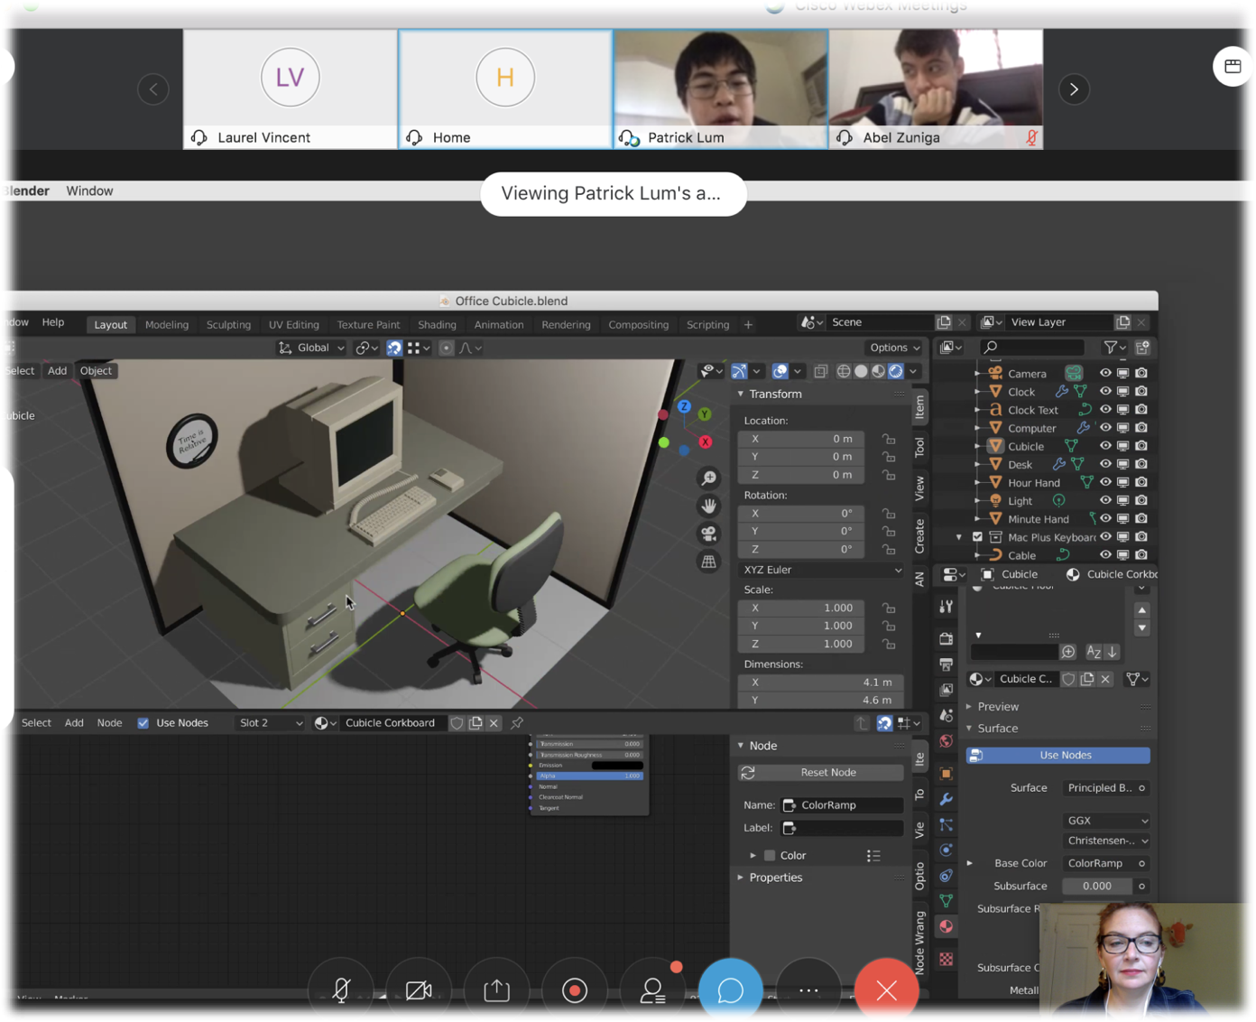
Should Studio Courses BE Live?
Have students share what they’re doing frequently with the whole class, whether asynchronously or live

Slide 13
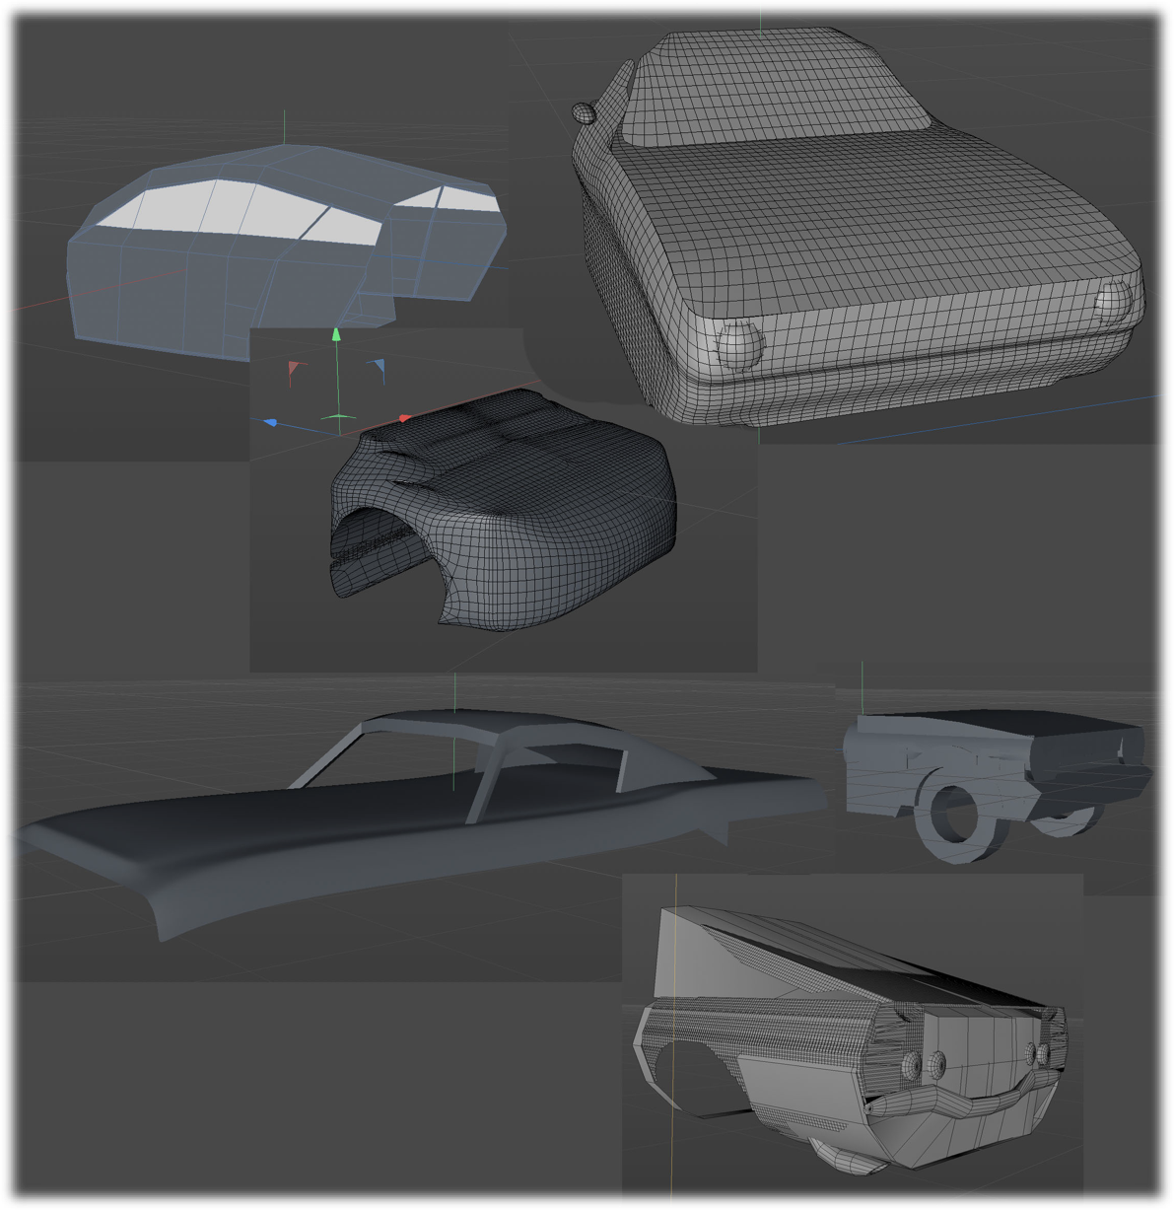
Should Studio Courses BE Live?
Help students to feel invested in content, skill testing, and in the progress of their peers by using competitive small group work

Slide 14
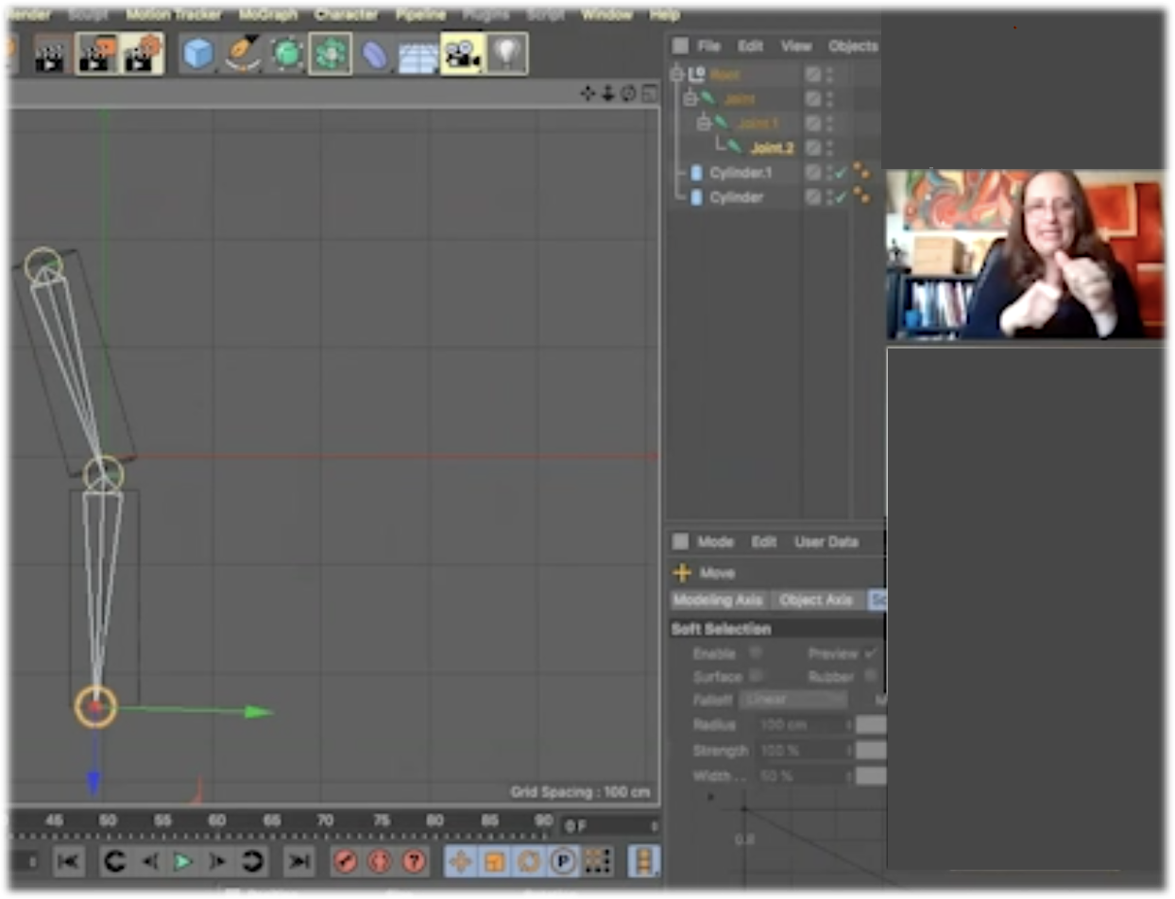
Should Studio Courses BE Live?
Teach live and record the live demos for later review by students

Slide 15
Should Studio Courses BE Live?
Create clear expectations for how I will be present and how students should be present regardless of synchronicity

Slide 16
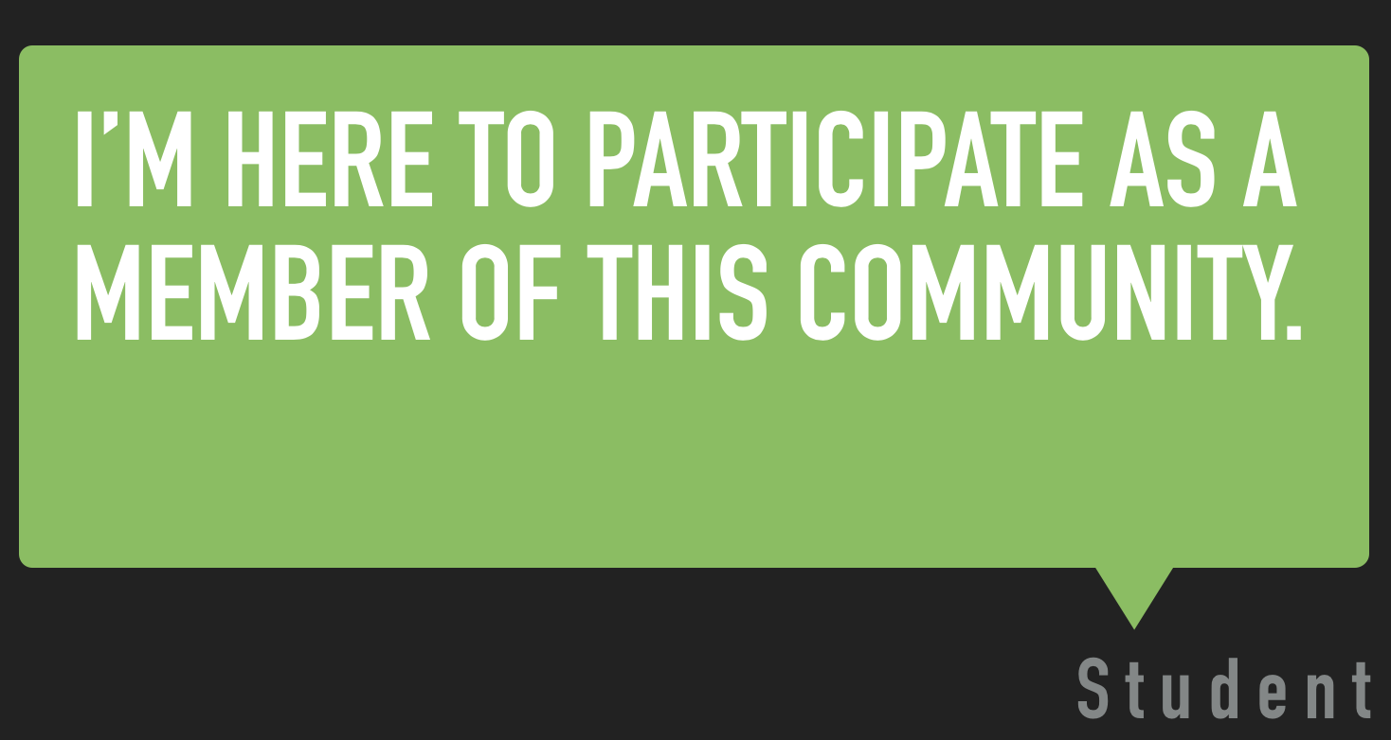
Assessing emergency Learning
Was this an appropriate time to assess whether students were fully engaged community members?

Slide 17
Signs that students are fully invested (informal)

Slide 18
Signs that students are fully invested (informal)
-ask questions and offer answers during live sessions

Slide 19
Signs that students are fully invested (informal)
-ask questions and offer answers during live sessions
-reach out to each other for support during class breaks

Slide 20
Signs that students are fully invested (informal)
-ask questions and offer answers during live sessions
-reach out to each other for support during class breaks
-maintain contact with each other re: coursework throughout the week

Slide 21
online Exams & quizzes
-Request students to apply knowledge (instead of asking for something that can be looked up)
-measure more complex understandings of relationships between materials provided
-measure technical skills live or asynchronously

Slide 22
synchronous vs Self-directed exams
testing
Live final exams for lecture-style courses?
-Helpful for students with high anxiety (asked questions live resulting in reading through the material more thoroughly)
MAYBE THIS SHOULD NOT HAVE BEEN LIVE

Slide 23
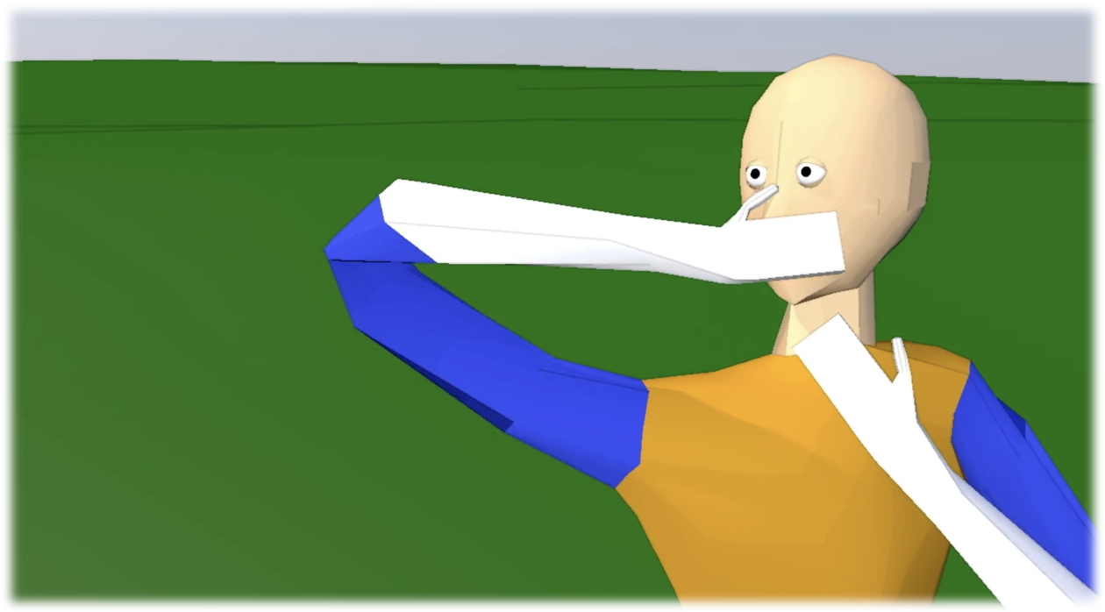
synchronous vs Self-directed exams
testing
Live critiques were necessary for final projects in studio courses.
Asking animators to apply to festivals live as part of the exam was also successful as a type of supportive push.
The time constraint of the exam was very motivating!
Don’t Sneeze, Animation, 01:57 Eduardo Cermeno

Slide 24
Equity in materials access
A concern for remote education everywhere.

Slide 25
Equity in materials access
Stop using professional tools & materials in favor of free/inexpensive tools?

Slide 26
Equity in materials access
Create “Safe” virtual or one-on-one access to our equipment?

Slide 27
Equity in materials access
Thank you to our ITS department and Provost Gaulden for offering to get hardware and software out to students.

