Slide 1
Active Learning for Remote Teaching
Reba Wissner, Adjunct Professor
Department of Music, School of Contemporary Arts
rwissner@ramapo.edu

Slide 2
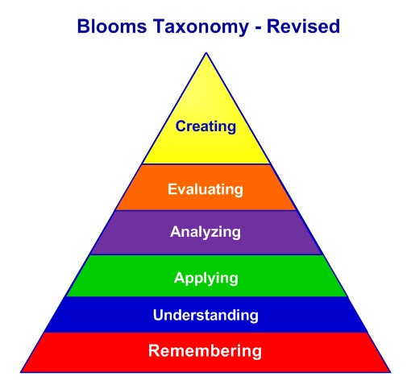
Maslow’s Hierarchy of Needs

Slide 3
Engaging Active Learning Assignments that Build Community
Discussions
Discussion board, video discussion, Flip Grid
Assignment sharing
Infographics, Mapping, etc.
Online tools: shorturl.at/dxNP6
Peer-review
Scavenger Hunts
Modified In-Person Activities
Postcard activity, Virtual museum tours

Slide 4
Resources for Remote Teaching Activities
Bonk, Curtis J. and Elaine Khoo. Adding Some Tec-Variety: 100+ Activities for Motivating and Retaining Learners Online. Bloomington: Open World Books, 2014.
Bonk, Curtis J. and Ke Zhang. Empowering Online Learning: 100+ Activities for Reading, Reflecting, Displaying, and Doing. San Francisco: Jossey-Bass, 2008.
Conrad, Rita-Marie and J. Ana Donaldson. Continuing to Engage the Online Learner: More Activities and Resources for Creative Instruction (San Francisco: Jossey-Bass, 2012.
Conrad, Rita-Marie and J. Ana Donaldson. Engaging the Online Learner: Activities and Resources for Creative Instruction (San Francisco: Jossey-Bass, 2011.

Slide 5
Active Learning for Remote Teaching
Reba Wissner, Adjunct Professor
Department of Music, School of Contemporary Arts
rwissner@ramapo.edu

