Slide 1
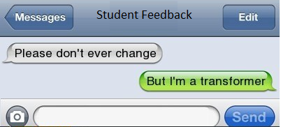
Transforming Assignments for Remote Learning

Slide 2
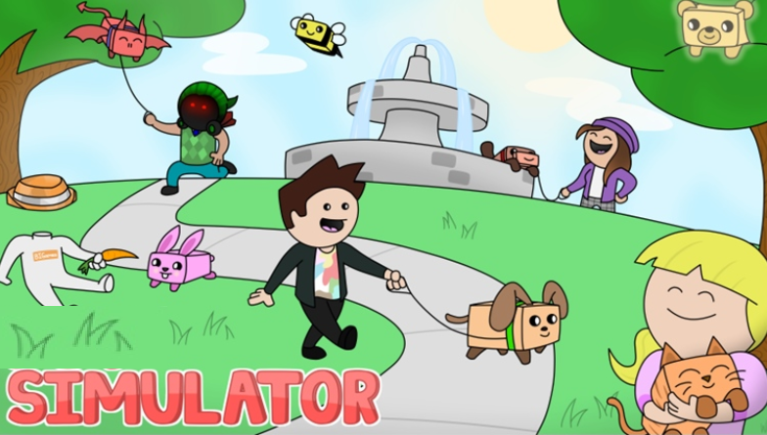
Pre-Remote Learning Setup

Slide 3
Objectives
Understand/Experience
the concept of forecasting
the concept of theory or constraints
the concept of inventory management
the concept of systems theory

Slide 4
Deliverables/Evaluation Criteria
Simulation Game Rank – Result of Group effort in the simulation
Team Presentation - Group
Self-Reflection Document - Individual

Slide 5
Team Simulation: Challenges of Remote learning

Slide 6
Difficult because
Simulation requires teams to discuss and build a strategy
Professor covers the topics and discusses the context of the game in each of the topics
Students brainstorm as a group and use the professor as a sounding board

Slide 7
The transformed model

Slide 8
Transformed Setup
Individual Assignment
Student do simulation right after each topic
Every simulation has a description video and a follow up quiz
The final simulation is when each student sees an integrated view

Slide 9
The only missing component in this learning

Slide 10
Added a new assessment

