Slide 1
Fabulous faculty
Creating active & effective remote teaching & learning Experiences

Slide 2
Good Morning! Thank you for joining us!
Notes:
--Orient audience to the aim of the event and for the day
--Acknowledge that every course is unique and what works for one may not work for another. The aim is to showcase some options and generate ideas for developing the right design for your course.

Slide 3
Backward Course Design
Identify Desired Results
Determine Acceptable Evidence
Plan Learning Activities
Notes:
Our work today will be grounded in the notion of backward curse design- that is the process by which decisions course design are made through a sequential process that begins with identifying what our students need to know and be able to do after taking out course (perhaps even 5 years after).
-- Once goals are established, we consider and design appropriate methods by which student will demonstrate that knowledge and those capacities.
--We lastly develop teaching and learning activities that will enable students to engage in the type or work, practice and experience that will prepare them to succeed on those assessments

Slide 4
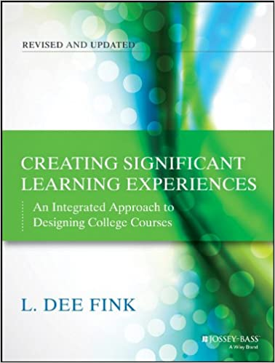
Course Design for the Remote Learning Environment
Fink’s Model (12 Steps)
INITIAL DESIGN PHASE: Build Strong Primary Components
Step 1. Identify important situational factors
Step 2. Identify important learning goals
Step 3. Formulate appropriate feedback and assessment procedures
Step 4. Select effective teaching/learning activities
Step 5. Make sure the primary components are integrated
LINK
LINK to FINK’s ONLINE GUIDE FOR COURSE DESIGN
Notes:
Brief reminder of Fink’s model for course design and highlight that an online guide is available free on the internet-

Slide 5
Integrated Course Design Model
Learning Goals
Teaching/ Learning
Activities
Feedback/ Assessment
Situational Factors
Fink 2013
Notes:
Reminder of components we will focus on for today- adding we will discuss building community as part of our consideration of situational factors AND on Day 2

Slide 6
Situational Factors
distance learning versus face to face learning
Technological issues and tools
obstacles students may face
Notes:
We will begin by considering situational factors in three areas
Of course there are other special situational considerations- and we have tried to create spaces for some of us to discuss challenges specific to lab, studio, and fieldwork courses- but conversations about these may also be appropriate with your convening group colleagues and/or colleagues at other institutions

Slide 7
Situational Factors
How does distance learning differ from face to face learning?
What challenges does distance learning pose to the achievement of student learning outcomes?
What adjustment may be needed for effective assessment of student learning in a course?
How do I engage students and build community?
What changes might be needed in teaching and learning activities?
How does my behavior change?
Notes:
--Fundamental methods for helping students learn and make progress toward learning goals require adjustment when a course transitions to a remote delivery modality- although the actual outcomes do not need to change.
--The strategies we typically use for delivering content and for measuring student progress in on site courses are difficult and at times inefficient in a remote learning environment
---some of the effective strategies in the onsite environment become much less effective in the remote context
---It is more difficult and in some ways impossible to replicate the sense of community that can evolve in a face to face course

Slide 8
Situational Factors
What Technological issues and tools do I need to consider?
What tools might I need?
What tools are available to me?
What is my skill level? What do I need to learn about using these tools?
How do I match the design of my course and the tools used within my skill level?
Notes:
---complicated tools are not required for significant learning- what is more important is that the course is well structured and that the tools you select allow you to implement the design well.
---Thinking first about the design of the course (LG, Assessments, Learning activities) and then those decisions will determine what technology you might need.
---We will be showcasing the use of various tools available through IDC- but there may be others available online
---Important to honestly assess our own skills and to seek training opportunities where needed to avoid unnecessary stress for us and for students
--ultimately, decision about tools is made by considering the aims and design of the course, as well as your access and skill level with the tools needed

Slide 9
What tools should I use?
Consider students experiencing different systems for every course

Slide 10
Situational Factors
What obstacles might students face when engaging in remote learning?
Students need to be oriented to the Remote Learning Environment
Access to resources?
Tech Skill?
Disabilities or special needs?
Setting?
Notes:
---students need to be oriented to remote learning and be prepared to be more active in independently acquiring knowledge- discuss expectations and the changes in your role; availability, etc…course policies
----While we cant solve all the problems student may face, we can do our best to create courses that are reasonably accessible to students
---consider that students are used to teaching themselves how to use technology, but they will expect you to be able to manage any problems they encounter and to teach them when they cant figure things out on their own.
---Our OSS staff has always been very helpful in helping many of us address challenges related to disabilities and these come up quite a lot- faculty should consult with OSS often when needed and use the resources in the IDC to learn about tools available to help with some accommodations related to technology

Slide 11
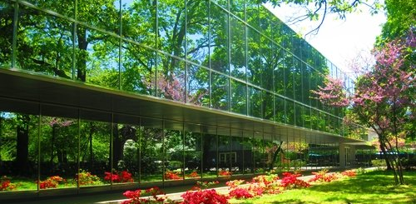
Thoughts? Comments? Questions? Suggestions?

Slide 12
Where to go for help
Online Tutorials & Recorded Workshops from the IDC:
https://www.ramapo.edu/idc
All Technology-Related Questions:
helpdesk@Ramapo.edu

Slide 13
Where to go for help
For a canvas course about backward course design using canvas (with links to many additional resources): https://canvas.ucdavis.edu/courses/34528/pages/teaching-an-online-course
Guidelines and Best Practices for slide presentations online: LINK
For non-copyrighted images: http://compfight.com/

Slide 14
Fabulous faculty
Creating active & effective remote teaching & learning Experiences:
Measuring student progress

Slide 15
Measuring student progress in remote learning environments
Notes:
----Ensuring the integrity of our assessment of student learning is our responsibility
---Situational factors related to distance learning require that we design assessments differently. All exams are open book- with short answer or objective exam questions students are good at using control F during exam and not having to read at all…
---Students have extensive access to different and much more effective resources that make cheating easy and tempting in a remote environment (Socratic by Google, peer collaboration, course-section-specific facebook pages with resoures, etc…)

Slide 16
Formulate appropriate feedback and assessment procedures
What will students have to do in order to demonstrate they have achieved the Learning Goals we set for A course?
Fink 2013
Notes:
----Many best practices for face-to-face assessment also apply to online learning assessment. Yet, there are differences between the two modalities that must be taken into account when developing online courses.

Slide 17
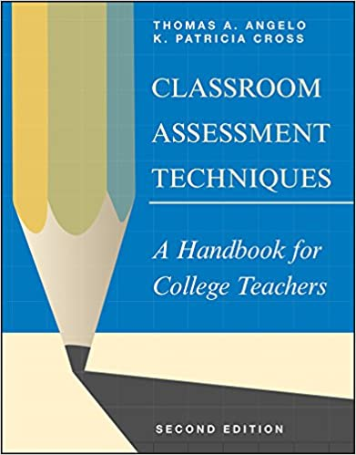
Formative assessment
the gathering of information about student learning-during the progression of a course or program and usually repeatedly-to improve the learning of those students (AACU, 2002)
Classroom Assessment Techniques
Angelo & Cross, 1993
Notes:
If you need some inspiration to get your creative mind going, we suggest some consideration of Angelo and Cross’ book—first edition LINKED

Slide 18
Classroom assessment techniques
declarative learning - content knowledge
Skill in Analysis and Critical Thinking
Minute Paper
Muddiest Point
Content form & function outline
Analytic Memos
Skill in Synthesis and Creative Thinking
Skill in Problem Solving
Concept maps
One Sentence Summary
Problem Recognition Tasks
Documented problem solutions
https://www.uky.edu/celt/50-classroom-assessment-techniques-cats
Notes:
MANY MORE One Sentence summary “Who does what to whom, when, where, how, and why?”

Slide 19
Forward-looking assessment
incorporates exercises, questions, and/or problems that create a real-life context for a given issue, problem, or decision to be addressed
Look ahead to a time after the course has ended
Consider situations where students may need or be able to use the knowledge and skills
Create a question or project or problem that replicates that real-life context
Notes:
--One way to approach the development of effective course-level assessment methods for both remote and on site courses is to create forward looking assessments
Authentic tasks are an example of this
--Different from summative or backward-looking assessment common in multiple choice and other concept-focused questions.
--The problem also should be somewhat open-ended and not totally pre-structured.

Slide 20
Forward looking assessment
Essay questions
Graded discussions (in groups or whole class)
Reading analyses/annotations
Critiques
Integration assignments
Concept maps/outlines
Problem-based questions, discussion prompts, projects
Application assignments, essay questions, papers
Journals/learning portfolios
Research projects
Presentations
Authentic tasks
It is easy to incorporate media into various assignments in Canvas
Notes:
Forward looking assessments can be delivered in multiple formats (see samples):
Pause for sharing of examples of successful assignments

Slide 21
Demo in Canvas
Pause to demo some canvas functionality and to share any successes

Slide 22
Self- assessment and peer-assessment
enhance learning and provide another method for evaluating student progress
Learning portfolios
Peer & self assessment with rubrics
Peer review
Notes:
-Qualtrics survey for peer feedback on student presentations
-Create a worksheet or google form students use to provide self- or peer assessment and grade the assessment

Slide 23
Demo in canvas
Pause to demo rubrics in canvas and to share any successes

Slide 24
The importance of criteria & standards
Explain Clearly the criteria and standards that will be used to assess student work.
Criteria for evaluation→ “What are the general traits or characteristics of high quality work in this area?”
Standards→ “On each of these criteria, how good does the work have to be, to be acceptably good or exceptionally good?”
Fink, 2003
Notes:
Discuss the benefits of rubrics
---increase motivation by linking assignment to SLO
---communicates expectations as students develop the work product
---reduce need for extensive feedback
---make grading easier
---reduce student questions about grades on writing assigments

Slide 25
Demo in Canvas
Pause to demo some canvas functionality with rubrics and to share any best practices/successes

Slide 26
Important considerations
Link assessments to Student learning goals → increased motivation and compliance
Clarity and depth of instructions → promote success and student comfort (reduce emails too…)
Accommodations?
Turnitin system
Students share…Refresh often
Notes:
Unless proctoring is available, assume all assessment is open book and students have access to the publisher’s test banks (if you use one and to the work of previous students)

Slide 27
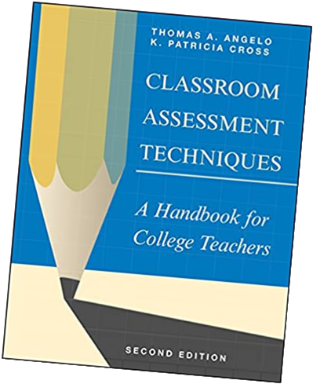
Where to go for help
FCR: Tredd@Ramapo.edu
For a listing a brief description of useful “CATS” (classroom Assessment techniques, Angelo and Cross, 1993): https://www.uky.edu/celt/50-classroom-assessment-techniques-cats
A fuller description of all “CATs”: https://library.gwu.edu/utlc/teaching/classroom-assessment-techniques-cats
A fuller description of some “CATS”: https://poorvucenter.yale.edu/Classroom-Assessment-Techniques

Slide 28
Thoughts? Comments? Questions? Suggestions?

Slide 29
Fabulous faculty
Creating active & effective remote teaching & learning Experiences:
Content Delivery

Slide 30
Content delivery
Effective Teaching and Learning Activities for Engaging Students with Course Material

Slide 31
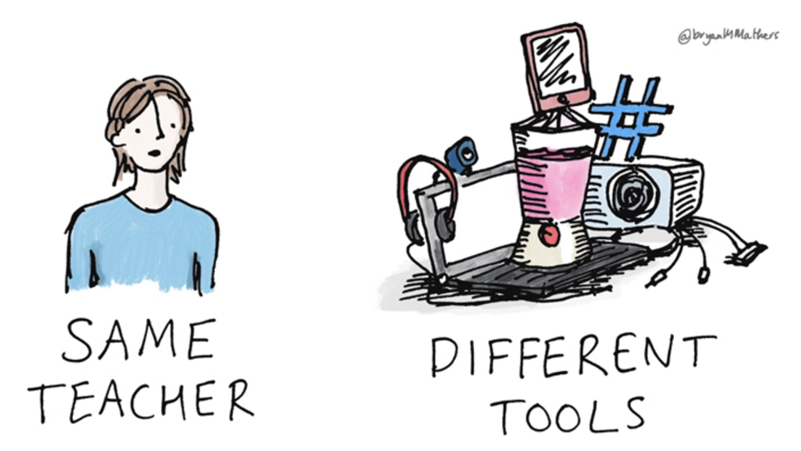
Backward course design
What would have to happen during the course in order for students to do well on the Feedback & Assessment activities? (fink, 2013)

Slide 32
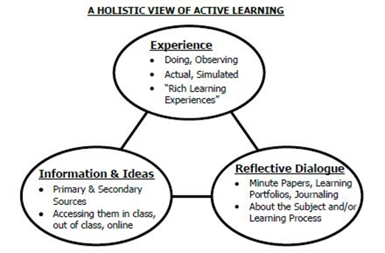
Fink’s Holistic View of active learning
https://www.freepik.com/free-photos-vectors/building">Building vector created by stories - www.freepik.com</a>
Fink, 2013
An effective set of learning activities includes all three components

Slide 33
Active & passive learning activities fink 2013
Passive Learning activities: receiving Information and Ideas→
Lecture
Reading
Videos
Receiving information from other resources (open educational resources, websites, articles, etc…)
Active Learning activities: Evaluating and or engaging with information and idea→
Doing
Observing
Writing
discussion with others,
Critique
reflective dialogue

Slide 34
Transition to remote delivery
ON SITE: lecture and discussion are most commonly used methods for engaging students with new content
In the online/remote learning context: lecture and discussion are still possible (both synchronous and asynchronous)

Slide 35
Content delivery: Lecture
Asynchronously: students participate at different times and view pre-recorded lectures (e.g. slides with voice over in TechSmith Relay)
Synchronously: students must be present online at the same time using Webex, Zoom, Google Meets, etc.
or a combination of the two

Slide 36
Content delivery: Discussion
Asynchronously: students participate at different times in writing or with video in a discussion board in CANVAS
Synchronously: students must be present online at the same time using Webex, Zoom, Google Meets, etc. or may be carried out synchronously in writing, as in a chat or discussion forum

Slide 37
Planning Synchronous events
Three and a half hours per week of live meetings is not the best idea in most courses

Slide 38
Planning Synchronous events
How Video Production Affects Student Engagement: An Empirical Study
A large-scale study from researchers at MIT that used data from 6.9 million video watching sessions. The top of the second page has recommendations for the types of videos that work best, including a recommendation that videos should be shorter than six minutes in length.
Leveraging Recorded Mini-Lectures to Increase Student Learning
This study concludes, “A majority of students believed the videos helped them learn course content and that the videos were best kept to less than 15 minutes in length.”
https://www.qualitymatters.org/qa-resources/resource-center/articles-resources/research-video-length

Slide 39
Synchronous vs asynchronous
Synchronous →
May feel more like traditional delivery
Disruption from tech issues
Students may appear to be present but not be attending
If students are not able to attend, they miss material
Asynchronous →
Increase scheduling flexibility
students can access the material repeatedly
less traditional interpersonal interaction

Slide 40
Resources for content delivery
https://www.merlot.org/merlot/
https://www.oercommons.org/
https://www.ted.com/talks
George T. Potter library (streaming video; course guides; online reference materials, etc…)
Course site and other resources from publisher

Slide 41
Canvas & other technologies
Discussion of tools for lectures/discussions
Sharing successes and best practices

Slide 42
Content delivery: active learning activities
effectively and deeply engage students with content but do not require lecture (or may be a complement to brief lectures/discussions)
“[involving] students in doing things and thinking about the things they are doing” (Bonwell & Eison, 1991)
debates, simulations, guided design, small group problem solving, case studies, etc.
<a href="https://www.freepik.com/free-photos-vectors/infographic">Infographic vector created by upklyak - www.freepik.com</a>

Slide 43
Holistic Active learning Fink 2013

Slide 44
Common Active Learning tasks
Problem-based assignments
Reading analyses
Analyses of observations
Experiential activities
Discussions
Peer reviews
CLASSROOM Assessment Techs
Service Learning
Situational Observations
Authentic Projects
Case studies
Simulations
Research activities
presentations
Your choice of product and the learning activity designed to generate the work product
should be determined by the learning outcomes
…and this should be obvious to students
Any tangible product from a learning activity can be used as evidence of progress (assessment)

Slide 45
Active learning: Reflective Dialogue FINK 2013
“In-depth Reflective Dialogue” for students to think and reflect (And write) about what they are learning, how they are learning, and the significance of what they are learning.
One can reflect with oneself (as in writing in a journal) or with others (as in engaging in discussions with a teacher or others)

Slide 46
Reflective dialogue
Paper, journal, learning portfolio: What am I learning? What is the value of what I am learning? How am I learning? What else do I need to learn?
One-minute paper: The teacher poses a short, but well-focused, question for students to answer once a week or at the end of each class.
“What is the most important thing you learned today? What is the “muddiest point” of this class?”

Slide 47
Pause for demos
…or for sharing successes

Slide 48
Integration: goals, Assessment and activities
Learning Outcomes | Assessment Method | Learning Activities | Content and Resources Needed

Slide 49
Common mistakes for beginners
Spending too much time adding content, bells and whistles
Using test bank multiple choice exams
Thinking 3 hours of synchronous activity would be a good idea in a remote context
Not thinking enough about building community and providing informal access to meetings with me
Lack of clear instructions, standards and grading criteria

Slide 50
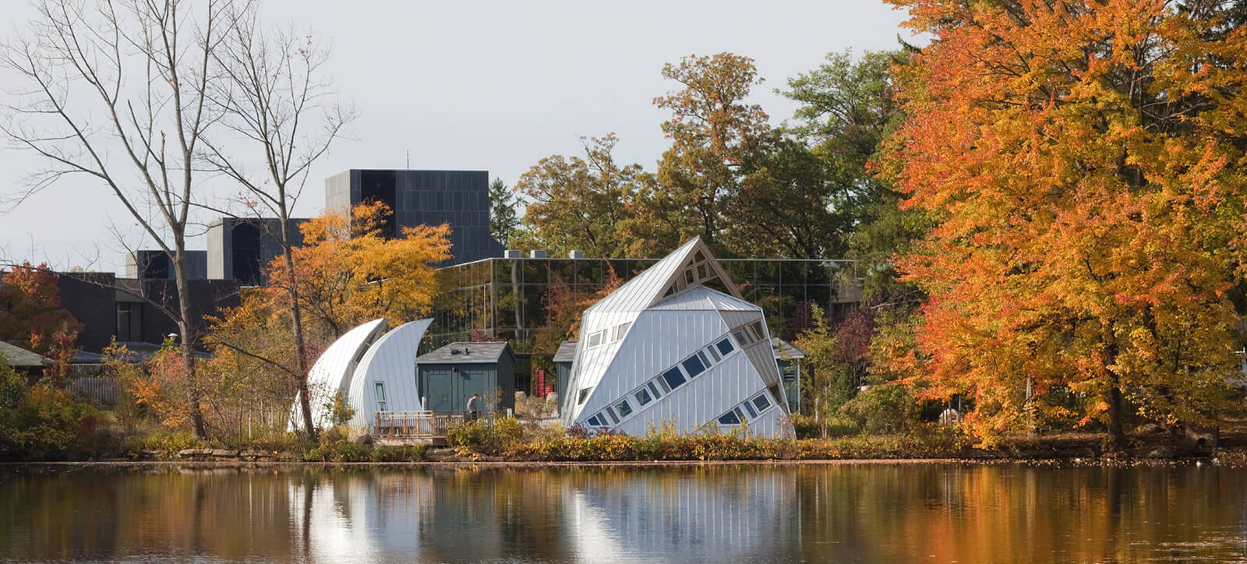
Thoughts? Comments? Questions? Suggestions?

Slide 51
Sample course design: Assessment
Weekly chapter quizzes (CATS & short essay)
Weekly problem-based discussion Questions (teams of 4 or 5)
biWeekly experiential activity →“iConnect papers”
Semester long applied research projects or service projects or case analysis→ journaling and final paper (individually or in groups)
Final reflection paper

Slide 52
Sample course design: Learning activities
Receiving info and ideas
Assigned Readings
Documentaries
Brief lectures/ demonstrations using tech smith
Weekly office hour
EXPERIENCING AND REFLECTION Research
Discussion
Reflection
Self & Peer assessment
Service/research
Application activities (iConnect activities)

Slide 53
Sample iConnect assignments 3 page limit
Reading or case analysis (integration or examination of theory/research)
Respond to critical thinking question of the week
Observe a person or system and apply/consider X theory or concept (several options like this with different theories or concepts)
Conduct an interview and analyze the data using course concepts
Critical analysis of documentary, movie or research article applying knowledge from course (multiple options)
“You choose” Students create their own iConnect assignment

Slide 54
iconnect rubric
F = unsatisfactory or no submission
C / D = Summary level work. The student has carried out the required activity as instructed and demonstrates familiarity with the course material, but analysis or application is lacking or inconsistent
B = Analytic level work. The student has carried out the required activity as instructed and demonstrates the ability to critically analyze material and experience. Application of course content and/or depth of analysis /critical thinking need development.
A = Synthesis level work. The student has carried out the required activity as instructed and demonstrates the ability to critically evaluate course experience and material; integrate course knowledge, prior knowledge & experience; apply knowledge of psychology. The final product suggests the development of new knowledge.

