Slide 1
Building community using online resources
Share my experience of successfully translating a course with a 16 hour weekend in person component to fully online
Share some tools and ideas from that experience
Participants will have new ideas for teaching online, including community building

Slide 2
The resources I used: Content from experts in the field
Alexander Street videos via Ramapo College Library
Webinars
Including a webinar on providing play therapy via telehealth during covid!
YouTube
Podcasts

Slide 3
Tips: Content from experts in the field
Who are the experts on the topic? Try the library first for high quality content, then Google search. Terms like “video” and “lecture” helped. Select high quality content. This takes alot of time.
Develop meaningful questions to ensure task completion and make learning meaningful and relevant. Content and application. This also takes a lot of time.
Students will now have ‘engaged’ with the experts in the field.

Slide 4
The resources I used: Content from professional organizations
National Association of Social Workers
Code of ethics
Association for Play Therapy
Best practices
Free graduate student membership
Includes a listserv, electronic magazine and journal subscription

Slide 5
Tips: Content from professional organizations
Are there professional organizations, groups, associations that share high quality content and/or offer free student memberships?
Student can engage with, and possibly join those communities.

Slide 6
The resources I used: WebEx
Synchronous recorded sessions
Students attended live if possible
Recordings were sent to students who could not attend live
Send me an email: one thing you learned, any questions you have
Attendance credit
Depending on length, recording available 1-5 hours later

Slide 7
The resources I used: WebEx
I needed to create some original content when available sources were lacking.
I recorded lectures with PowerPoint and WebEx.

Slide 8
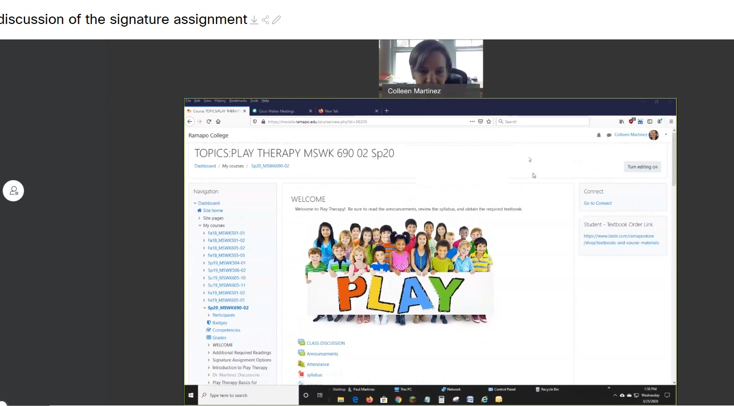
The resources I used: WebEx
I needed to answer all of the students’ questions about the assignment options.
I recorded discussions with my course shell, PowerPoint and WebEx.

Slide 9
The assignment
Originally a paper
Paper as an option, video presentation with submission of some materials as another option
Less writing, formatting required
Clinical presentation skills are equally valuable

Slide 10
About 2/3 chose the video presentation, most used Webex.
Emailed link,
or MP4 file

Slide 11
Grading process
Outcomes

Slide 12
My lessons learned
Being forced to think outside of the box made me try new things, and I’m glad I did
Being flexible with assignments can be better for me and my students’ learning
I miss being with my students
They miss being together

Slide 13
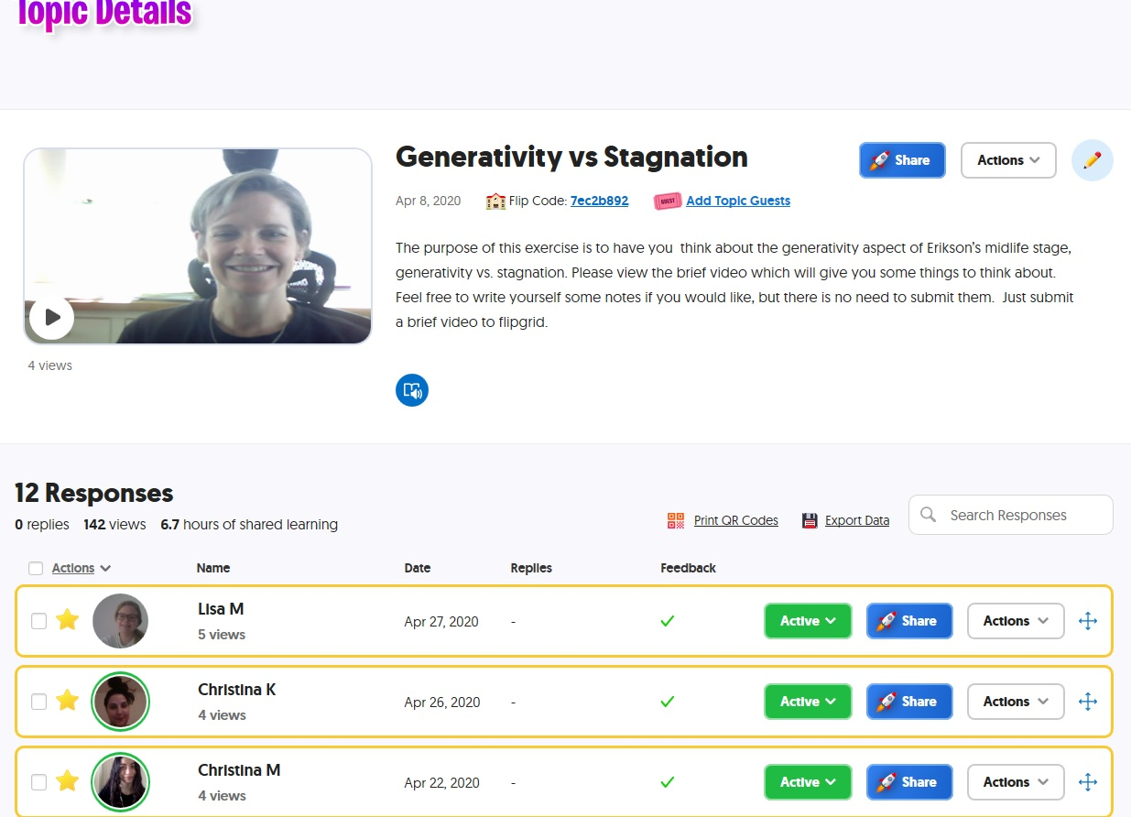
The resource I didn’t use in this class, but will in the future: Flipgrid
Flipgrid allows video posts by educators with a free account. Students respond in video format. They can see and react to each other’s videos.

Slide 14
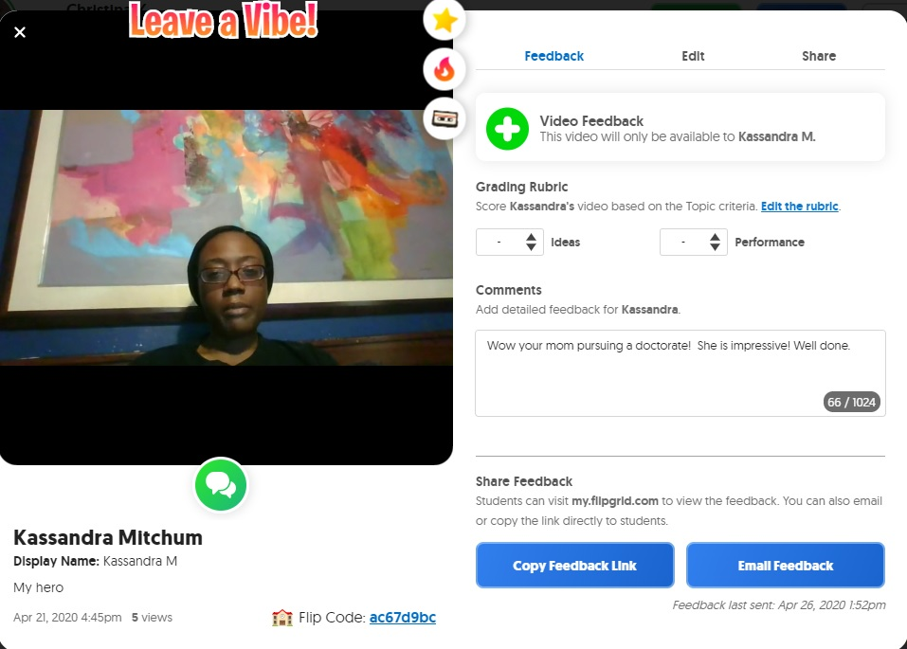
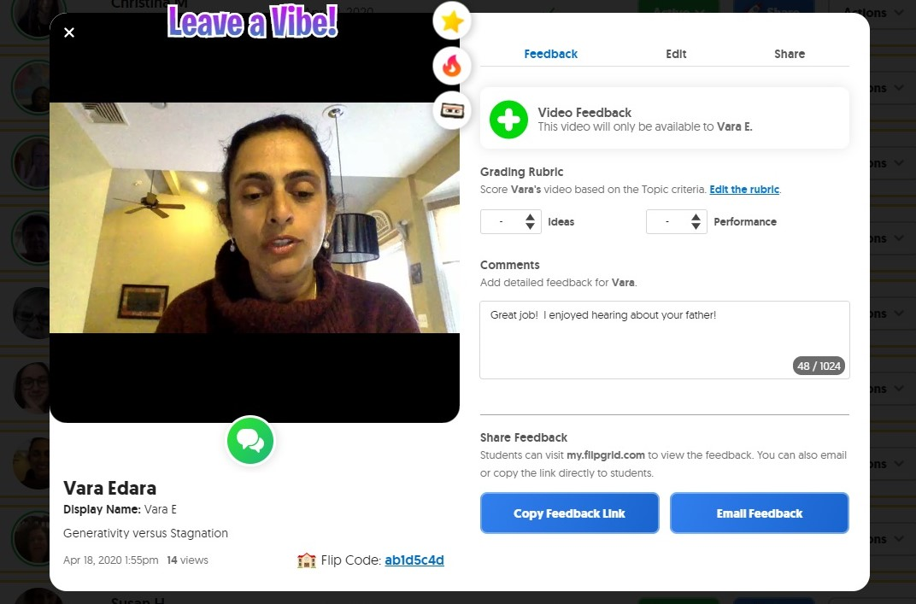

Slide 15
How did we build community?
Students connected with me, and each other
Audio
Video
Live/Synchronous
Asynchronous
Students engaged with content from experts in the field
Students engaged with, and became student members of a professional organization

Slide 16
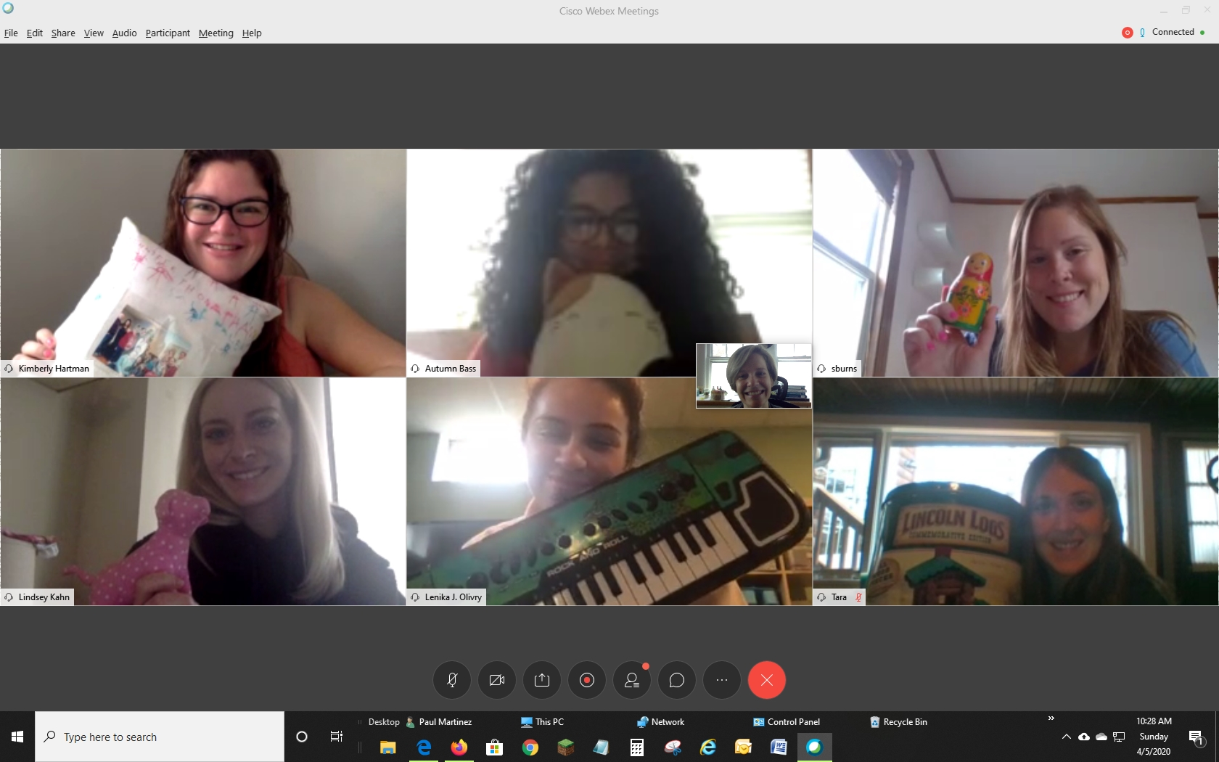
Community is necessary and possible!

Slide 17
Questions? Resources?
Colleen Martinez, PhD, LCSW, RPT-S School of Social Science and Human Services Social Work Program
cmarti13@ramapo.edu
Stay well, thank you, I can’t wait to see you again!

