Slide 1
How to organize team projects in canvas
Christina Chung
Marketing

Slide 2
Project Section in Canvas Home Page

Slide 3
[1] IMC CAMPAIGN MATERIALS
Post campaign materials and open step-by-step based on the schedule
FOR EACH GROUP
[2] GROUP DATABASE
Students save group work in their team group database:
All members can share their files
Professor sends feedback:
Team members can receive feedback at the same time
[3] GROUP ASSIGNMENT DROPBOX
Team leader (or one of group members) submits a group project assignment
All team members can see when and what they submitted

Slide 4
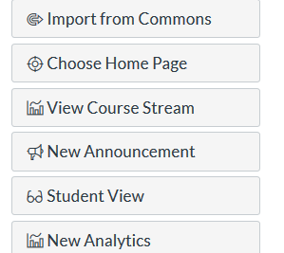
Project section in Canvas Front Page
[1] Click “Pages” and create a front page
[2] Publish and choose “use as front page” from
[3] Go to Home page and Click “Choose Home page”
[4] Click Edit
[5] Add titles (ex: Project Materials, Group Database, Group Assignment Dropbox, etc). Also, you can add icons.

Slide 5
How to create (1): Project Materials section
[1] Save all group materials in Files
[2] Make a Module and post all group materials from the Files
[3] From the Home page, click “Edit.”
[4] Write the title (ex: Project Materials)
[5] Connect to the Module
[6] Open materials step-by-step

Slide 6
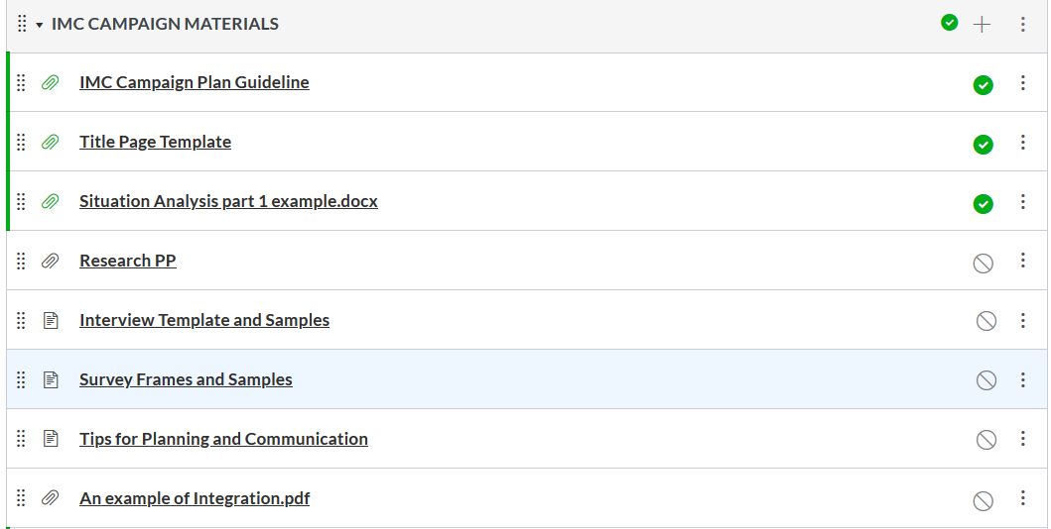
Project Materials Module

Slide 7
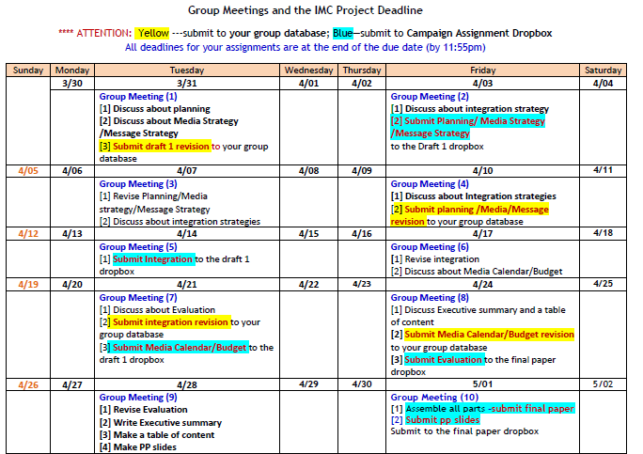
Project schedule and agenda

Slide 8
Create Group
Click “People” → Choose groups→ make groups
Add students to each group

Slide 9
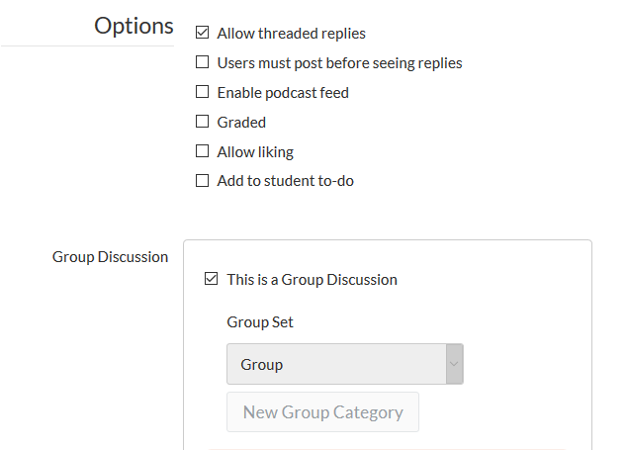
How to create (2): Group Database
Create one “Discussion”
Title: Group Database
Mark on
Click “Save”

Slide 10
Group Database: Student View
They will see only their group.

Slide 11
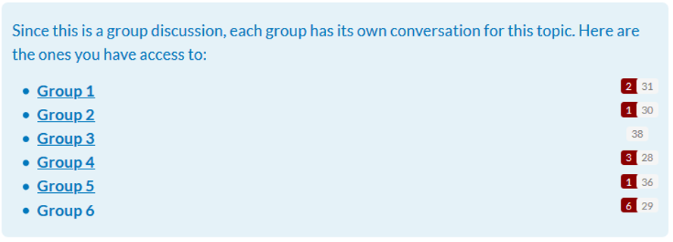
Group Database: Instructor’s View

Slide 12
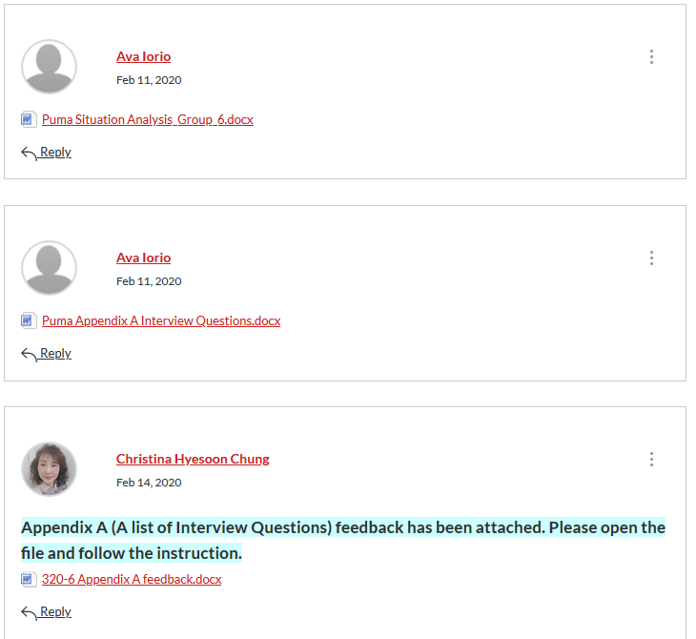

Slide 13
How to create (3): Group Assignment Dropbox
Using the “Discussion,” make each assignment drobox and give a title to each discussion
Mark on “This is a Group Discussion”
Create a Module
Add all group assignment dropboxes to the Module
From the Home page, make a title, “Group Assignment Dropbox,” and connect to the Module.

Slide 14
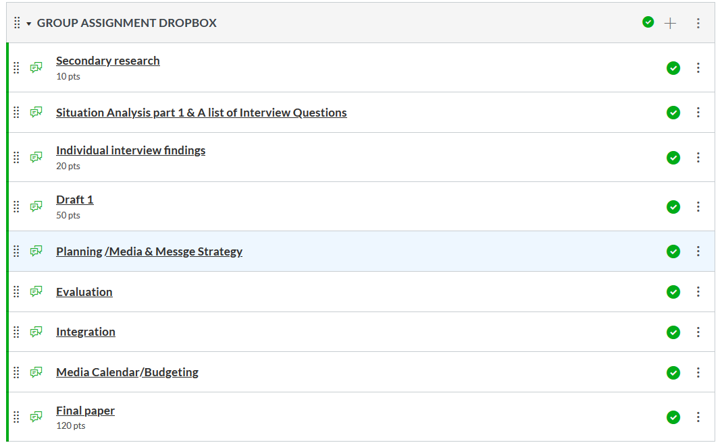
Group Assignment Dropbox Module

