Slide 1
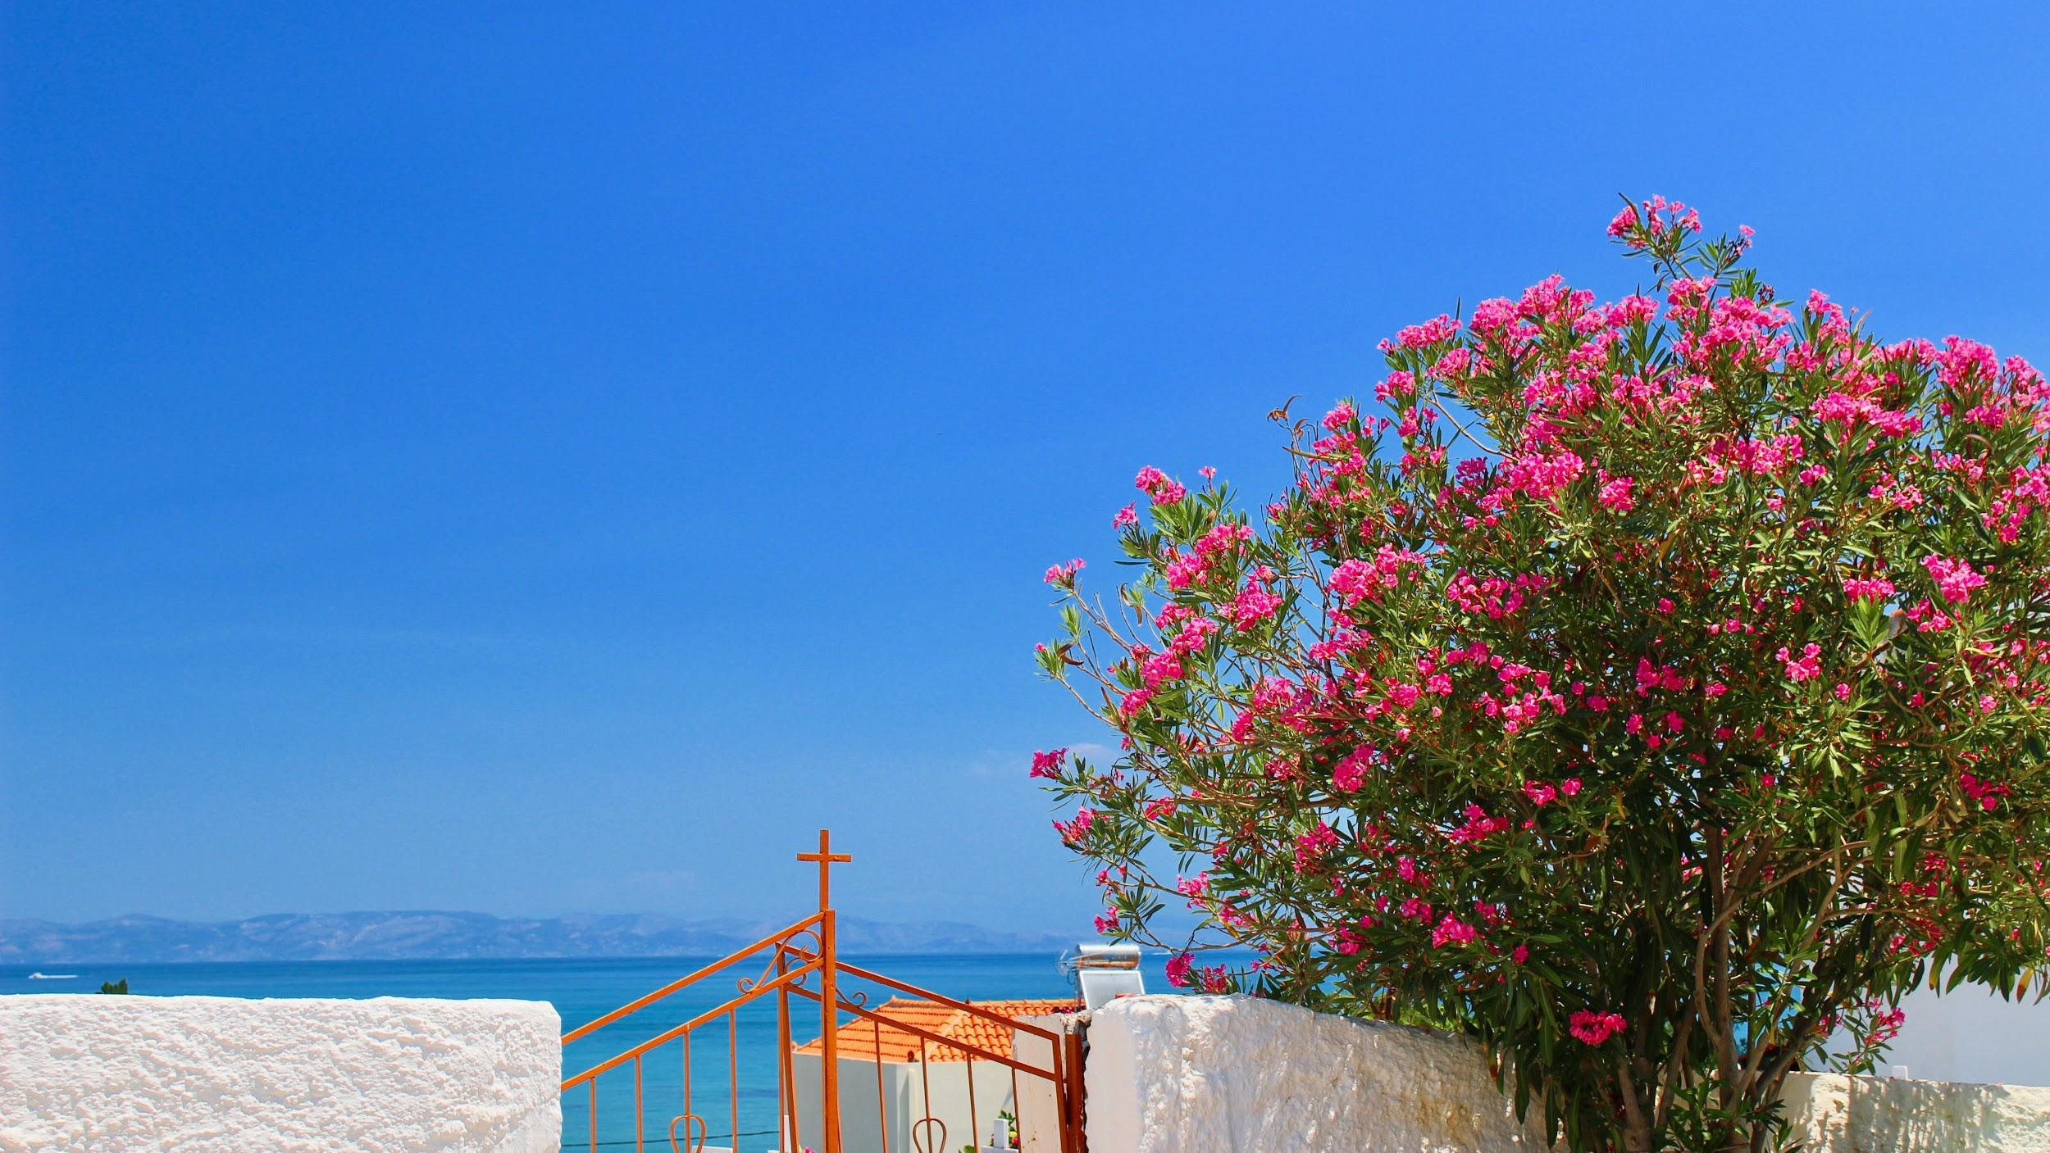
ÉRROSTHE
AUTHOR:
Mehnaz Ladha
ADVISORS:
Rebecca Leung, Edna Negrón
& Rebecca Root

Slide 2
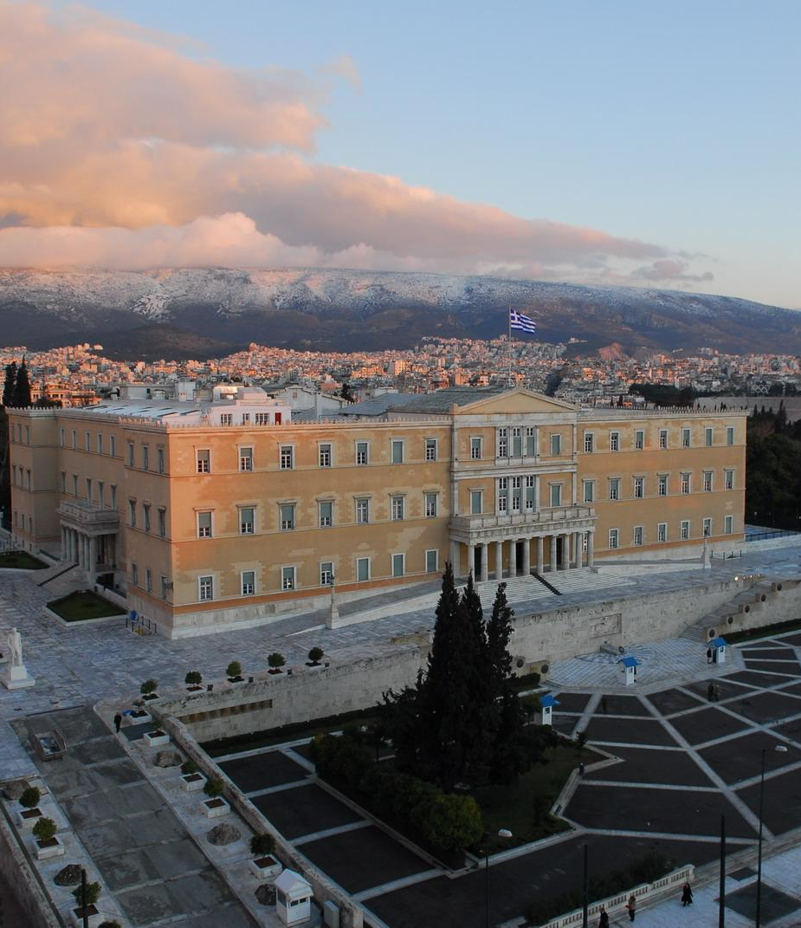
EXPLAINING THE BAILOUT CRISIS
— — —
Contributing Factors
The Trigger Point
Conditions of Austerity

Slide 3
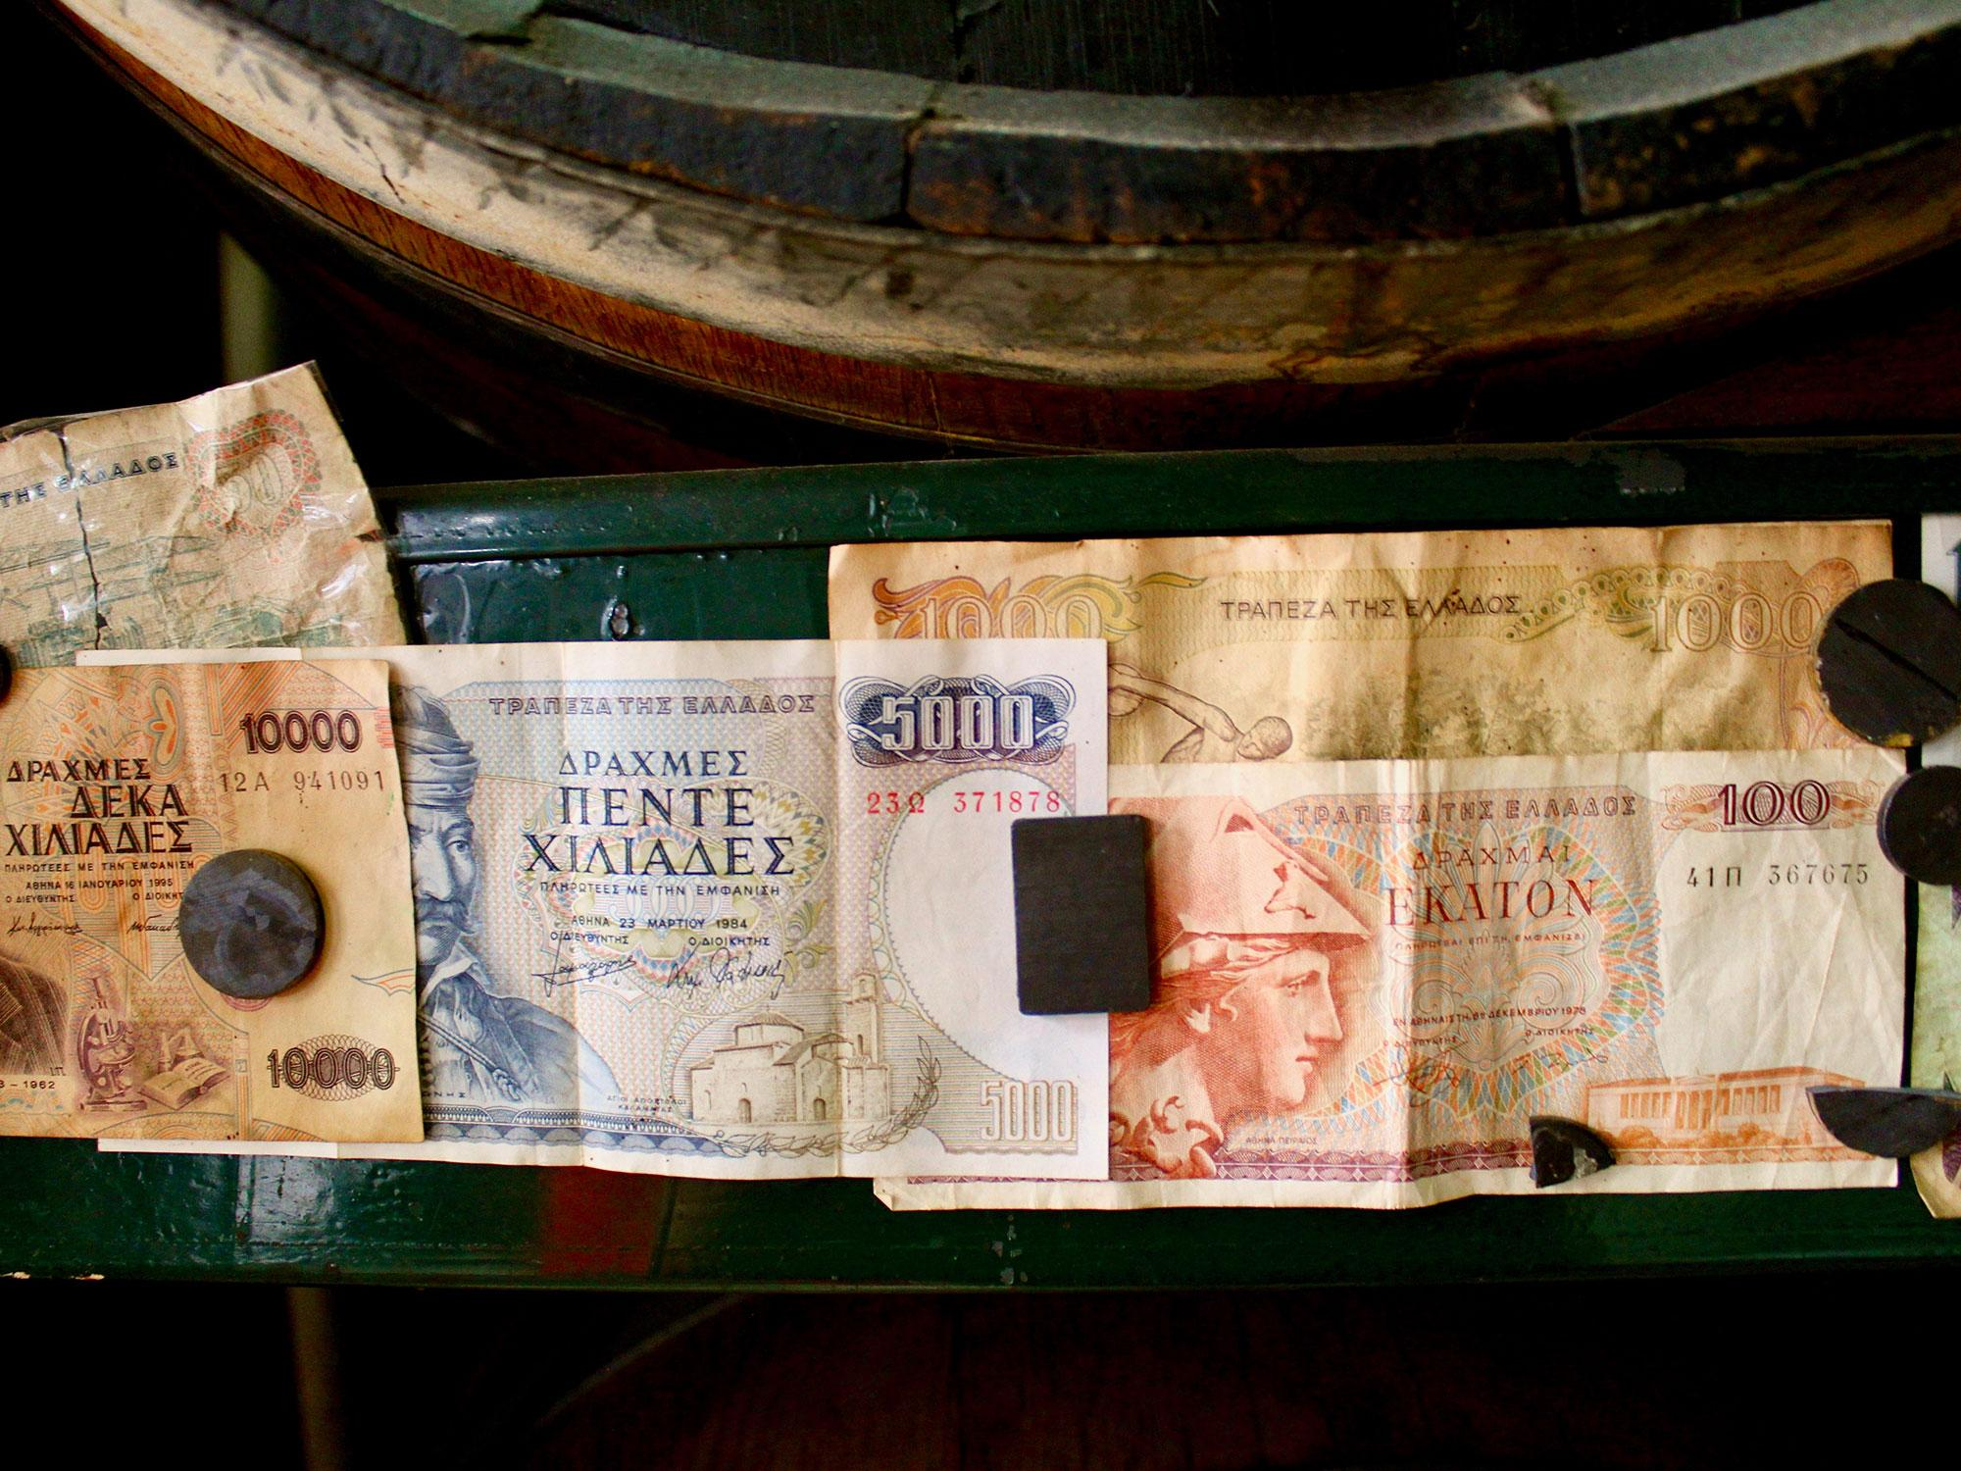
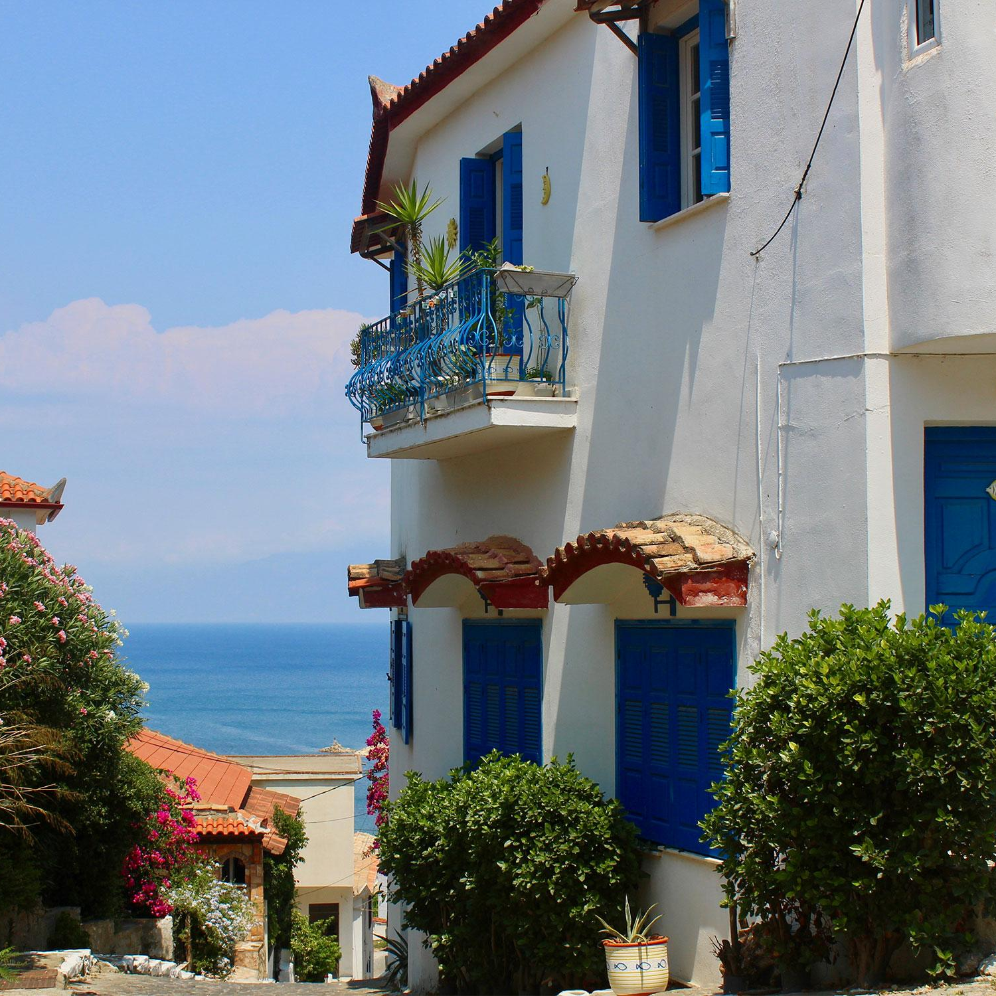
THE EXPERT OPINION
ODYSSEAS KATSAITIS
DEREE - The American College of Greece
AIMEE PLACAS
DIKEMES - College Year
in Athens
ANDREAS PAPANDREOU
National University
of Athens

Slide 4
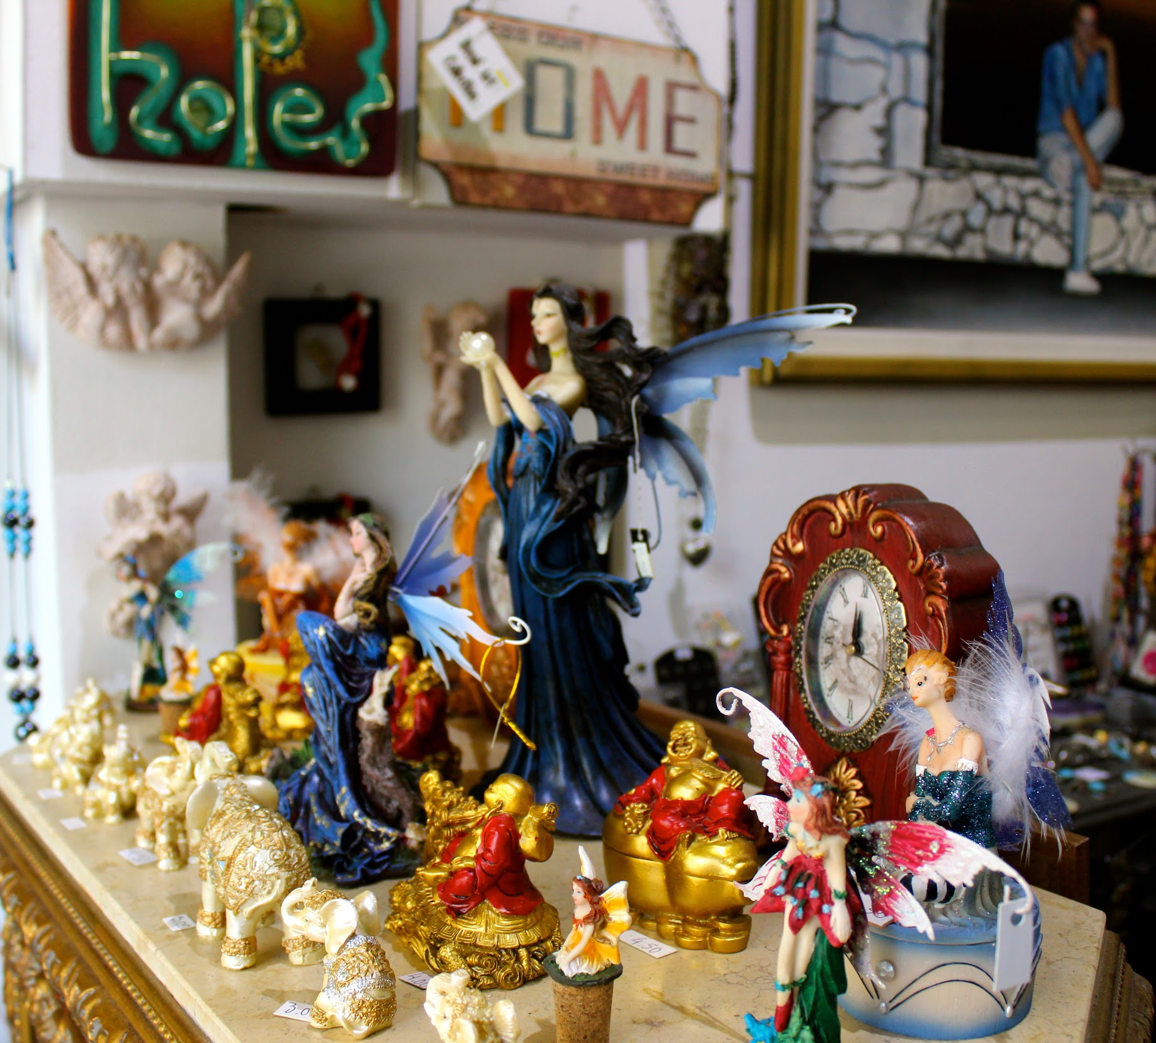
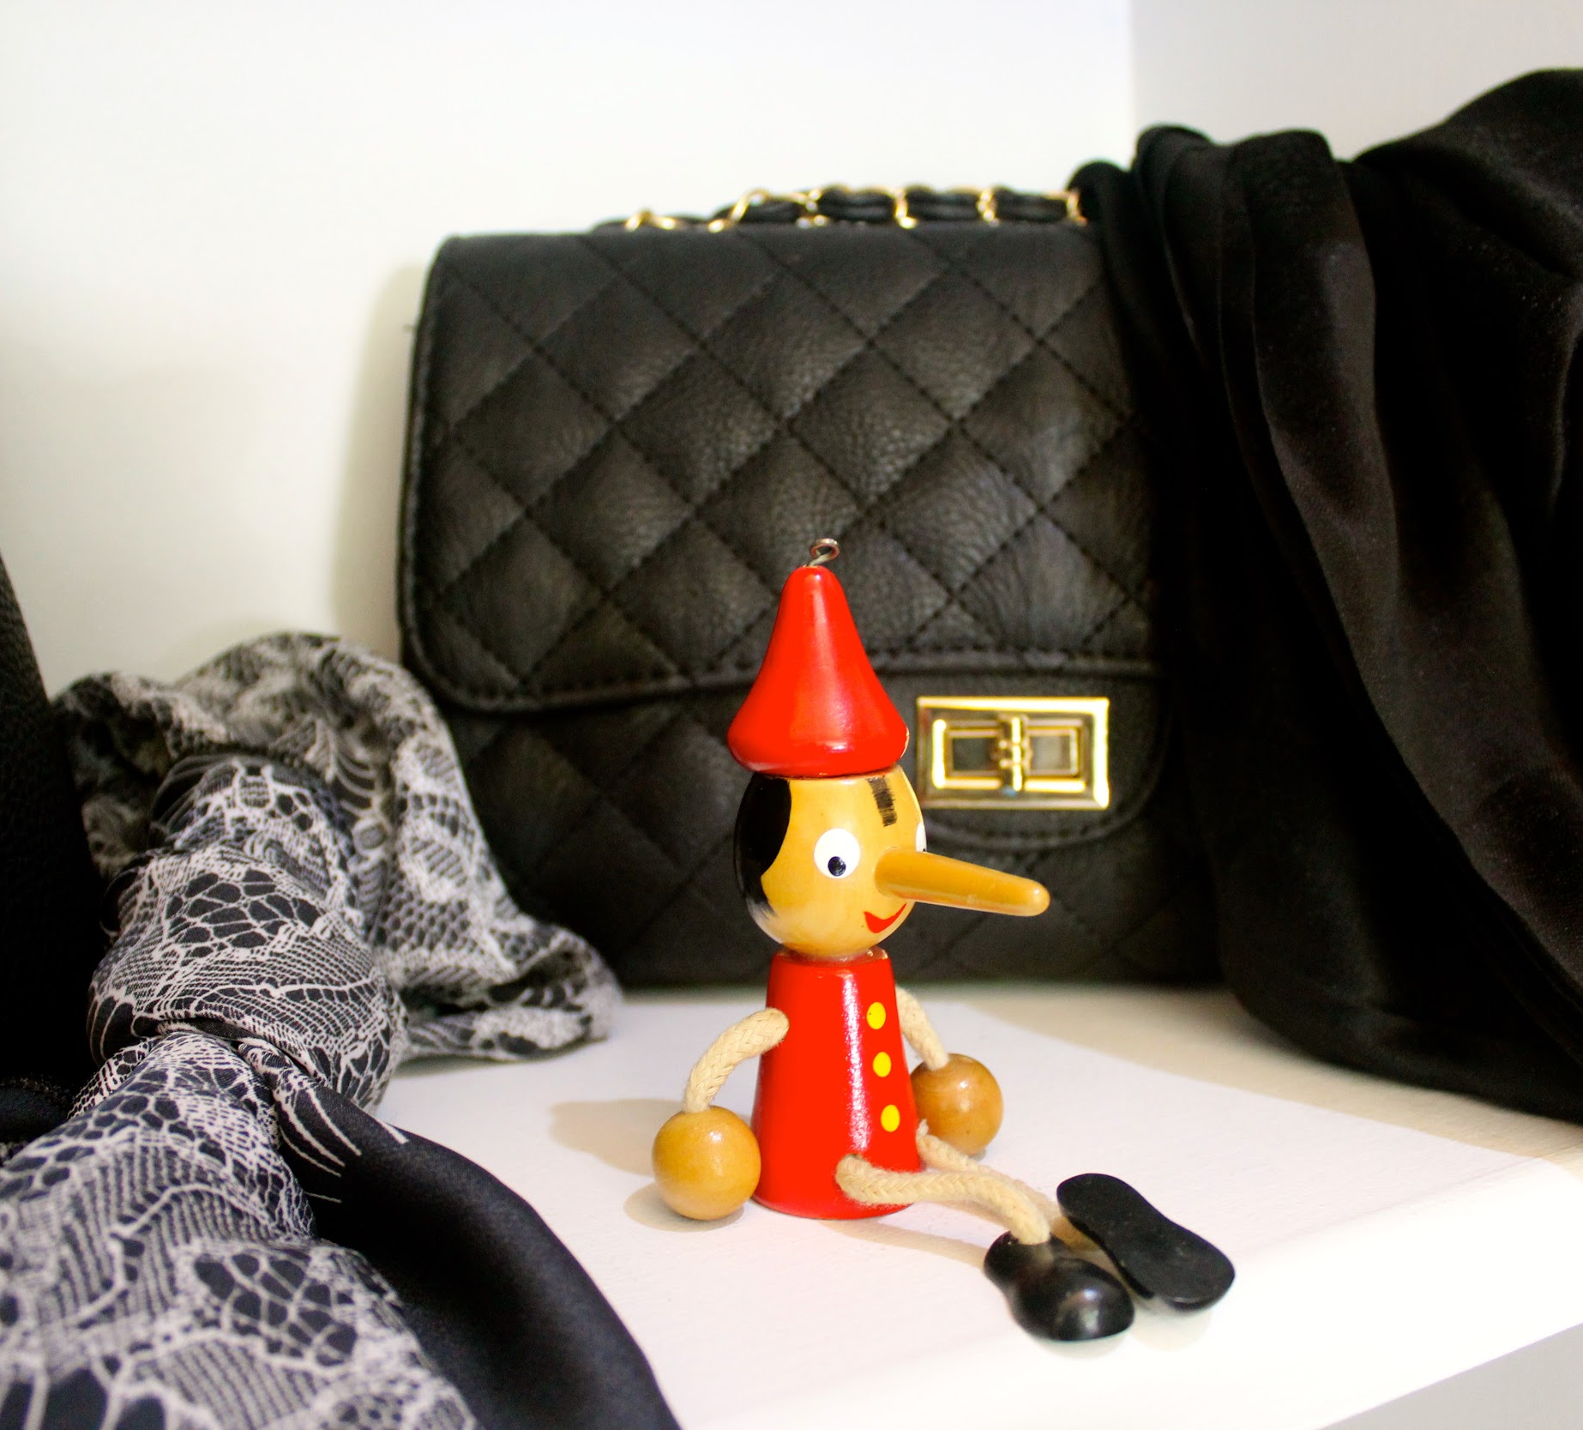
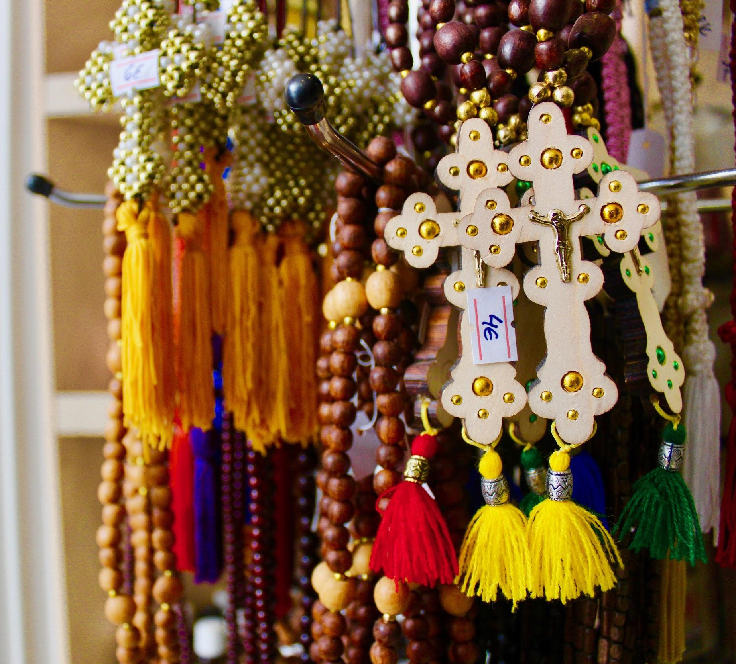
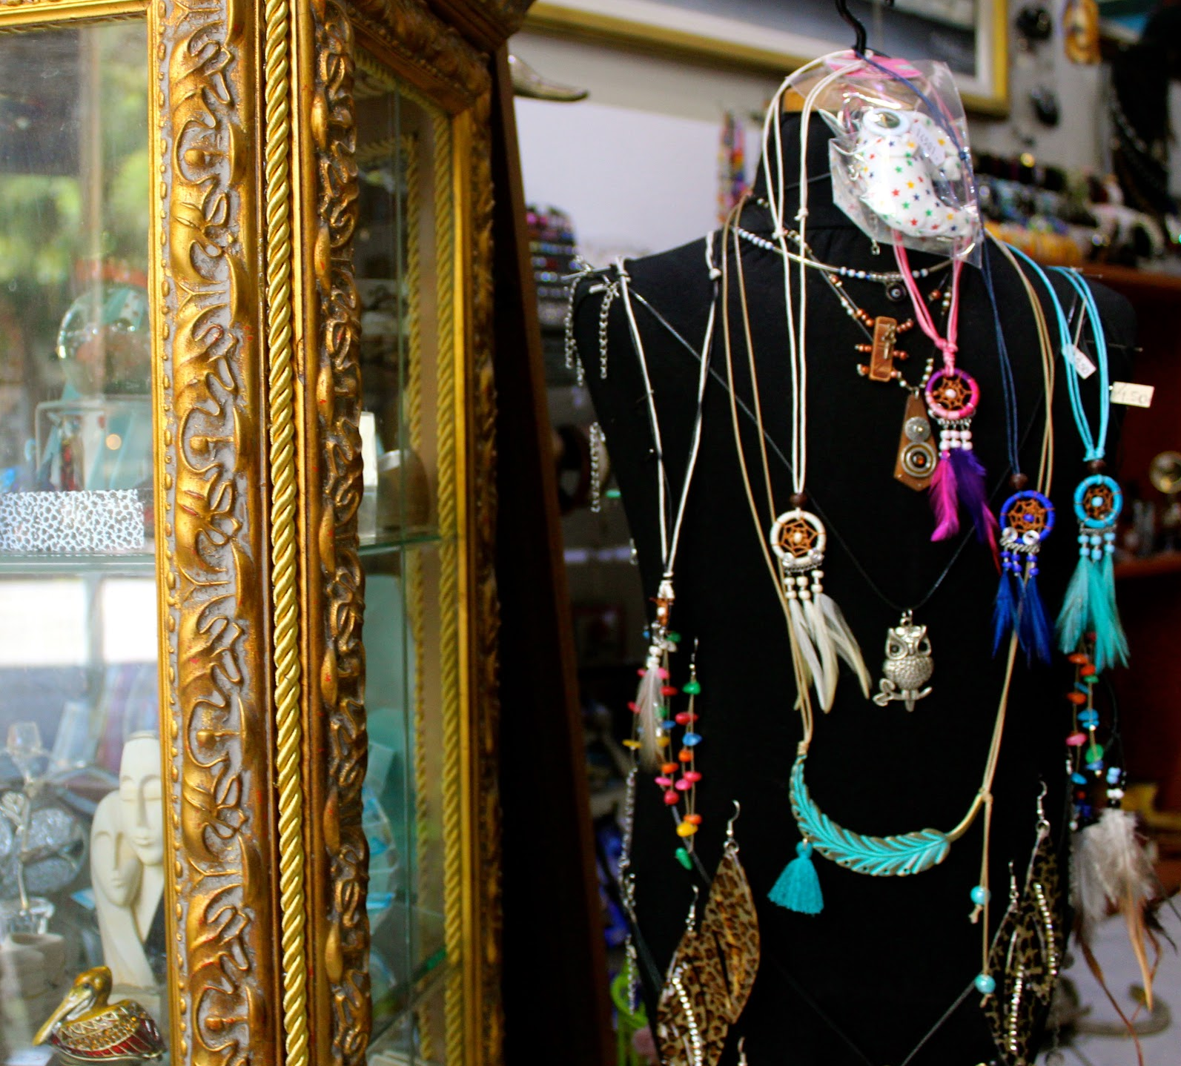
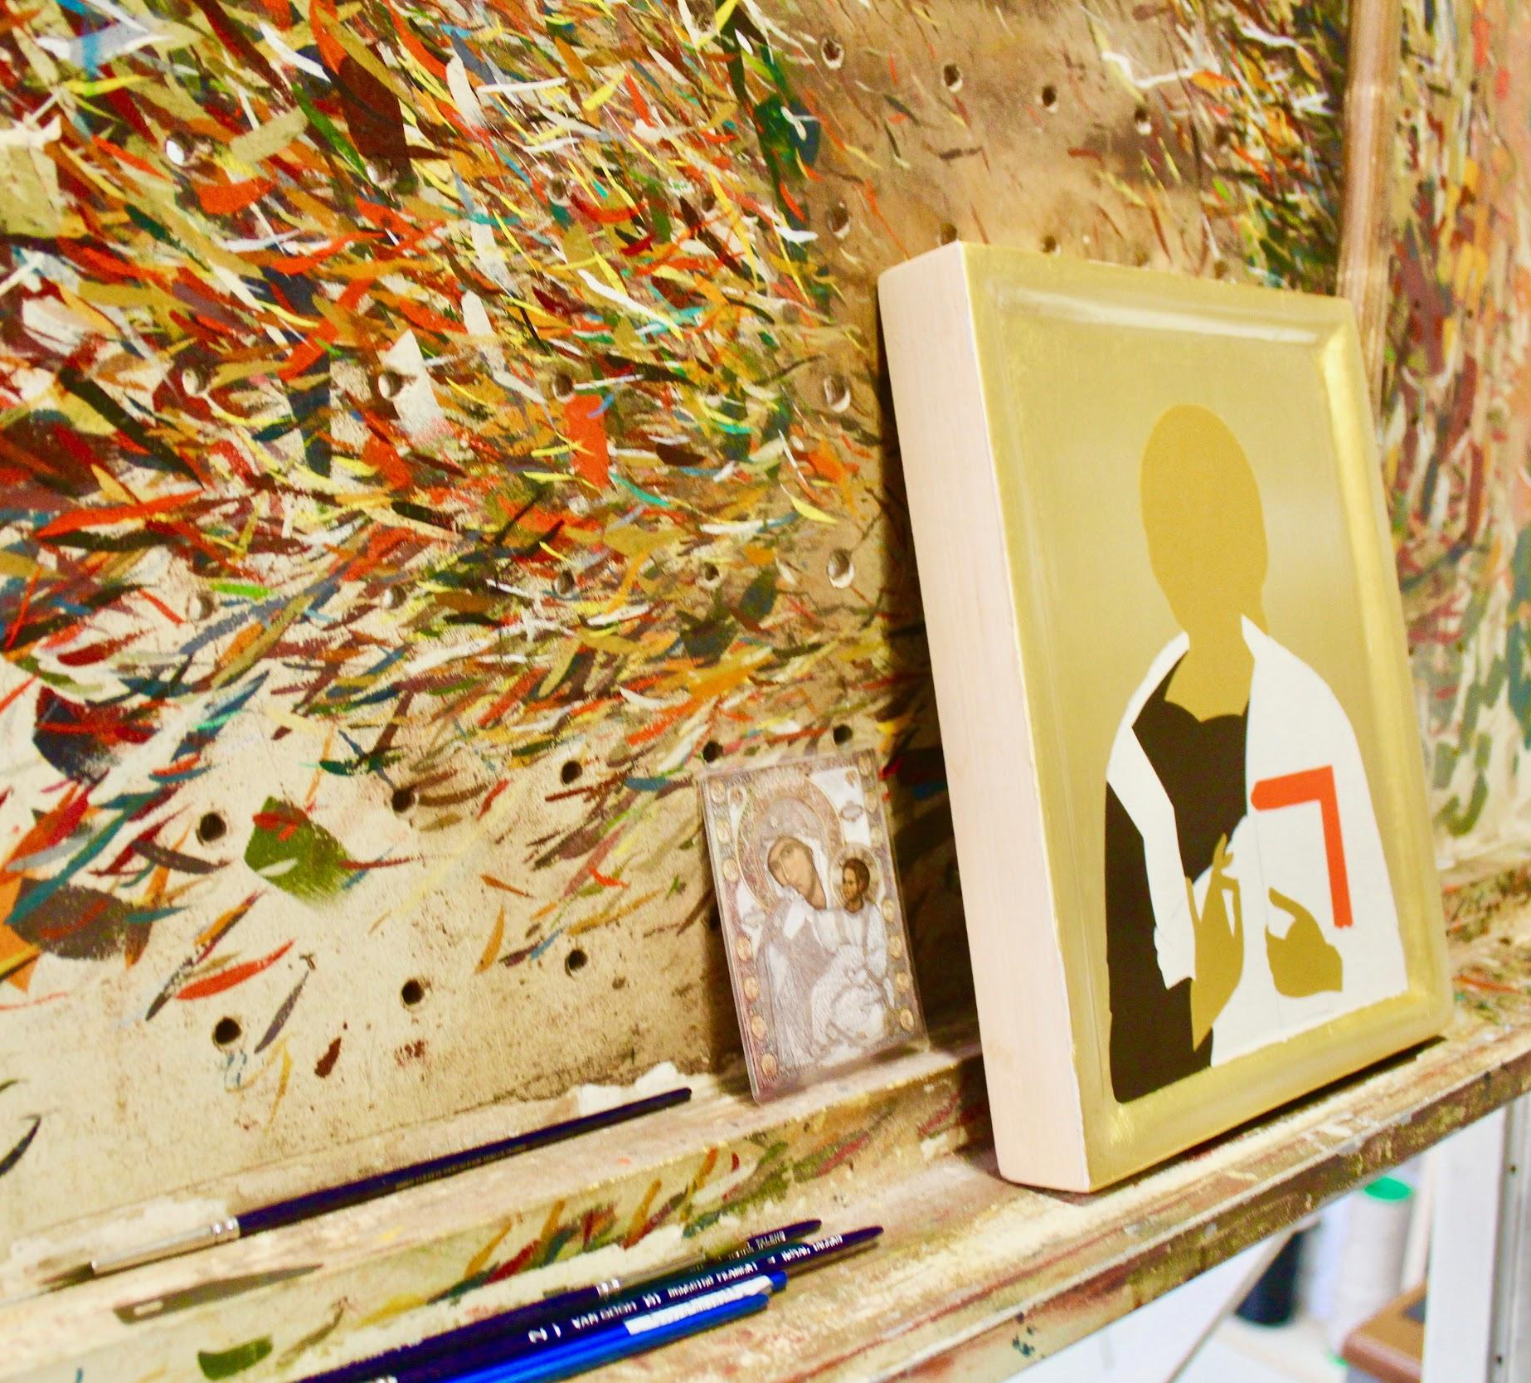
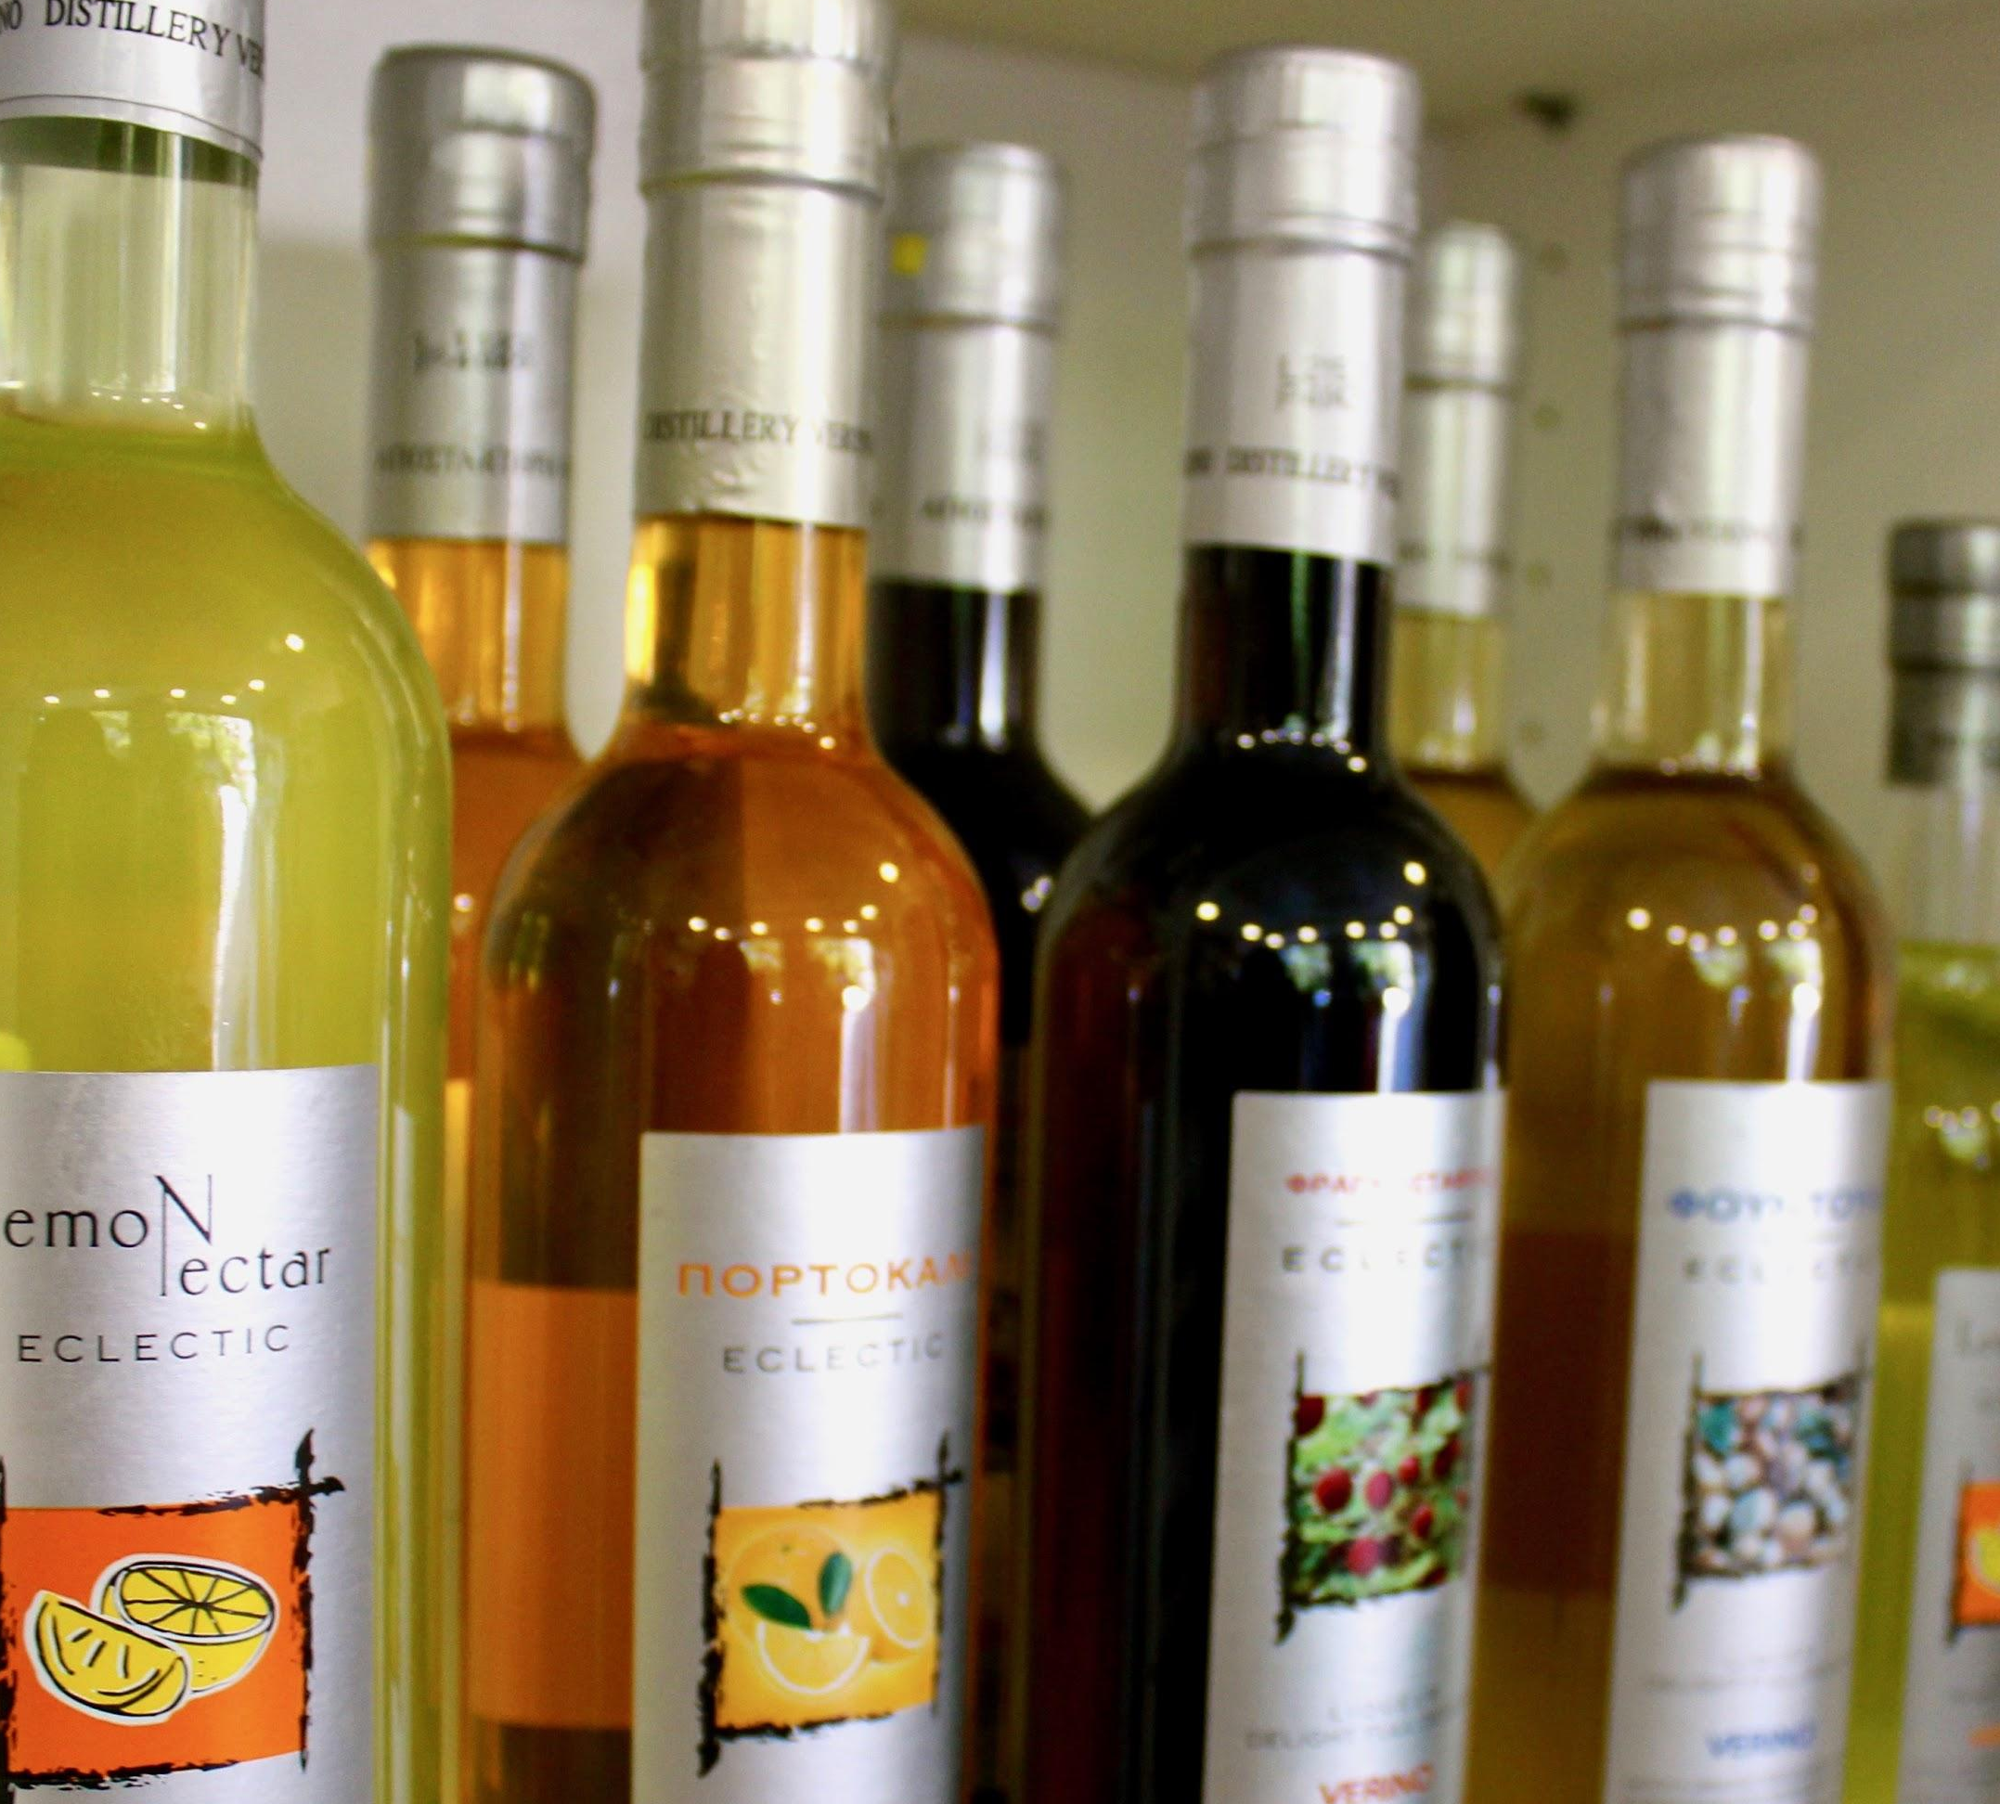
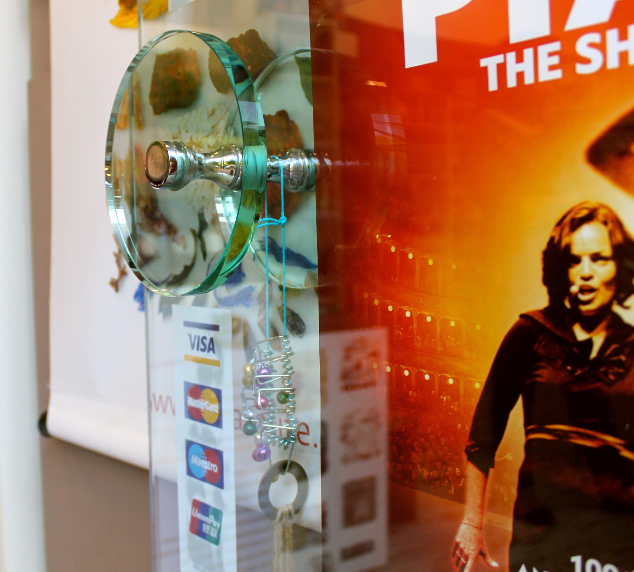
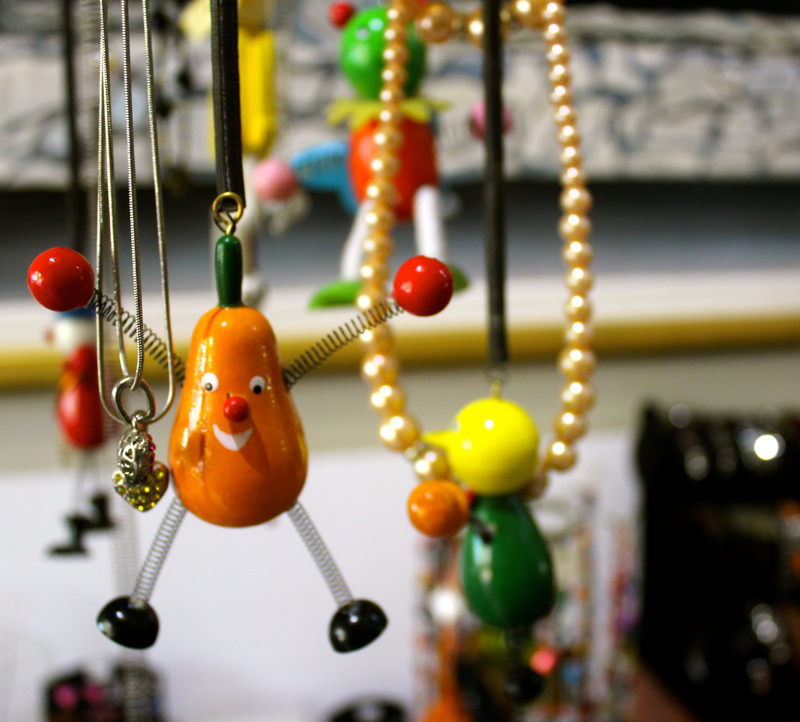
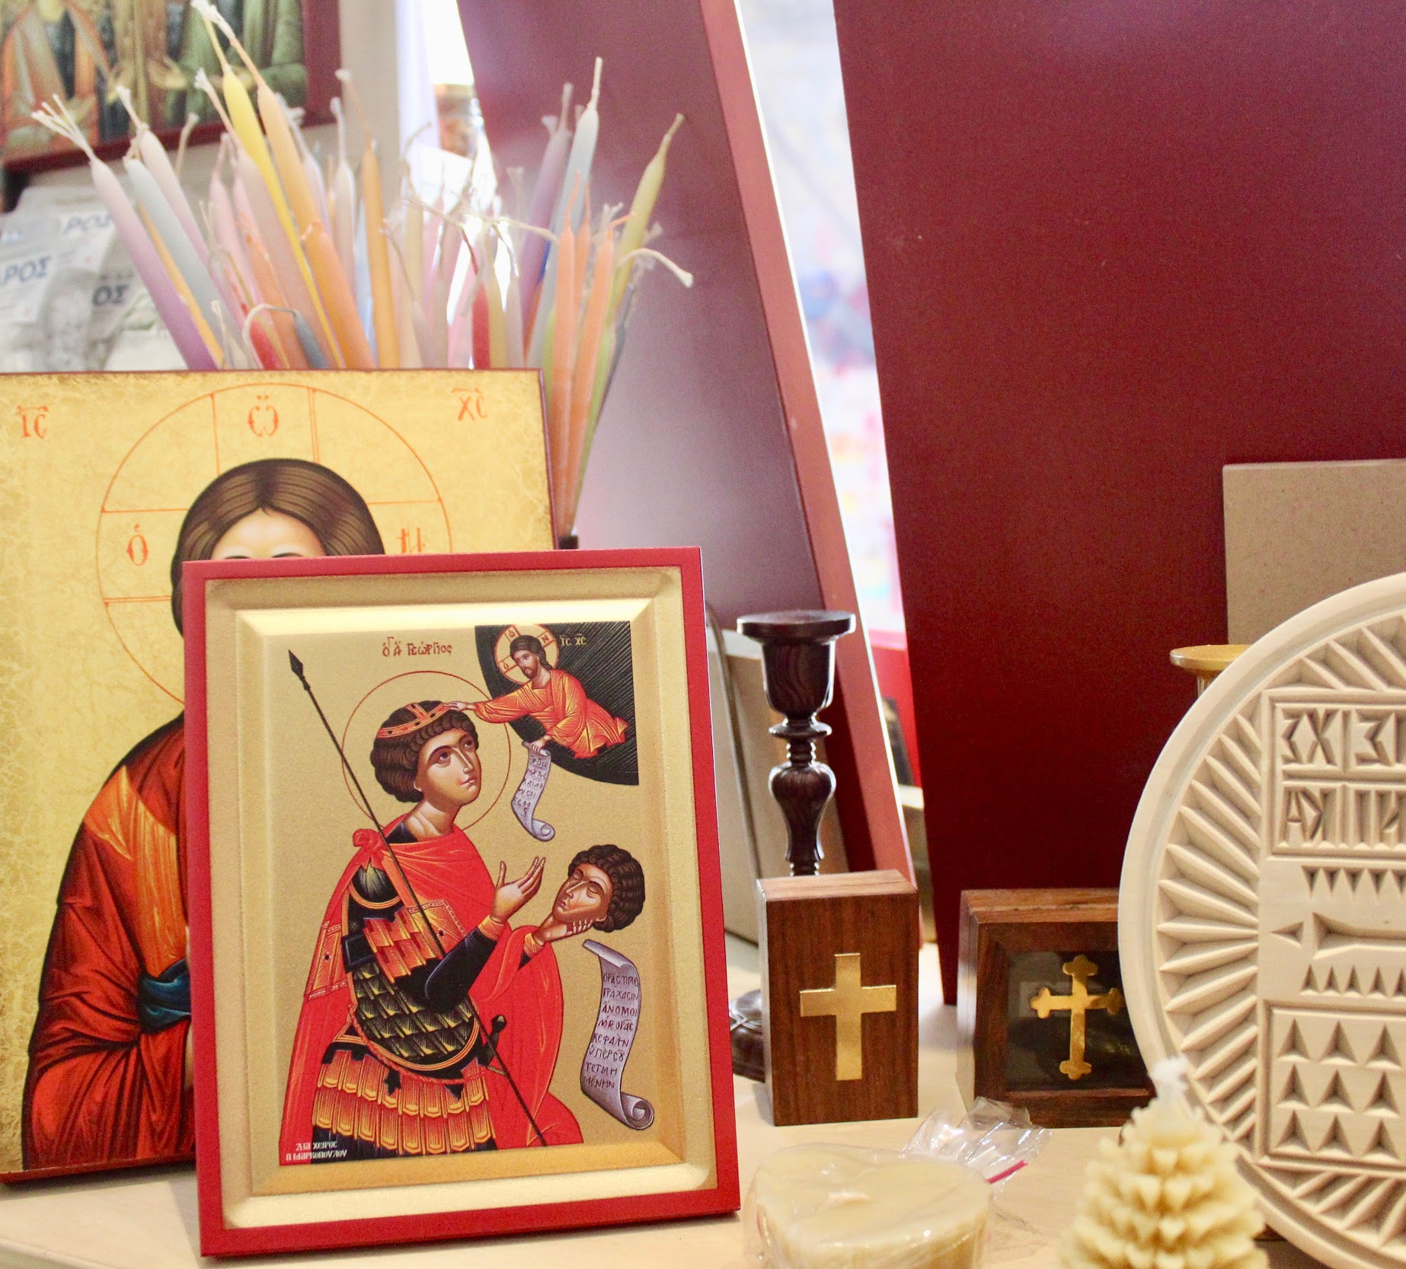
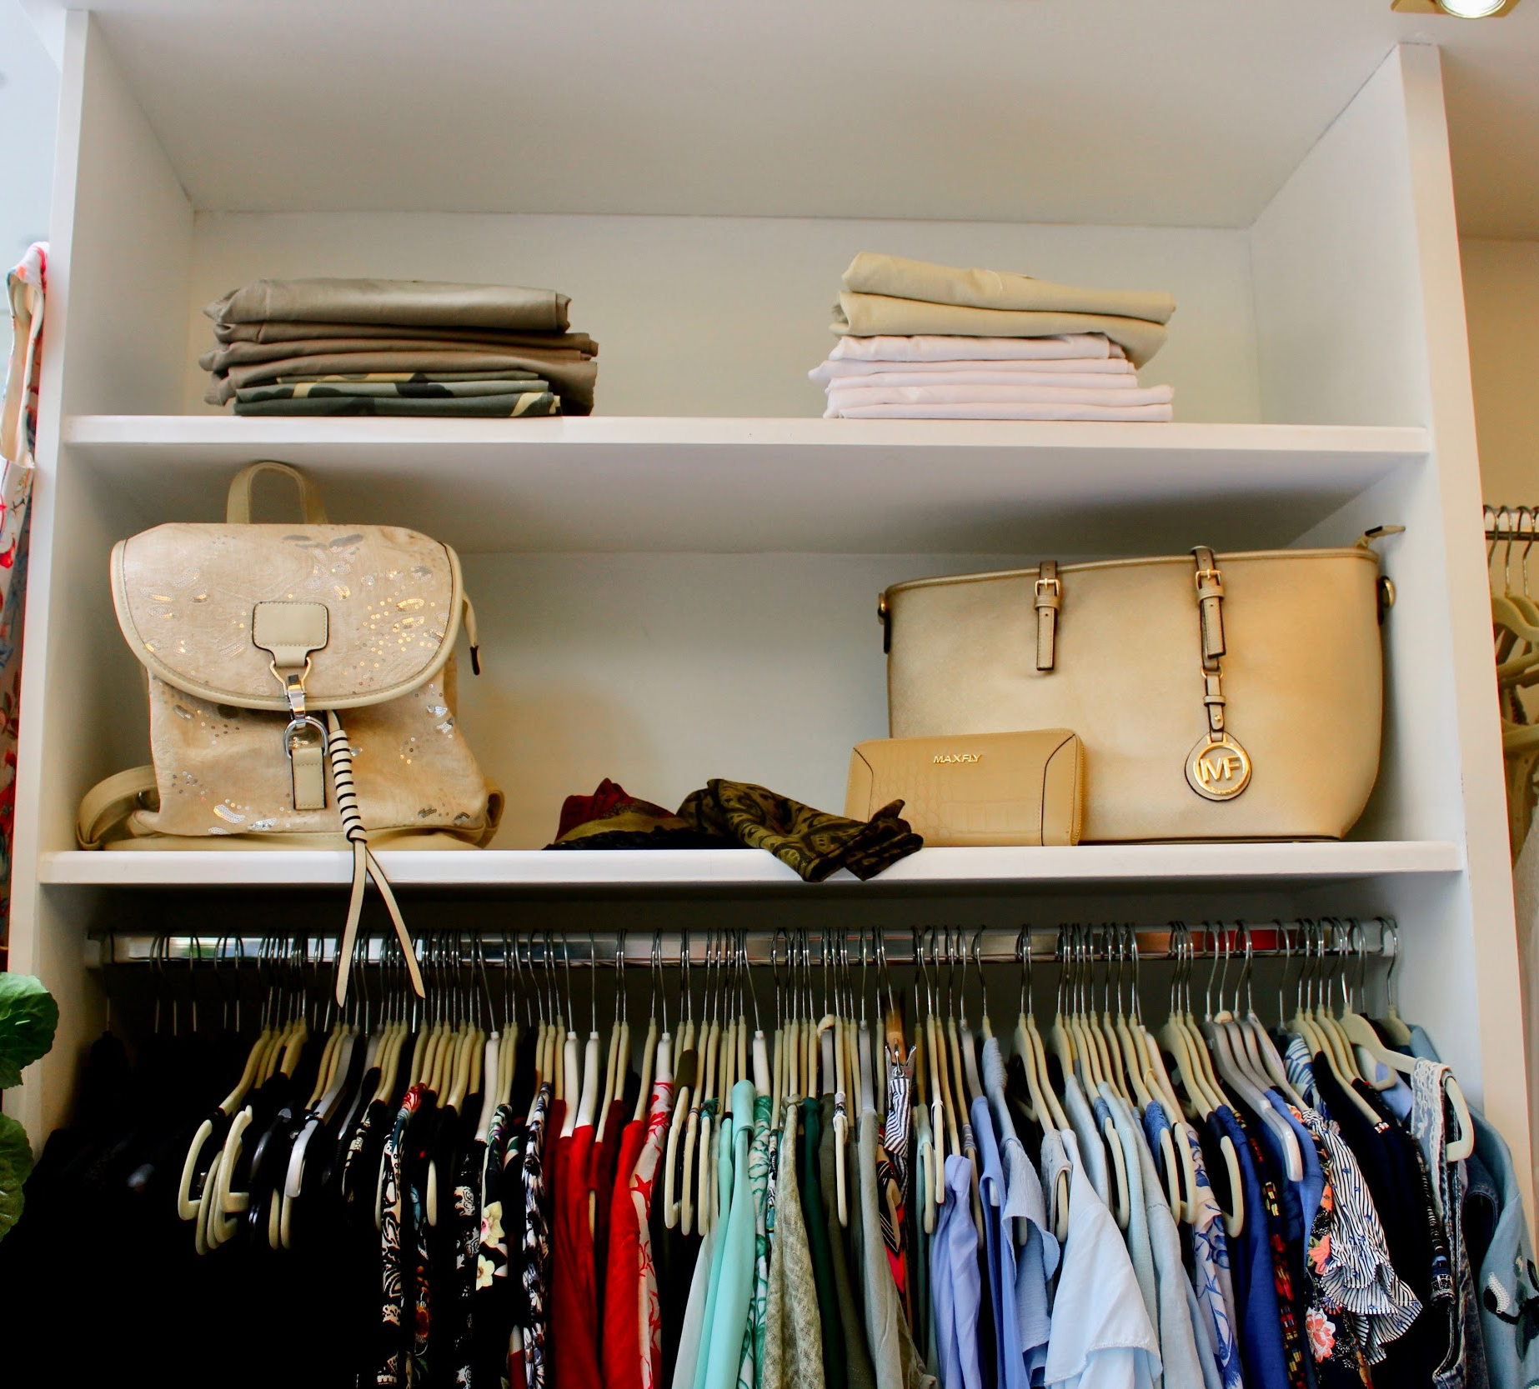
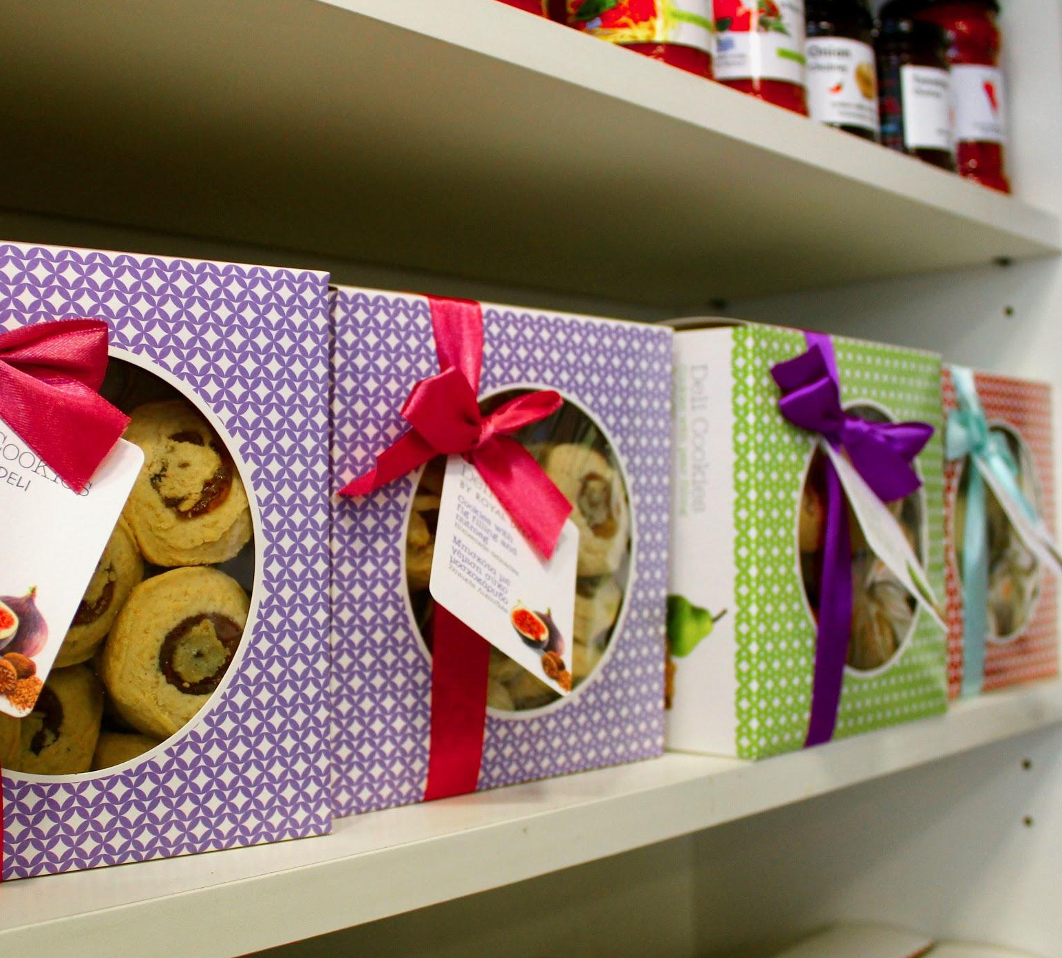
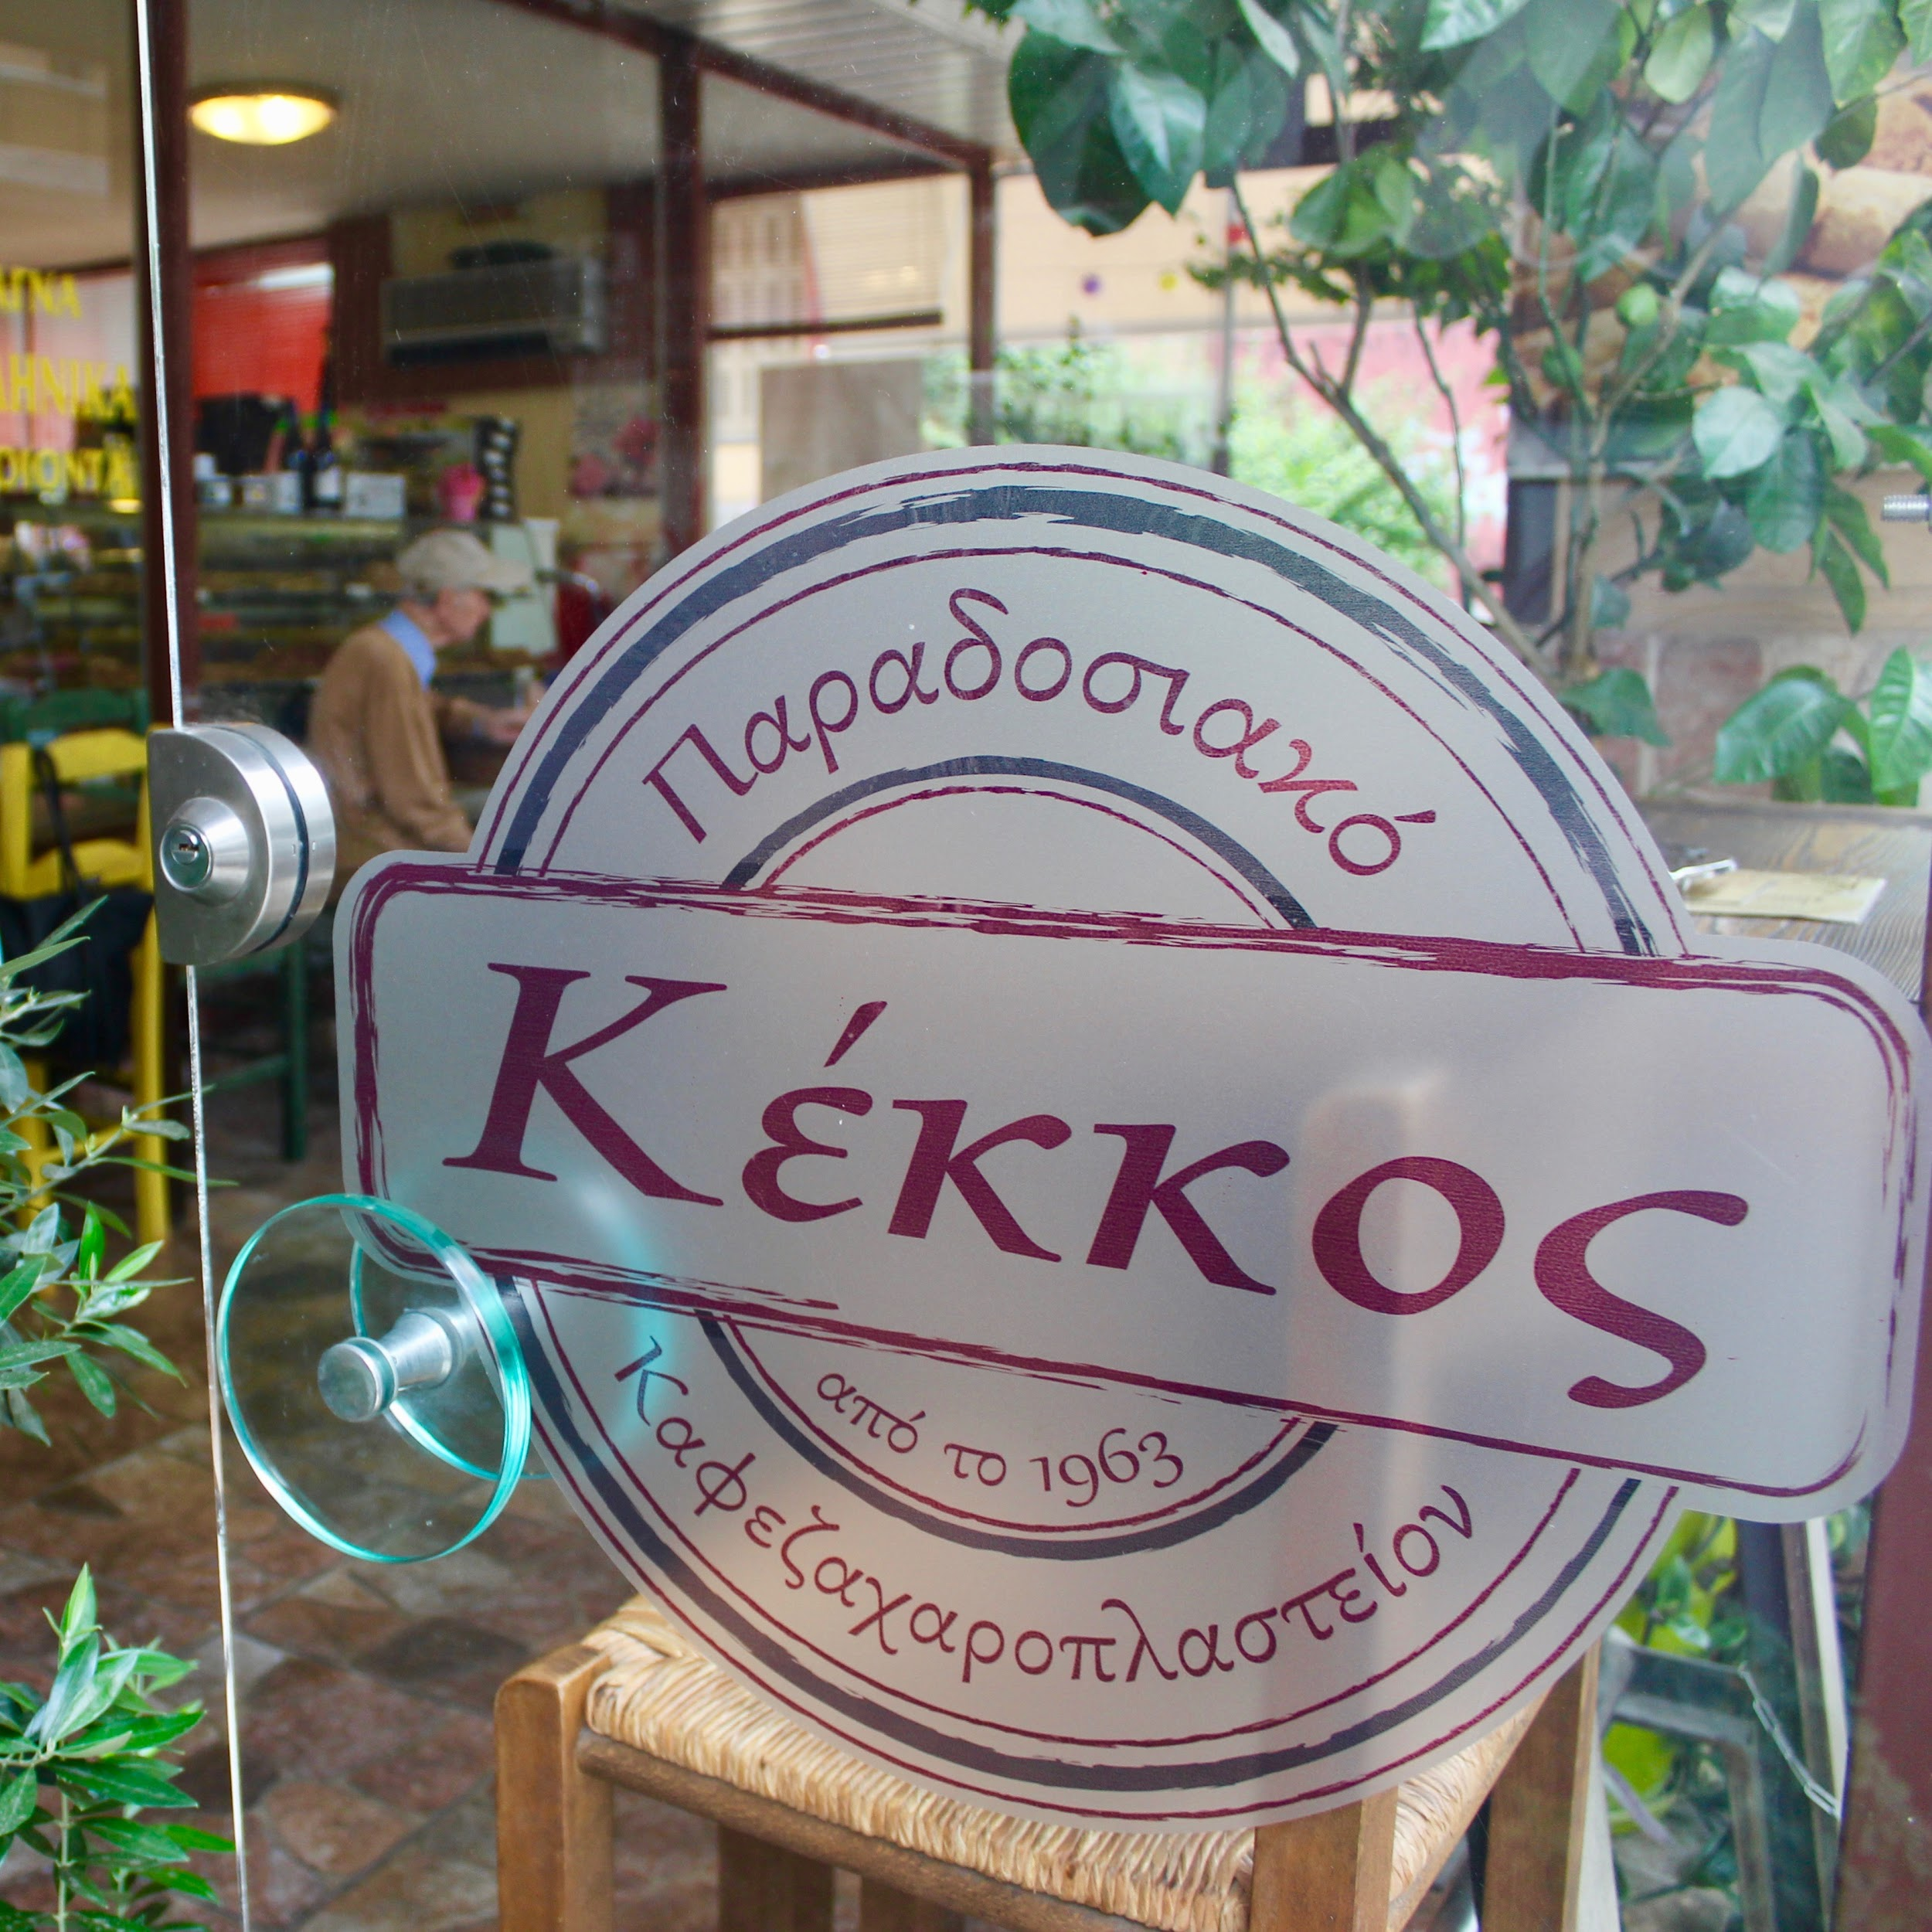
SMALL BUSINESS PROFILES

Slide 5
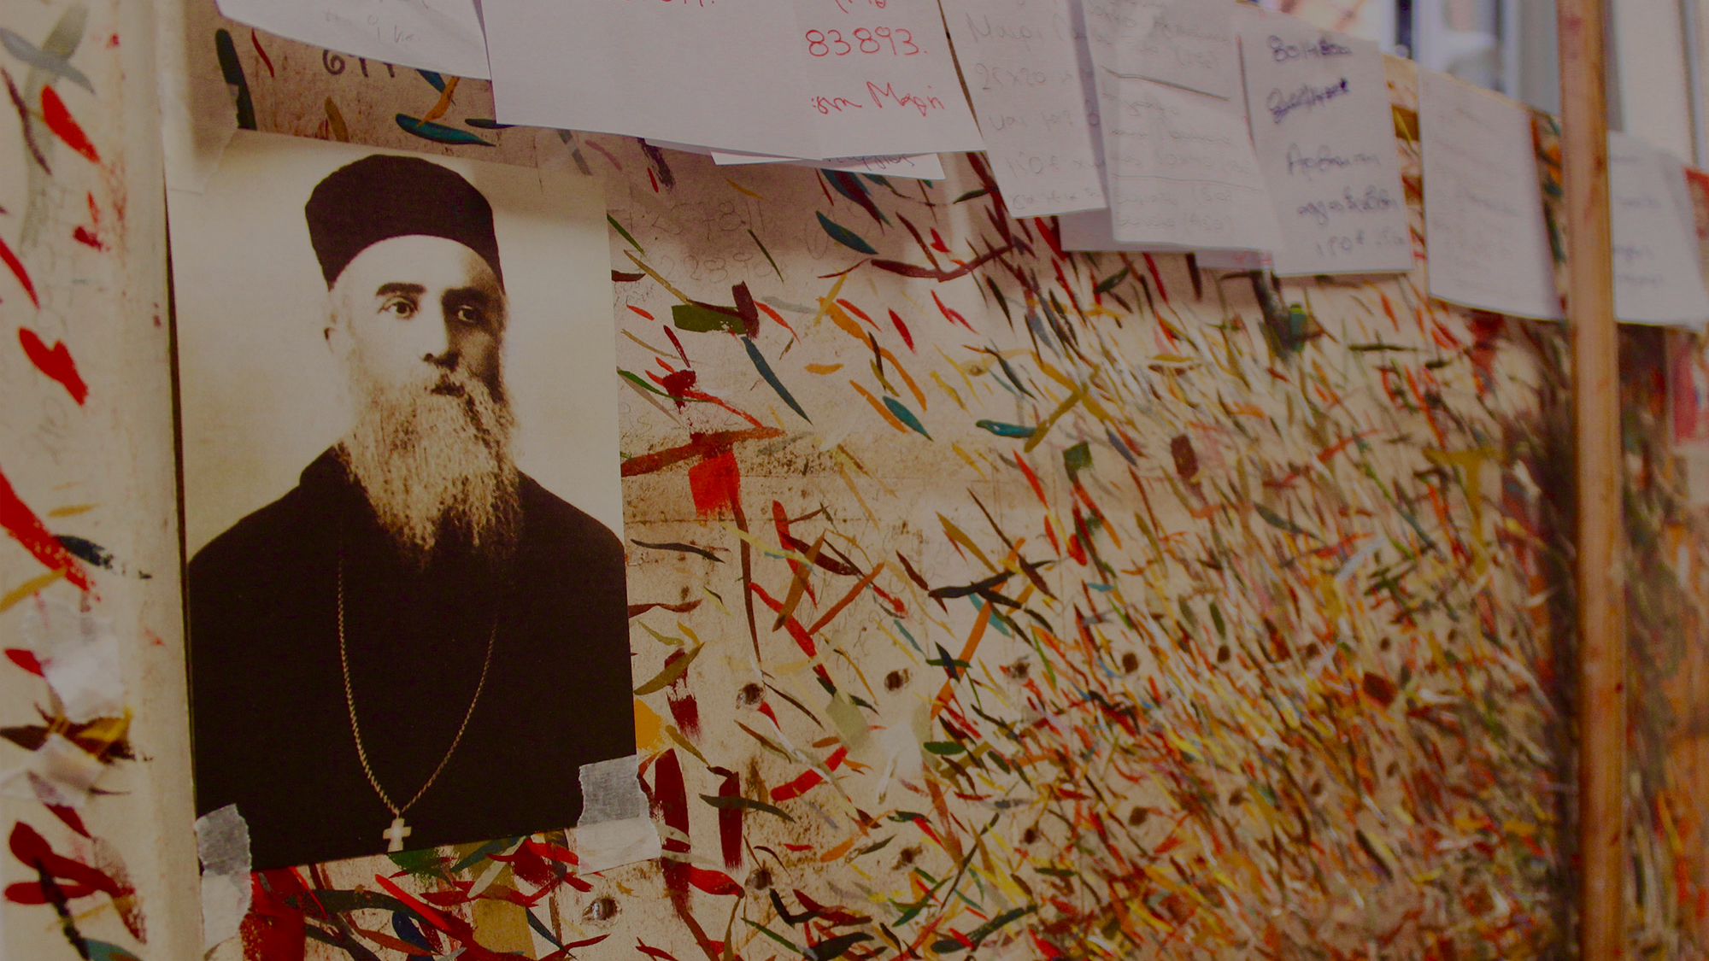
AGIOKERI
Tapping into a niche market has its advantages and disadvantages, but the owner of this iconography shop has faith that his line of work will keep his tiny storefront around for years to come.

Slide 6
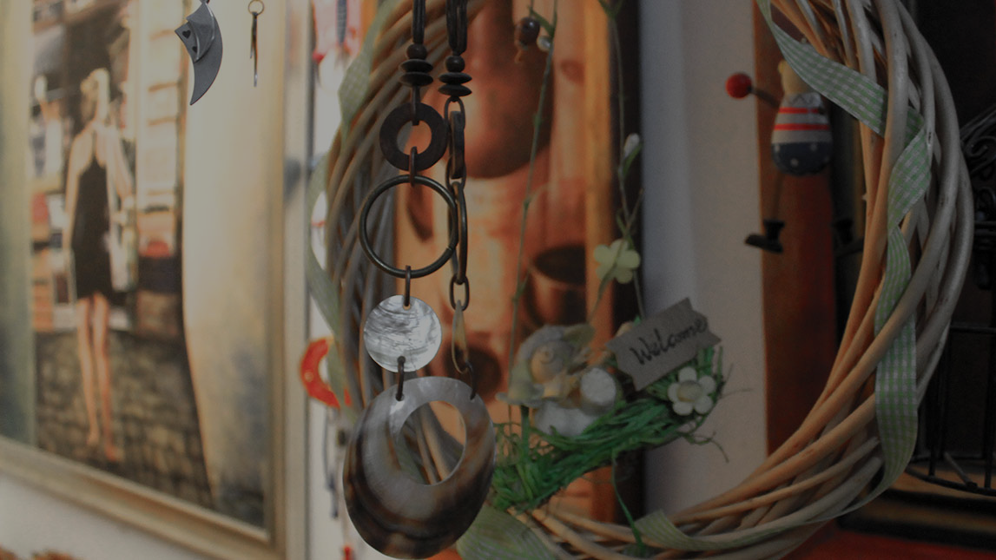
CHÓROS TÉCHNIS ZN
The eclectic artist is one of many Greeks who disagrees with the picture painted by the government and media outlets, choosing instead to believe that the crisis is a byproduct of corruption.

Slide 7
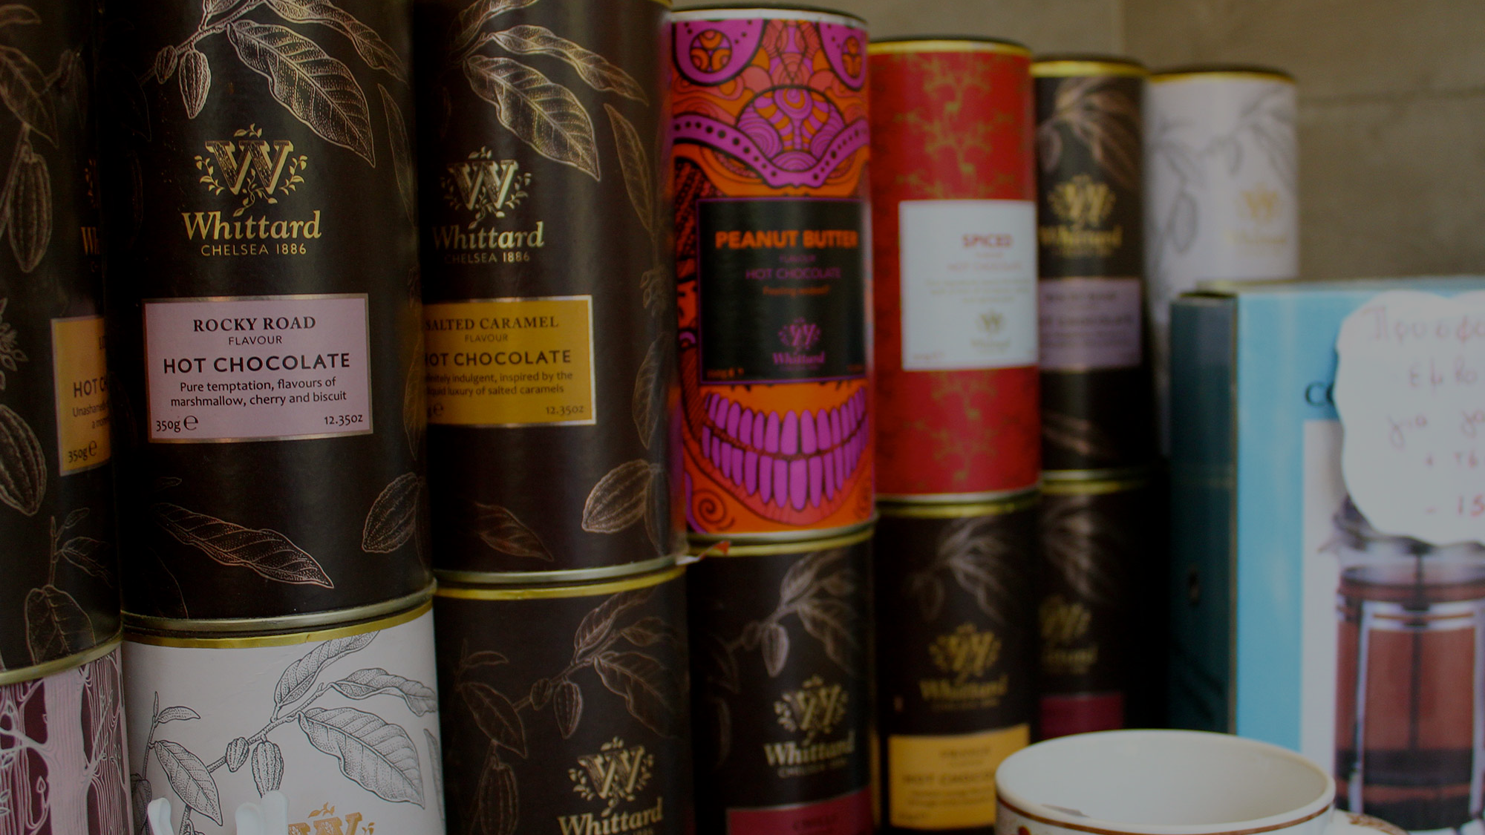
COFFEE NATION COFFEE ROASTERS
His dreams of creating the next national coffee chain with franchise locations across Greece quickly became a distant desire once the crisis happened.

Slide 8
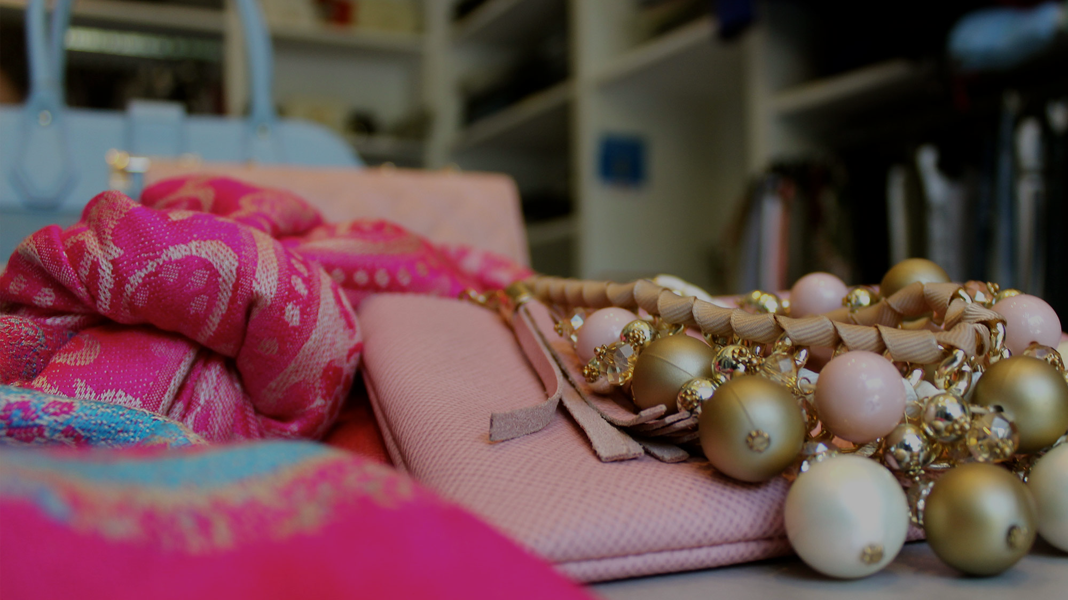
HILDA VANDO
FASHION CREATIONS
For this young entrepreneur, her current business struggles only encourage her to continue planning for the future of her clothing boutique.

Slide 9
KÉKKOS CÁFE
This quaint coffee shop has been around for 55 years, but its owners have never seen greater economic turmoil than the crisis of 2009 that left them uncertain about the longevity of their business.

Slide 10
10 YEARS LATER
€320
21%
€158
GREEK DEBT
(in billions)
UNEMPLOYMENT
RATE
GREEK GDP
(in billions)

Slide 11
mehnazladha.com/errosthe

