Slide 1
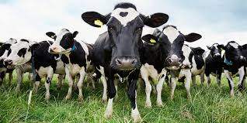
Where’s the Beet: A Correlation Between a Vegan Diet & the Reduction in Type 2 Diabetes
Rachel Lubitz
Ramapo College of New Jersey

Slide 2
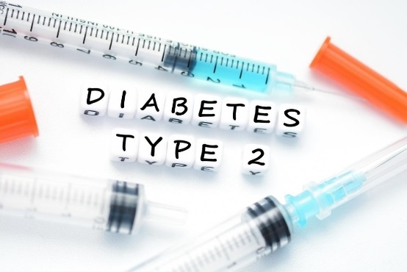
What is Type 2 Diabetes (T2D)?
A chronic condition that affects the way the body processes blood sugar aka glucose
T2D is one of the major chronic and rapidly growing public health issues in the United States. An approximated 382 million adults worldwide had diabetes in 2013; this number is projected to rise to 592 million by 2035, (Kahleova et al, 2017) almost doubling the number of diagnoses in about 20 years.
T2D has risen to the 7th leading cause of death in the United States in 2015
The major factor in the prevalence of diabetes is poor diet

Slide 3
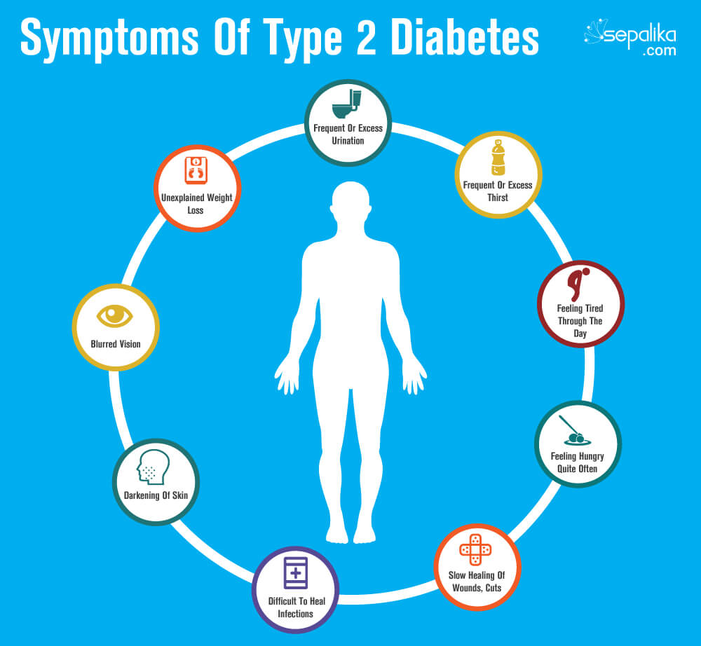
How do you develop Type 2 Diabetes?
T2D is a chronic disease: develops over time
Risk factors for Type 2 Diabetes:
Weight
Family history
Inactivity
High Blood pressure
High cholesterol & triglyceride levels
DIET
Body Mass Index, Triglyceride Levels, Glycemic Levels (HbA1c)

Slide 4
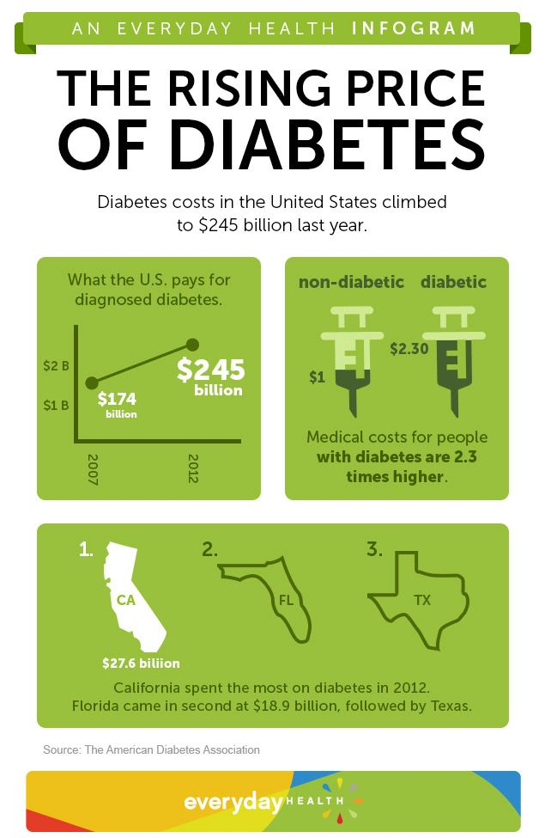
Effect of T2D in Healthcare Industry
Chronic diseases account for the vast majority of health spending. In the United States, total spending on public and private health care combined amounted to about $2 trillion in 2005. Of the $2 trillion spent, more than 75% went towards the treatment of chronic diseases, such as procedures (Rogers, 2016).

Slide 5
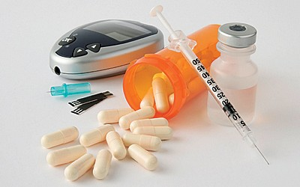
Current “Solutions” to Type 2 Diabetes
Medications
-Insulin: Metformin
-Oral Diabetics
Weight loss
-Bariatric surgery
-Exercise

Slide 6
Most effective intervention…DIET
American Diabetic Diet
The creation of the American Diabetic Association (ADA) diet and the use of synthetic insulin have proven to be helpful but not effective in managing the condition and preventing further damage.
Attempts to comply with the “diabetic diet” tend to result in unnecessary restrictions of the wrong foods and overindulgence or monotonous consumption of certain food items (Asif, 2014).
It is believed that this is due to the many misconceptions about what a diabetic can and should eat.

Slide 7
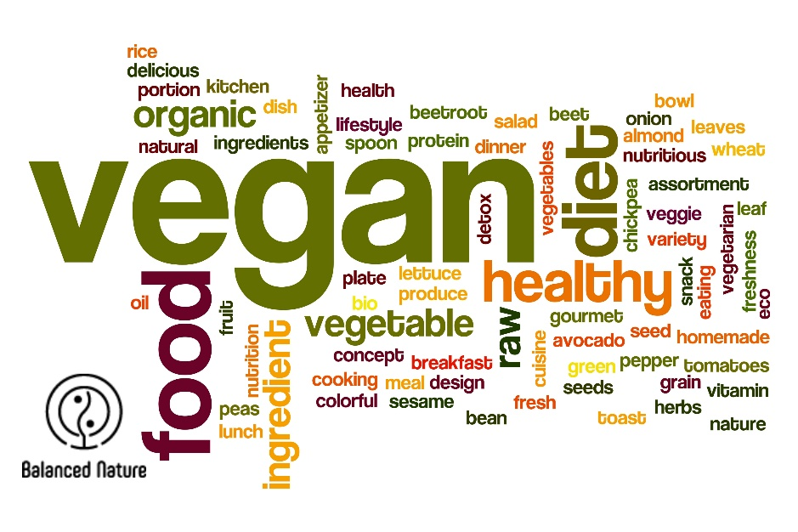
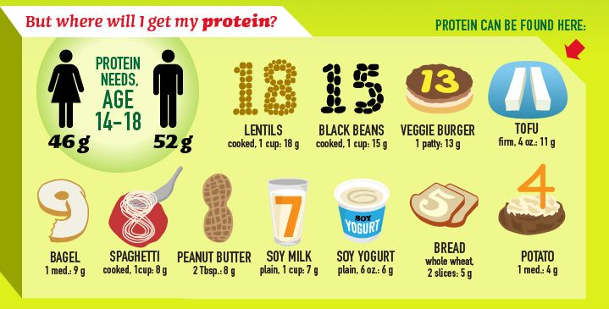
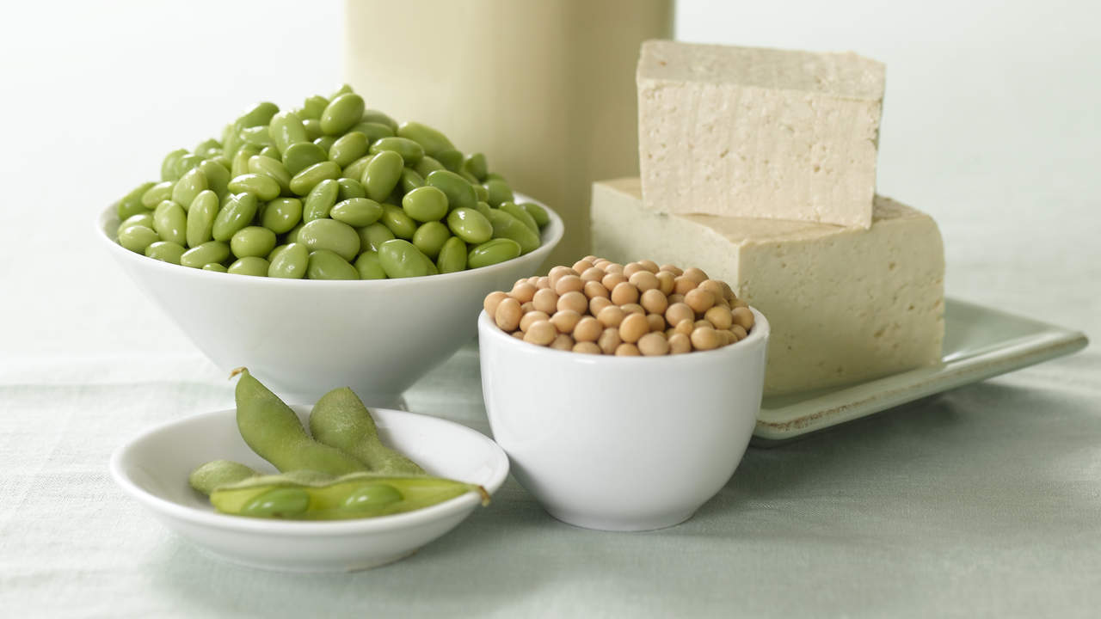
VEGANISM

Slide 8
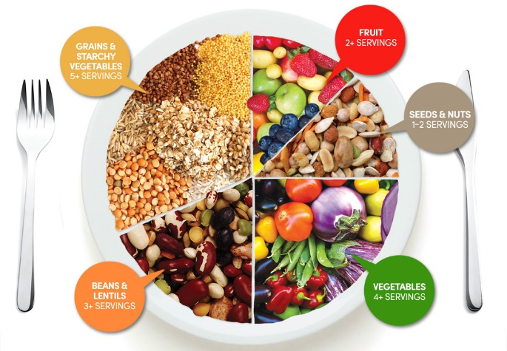
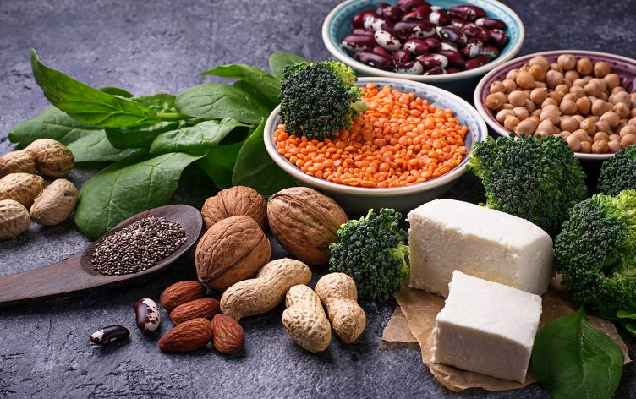
What is Veganism?
Veganism is the practice of abstaining from the use of animal products, particularly in diet
A healthy plant-based diet is one that aims to maximize consumption of nutrient-dense plant foods while minimizing processed foods, oils, and animal foods, including dairy products and eggs (Hart, 2015).
A vegan diet emphasizes unrefined carbohydrates and high-fiber foods, like fruits and vegetables and whole grains.
LOT OF CARBS??

Slide 9
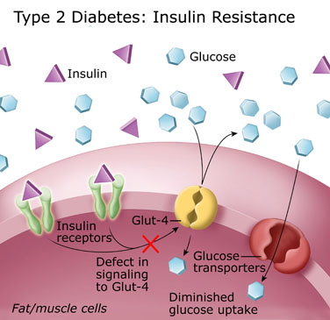
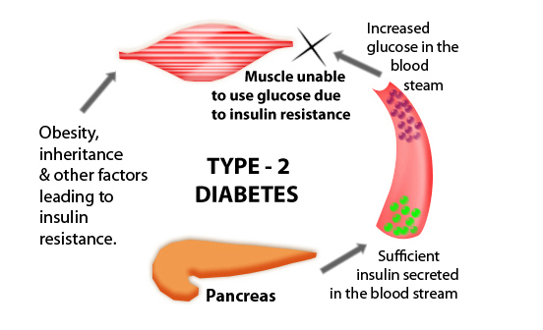
Correlation between Fat & T2D
A high FAT diet will lead to T2D, not a diet high in carbohydrates and sugar
Insulin is like a key that unlocks the door to let sugar from our bloodstream into the cell. Without insulin, blood sugar will remain in the bloodstream without any way to get into the cell, so with nowhere to go, blood sugars will therefore, rise!!
Results in high serum glucose levels!!

Slide 10
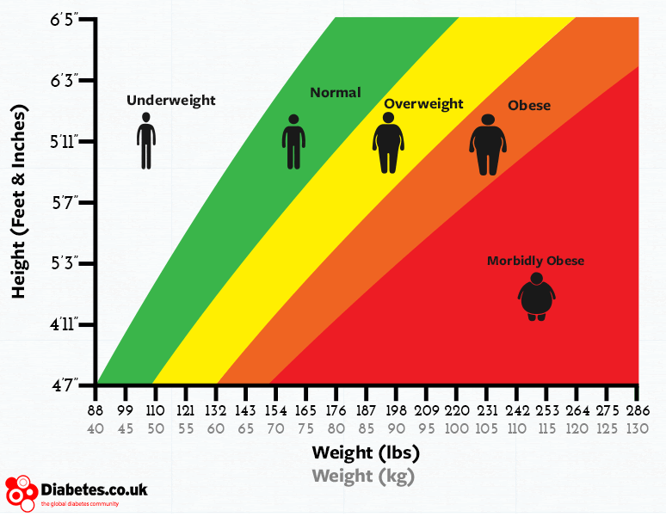
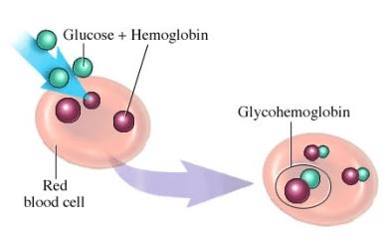
Vegan Diet & T2D
Research looked at 3 main factors:
Body Mass Index (BMI):
Normal: 18-24.5
Overweight: 24.5-29.5
Glycated Hemoglobin (HbA1c):
Non-diabetics: <5.5%
Diabetics: 5-7%
Triglyceride levels:
Total cholesterol: <200
Normal LDL: <100
Normal triglyceride: <150

Slide 11
Criteria for Integrative Literature Review
Over 20 different studies
4 strongest studies were randomized controlled trials
Conventional group (ADA diet, Mediterranean diet, regular diet) vs Vegan/Plant-based Diet
All participants had to be diagnosed with Diabetes Mellitus beforehand
Diet was the only factor—exercise level & food size proportions were not affected

Slide 12
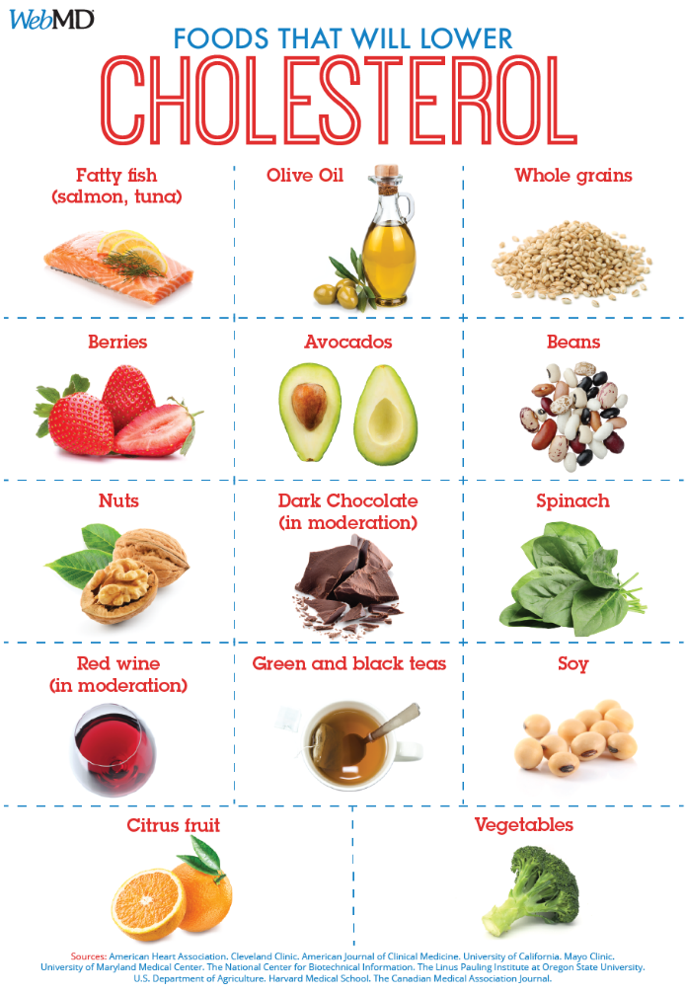
Results-BMI & Triglyceride
BMI: At the end of the 18 weeks, mean body weight decreased by 3kg in the intervention group and 0.06kg in the control group (Mishra et al, 2013). In terms of BMI, the mean BMI of the intervention group dropped by 1, whereas the mean BMI for the control group dropped by 0.01 (Mishra et al, 2013).
Triglyceride levels were also 30% lower after four weeks on the vegan diet. In regards to the test meals, both triglycerides and cholesterol levels were lower after the test meal of the high-carbohydrate and high-fiber diet.

Slide 13
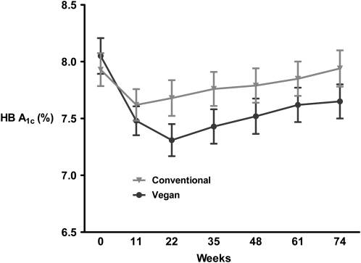
Results: HbA1c
The evidence indicated that there was twice as much a decrease in the vegan diet group in comparison with the control group (Lee et al, 2016).
The participants in the vegan diet group, after only 74 weeks, were able to drop almost a whole percentage in A1c levels, which is significant as typically, A1c levels are usually consistent.

Slide 14
What can we do now??
A caregiver can do everything to manage the symptoms and the secondary issues to the chronic illness and educate the patient on the best lifestyle choices; however, it is ultimately up to the willingness of the patient to actually make a change.
Primary prevention: Education!!
Start young! Habits start early, hard to break

Slide 15
”why does this matter to me?”
Chronic diseases are becoming more prevalent in our society- lifestyle choices
Not just T2D, it includes heart disease, stroke, kidney disease
Healthier, less invasive, more sustainable alternatives to medications & surgery

Slide 16
Conclusion
Chronic disease epidemic
Power of the plants!!!
We have the power!
Every individual, regardless of gender, race and family history has the ability to control what goes into his/her body and therefore, has the ability to control what happens after.
The focus on sugar and the irrational belief that ingesting high amounts of sugar will lead to diabetes has taken the focus off of the real issue, which is the significant effects of meat and dairy on the body

Slide 17
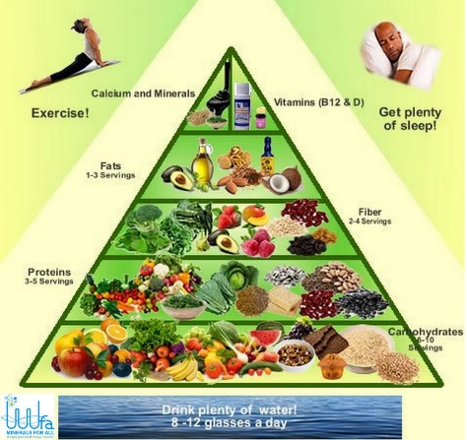
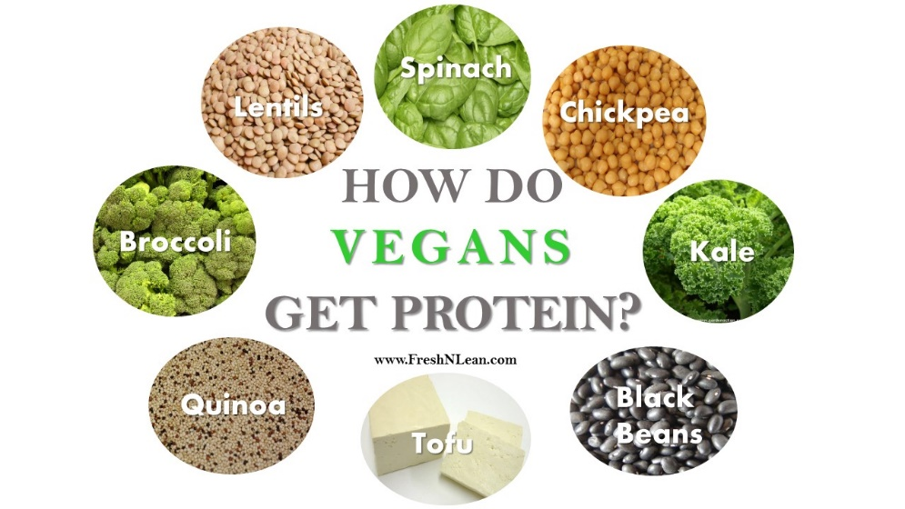
The proof is in the plants; the studies show that society can not only survive on a purely vegan, plant-based diet, but also that we can thrive!!

Slide 18
