Slide 1
STUDENT SUCCESS
ADVISEMENT,
CAREER DEVELOPMENT, CONNECT,
EOF, FIRST-GEN STUDENT CENTER, NEW STUDENT EXPERIENCE, STEM CENTER, TESTING CENTER, TRANSFER CENTER AND VETERANS CENTER
Academic Year 2026-2027
Contact information:
Joseph Connell, AVP Student Success
jconnell@ramapo.edu
Center for Student Success, D207
(201) 684-7441
success@ramapo.edu

Slide 2
MISSION STATEMENT
Our Purpose:
Student Success guides students towards graduation by providing services, resources, mentoring and community-building experiences that strengthen our diverse students acclimation and success in the Ramapo College community as both an academic scholar and engaged participant.

Slide 3
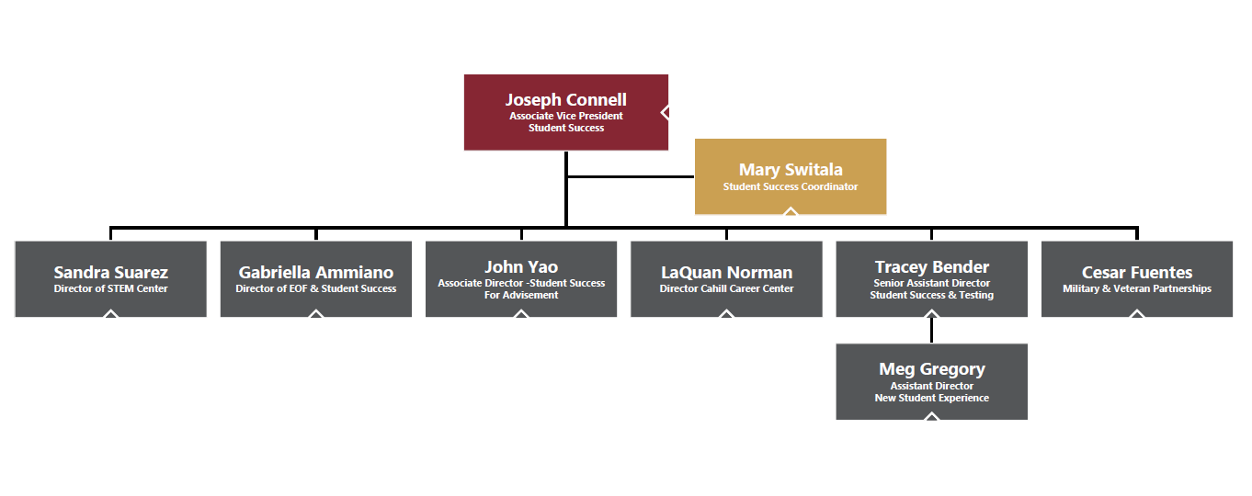
Student Success
Organizational Chart
Notes:
J

Slide 4
CONNECT
Tracey Bender, Senior Assistant Director of Student Success & Testing
tpastori@ramapo.edu
connect@ramapo.edu
201-684-7480

Slide 5
CONNECT
Academic Progress Survey Software
  Accessible through web.ramapo.edu or Canvas
  Displays students in your courses automatically
  Monitor student progress and learning
    Raise academic progress items for excellent or concerning work
    Review academic progress items that have been raised about your students
  Professional staff and other faculty on campus who can intervene become aware
Resource Website
  http://www.ramapo.edu/connect

Slide 6
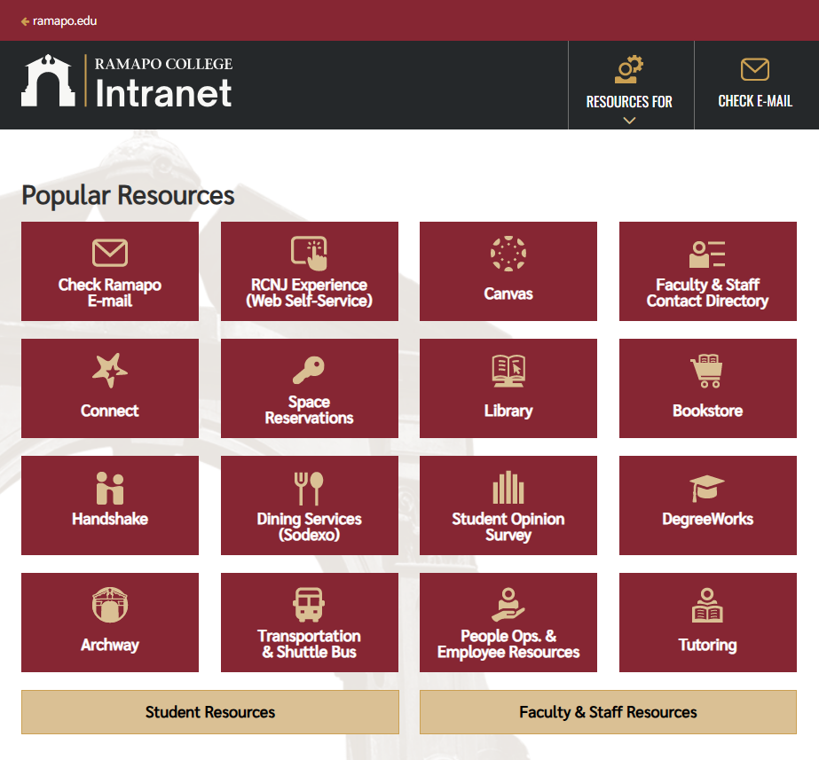
Ramapo’s Intranet

Slide 7
ACADEMIC ADVISEMENT
CENTER FOR STUDENT SUCCESS
John Yao, Associate Director, Student Success for Advisement
jyao@ramapo.edu
201-684-7441

Slide 8
ACADEMIC ADVISEMENT
Current Plan
  First-Year students are advised by professional advisors in Student Success
    Mandatory advisement occurs prior to and throughout their first year
  Upper-level students are advised by faculty academic advisors
    Mandatory advisement occurs in the third, fourth, and sixth semesters
Coordinates the Academic Advisement Council
Definition of Academic Advisement
  Academic advisement at Ramapo College of New Jersey seeks to engage students in the process of defining and achieving their academic objectives, as well as career and life goals. This is a collaborative process of shared responsibilities between students and advisors that includes selecting a course of study; understanding academic policies, procedures, and requirements; becoming familiar with campus resources and opportunities; and identifying and fostering goals for success in college and beyond.

Slide 9
ACADEMIC ADVISEMENT
Websites
  http://www.ramapo.edu/myadvisor
  http://www.ramapo.edu/myadvisees
Upcoming Trainings:
  Dates to Look For:
    New Faculty Orientation Extended Session – TBD
    Unit Council Meeting: Student Success advisors will be presenting on September 30th (for Advisement Month).
  Unit Council/School Liaisons
    ASB – Jessica Steinheimer, jsteinhe@ramapo.edu
    AHE – Paola Guevara, pguevara@ramapo.edu
    SSSW – Megan Greer, mgreeer2@ramapo.edu
    SNH – Caitlyn Campbell, ccampbe4@ramapo.edu

