Slide 1
New Faculty Orientation:
Center for Student Wellness
Behavioral Intervention team
Presented by:
Judith Green, Psy.D.
Director, Center for Student Wellness

Slide 2
Center for Student Wellness
Health Services run by Valley Medical Group
Counseling Services
ENHANCE Program
Alcohol and other drug Prevention
Roadrunner Collegiate Recovery Program (RCRP)
Health Promotion

Slide 3
Valley Medical Group @ Health Services

Slide 4
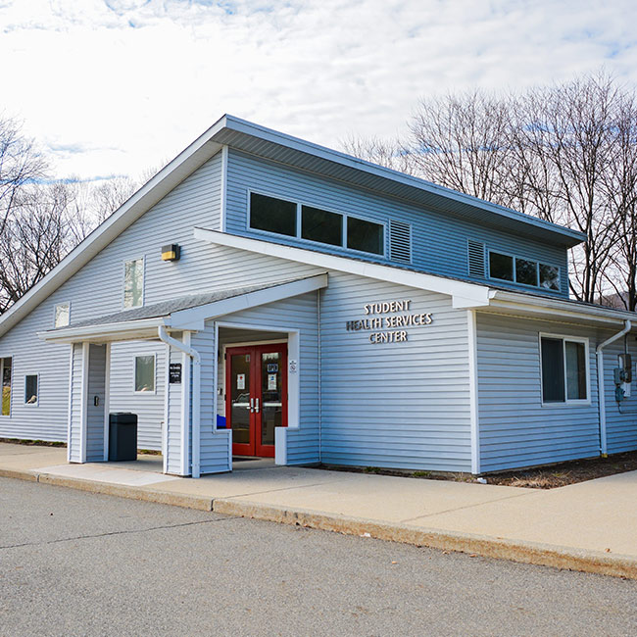
Medical Services Provided
Call 201-684-7536 for appointments
Save my Spot feature on website www.valleyhealth.com/ramapo-college-health-services
Walk-ins are welcome
Primary care and sick visits
Prescription delivery to VMG
Reproductive health care - STI testing, contraception, gynecology
HIV management
Adult transgender care
Immunization records intake and management
Emergencies? Call 911!

Slide 5
Billing
Insurance will be provided to Health Services to cover the cost of services
  Your visit will likely have a copay
There is a reduced cost self pay option for students
Concerns about affording care can be addressed with Valley at the visit - please seek care if you need it!

Slide 6
Medical Notes
Determining an excused absence is at the discretion of the faculty member.
VMG/Health Services can provide documentation for a student if they are seen at the time of their illness on that date. However, Health Services cannot provide documentation for absences when the student was not seen on the day the absence occurred or when symptoms have passed.
Please refrain from sending students to Health Services for documentation after an illness when they weren’t seen during the illness since that limits the availability of our health care providers to care for students who are experiencing illness.

Slide 7
Counseling Services
D-216
201-684-7522

Slide 8
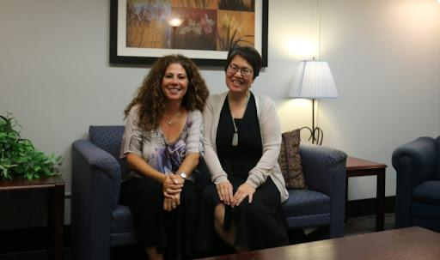
Counseling Services
ramapo.edu/counseling
8:30 am - 4:30 pm, D-216
Time-limited, individual counseling (appt required)
Drop-In Hours (no appt):
  Monday - Friday, 1 pm to 3 pm
  First come, first served
Emergency Counseling 24/7/365
  Call 201-684-7522
Medication Management
Referrals to Community Help
Caring. Confidential. Free.

Slide 9
Most Common Presenting Problems
Anxiety
Depression (including suicidality)
Trauma
Substance-related disorders
Transitional adjustment issues affecting mental health
Relational concerns (family, friends, partner)
Academic difficulties affecting psychological functioning

Slide 10
Medical Leave of Absence
Overview of Policy:
Students may apply for a Medical Leave of Absence (MLOA) from the College for reasons of physical or psychological illnesses. Students must withdraw from all registered courses under this policy. Exceptions may be considered on an individual basis. The grade for each course will be recorded as “W” on the student’s transcript. There will be no refund if the request for an MLOA is completed after the College refund deadline (see Academic Calendar on the web)
https://www.ramapo.edu/chcs/files/2019/08/MLOA-2019-Revision.pdf

Slide 11


Slide 12
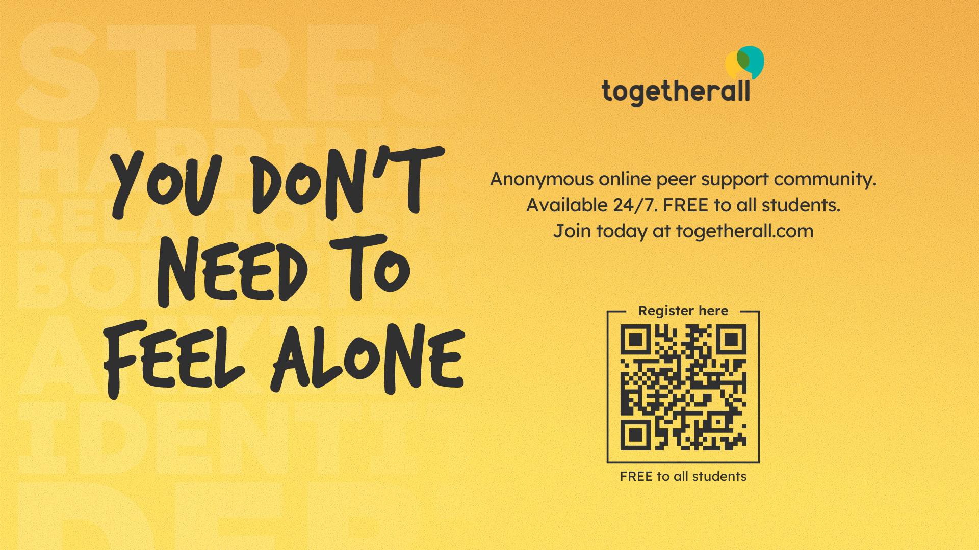
Togetherall

Slide 13
Syllabus Statement
Ramapo faculty recognize that mental health concerns can impact academic performance and interfere with daily life activities. Because stress is a normal part of the college experience, learning to manage stress effectively is crucial to your well-being and overall success. When you are part of the RCNJ community, you are not alone. The Center for Health and Counseling Services (CHCS) can support and help you improve your ability to balance the many demands on the road towards earning your degree. Counseling is confidential and free to all Ramapo students. You are encouraged to reach out to the Counseling Services regarding any mental health concerns (Office location: D-216, 201-684-7522) For emergencies outside of business hours call 201-684-7522 and press 2) to speak with a counselor. To find more mental health resources and information about CHCS services visit their website: https://www.ramapo.edu/chcs/

Slide 14


Learn how to:
identify people at risk for suicide
recognize the risk factors, protective factors, and warning signs
respond and help people
It takes only 20 minutes

Slide 15
Health Promotion
Wellness is Now (WIN) Peers
Wellness Room
Therapy Animal Visits

Slide 16
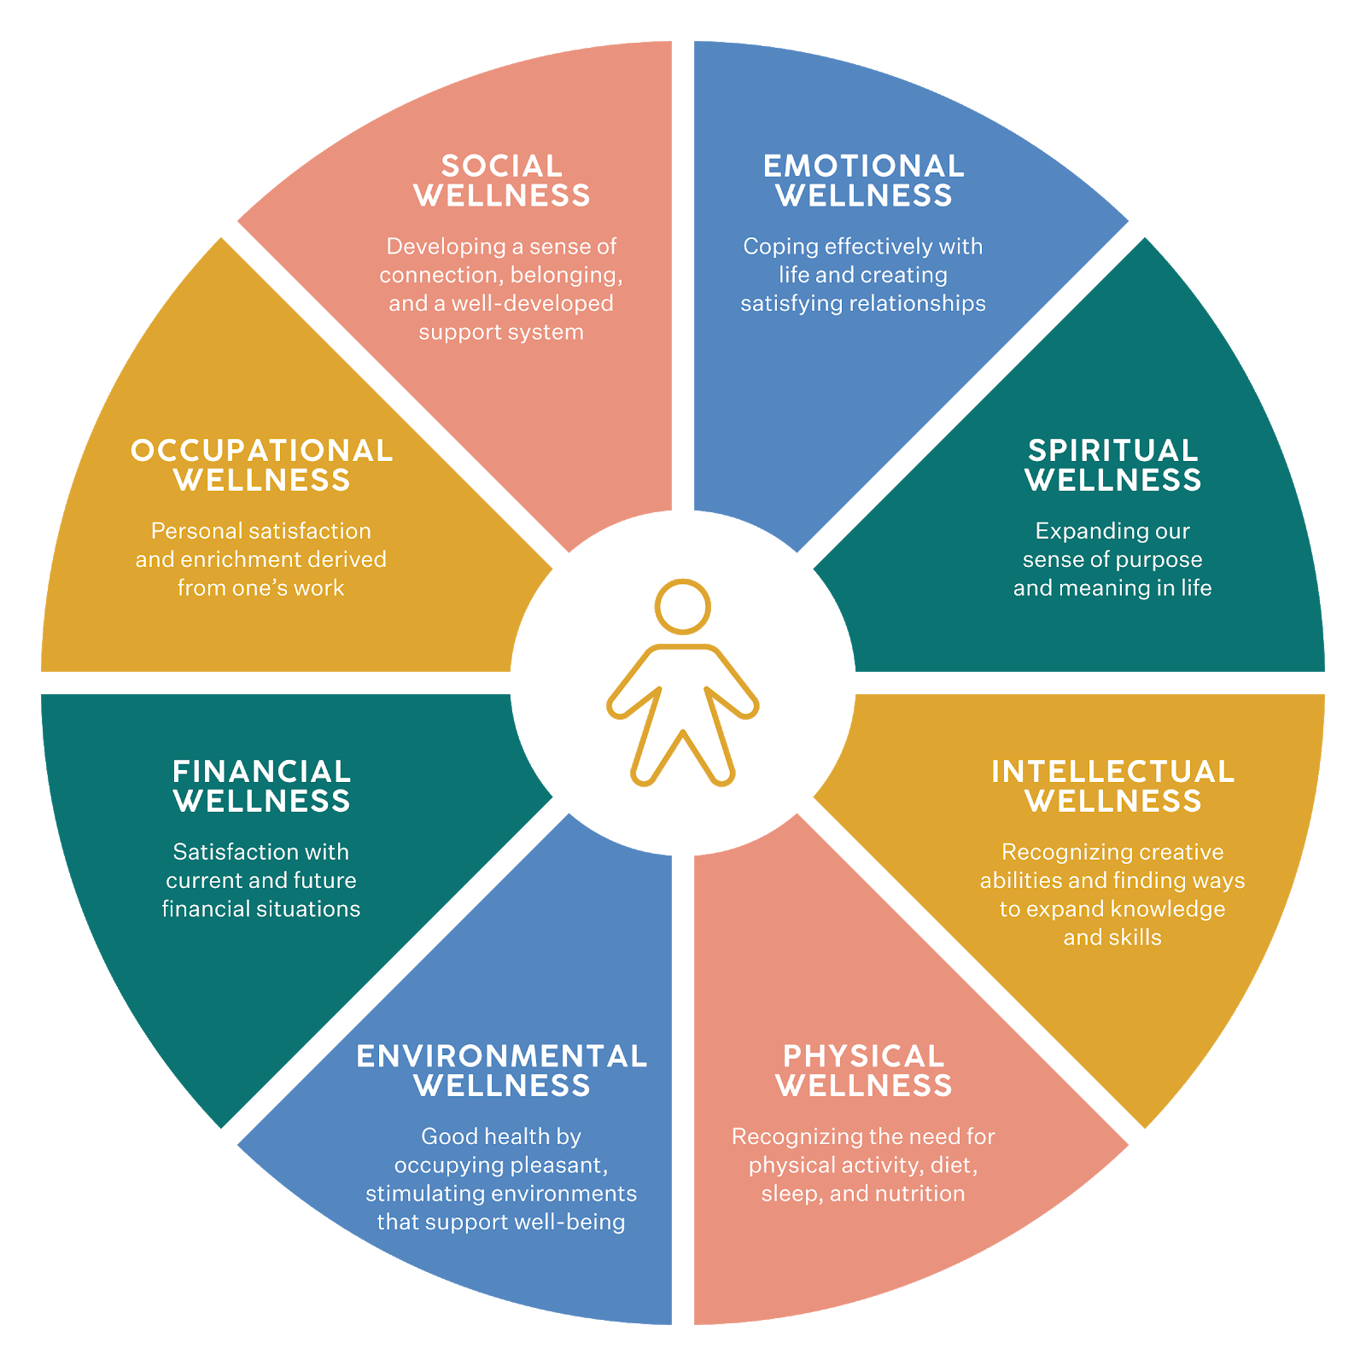
Wellness Wheel
(8 Dimensions of Wellness)
Social
Emotional
Spiritual
Intellectual
Physical
Environmental
Financial
Occupational
Wellness Wheel created by SAMHSA

Slide 17
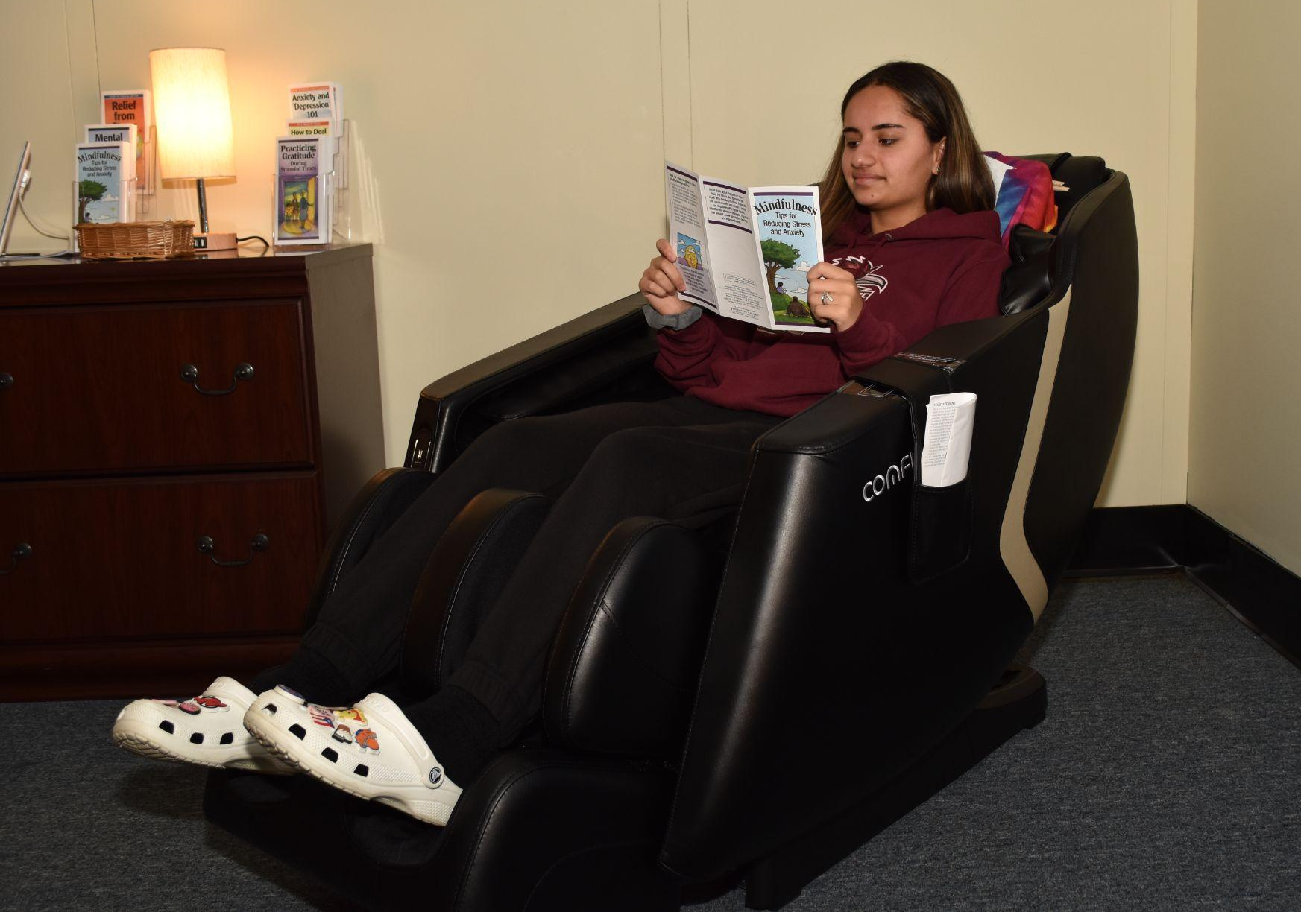

Wellness Room E-216
Massage Chair
Light Therapy Lamp
Yoga
Weighted Blanket
Stress Balls + Fidget Toys
Bracelet Making
Coloring
Wellness + Mindfulness Card games

Slide 18

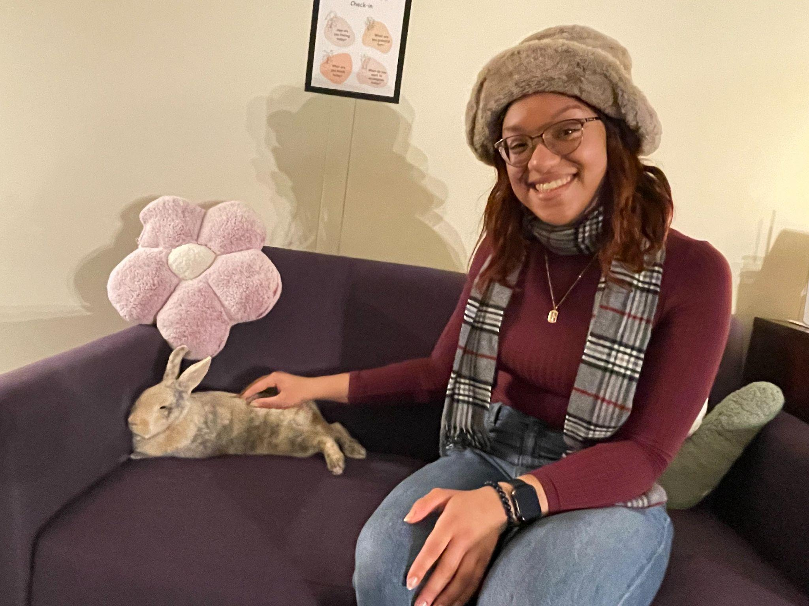


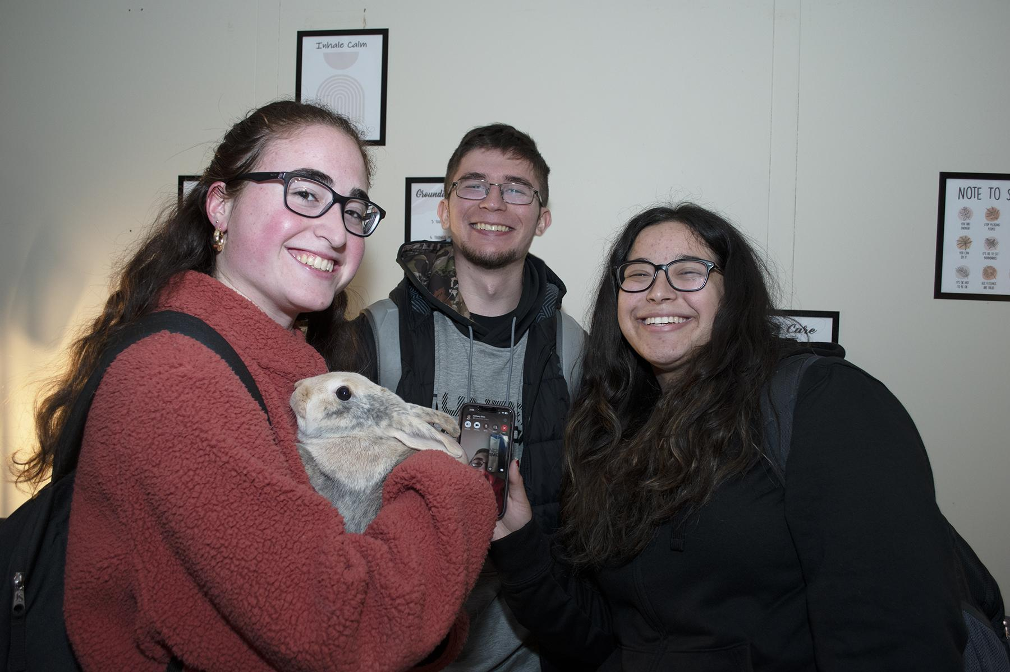

Therapy Animal Visits

Slide 19
ENHANCE Program

Slide 20
ENHANCE Program
The ENHANCE program is a therapeutic support program which takes a holistic approach and focuses on social, emotional, and organizational growth to assist those students with Autism Spectrum Disorder (ASD) in adapting and flourishing in college and beyond. ENHANCE offers additional services and resources to support our students over and above what is required under current disability law.
Program growth - The ENHANCE program, which began in 2018 with just 4 students, has grown 650% to 30 students

Slide 21
ENHANCE Services
Individualized weekly appointments with counselor
Weekly group meetings for peer support
Students to be paired with trained Peer Mentors
Social Events
Academic Workshops
Parent Consultations

Slide 22
Substance Use Disorder Prevention

Slide 23
Substance Use Disorder Education and Prevention Services
Outreach Education
Assessment
Counseling
Mandated Assessments following Code of Conduct violations (CheckPoint program)
Treatment Referrals

Slide 24
Roadrunner Collegiate Recovery Program (RCRP)

Slide 25

Roadrunner Collegiate Recovery Program
A Harm Reduction Program:
Not abstinence based for admission
Recovery curious individuals are welcome!
The program is available when in or interested in recovery from any substance
There is a Recovery Allies peer program to connect those in recovery to a supportive community. Peers can also advocate and educate on substance use and recovery to the campus community.
https://www.ramapo.edu/sud/recovery-program/

Slide 26
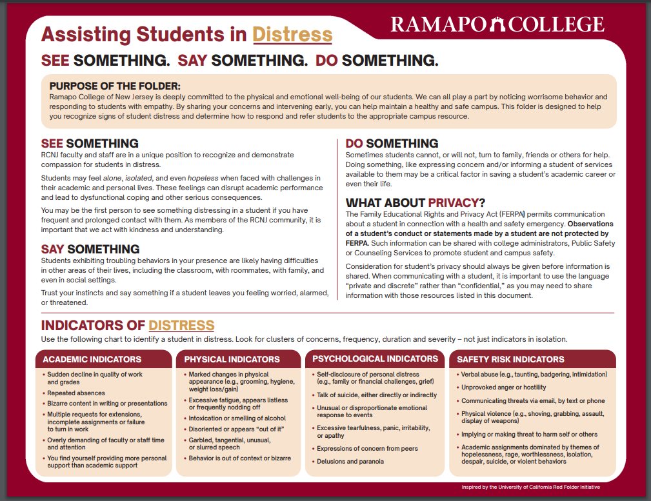
Red Folder

Slide 27
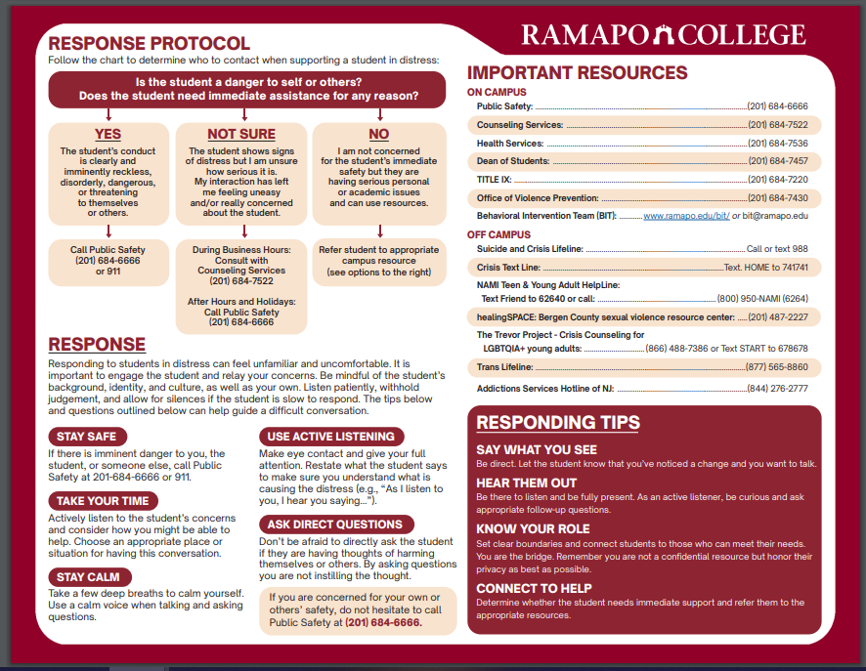
https://www.ramapo.edu/counseling/red-folder/

Slide 28
Behavioral Intervention Team
The Team serves as a central network focused on caring prevention and early intervention for students experiencing serious distress or engaging in harmful or disruptive behaviors. This process provides the community with a tool and conduit with which to alert relevant campus authorities of their worry and concern for a student.
The Team does not serve as a crisis response unit, nor does it replace faculty classroom management
Emergencies must be reported to the Department of Public Safety at 201.684.6666

Slide 29
Behavioral Intervention Team
Receive and gather information pertaining to students of concern.
Develop specific strategies to manage potentially harmful or disruptive behavior.
Inform the referral person concerning next steps taken with the student. The referral person must understand that not all action steps will be discussed given the confidential nature of the information and what is permissible under the eyes of the law.
Education and train the community on identification of concerning behaviors and proactive options to assist students

Slide 30
BIT Composition
Kathleen Hallissey – Director, Office of Student Conduct (chairperson)
Jason Balsan – Director, Department of Public Safety
Dr. Rick Brown – Director, Center for Student Involvement
Lisa Gonsisko – Director, Office of Residence Life
Dr. Judith Green – Director, Center for Health and Counseling Services
Dr. David C. Nast – Director, Office of Specialized Services

Slide 31
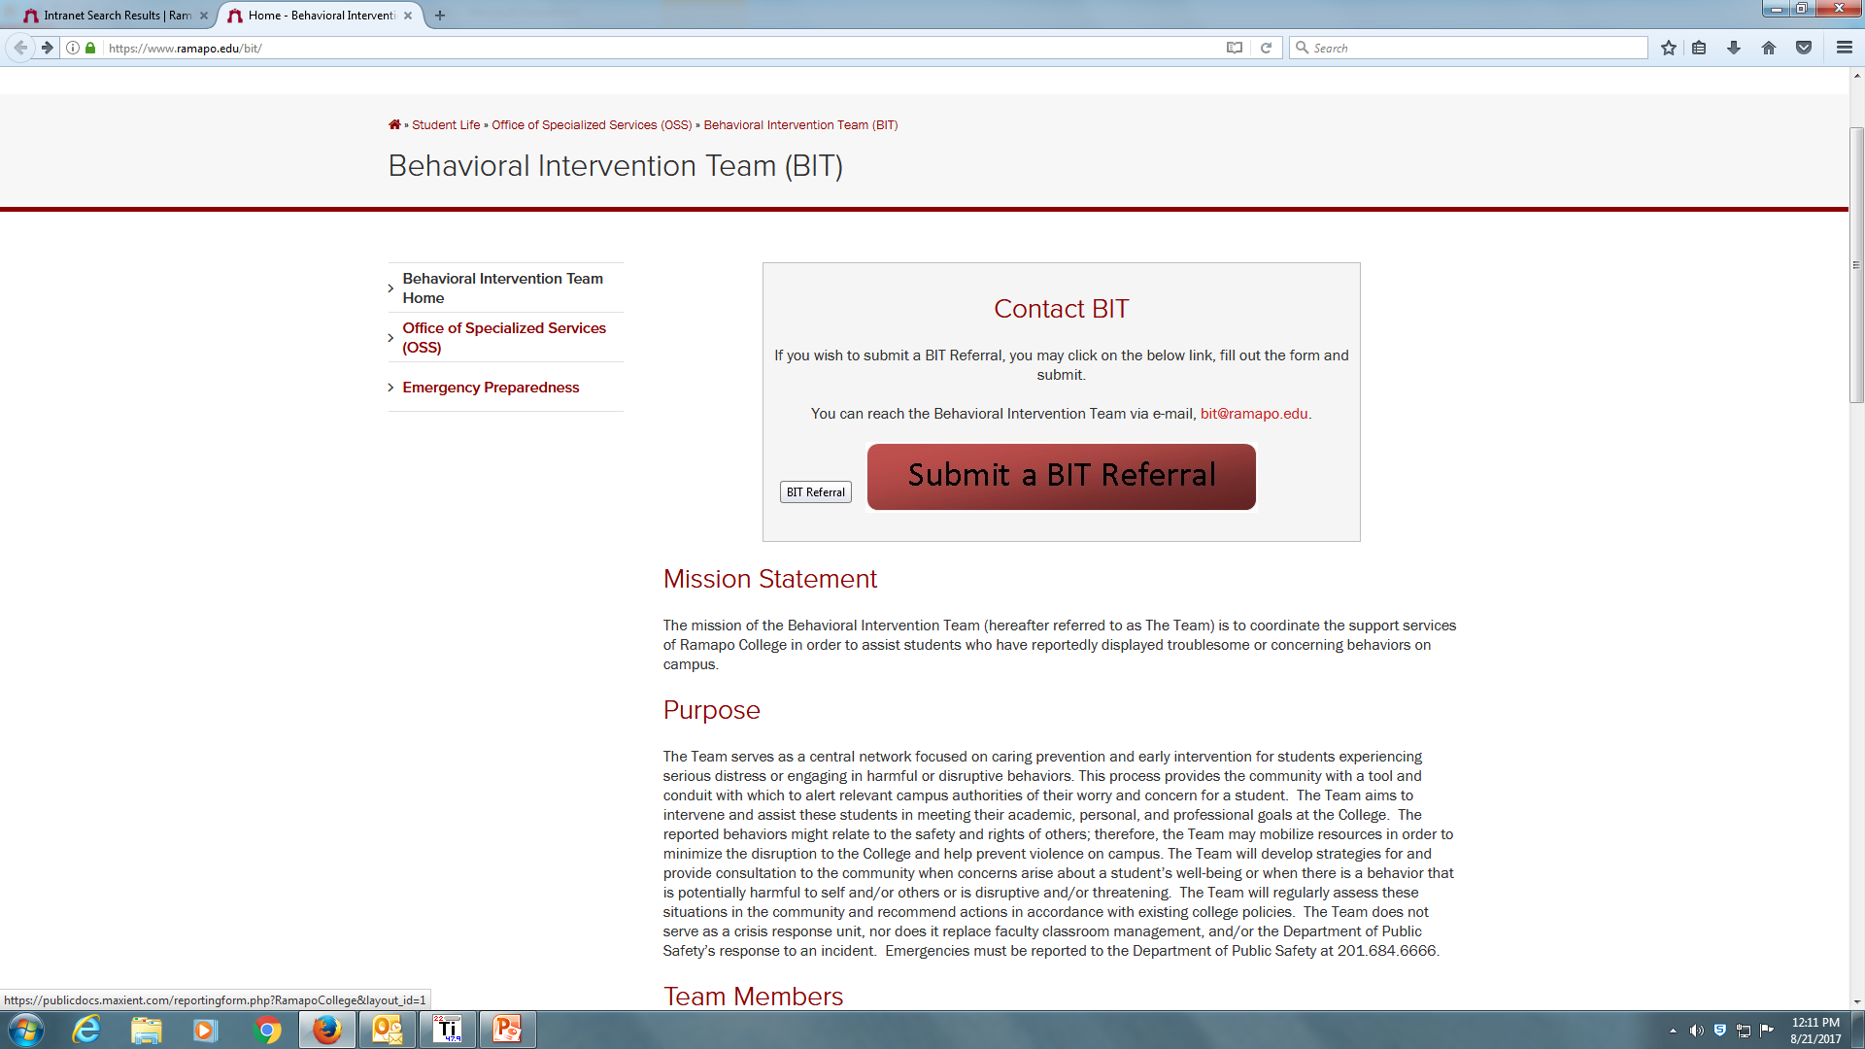
https://www.ramapo.edu/bit/
https://www.ramapo.edu/bit/

