Slide 1
Office of Employee Relations (ER) and
Faculty Resources
2025-2026 New Faculty of
Ramapo College
Jennifer Hicks McGowan x7589

Slide 2
Agenda
Mission
Our Purpose
Governance
Office of Employee Relations Organizational Chart
Office of Employee Relations Overall Responsibilities
Office of Employee Relations Key Duties and Responsibilities
Contact Information
ER Webpage Information
Questions

Slide 3
Ramapo College of New Jersey
Mission, Vision, Values
Mission: Ramapo College is New Jersey’s Public Liberal Arts College, dedicated to providing students a strong foundation for a lifetime of achievement. The College is committed to academic excellence through interdisciplinary and experiential learning, and international and intercultural understanding. Ramapo College emphasizes teaching and individual attention to all students. We promote diversity, inclusiveness, sustainability, student engagement, and community involvement.
Vision: Ramapo College delivers a transformative education in a diverse community dedicated to welcoming and mentoring students who bring with them a range of lived experiences. We will achieve national distinction for developing empathetic problem solvers, ethical change agents, and responsible leaders who make a positive impact and thrive in a changing world.
The Board of Trustees reaffirmed the College mission and adopted a revised vision statement on January 30, 2023.
Values: Ramapo College is the Public Liberal Arts College of the state of New Jersey. The work of the College and its members is conducted with integrity. Our values are:
  Teaching, learning, and mentoring–we are actively engaged in and out of the classroom.
    Developing the whole person–we are scholars, we are creators, we are local and global citizens, and we are individuals.
    Respecting each other and our environment–we are an open, inclusive, supportive, and sustainable community.
The Values Statement was approved by the President’s Advisory Council on September 26, 2016, and reaffirmed by the Board of Trustees on January 30, 2023.

Slide 4
Our Purpose
Meet the needs of the Office of the Provost and Teaching, Learning and Growth Core (TLC) by striving to build trust, professional relationships, and confidence between Ramapo College of New Jersey Faculty/Professional Staff and the Office of Employee Relations by providing accurate, courteous, and timely customer support

Slide 5
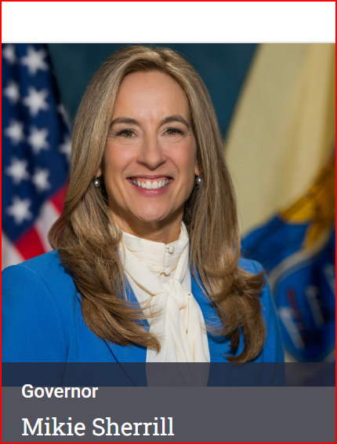
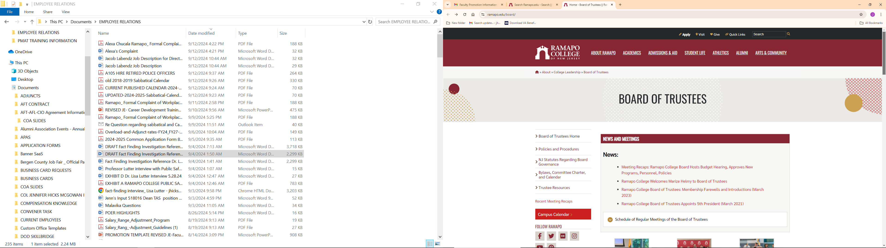
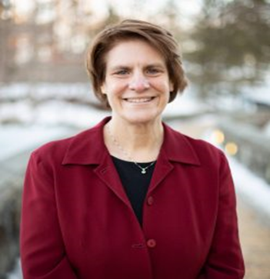
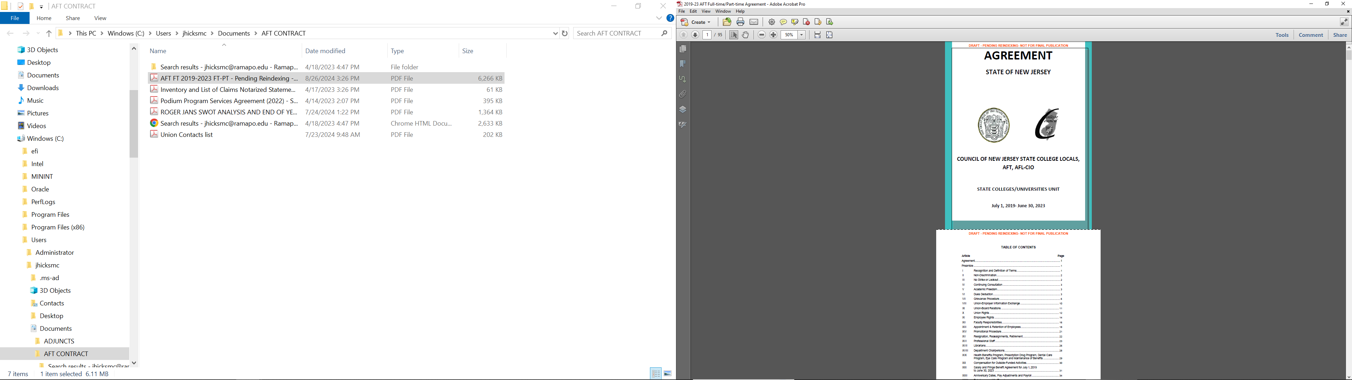
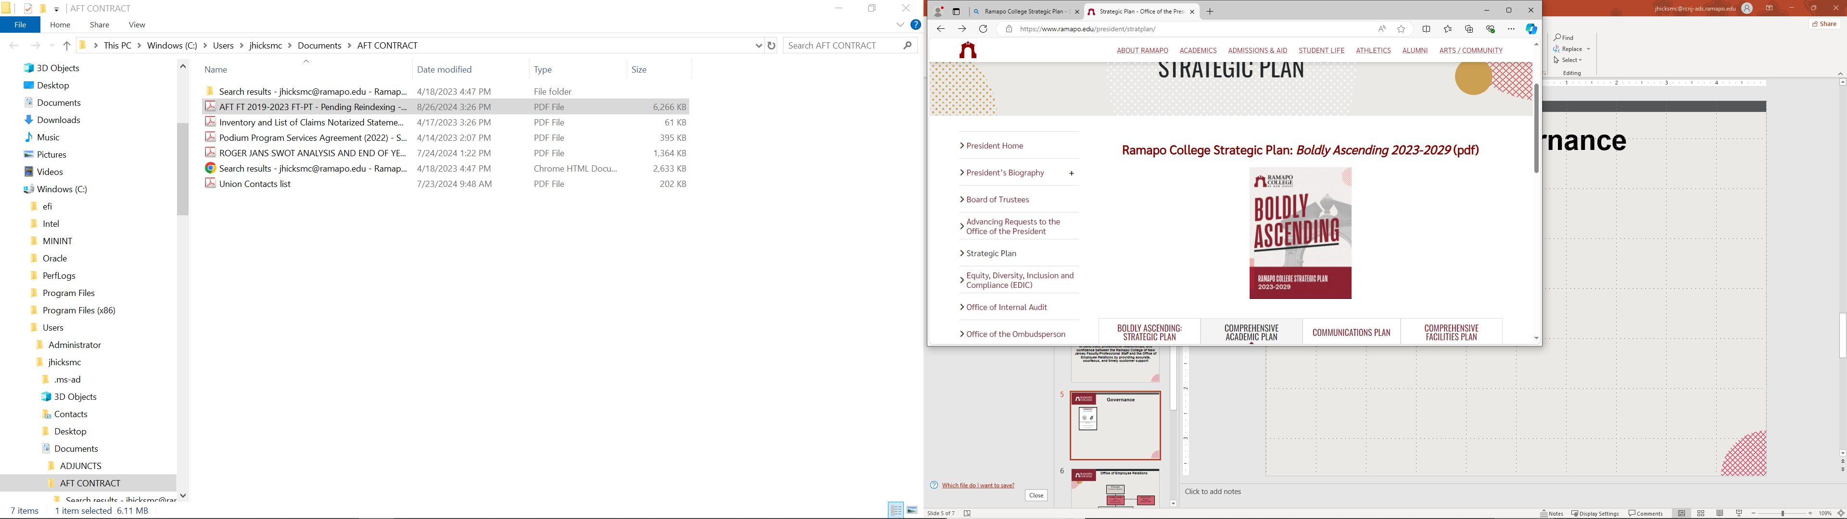
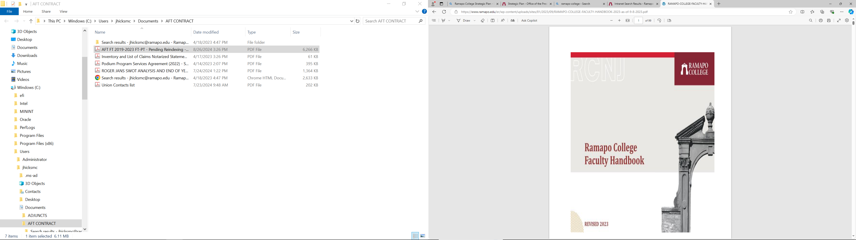
Governance
New Jersey Governor Mikie Sherrill
Ramapo College President Cindy Jebb
American Federation of Teachers (AFT)
Contract
Ramapo College Strategic Plan
Ramapo College
Faculty Handbook

Slide 6
Office of Employee Relations
Overall Responsibilities
The Office of Employee Relations is responsible for administering faculty personnel processes to include but not limited to reappointments, promotions, tenure, career development procedures; ensuring and monitoring compliance with the Current Contract (Collective Bargaining Agreement) between the College and the American Federation of Teachers (AFT), and other labor relations matters.
Additional responsibilities of the office include the administration of disciplinary, reappointment, performance appraisal and professional procedures (APAS, and PAR).
The office also monitors compliance with the College’s policy on Conflict of Interest, Intellectual Property, Code of Professional Responsibility, conducts fact-finding investigations, training and policy development, as well as other policies, statutes, regulations and procedures aimed at improving employee relationships across Ramapo College.

Slide 7
Office of Employee Relations
Key Duties and Responsibilities
OER Executive Director
Jennifer “Jenn” Hicks McGowan x7589
Academic Operations
Rosemary “Ro” Cline x7526
Administrative Operations
Shahriyar “Shah” Ahmed x7504
Strategic Outlook
Strategically aligns, coordinates, and organizes ER efforts to fully support the College Mission, Vision, and Values including its initiatives and interests
Reports to and serves as one of the principle advisors to the Provost regarding the AFT Contract. Makes recommendations regarding training, work allocations and problem resolution for AFT Union Members.
Interprets, facilitates, and complies with the American Federation of Teachers (AFT) Collective Negotiations Agreement (CURRENT CONTRACT).
Coordinates and collaborates with the College and Union Leadership including, Cabinet of Agents (COA), Faculty Leaders, AFT Leaders, Faculty Assembly (FA); Faculty Assembly Executive Council (FAEC), other Faculty Leaders to include Deans, Directors, Conveners and various Committee Chairs that will positively effectively and efficiently support the Faculty and Professional Staff
Oversees Faculty processes including, Career Development, Promotions, Reappointments, Tenure, Sabbatical, Faculty Scholarship Funding, Professional Leaves, etc. .
Provides staff assistance and streamlines the business processes practices of the Office of Employee Relations; strives for continuous process improvement
Conducts Fact Finding Investigations
Faculty Handbook Revisions
Oversees ER Technological Advancement (Strives for automative enhancements for faculty and staff processes)
Adjunct Focus
Produce, process, track and monitor Adjunct Contracts
Maintain accurate adjunct/professional staff teaching records
Process accurate payments for adjuncts and professional staff for all semesters
Process accurate payments for full-time faculty teaching during Winter/Summer sessions
Work with various offices regarding adjunct/faculty teaching loads and payments
Work with POER. Registrar’s Office and Payroll regarding adjuncts, full-time faculty, and payrolls
Monitor Overload requests and payments
Support review of Special Payment Requests
Facilitate Contract Season:
Spring Adjuncts Contract Window: Oct-Jan
  Winter: Oct-Dec
  Fall: Jul-Sep
  Summer I/II: Mar-Jul
  Contract: NLT April First; Full Time
  Fall Contracts: NLT October NLT Thanksgiving
Faculty Resources/Professional Staff
Supports the Executive Director in all assigned areas
Faculty and Staff Personnel Process Calendar Revisions
Supports all related AFT staff and faculty personnel processes calendars, administrative and academic regulations, related training sessions, and contractual reporting requirements;
Performs related work, as required, within the context of established College policies, contracts, legal guidelines and procedures and stays abreast of policy and process changes as they occur and ensures compliance.
Support production of offer letters for faculty
Support production of Faculty Personnel and Professional Staff Letters
Support BOT products for committee meetings

Slide 8
Contact Information
Jennifer “Jenn” Hicks-McGowan
Executive Director of Employee Relations and Faculty Resources
jhicksmc@ramapo.edu
Office: G-255 or G258
Phone: (201) 684-7566 or x7589
Rosemarie “Ro” Cline
Academic Operations
rcline@ramapo.edu
Office: G- 245
Phone: (201) 684-7527
Shahriyar Ahmed
Administrative Operations
sahmed16@ramapo.edu
Office: G-254
Phone: (201) 684-7504
Employee Relations:
https://www.ramapo.edu/er/
201-684-7566
ER@ramapo.edu
Hours of Operation
Fall/Spring - Monday – Friday 8:30 am - 4:30 pm
Summer - Monday – Thursday 8:00 am - 5:15 pm (Closed on Fridays)

Slide 9
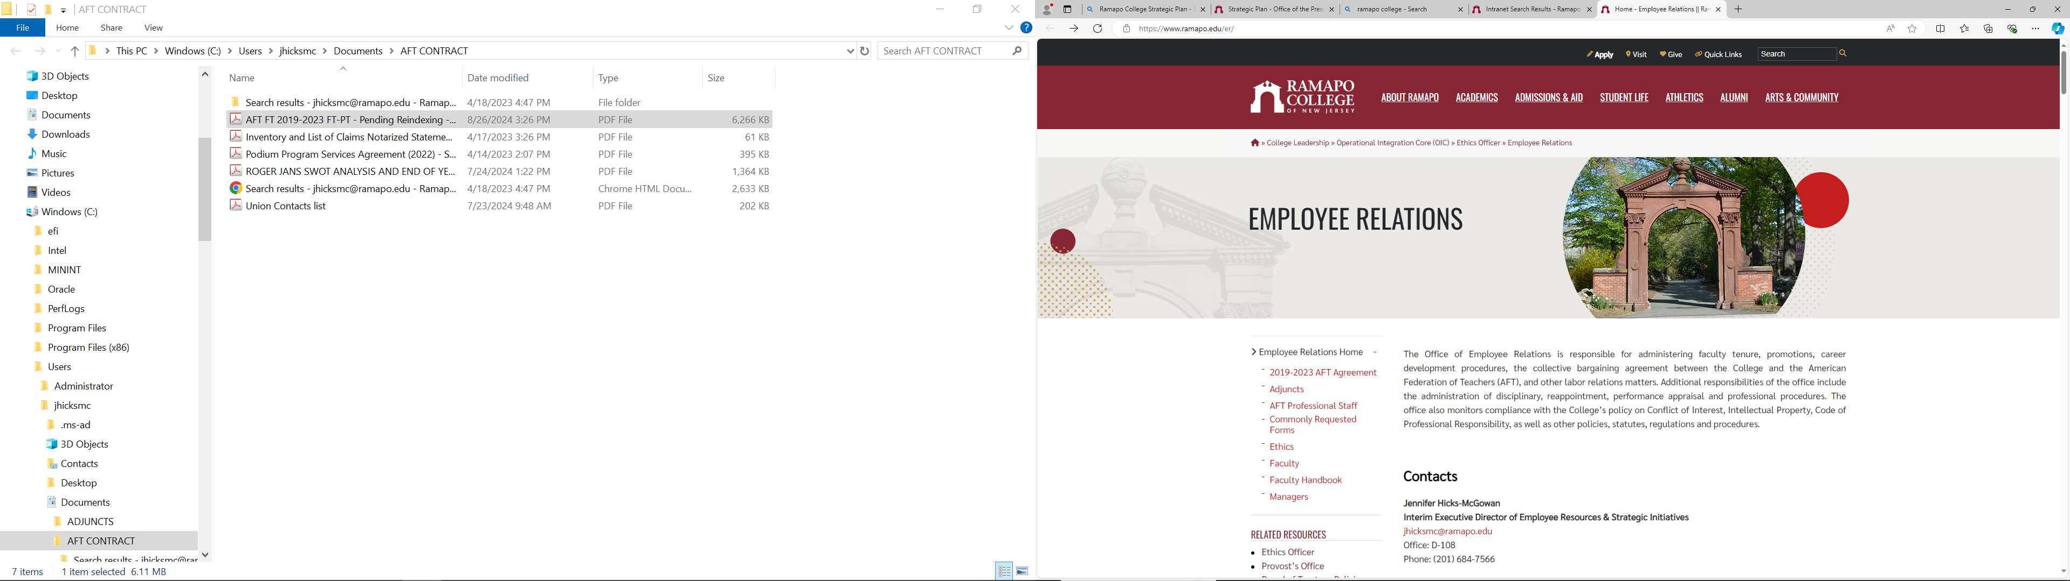
Employee Relations Website
Home - Employee Relations || Ramapo College of New Jersey
https://www.ramapo.edu/er/

Slide 10
Questions?

