Slide 1
Office of Specialized Services (OSS) – Quick Overview
OSS Homepage Link

Slide 2
Ramapo College is Nationally Recognized for Supporting Students with Disabilities
“10 Best Campuses for Students with Physical Disabilities” - College Magazine March 2019
“30 Best Small Colleges for Students on Autism Spectrum” - Applied Behavior Analysis Program January 2020
24th on a list of “Disability Friendly Schools” – Great Value Colleges July 2023

Slide 3
OSS Student Population - Fall 2025
769 Students Affiliated at the end of the Spring Semester
  713 Undergraduate Students
  56 Graduate Students
Top 5 Disability Categories
  Learning Disabilities (LD)
  Psychological/Mental Health
  Attention ADD/ADHD
  Autism Spectrum Disorder (ASD)
  Chronic Medical

Slide 4
OSS Staffing
7 Full – Time Staff Members (Director, Assistant Director, 4 Counselors, Office Coordinator)
Part – Time Graduate Assistant
Technology Specialist – Student Works
TRIO Student Support Grant funds:
  Hourly Professional Writing Tutors
  Hourly Peer Subject Tutors

Slide 5
TRIO Student Support Services (SSS) Grant
185 students are allowed to be part of Trio during the year
Trio includes the following services:
  supplemental academic advisement
  learning strategies instruction
  career counseling
  tutoring

Slide 6
Accommodations
Students must provided documentation of disability
OSS Staff view review accommodations request
Approved accommodations are recorded in students’ OSSOnline profile.
Students are able request to have Accommodation Notices sent to their professors via OSSOnline
Professors receive Accommodation Notices via email and they are viewable in the Instructor Portal

Slide 7
Accommodation are Exceptions
Most accommodations represent exceptions to the general rule for a class
Disability accommodations are intended to allow for equal access to the educational experience/environment
If a professor believes a student’s accommodation is not appropriate for their class, the instructor should disuses the situation with the student’s OSS Counselor

Slide 8
Instructor Portal Features
Enhances communications among students, OSS, and faculty
All the accommodation information in one place for Instructors:
  View accommodation letters of students enrolled in a professors classes
  Complete and view the Faculty Alternative Testing Agreements
  View exam sign-ups by student per course, per exam
  Upload exams

Slide 9
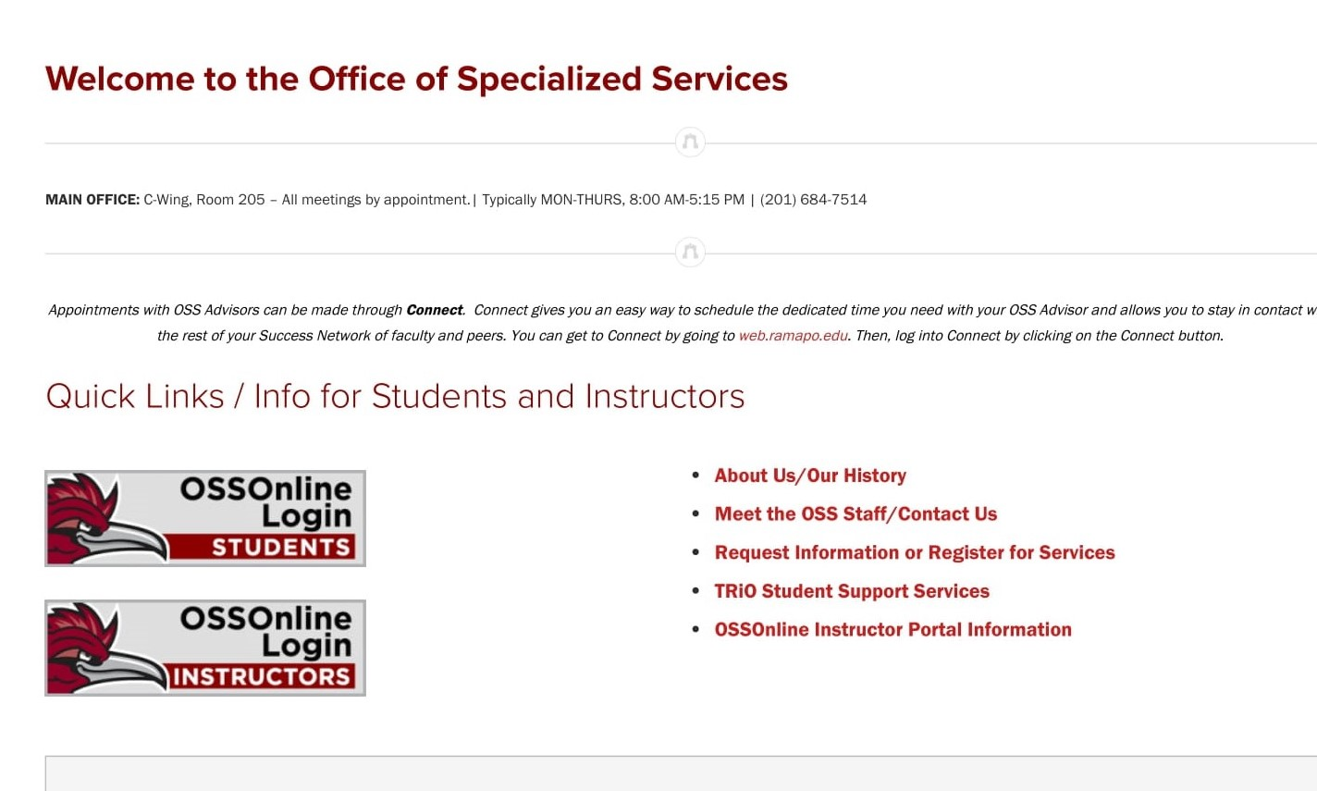
OSSOnline Faculty Portal
www.ramapo.edu/oss/

Slide 10
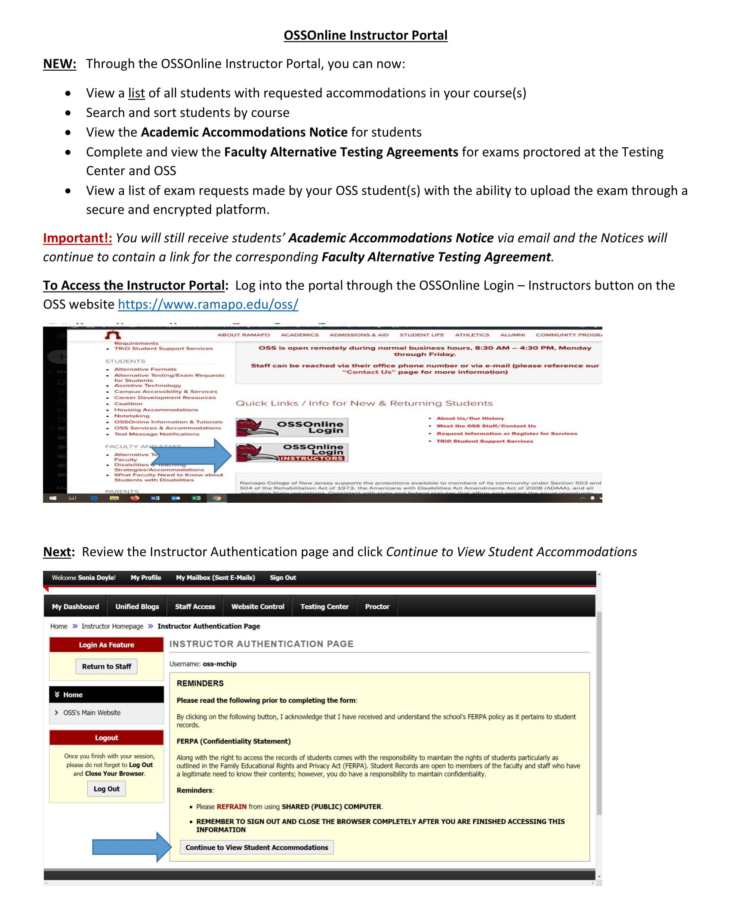
OSSOnline Instructor Portal Guide
Instructor Portal Guide Link

