Slide 1

Start Here - WELCOME!
Orientation to New Full-Time Faculty
Ramapo College of New Jersey

Slide 2
Fast Facts about Ramapo
Ramapo College of New Jersey
Founded: 1969
Students: 6100 (~ 5500 UG; 500 G)
Average class size: 22
Just under 50% of our undergraduate students live on campus
Just under 50% of student are First Generation College Students
Four schools (Fall 2026); convening groups (not departments) housed within each college/school: Anisfield School of Business (ASB), School of Social Sciences and Social Work (SSSW), School of Science, Nursing, and Health (SNH), School of Arts, Humanities and Education (AHE)
Ramapo College Fact Facts—Spring 2025

Slide 3
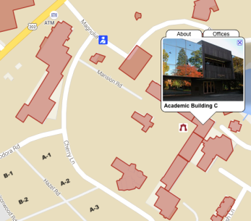
Public Safety
Location: C-102
Go to C-101 to get your ID card
Go here for parking passes (https://rcnjpublicsafety.omnigo.one/CESIReportExec/opr/OPRMain.aspx?IsAuth=1&groupid=102&groupname=PUBLIC+SAFETY)
Campus Public Safety Emergency: (201) 684-6666
Non-Emergency Calls: (201) 684-7432
(201) 684-7433

Slide 4
Technology Problems?
Just dial 201.684.7777 or email helpdesk@ramapo.edu
Tech Support Help Desk
They are not always the answer to your problem, but they will connect you to the right person!

Slide 5
Academic Calendar
http://www.ramapo.edu/academic-calendars/
Important Dates:
  First Day of Classes: 8/26/26
  Add/Drop Ends 9/1/26 (Full Semester Courses)
  Last Day to give a “W” Grade 11/6//26
  Thanksgiving Break (college closed) 11/25-11/29
  Final Exams: 12/9-12/15
  Final Day to Give an “I” (Incomplete): 12/15
  Spring Break (college closed): 3/14/27-3/21/27
Note: classes held, offices closed on certain days!

Slide 6
Meeting Schedule
Visit the following link to the Faculty Meeting Calendar:
  https://www.ramapo.edu/fa/calendar/
  -Faculty Assembly
  -Unit Council Meetings
  -AFT Union Meetings
  -Major/Minor Convening Group Meetings

Slide 7
Speaking of AFT (Local 2274)
Local 2274 negotiates with 8 other NJ state colleges and is part of a national union with 1.8 million members!
Collective bargaining has resulted in full-time employees receiving a 3.5% across-the-board increase in each year of the contract.
Learn more:
  https://ramapoaft.org/
To join:
  https://www.cnjscl.org/membershipcard.htm

Slide 8
AFT Local 2274 Contacts
Ed Shannon, President Local 2274
ed.shannon@ramapoaft.org
AFT Office is ASB 102
201-684-7108

Slide 9
What You Will Find in a Ramapo Classroom
Classrooms should have white (not smart!) boards.
  Ask Unit Secretary for Markers or Bring Your Own
  Don’t necessarily expect erasers.
    Again, ask Unit Secretary
Classrooms have audio/visual lecterns/podiums/units
  All should have desktop computer
  Should be ports to link your laptop–bring cords in case
  All classrooms have WiFi
  All computers use multi-factor authentification
  Should be DVD players and overhead projectors
Always have a Plan B!

Slide 10
Preparing Your Syllabi
Unit (School) Secretaries ask for Syllabi 2 weeks before semester begins
Ask Conveners for Copies of Previous Syllabi
Academic Review Committee (ARC) Manual has specific guidance:
  https://www.ramapo.edu/fa/arc/
  Course Preparation Guidelines
  Syllabus Checklist
    Check for Accessibility

Slide 11
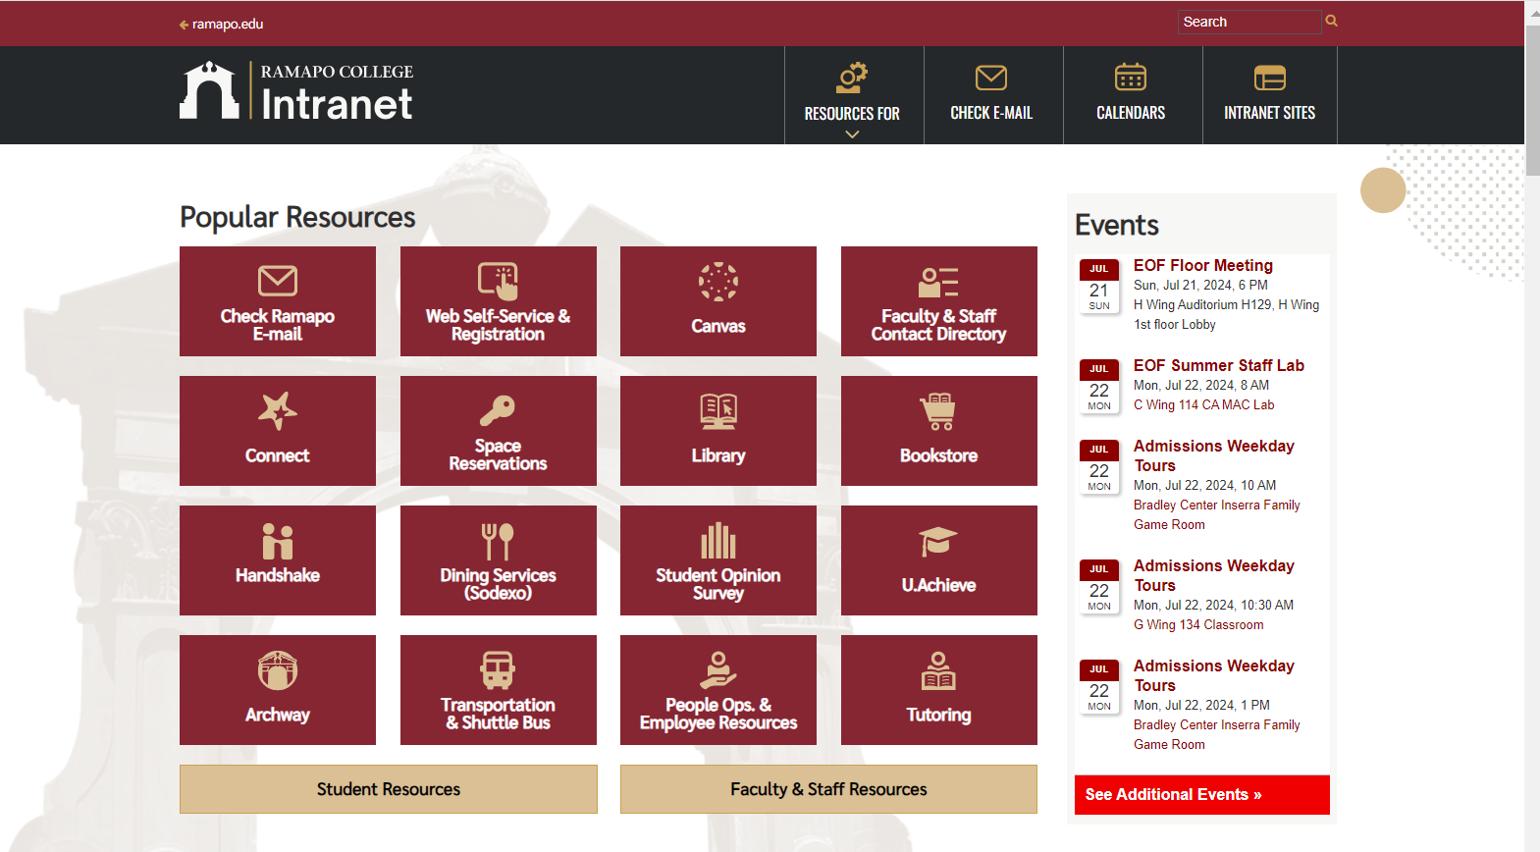
web.ramapo.edu
Our Intranet is the place to access most of what you will need, including class rosters, employee information, etc.

Slide 12
Learning Management System https://web.ramapo.edu/
We are a Canvas-based institution:

Slide 13
Instructional Design Center
Get one-on-one support and attend workshops on Canvas, instructional design, and other technologies such as Kahoot, Turnitin, Respondus, and more.
Online office hours, or visit the IDC Lab in LC201
  Director: Michael Bitz (SSHS): mbitz@ramapo.edu
For more info:
  http://www.ramapo.edu/idc

Slide 14
Instructional Design Center
Upcoming IDC Workshops
Monday, August 24, 2026:
10am-10:50am: Getting Started with Canvas
11am-11:50am: Gamify Your Course with Kahoot!
12:00pm-12.50pm: Ways to Embrace and Prevent AI: Faculty Panel Discussion
1:00pm-1:50pm: Canvas Assignments, Quizzes, and Gradebook
2:00pm-2:50pm: Canvas Templates and Master Courses
3:00-3:50pm: ADA Accessibility for Digital Course Materials
Register in advance at: https://www.ramapo.edu/idc/workshops-and-training/

Slide 15
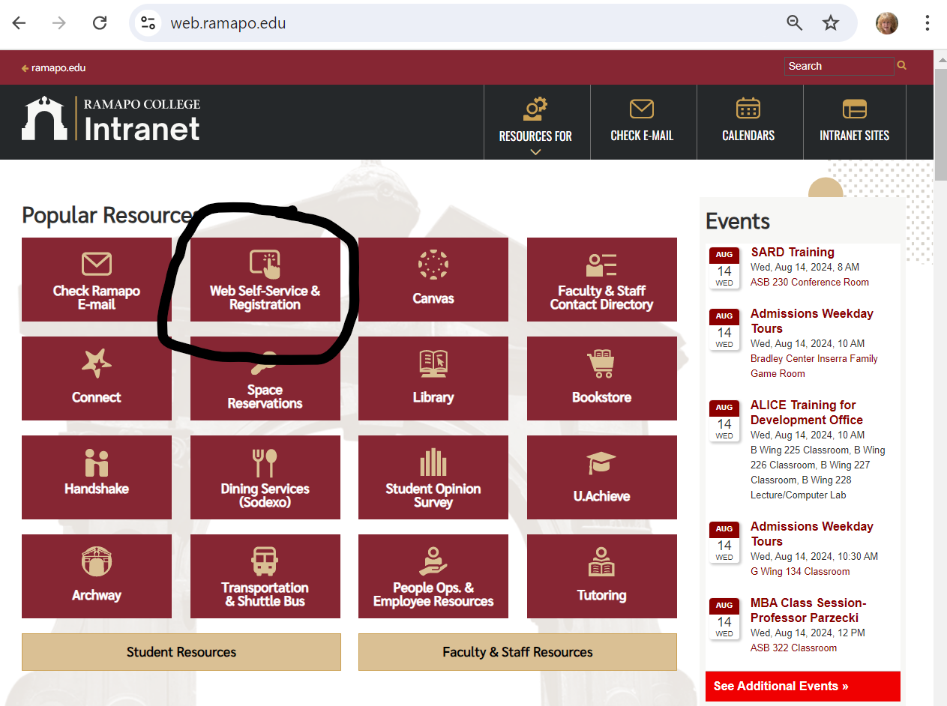
Course Administration Through RCNJ Experience (Web Self-Service)
Experience Interface
  Enter Secure Area
    Faculty Services Includes:
      Grade Entry
      Student Search
      Overrides

Slide 16
Center for Student Success (CSS)
ADVISEMENT,
CAREER DEVELOPMENT, CONNECT,
EOF, FIRST-GEN STUDENT CENTER, NEW STUDENT EXPERIENCE, STEM CENTER, TESTING CENTER, TRANSFER CENTER AND VETERANS CENTER
Contact information:
Joseph Connell, AVP Student Success
jconnell@ramapo.edu
Center for Student Success, D207
(201) 684-7441
success@ramapo.edu

Slide 17
Center for Student Success (CSS) CONNECT
Academic Progress Survey Software
  Accessible through web.ramapo.edu or Canvas
  Displays students in your courses automatically
  Monitor student progress and learning
    Raise academic progress items for excellent or concerning work
    Review academic progress items that have been raised about your students
  Professional staff and other faculty on campus who can intervene become aware
Resource Website
http://www.ramapo.edu/connect
Tracey Bender, Senior Assistant Director of Student Success & Testing
tpastori@ramapo.edu
connect@ramapo.edu
201-684-7480

Slide 18
Office of Specialized Services (OSS)
The Office of Specialized Services (OSS) serves our population of students with disabilities. This office offers multiple services to help these students (and their faculty members) succeed.
Contact: David Nast, OSS Director, dnast@ramapo.edu
https://www.ramapo.edu/oss/

Slide 19
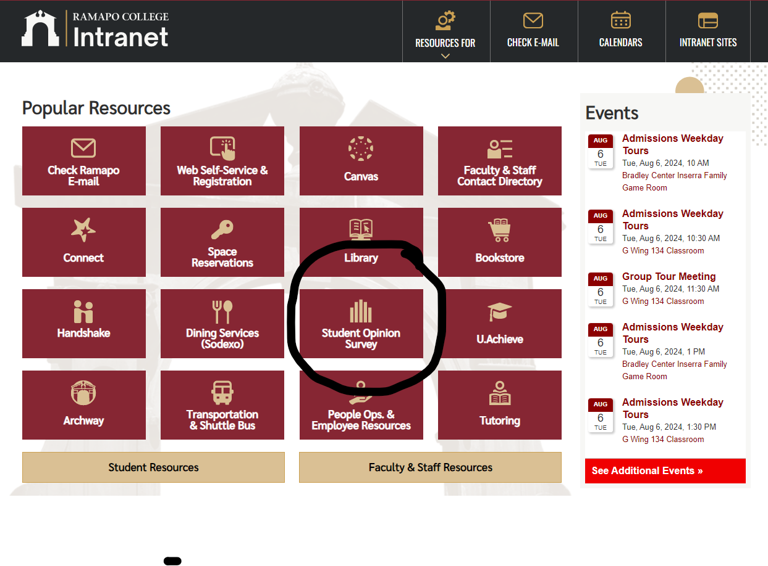
Finishing Up the Semester
Course Evaluations
  Peer Evaluations
  Dean Evaluations
  Student Opinions
Final Exam Schedule:
  https://www.ramapo.edu/web-resources/exams/

Slide 20
Questions?
Contact your convener!
Contact your Unit secretary!
Contact your Deans!
Contact me! Rikki Abzug: Rabzug@ramapo.edu

