Slide 1
Institutional Review
Board 2025-2026
New faculty orientation
Colleen Martinez - chair
Kristin Kenneavy - former chair

Slide 2
IRB@ramapo.edu
Chair: Colleen Martinez (social work) cmarti13@ramapo.edu
Co-Chair: Shaziela Ishak (psychology) sishak@ramapo.edu
Questions are always welcomed!
Colleen’s Fall 2025 office hours
Monday 12-1, 2-3, and by appointment
G262 or WebEx by request
x7849

Slide 3
Human Subjects Research
Does your research involve live humans at Ramapo College or affiliated sites about whom the investigator obtains data? If yes, continue, if no, IRB approval not needed. (“obtaining data” is defined as gaining information through intervention, interaction, or in any way gaining identifiable private information).Examples of categories of research with human subject that need IRB approval:
Faculty or staff research projects (including those which are funded).
Research by an investigator not affiliated with Ramapo College of New Jersey who proposes to involve Ramapo College of New Jersey students, staff, or faculty as subjects in the proposed research project.
Undergraduate student research within Honors and independent study projects.
Graduate student research projects.
Studies expected to result in publication, presentation outside the college, or public dissemination in some other form.
Research conducted outside the college if it involves: minors (i.e. persons under the age of 18); a targeted population of adults whose ability to freely give informed consent may be compromised (i.e. persons who are socio-economically, educationally, or linguistically disadvantaged, cognitively impaired, elderly, terminally ill, or incarcerated); pregnant women and/or fetuses who may be put at risk of physical harm; a topic of a sensitive or personal nature, the examination or reporting of which may place the research participant at more than minimal risk, or any type of activity that places research participants at more than minimal risk.

Slide 4
Undergraduate research projects that have a low likelihood of being presented in a forum outside of the College do not need to undergo IRB review unless the risk exceeds minimal risk. However, all human subject research done by undergraduates is the responsibility of the course instructor, who is required to undergo the online training provisions listed in section 6.7 of the Ramapo College IRB Policy. (If the data collected in the context of a course is for classroom use only, the Ramapo IRB suggests the instructor use a “best practices” instructor course research approval form and that the instructor act as the research review chair with responsibility for reviewing the project).

Slide 5
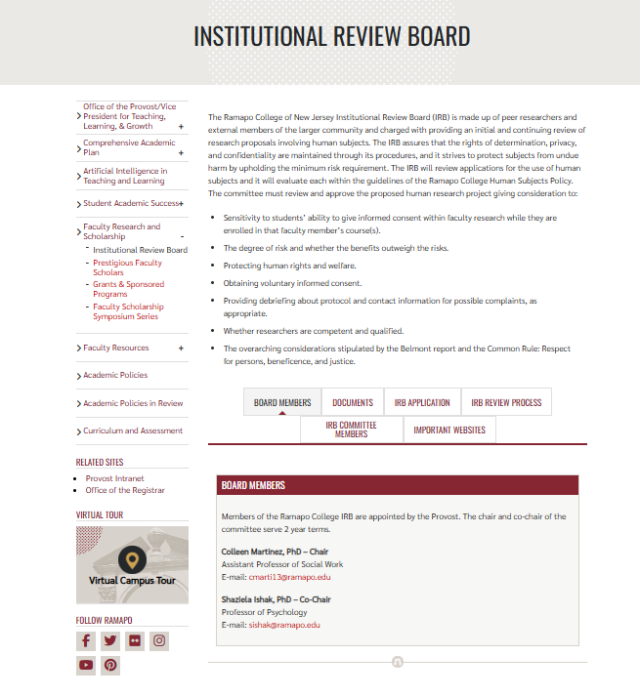
https://www.ramapo.edu/provost/research-and-scholarship/institutional-review-board/

Slide 6
The IRB assures that the rights of determination, privacy, and confidentiality are maintained through its procedures, and it strives to protect subjects from undue harm by upholding the minimum risk requirement. The IRB will review applications for the use of human subjects and it will evaluate each within the guidelines of the Ramapo College Human Subjects Policy. The committee must review and approve the proposed human research project giving consideration to:
Sensitivity to students’ ability to give informed consent within faculty research while they are enrolled in that faculty member’s course(s).
The degree of risk and whether the benefits outweigh the risks.
Protecting human rights and welfare.
Obtaining voluntary informed consent.
Providing debriefing about protocol and contact information for possible complaints, as appropriate.
Whether researchers are competent and qualified.
The overarching considerations stipulated by the Belmont report and the Common Rule: Respect for persons, beneficence, and justice.

Slide 7
IRB applications
-reviewed on a rolling basis September to June 1
-applications received in the summer will be reviewed in September
-CURRENT application and policies on the website
-CURRENT ethics training required https://ori.hhs.gov/education/products/montana_round1/research_ethics.html “the Montana training”
-fill out completely, include informed consent, survey materials, outreach materials
-email to IRB@ramapo.edu
-always ok to follow up

Slide 8
Reviews
-we need to ensure all regulations and ethics standards are met
-exempt, expedited, full, extension
-same process just # reviewers varies
-same experience from applicant perspective
-chair or co-chair review, then IRB member(s) review
-all communications between chair or co-chair and PI by email
-applications usually require editing, updating
-work with you until approval if possible
-once application (including all materials) is complete we aim for a 2 week turn around

Slide 9
Federal Regulations
https://www.hhs.gov/ohrp/regulations-and-policy/regulations/common-rule/index.html

Slide 10
IRB members
20+ faculty from all disciplines
need more from TAS
community members
also need more community members
low demand, high importance all college service
average 3 applications to review per year
all work done by email
great way to learn about research and IRB processes

Slide 11
Exempt
-Exempt from further IRB review
-Research involving children or prisoners cannot be exempt
-Cannot be greater than minimal risk. “Minimal risk means that the probability and magnitude of harm or discomfort anticipated in the research are not greater in and of themselves than those ordinarily encountered in daily life or during the performance of routine physical or psychological examinations or tests.”
-Submit an application and obtain an IRB approval number, even if you believe it’s exempt
-May be required for publication, funding sources

Slide 12
Exempt
-Normal education practices
-Educational tests, surveys, interviews
-Observation of public behavior
-Secondary analysis
-Minimal risk
-Chair or co-chair review

Slide 13
Expedited
-No more than minimal risk
-See regulations for specific categories, but typical non experimental research procedures
-Chair or co-chair plus one (or more) IRB member

Slide 14
Full IRB Review
-Any research with more than minimal risk
-Experimental
-Touch
-Interventions
-Risk may be ok as long as the is an appropriate balance of potential risk/benefit
-More eyes on the application is better
-Chair or co-chair plus 1 related faculty, 1 unrelated faculty, 1 community member
-Typically same time frame
-Funding question is important

Slide 15
Extension
-Continuing research after initial 1 year approval period
-Submit before expiration
-Indicate approval # in email request
-Indicate if there are any changes to the study
-Chair or co-chair review
-Changes may require a new application
-Expiration requires a new application

Slide 16
Additional items
-compensation to participants
-no pressure for students to participate
-psychology pool
-informed consent

Slide 17
Elements of consent forms
Make sure that your consent form addresses the following questions and issues in a form that is understandable by your potential participants.
1. In brief, what is the purpose of the research?
2. How many participants will be needed?
3. What is the expected duration of the participation for each participant?
4. What will the participant be asked to do?
5. What are the reasonably foreseeable risks or discomforts to the participant?
6. What are the benefits to the participant or to others which may reasonably be expected from the research?
7. How will the confidentiality of records identifying the participant be maintained?
8. Who to contact for answers to pertinent questions about the research and research participants’ rights, and who to contact in the event of a research-related injury to the participant.
9. A statement that participation is voluntary, refusal to participate will involve no penalty or loss of benefits to which the participant is otherwise entitled. The participant may discontinue participation at any time without penalty or loss of benefits to which they are otherwise entitled.
10. Statement of Consent: I am at least 18 years old and I have read the above information. I have asked questions and have received answers. I consent to participate in the study.
Include spaces for signatures and date

Slide 18
Considerations in reviews
Risks to subjects are minimized.
Risks to subjects are reasonable in relation to anticipated benefits, if any, to subjects, and the importance of the knowledge that may reasonably be expected to result.
Selection of subjects is equitable.
Consent document: Is the consent form clear in describing the essential elements?
Consent process: Is the process for obtaining consent adequately described and appropriate?
It is clear from the consent process and setup that participation is voluntary and participants can opt out at any time?
The research plan makes adequate provision for monitoring the data or procedures to ensure the safety of subjects.
There are adequate provisions to protect the privacy of subjects and to maintain the confidentiality of data.
When some or all of the subjects are likely to be vulnerable to coercion or undue influence, such as children, prisoners, individuals with impaired decision-making capacity, or economically disadvantaged persons, additional safeguards have been included in the study to protect the rights and welfare of these subjects.

Slide 19
Outcomes
____ I have no ethical concerns and approve this study
____ Feedback/suggestions for the PI (anonymously shared)
____ I have questions/concerns to share with the chair (and possibly anonymously with the PI)

Slide 20
Questions?

