Slide 1

Start Here - WELCOME!
Orientation to New Full-Time Faculty
Ramapo College of New Jersey

Slide 2
Fast Facts about Ramapo
Ramapo College of New Jersey
Founded: 1969
Students: 6,110 (~ 5600 UG; 500 G)
Average class size: 21
Just under 50% of our students live on campus
Five colleges/schools; convening groups (not departments) housed within each college/school: ASB, CA, HGS, SSHS, TAS
Primarily undergraduate, but there are 9 graduate programs
Emerging Hispanic Serving Institution (HSI)!
Ramapo College of New Jersey FAST FACTS - SPRING 2024

Slide 3
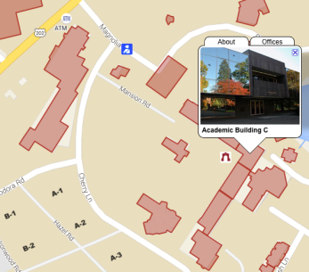
Public Safety
Location: C-102
Go to C-101 to get your ID card
Go here for parking passes (https://rcnjpublicsafety.omnigo.one/CESIReportExec/opr/OPRMain.aspx?IsAuth=1&groupid=102&groupname=PUBLIC+SAFETY)
Campus Public Safety Emergency: (201) 684-6666
Non-Emergency Calls: (201) 684-7432
(201) 684-7433

Slide 4
Technology Problems?
Just dial 201.684.7777 or email helpdesk@ramapo.edu
Tech Support Help Desk
They are not always the answer to your problem, but they will connect you to the right person!

Slide 5
Academic Calendar
http://www.ramapo.edu/academic-calendars/
Important Dates:
  First Day of Classes: 8/27/25
  Add/Drop Ends 9/2/25 (Full Semester Courses)
  Last Day to give a “W” Grade 11/25/25
  Thanksgiving Break (college closed) 11/26-11/30
  Final Exams: 12/10-12/16
  Final Day to Give an “I” (Incomplete): 12/16
  Spring Break (college closed): 3/15/26-3/22/26
Note: classes held, offices closed on certain days!

Slide 6
Meeting Schedule
Visit the following link to the Faculty Meeting Calendar:
  https://www.ramapo.edu/fa/calendar/
  -Faculty Assembly
  -Unit Council Meetings
  -AFT Union Meetings
  -Major/Minor Convening Group Meetings

Slide 7
Speaking of AFT (Local 2274)
Local 2274 negotiates with 8 other NJ state colleges and is part of a national union with 1.8 million members!
Collective bargaining has resulted in full-time employees receiving a 3.5% across-the-board increase in each year of the contract.
Learn more:
  https://ramapoaft.org/
To join:
  https://www.cnjscl.org/membershipcard.htm

Slide 8
Preparing Your Syllabi
Unit (School) Secretaries ask for Syllabi 2 weeks before semester begins
Ask Conveners for Copies of Previous Syllabi
Academic Review Committee (ARC) Manual has specific guidance:
  https://www.ramapo.edu/fa/arc/
  Course Preparation Guidelines
  Syllabus Checklist

Slide 9
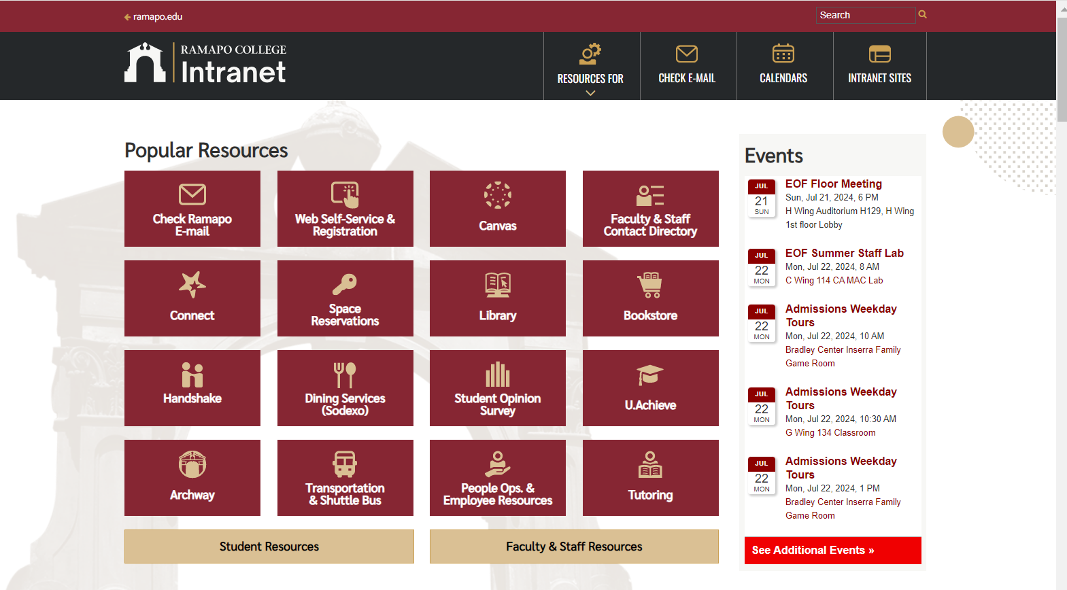
web.ramapo.edu
Our Intranet is the place to access most of what you will need, including class rosters, employee information, etc.

Slide 10
Learning Management System
We are a Canvas-based institution:

Slide 11
Instructional Design Center
Get one-on-one support and attend workshops on Canvas, instructional design, and other technologies such as Kahoot, Turnitin, Respondus, and more.
Online office hours, or visit the IDC Lab in LC201
  Director: Michael Bitz (SSHS): mbitz@ramapo.edu
For more info:
  http://www.ramapo.edu/idc

Slide 12
Instructional Design Center
Upcoming IDC Workshops
Wednesday, August 20, 2025:
9am-10am: Course AI Policy: Getting it Right for Your Students and You
10am-11am: Getting Started with Canvas
11am-12pm: Canvas Assignments, Gradebook & Speedgrader
1:00pm-2:00pm: Navigating the New Course Template
2:00pm-3:00pm: Designing for Student Engagement
Register in advance at: https://www.ramapo.edu/idc/workshops-and-training/

Slide 13
Instructional Design Center
Upcoming IDC Workshops
Thursday, August 21, 2025:
9am-10am: AI Prompt Engineering 101 for College Faculty
10am-11am: Turnitin in Canvas: What’s New & How to Use It
11am-12pm: Panopto + Canvas: Supercharge Your Course With Engaging Video and Lecture Capture
1:00pm-2:00pm: Utilizing Master Courses: What, Why, and How
2:00pm-3:00pm: Gamify Your Course
Register in advance at: https://www.ramapo.edu/idc/workshops-and-training/

Slide 14
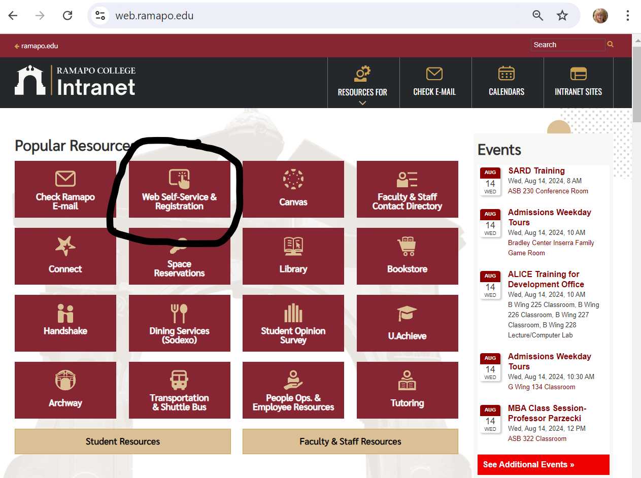
Course Administration Through Web Self-Service
Enter Secure Area
  Faculty Services Includes:
    Grade Entry
    Student Search
    Overrides

Slide 15
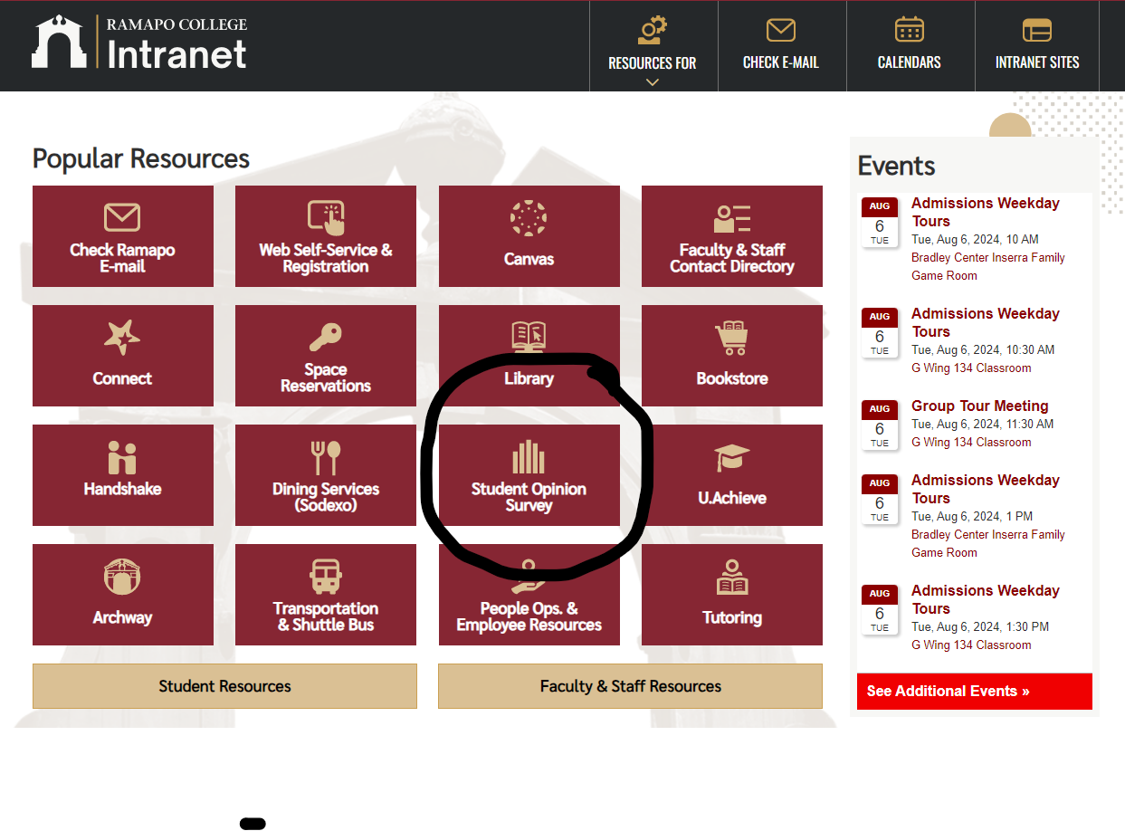
Finishing Up the Semester
Course Evaluations
  Peer Evaluations
  Dean Evaluations
  Student Opinions
Final Exam Schedule:
  http://www.ramapo.edu/web-resources/exams/

Slide 16
Questions?
Contact your convener!
Contact your Unit secretary!
Contact your Deans!
Contact me! Rikki Abzug: Rabzug@ramapo.edu

