Slide 1
People Operations & Employee Resources
(POER)
New Faculty/Adjunct Orientation Training 2025

Slide 2
New Hire Overview
The purpose of this section of the presentation is to provide an overview of the POER website, POER services and introduce the team.
The presentation will cover the following topics:
  President & Core Leaders
  History
  POER Team
  POER Mission
  Collaborating Units
  New Hire Checklist
  Website Landing Pages
  Wellness Benefits
  Contact Information

Slide 3
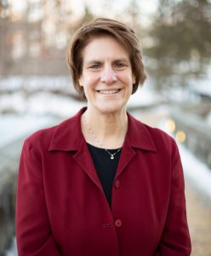
President
Dr. Cindy R. Jebb became Ramapo College’s fifth president on July 6, 2021
Dr. Jebb earned a B.S. from the United States Military Academy at West Point, a M.A. in Political Science from Duke, an M.A. in National Security and Strategic Studies from the Naval War College, and a Ph.D. in Political Science from Duke University

Slide 4
Mission Element Team
(MET)
President – Cindy Jebb, PhD
Provost – Michael Middleton, PhD
VP For People Operations & Employee Resources – Virginia Galdieri, MBA
VP Fiscal Health & Chief Financial Officer – Colleen O’Keefe, CPA
VP Chief Equity & Diversity Officer - Nicole Morgan Agard, Esq.
VP for Strategic Enrollment, Outreach & Engagement - Christopher Romano, EdD
VP for Student Well-being, Dean of Students - Melissa Van Der Wall, MPA
VP Chief of Staff & Board Liaison - Brittany Williams-Goldstein, EdD
VP for Operation & Administrative Integration - Michael Yankovich, PhD

Slide 5
History
Established in 1969
Accredited by Middle States Association of Colleges and School in 1975
Today - Enrollment is approximately 6,000
  Organized into five interdisciplinary schools with more than 500 course offerings
  Eleven programs are offered leading to a master's degree and one doctoral program: the Doctor of Nursing Practice (DNP)
  Five interdisciplinary schools
  Anisfield School of Business,
  School of Contemporary Arts
  School of Humanities and Global Studies
  School of Social Science and Human Services
  School of Theoretical and Applied Science.
Notes:
16:1 Student teacher average class size 21 . Just opened a new Learning Commons

Slide 6
People Operations & Employee Resources Team
(POER)
Virginia Galdieri, Vice President, People Operations & Employee Resources - vgaldier@ramapo.edu (201) 684-7506
Jill Brown, Director of People Operations - jcbrown@ramapo.edu (201) 684-7507
  Lauren Cioffi, Associate Director Professional Development , Training and Compensation lcioffi@ramapo.edu (201)-684-7231
  Cindy Robles, Associate Director Employment Operations, Payroll & Benefits - crobles2@ramapo.edu (201) 684-7502
Johnie Burton, Benefits Supervisor - jburton@ramapo.edu (201) 684-7230
Ivy Payne, Benefits Specialist – ipayne@ramapo.edu (201) 684-7617
Joanne Ehlermann – Talent Acquisition & Onboarding Mgr. jehlerma@ramapo.edu
Betty Ann Dobson - Payroll – payroll@ramapo.edu (201)684-7770

Slide 7
POER Mission Statement
Through strategic partnerships and collaboration with the Ramapo College Community, the People Operations and Employee Resources Department supports the College’s financial strength and institutional sustainability by recruiting, developing, and retaining a high performing and diverse workforce. People Operations and Employee Resources Department (POERD) fosters a healthy, safe and productive work environment by promoting teamwork, communication, leadership, integrity and trust.

Slide 8

Ramapo College Mascot

Slide 9

Equity, Diversity, Inclusion & Compliance Team
Nicole Morgan Agard, Esq., Chief Equity and Diversity Officer/ Director of Employee Relations
Email: nmagard@ramapo.edu
Office: D-106
Phone: (201) 684-6693
Kat McGee, J.D., Director of Title IX, ADA and Compliance Training
E-mail: kmcgee@ramapo.edu
Office: D-104A
Phone: (201) 684-7220
Costin Thampikutty, Associate Director, Equity & Diversity
E-mail: cthampik@ramapo.edu
Office: D-104
Phone: (201) 684-7487
Vacant, Equity & Compliance Investigator
E-mail:
Office: D -
Phone: (201) 684-

Slide 10

Public Safety
Campus Closing Information
  Alert Me Now
  Closing Number - 201- 236-2902
Campus Outreach
  Crime Reporting
  Parking
Sexual Assault Resources
Contact Number – Ext.6666
Website - https://www.ramapo.edu/publicsafety/

Slide 11
Information Technology Services (ITS)
Help Desk: ext. 7777, or helpdesk@ramapo.edu
Client Services
Banner application development
Networking Infrastructure (network, telephone, servers)
Learning Commons – 4th Floor www.ramapo.edu/its/
Academic Media Services (AMS)
Audio/video equipment and production for campus events
Located in H-205, ext. 7400 • www.ramapo.edu/ams/

Slide 12
Instructional Design Center (IDC)
Attend our technology workshop series: training.ramapo.edu
Drop in our lab for one-on-one assistance
Use our specialized computer equipment (scanners, printers, software)
Request department training
ext. 7103 • www.ramapo.edu/idc

Slide 13

New Hire Checklist https://www.ramapo.edu/newhires/
The checklist provides access to important benefits and new hire information/resources
Checklist is in steps to assist you with completing the required forms
  Step 1 - Required Forms:
    Data Sheet
    Federal and State Tax forms
    Direct Deposit Form
    Notification of Receipt of Policies including Gender Equity notification
    I-9 Employment Eligibility Verification
    Pension Enrollment
  Step 2- Policies and Procedures:
    Please read the policies and procedures and sign and
    Return the Notification of Receipt of Polices ( located in step 1)
  Step 3 – Electronic Services, Parking and ID Cards
    Register for your Parking Permit
    Email Activation
    Access the My Ramapo portal
    NOTE: If you have already completed the checklist and met with the Benefits Office, no further action is required

Slide 14
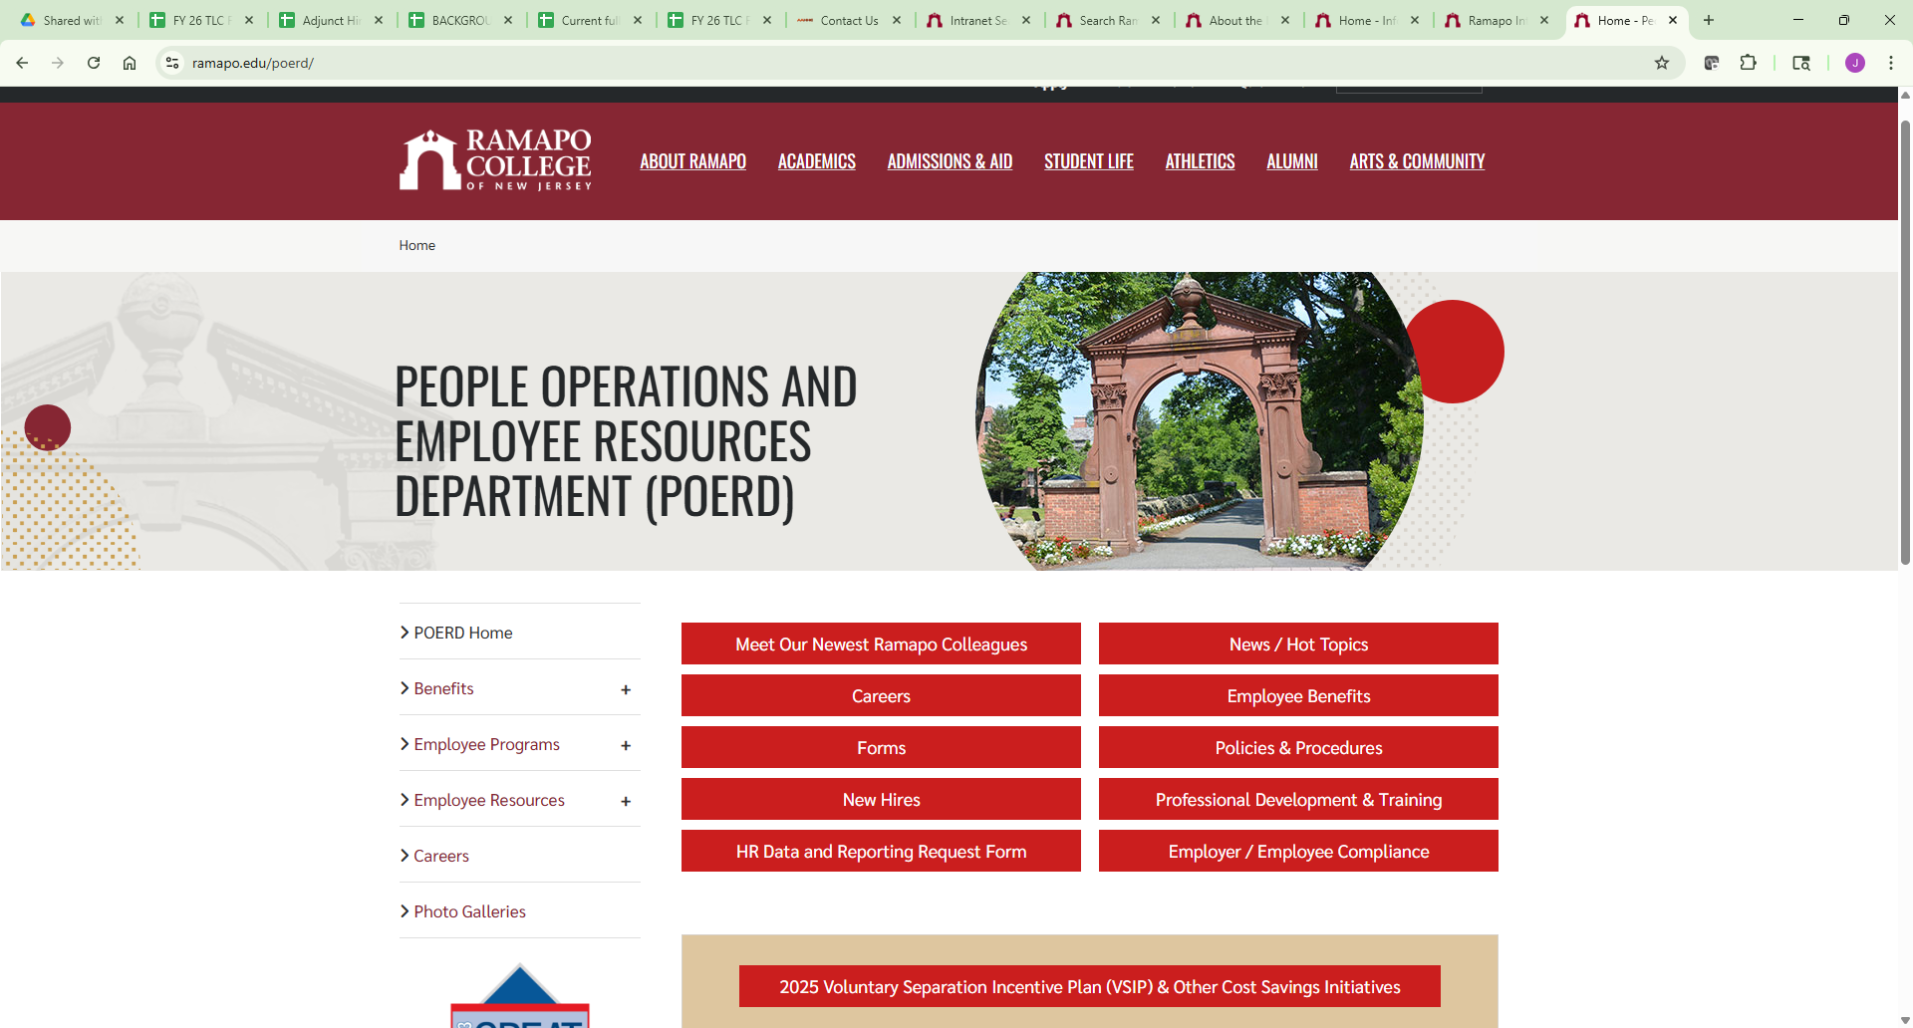
POER Web Page

Slide 15
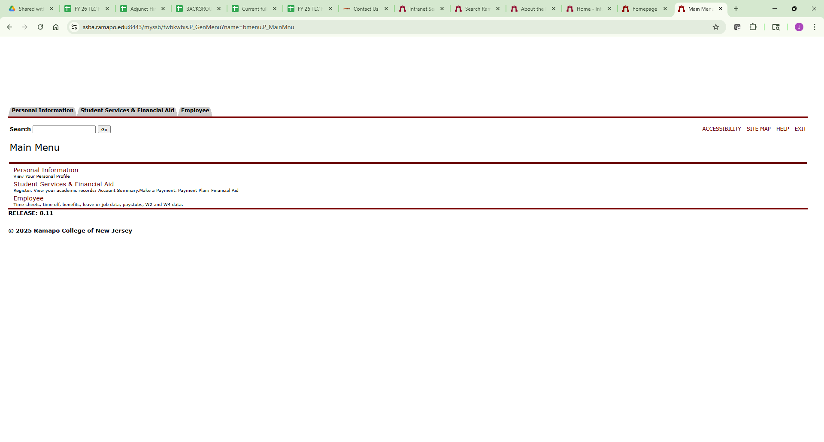
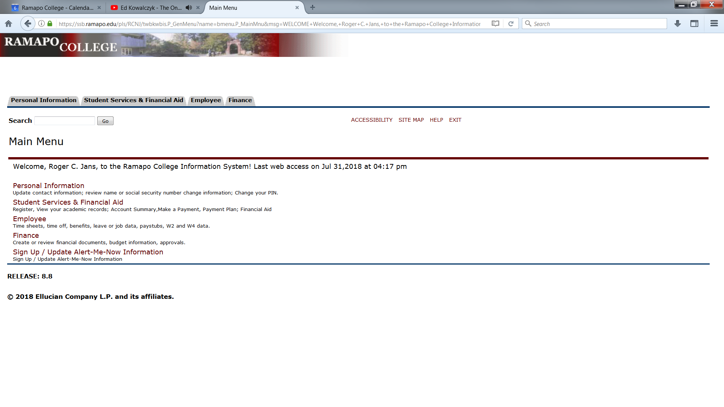
Web Self-Service

Slide 16

Employee Resources
Employee Assistance (EAP) – Dr. Kahn – 888-291-1524
Managing Stress
Alcohol Screening
Wellness
Learning & Development
News / Hot Topics

Slide 17
Contact Us
Benefits:
https://www.ramapo.edu/hr/
201-684-7230 or 201-684-7781
jburton@ramapo.edu or mbachma3@ramapo.edu
Payroll:
https://www.ramapo.edu/payroll/
201-684-7783
payroll@ramapo.edu
Employee Relations:
https://www.ramapo.edu/er/
201-684-7566
ER@ramapo.edu
Hours:
Fall/Spring - Monday – Friday 8:30 am - 4:30 pm
Summer - Monday – Thursday 8:00 am - 5:15 pm (Closed on Fridays)

Slide 18

Questions?

