Slide 1
AI, Research, and Publishing:
Uses and Application of AI Outside of the Classroom
23 October 2024
Ray Abruzzi
Senior Director
AI Product Strategy and Development
rabruzzi@wiley.com

Slide 2
Agenda
23 October 2024—AI Outside the Classroom
The Uses of Content in AI applications
AI Principles and Guidelines in Publishing: Authorship and Peer Review
AI in Research and Discovery
Q&A

Slide 3
The AI Landscape: Context from a Publisher
23 October 2024—AI Outside the Classroom
LLM Training rights
Large Language Model
LLM creates original outputs influenced by, but not directly matching, its training data
Wiley data licensing check
Tech customers
(Public or private industry use)
Content not displayed verbatim; insights extracted by AI
Society and Proprietary content
Fine-tuning rights
Customized Model
Specific training data sets are used to optimize the LLM for a specific purpose
Corporate customers
(Private industry use)
Verbatim quotes and/or direct link to source
RAG data rights*
AI Application
Enhances GenAI by allowing a model to access and use data from the Wiley database during the generation process
*RAG data rights licenses are data licensing opportunities where the AI model may share verbatim content
with the LLM during inference. This allows the user to validate the generative AI feedback by sharing a direct link or quote to
the source material. This is particularly needed in areas where there is higher risk or accuracy needed for GenAI output.

Slide 4
Wiley and other Publisher’s AI Principles
23 October 2024—AI Outside the Classroom
Principle 1—Human Oversight
Wiley believes AI solutions must be developed, leveraged, and maintained with human oversight.
We cannot rely solely on AI without continual human oversight and feedback. In the context of research and learning, any AI tool must ultimately rely on human decision making. We need human intelligence to determine if conclusions are valid, to check for bias, and to maintain ethical standards, with feedback loops from users and stakeholders as an essential part of the process. This approach ensures that AI acts as a tool for extending and augmenting human intellect and creativity – not replacing it.

Slide 5
Wiley and other Publisher’s AI Principles
23 October 2024—AI Outside the Classroom
Principle 2—Trustworthiness & Transparency
Wiley makes transparency and trustworthiness core elements of our AI use and development.
We are dedicated to protecting intellectual property and identifying piracy and copyright violations. We are actively working together with other organizations in efforts to define standards and tackle AI-created content integrity challenges. Our goal is to align with industry best practices and to contribute to a shared culture of ethical AI use in scholarly publishing. We are also committed to being transparent with our AI use and development, subject to the terms of agreements we have with others.

Slide 6
Wiley and other Publisher’s AI Principles
23 October 2024—AI Outside the Classroom
Principle 3—Safety & Fairness
Wiley is committed to ensuring our AI systems and processes are safe and fair.
We are concerned about individual human rights and privacy and uphold the strictest standards of data privacy and protection. We strive to protect our AI systems against errors, failures, and attacks, working vigilantly to prevent harm to users. We are equally committed to the development and use of AI that is accessible, inclusive, and ethical. We implement rigorous strategies to identify and mitigate biases in our AI models. Our decision-making frameworks ensure AI aligns with our ethical guidelines, promoting fairness and integrity in all AI-driven processes.

Slide 7
Wiley and other Publisher’s AI Principles
23 October 2024—AI Outside the Classroom
Principle 4—Governance & Accountability
Wiley will maintain appropriate governance over our use of AI and its incorporation into our business to manage risks and assure accountability.
We support greater transparency and accountability for AI model developers, including regulatory oversight where appropriate. To effectively address and manage risks, Wiley has established policies, procedures and controls designed to ensure that the incorporation of AI into our business is responsible, ethical and compliant with applicable laws. We will continue to educate colleagues on responsible use of AI.
Notes:
\

Slide 8
Wiley’s AI Author Guidelines
23 October 2024—AI Outside the Classroom
Generative Artificial Intelligence tools (GenAI)—such as ChatGPT and others based on large language models (LLMs)—can increase productivity and foster innovation if used appropriately in a safe, ethical and secure manner. STM has general guidance for all stakeholders in scholarly publishing which addresses the role of generative AI technologies.
If an author has used a GenAI tool to develop any portion of a manuscript, its use must be described, transparently and in detail, in the Methods section (or via a disclosure or within the Acknowledgements section, as applicable).
The author is fully responsible for the accuracy of any information provided by the tool and for correctly referencing any supporting work on which that information depends. GenAI tools must not be used to create, alter or manipulate original research data and results. Tools that are used to improve spelling, grammar, and general editing are not included in the scope of these guidelines. The final decision about whether use of a GenAI tool is appropriate or permissible in the circumstances of a submitted manuscript or a published article lies with the journal’s editor or other party responsible for the publication’s editorial policy.

Slide 9
Wiley’s AI Author Guidelines
23 October 2024—AI Outside the Classroom
GenAI tools cannot be considered capable of initiating an original piece of research without direction by humans.
Tools cannot be accountable for a published work or for research design, which is a generally held requirement of authorship (as discussed in the Authorship section in these guidelines), nor does it have legal standing or the ability to hold or assign copyright.
Therefore—in accordance with COPE’s position statement on Authorship and AI tools—these tools cannot fulfil the role of, nor be listed as, an author of an article.

Slide 10
Wiley’s View on AI in Peer Review
23 October 2024—AI Outside the Classroom
GenAI tools should be used only on a limited basis in connection with peer review. A GenAI tool can be used by an editor or peer reviewer to improve the quality of the written feedback in a peer review report.
This use must be transparently declared upon submission of the peer review report to the manuscript’s handling editor. Independent of this limited use case, editors or peer reviewers should not upload manuscripts (or any parts of manuscripts including figures and tables) into GenAI tools or services. GenAI tools may use input data for training or other purposes, which could violate the confidentiality of the peer review process, privacy of authors and reviewers, and the copyright of the manuscript under review.
Moreover, the peer review process is a human endeavor and responsibility and accountability for submitting a peer review report, in line with a journal’s editorial polices and peer review model, sits with those individuals who have accepted an invitation from a journal to undertake the peer review of a submitted manuscript. This process should not be delegated to a GenAI tool.

Slide 11
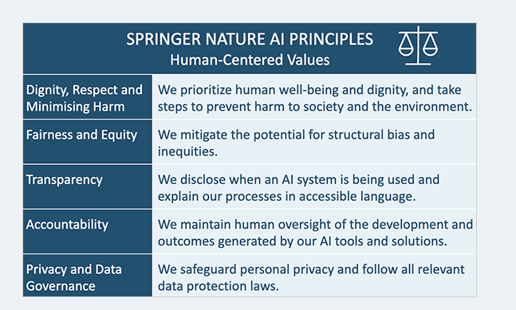
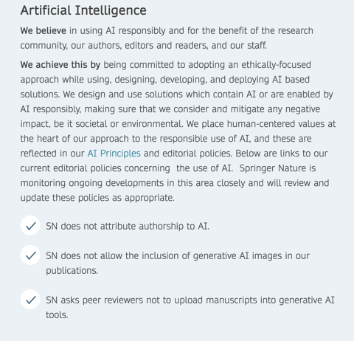
AI Principles and Author Guidelines—Springer-Nature
23 October 2024—AI Outside the Classroom

Slide 12
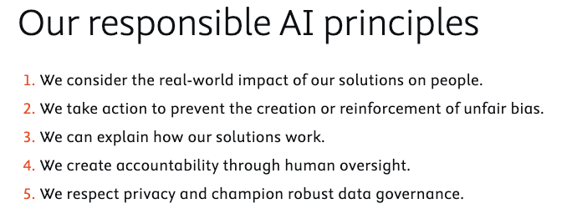
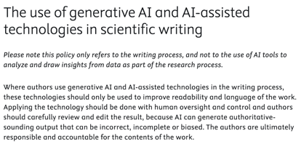
AI Principles and Author Guidelines—Elsevier
23 October 2024—AI Outside the Classroom
Author Guidelines

Slide 13
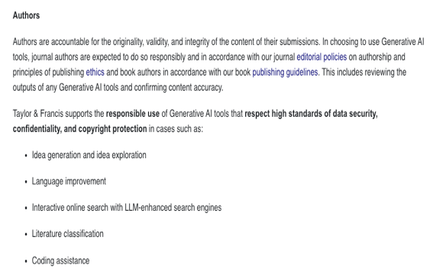
AI Risks and Author Guidelines—Taylor and Francis
23 October 2024—AI Outside the Classroom

Slide 14
AI: Possibilities in Research
23 October 2024—AI Outside the Classroom

Slide 15
Q&A

Slide 16
Thank you!

