Slide 1

WHAT CAN THE LIBRARY DO FOR YOU?
Christina Connor, MA, MSIS
Assessment & Instruction Librarian
New Faculty Orientation
September 3, 2024

Slide 2
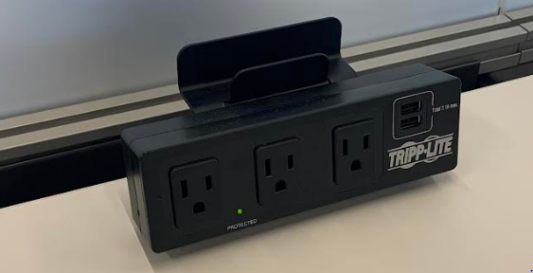
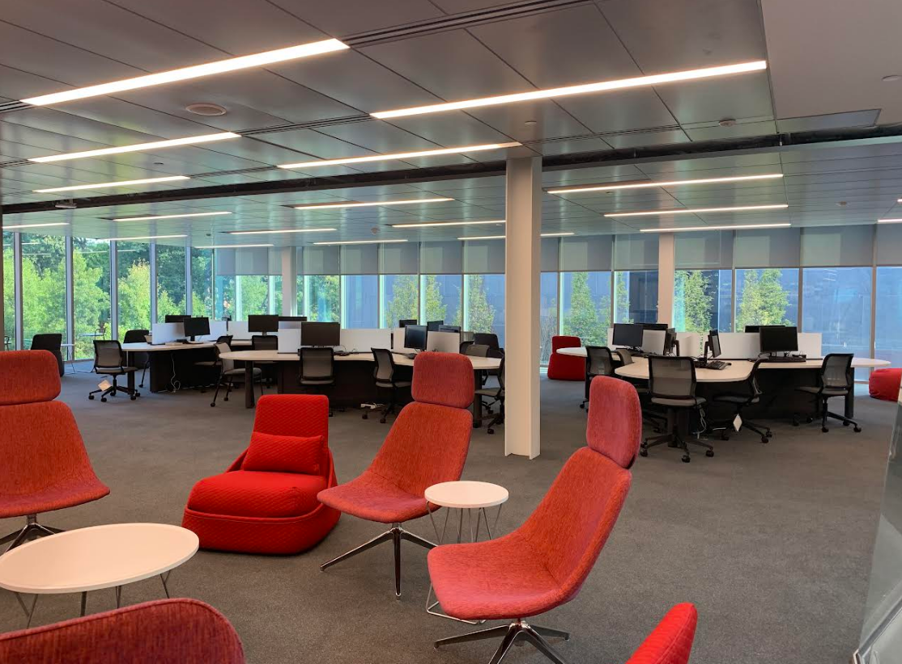
A Peek at the Library/Learning Commons
Connectivity
(Printing on every floor, ITS Help Desk on 4th)

Slide 3
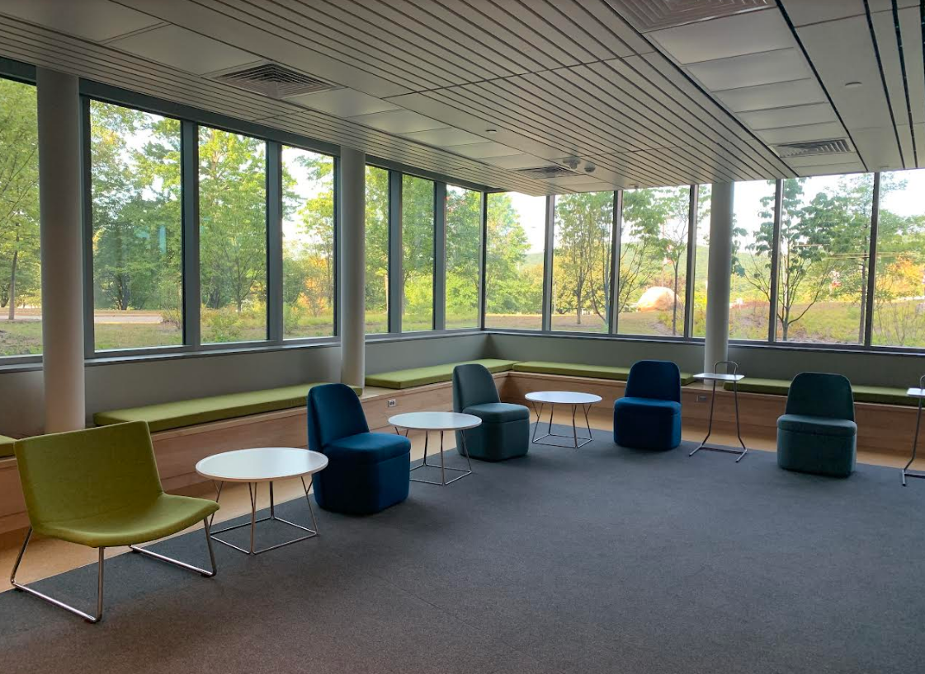
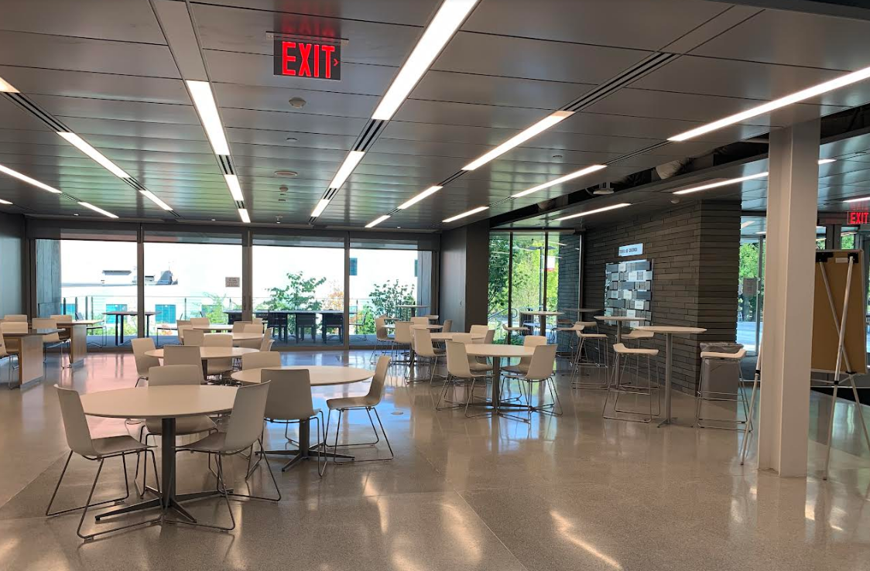
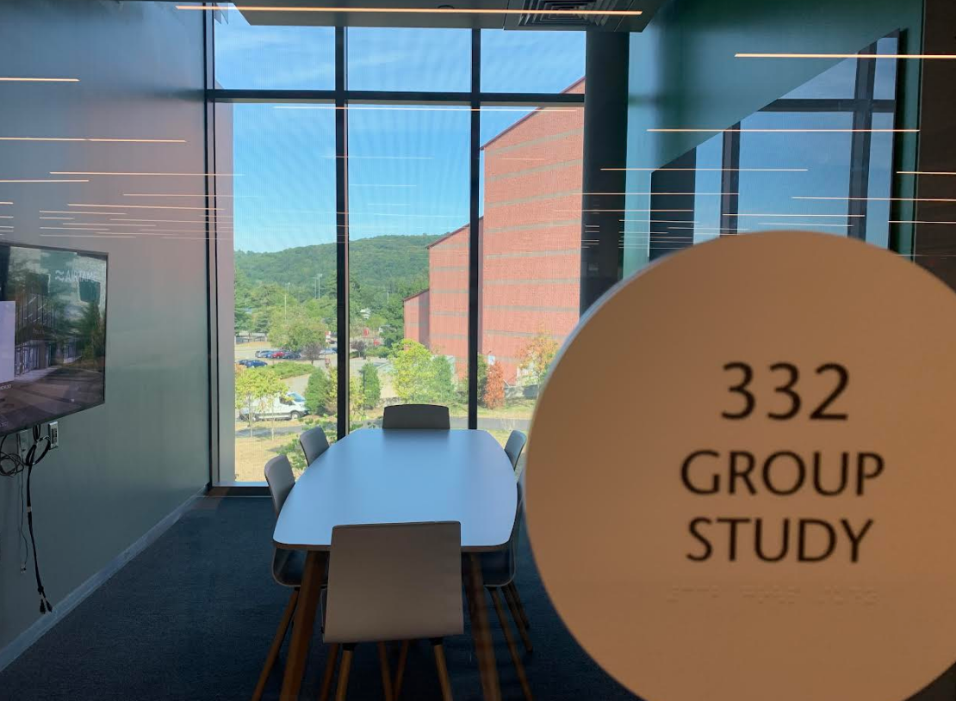
A Peek at the Library/Learning Commons
Various study options
(Cafe in the lobby with select hours)

Slide 4
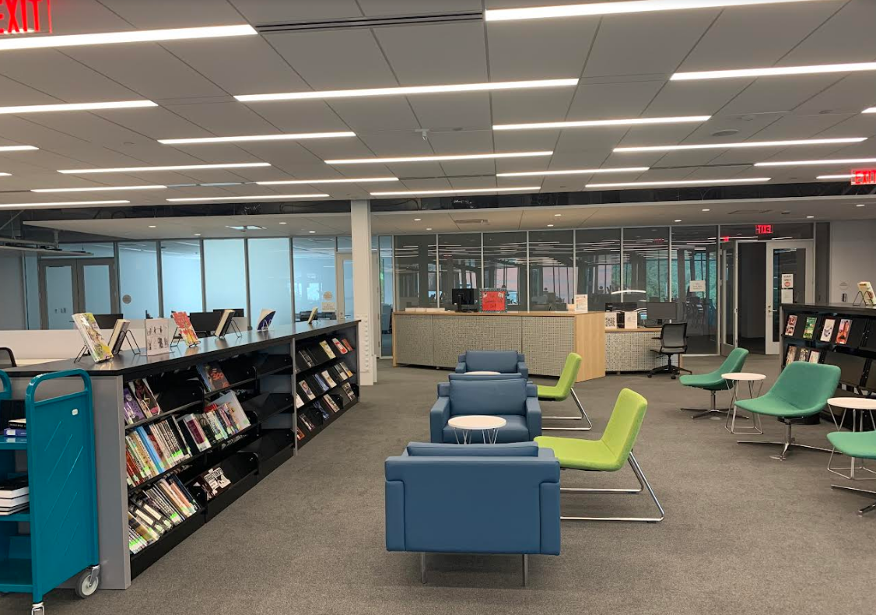
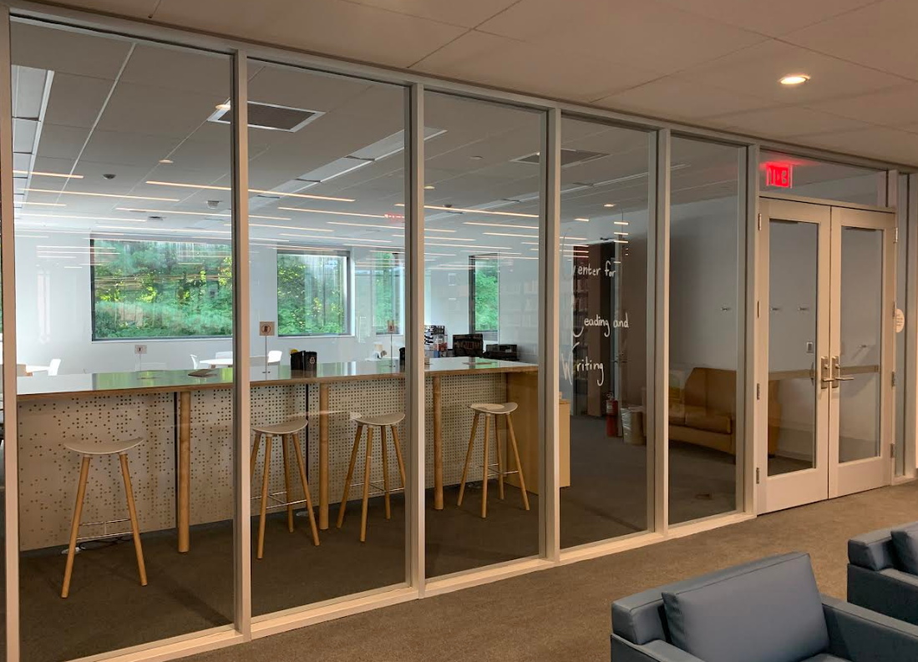
A Peek at the Library/Learning Commons
Research Help
Leisure Reading and Research Help Desk
3rd Floor
Center for Reading and Writing
4th Floor

Slide 5
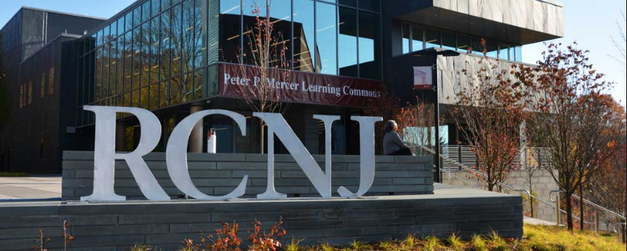
More about the Learning Commons
In addition to the Library, the Learning Commons contains:
  The Center for Reading and Writing
  The Instructional Design Center (IDC)
  The Faculty Resource Center (FRC)
  An ITS Help Desk
  The Jane Addams Papers Project
  The Gross Center for Holocaust and Genocide Studies
  The Investigative Genetic Genealogy Center

Slide 6

Main Areas of Support for Faculty
Unit Liaisons
Accessing Materials
Resources for Course Reserves
Information Literacy Sessions
Requests for Purchase

Slide 7
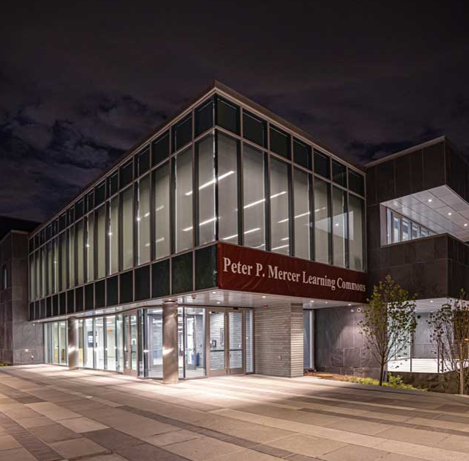
Unit Liaisons
(ASB) Christina Connor
  cconnor@ramapo.edu
(CA) Madel Tisi
  mtisi@ramapo.edu
(SSHS) Shirley Knight
  sknight@ramapo.edu
(HGS) Susan Kurzmann
  skurzman@ramapo.edu
(TAS) Samantha Wittenberg
  switten1@ramapo.edu

Slide 8
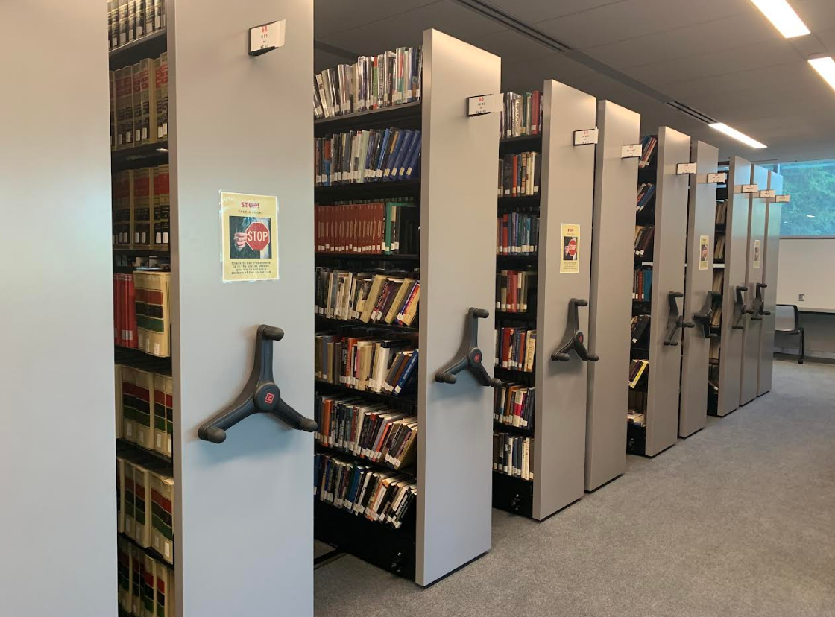
Accessing Materials
Collections throughout the building

Slide 9
Accessing Materials
Loan Periods:
Interlibrary Loan:
  You can log in to our ILL system from our website to place book/article requests and to manage your requests. https://www.ramapo.edu/library/interlibrary-loan/
Reciprocal Borrowing for you and your students: Please visit the Research Help Desk.
Patrons | Books | Course Reserves | Videos/ DVDs | Bestsellers
Ramapo Faculty | End of semester; no limit, no renewals | 3 days, limit 3, no renewals | 7 days, limit 3, no renewals | 28 days, limit 2, 1 renewal
Ramapo Adjunct Faculty & Staff | 28 days; no limit, no renewals | 4 hours, limit 1, no renewals | 7 days, limit 3, no renewals | 28 days, limit 2, 1 renewal

Slide 10
Course Reserve Items
Please review the Reserve Guidelines before filling out a Reserve Request: https://www.ramapo.edu/library/course-reserves/
For newly purchased items, allow at least one week to process items and two weeks at the start of the semester.
Faculty members are responsible for copyright compliance.
Photocopies under 25 pages are automatically processed as E-Reserves. We cannot process e-reserves over 25 pages.
Contact Marcia Sexton with questions: msexton@ramapo.edu

Slide 11
Information Literacy Sessions
Librarians focus on three main learning outcomes appropriate to the level of the course:
  Outcome 1: Determines a manageable idea/paper topic
  Outcome 2: Constructs and implements a search strategy and uses various information resources to obtain information in the library and beyond
  Outcome 3: Understands the difference between types of sources
Information literacy is taught developmentally at the Potter Library.
  100-200 level classes focus on the fundamental skills of information literacy and basic library resources.
  300-400 level classes transition to discipline-specific and non-traditional resources and advanced search methods.

Slide 12
About the Information Literacy Sessions
Sessions are faculty requested.
Submit your request at least two weeks before the desired date of the session.
If you do not request a specific librarian, one will be assigned to the class.
Sessions are tailored to the specific objectives of the class and needs of the students.
All library sessions are assessed using a librarian-developed assessment tool.
Please attend the session –
your participation is important!

Slide 13
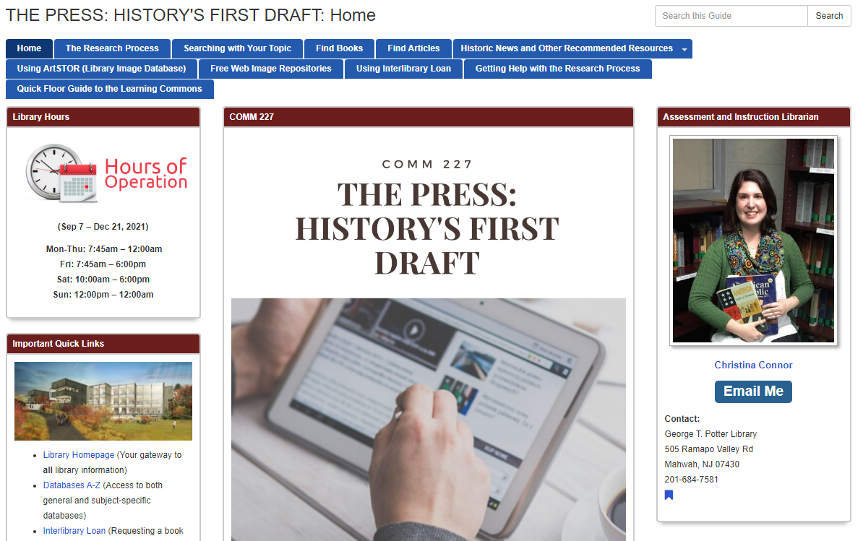
After the Session
As a supplement to your library session, librarians create customized research guides for your class, specific to the needs of course assignments. Students are able to access these materials any time after the session.

Slide 14
Questions about Information Literacy
Librarians are here to support you and your students!
Library sessions can be held remotely or in-person, but we see the benefit to in-person sessions.
If you have questions related to our Information Literacy Program, please contact our Information Literacy Coordinator, Christina Connor, at cconnor@ramapo.edu.

Slide 15
Requests for Purchase
Faculty are encouraged to make suggestions for the collection!
The core collection is intended to serve the broadest possible audience, with an emphasis on undergraduate research, in each discipline and for the long term.
You can contact your unit liaison regarding requests OR fill out the appropriate request form found on the library website.
Questions? Email colldev@ramapo.edu

Slide 16
Unit Liaisons
(ASB) Christina Connor
  cconnor@ramapo.edu
(CA) Madel Tisi
  mtisi@ramapo.edu
(SSHS) Shirley Knight
  sknight@ramapo.edu
(HGS) Susan Kurzmann
  skurzman@ramapo.edu
(TAS) Samantha Wittenberg
  switten1@ramapo.edu

Slide 17

General Questions?
Visit, chat, email, or text the Research Help Desk: https://www.ramapo.edu/library/research-help-services/
Contact your Unit Liaison or the appropriate service coordinator: https://www.ramapo.edu/library/staff-directory/
Visit our Faculty Resources page:
  http://www.ramapo.edu/library/faculty-resources/

Slide 18



To Keep Updated
Library Website: https://www.ramapo.edu/library/
Library Social Media:
  Facebook https://www.facebook.com/RCNJLibrary
  Twitter https://twitter.com/rcnjlibrary
  Instagram https://www.instagram.com/rcnjlibrary/
Reach out to your Unit Liaison

Slide 19
  Thank you
  and
  Welcome to Ramapo!

