Slide 1
Start Here - WELCOME!
Orientation to New Faculty
Ramapo College of New Jersey

Slide 2
Fast Facts about Ramapo
Ramapo College of New Jersey
Founded: 1969
Students: 5,302 (~ 4800 UG; 500 G)
Average class size: 23
Just under 50% of our students live on campus
Five colleges/schools; convening groups (not departments) housed within each college/school: ASB, CA, HGS, SSHS, TAS
Primarily undergraduate, but there are 9 graduate programs
Emerging Hispanic Serving Institution (HSI)!
Ramapo College of New Jersey FAST FACTS - SPRING 2024

Slide 3
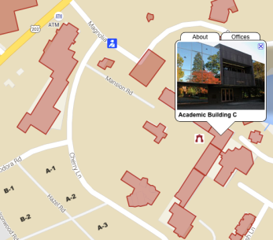
Public Safety
Location: C-102
Go here to get your ID card
Go here for parking passes
Campus Public Safety Emergency: (201) 684-6666
Non-Emergency Calls: (201) 684-7432 (201) 684-7433

Slide 4
Technology Problems?
Just dial 201.684.7777 or email helpdesk@ramapo.edu
Tech Support Help Desk
They are not always the answer to your problem, but they will connect you to the right person!

Slide 5
Academic Calendar
http://www.ramapo.edu/academic-calendars/
Important Dates:
First Day of Classes: 9/4/24
Add/Drop Ends 9/10/24 (Full Semester Courses)
Last Day to give a “W” Grade 11/15/24
Thanksgiving Break (college closed) 11/27-11/29
Final Exams: 12/14-12/20
Final Day to Give an “I” (Incomplete): 12/20
Spring Break (college closed)
Note: classes held, offices closed on certain days!

Slide 6
Meeting Schedule
Visit the following link to the Faculty Meeting Calendar:
https://www.ramapo.edu/fa/calendar/
-Faculty Assembly
-Unit Council Meetings
-AFT Union Meetings
-Major/Minor Convening Group Meetings

Slide 7
Speaking of AFT (Local 2274)
Local 2274 negotiates with 8 other NJ state colleges and is part of a national union with 1.8 million members!
Collective bargaining has resulted in full-time employees receiving a 3.5% across-the-board increase in each year of the contract.
Learn more:
https://ramapoaft.org/
To join:
https://www.cnjscl.org/membershipcard.htm

Slide 8
What You Will Find in a Ramapo Classroom
Classrooms should have white (not smart!) boards.
Ask Unit Secretary for Markers or Bring Your Own
Don’t necessarily expect erasers.
Again, ask Unit Secretary
Classrooms have audio/visual lecterns/podiums/units
All should have desktop computer
Should be ports to link your laptop–bring cords in case
All classrooms have WiFi
Should be DVD players and overhead projectors
Few classrooms have Webex Kits
Always have a Plan B!

Slide 9
Preparing Your Syllabi
Unit (School) Secretaries ask for Syllabi 2 weeks before semester begins
Ask Conveners for Copies of Previous Syllabi
Academic Review Committee (ARC) Manual has specific guidance:
https://www.ramapo.edu/fa/arc/
Course Preparation Guidelines
Syllabus Checklist

Slide 10
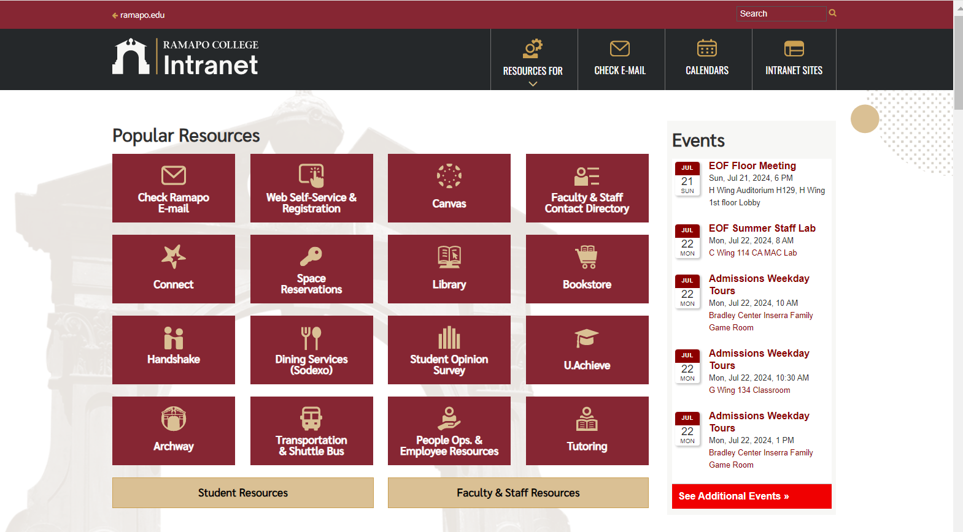
web.ramapo.edu
Our Intranet is the place to access most of what you will need, including class rosters, employee information, etc.

Slide 11
Learning Management System
We are a Canvas-based institution:

Slide 12
Instructional Design Center
Get one-on-one support and attend workshops on Canvas, instructional design, and other technologies such as Kahoot, Turnitin, Respondus, and more.
Online office hours, or visit the IDC Lab in LC201
Director: Michael Bitz (SSHS): mbitz@ramapo.edu
For more info:
http://www.ramapo.edu/idc

Slide 13
Instructional Design Center
Upcoming IDC Workshops
Wednesday, August 21, 2024:
9am-10am: Canvas: Getting Started
10am-11am: Canvas: Assignments & Gradebook
11am-12pm: Canvas: Templates
1:30pm-2:30pm: Kahoot!
2:30pm-3:30pm: Turnitin
Register in advance at: https://www.ramapo.edu/idc/workshops-and-training/

Slide 14
Instructional Design Center
Upcoming IDC Workshops
Thursday, August 22, 2024:
9am-10am: How to Talk With Students About AI
10am-11am: AI-Resistant and AI-Assisted Assignments
11am-12pm: AI Self-paced Course / Virtual Hub
1:00pm-3:00pm: New Faculty and New Semester Hands-on Support Session (in-person only)
Register in advance at: https://www.ramapo.edu/idc/workshops-and-training/

Slide 15
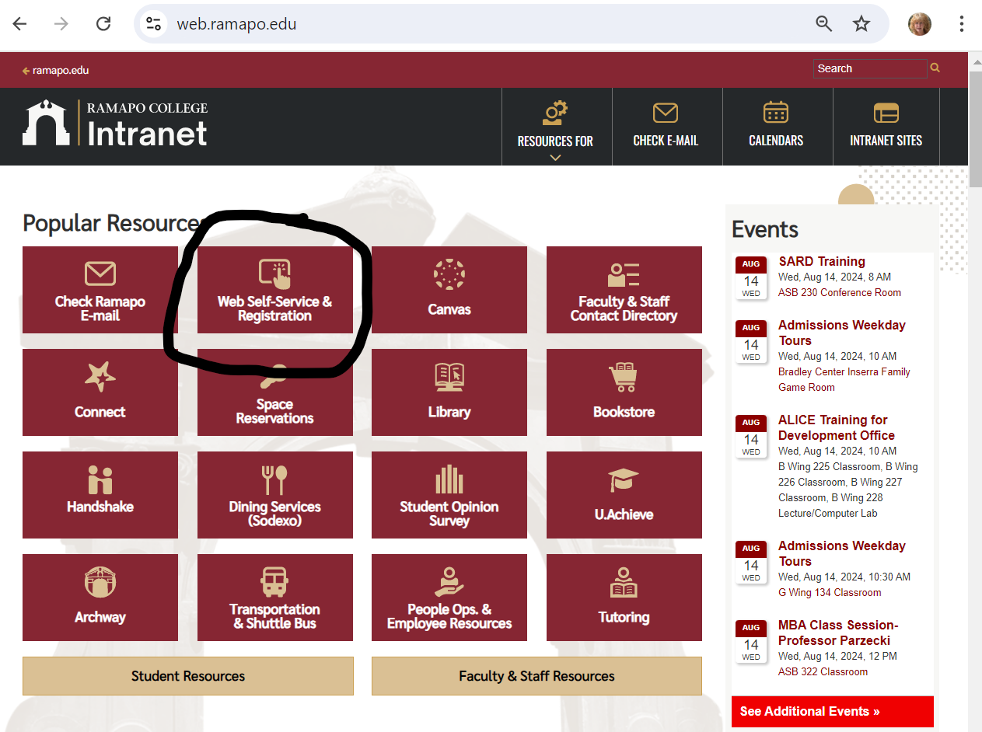
Course Administration Through Web Self-Service
Enter Secure Area
Faculty Services Includes:
Grade Entry
Student Search
Overrides

Slide 16
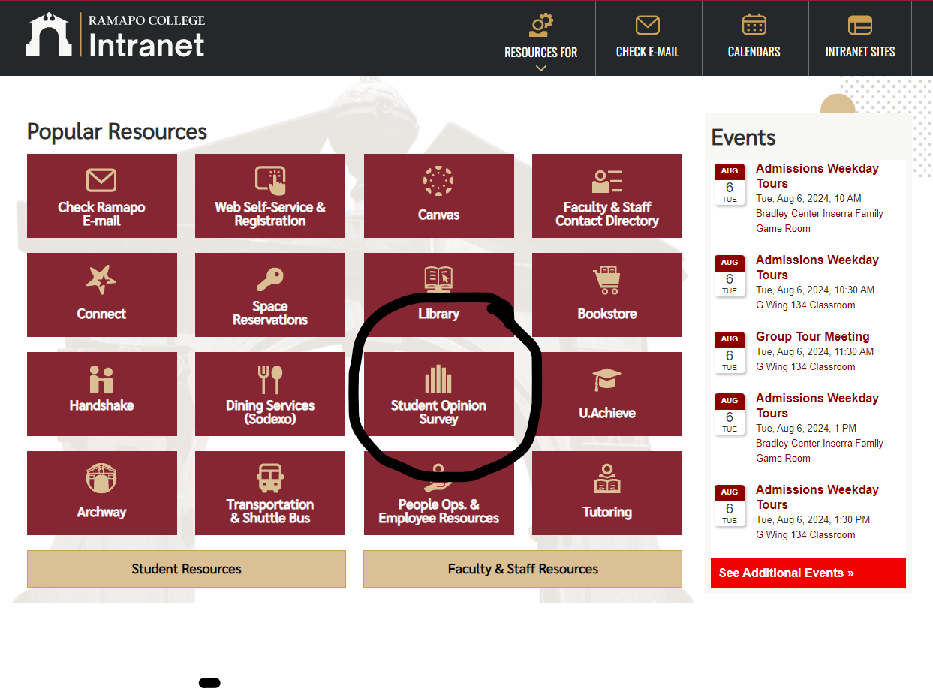
Finishing Up the Semester
Course Evaluations
Peer Evaluations
Dean Evaluations
Student Opinions
Final Exam Schedule:
http://www.ramapo.edu/web-resources/exams/

Slide 17
Questions?
Contact your convener!
Contact your Unit secretary!
Contact your Deans!
Contact me! Rabzug@ramapo.edu

